Slide 1
Controller Design
Presentation Exercise 1
Controlled and Uncontrolled Wind Turbine Cases

Slide 2
Content:
NREL 5 MW Wind Turbine Specifications
Uncontrolled Wind Turbine
Controlled Wind Turbine
Simulation Exercise

Slide 3
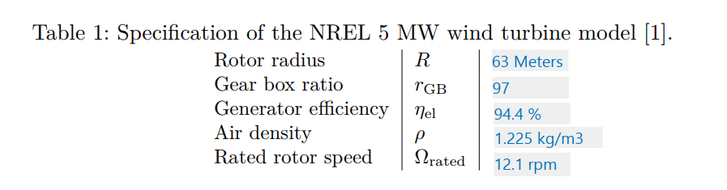
NREL 5 MW Wind Turbine Specifications Exercise _1.a

Slide 4


Uncontrolled Wind Turbine Exercise _1.1.b
a. Which tip-speed-ratio will the turbine approach in the uncontrolled case?
Answer: 18
Generator Torque will be zero
Turbine will accelerate and reach some Steady state according to the wind speed
Change in rotor speed will become zero leading to Aerodynamic Torque equal to zero
As Aerodynamic torque is zero, Cp will become zero also
Also pitch angle is zero (given)
From the Cp-Lambda curve for zero degree pitch angle, our lambda is “18” at Cp=0.

Slide 5
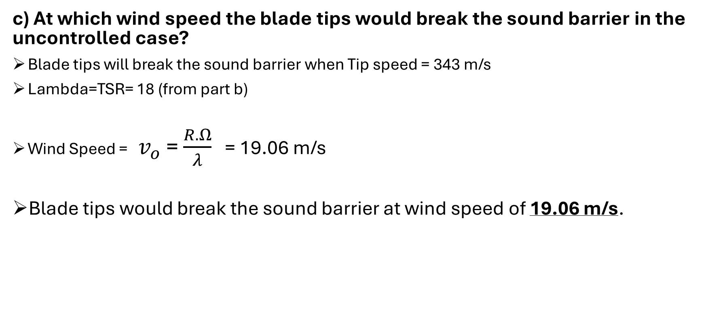
Uncontrolled Wind Turbine Exercise _1.1.c
c) At which wind speed the blade tips would break the sound barrier in the uncontrolled case?
Blade tips will break the sound barrier when Tip speed = 343 m/s
Lambda=TSR= 18 (from part b)
Wind Speed = $v_{ο}$ = $\frac{R. Ω}{λ}$ = 19.06 m/s
Blade tips would break the sound barrier at wind speed of 19.06 m/s.

Slide 6
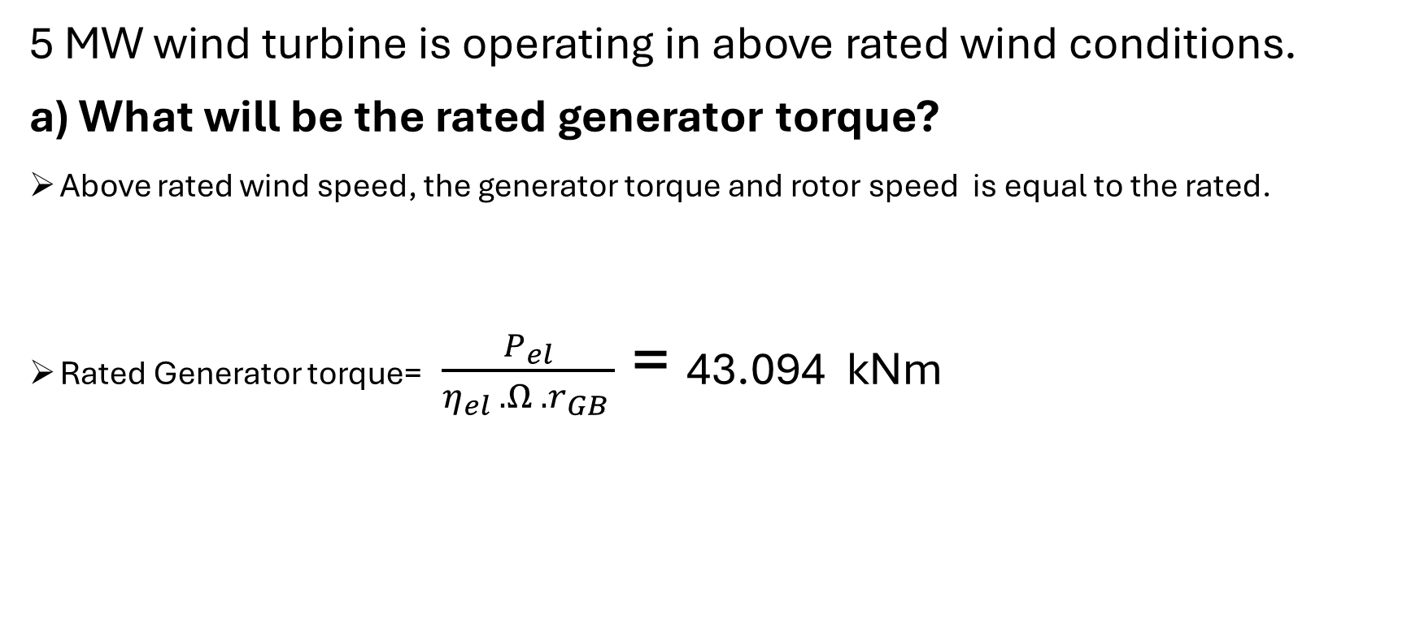
Controlled Wind Turbine Exercise _1.2.a
5 MW wind turbine is operating in above rated wind conditions. a) What will be the rated generator torque?
Above rated wind speed, the generator torque and rotor speed is equal to the rated.
Rated Generator torque= $\frac{P_{el}}{η_{el} .Ω .r_{GB }}$ = 43.094 kNm

Slide 7
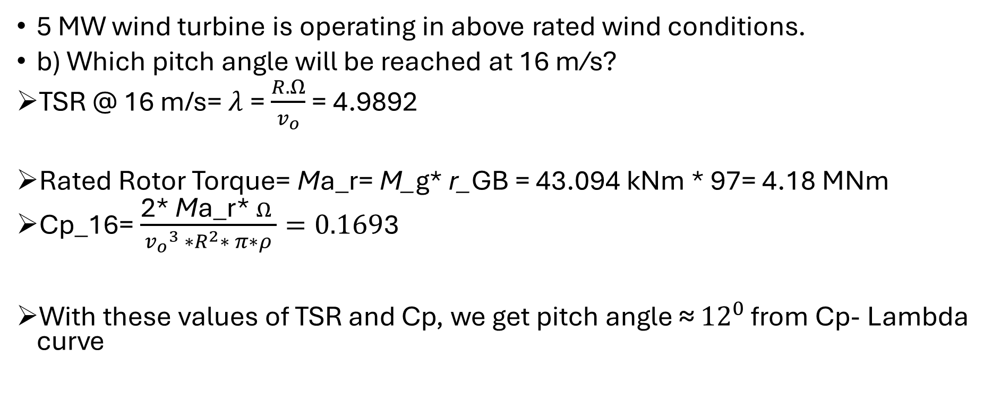
Controlled Wind Turbine Exercise _1.2.b
5 MW wind turbine is operating in above rated wind conditions.
b) Which pitch angle will be reached at 16 m/s?
TSR @ 16 m/s= $λ$= $\frac{R. Ω}{v_{ο}}$ = 4.9892
Rated Rotor Torque= Ma_r= M_g* r_GB = 43.094 kNm * 97= 4.18 MNm
Cp_16= $\frac{\text{2∗} \text{M}\text{a}\text{_}\text{r}\text{∗} Ω }{{v_{ο}}^{3} ∗R^{2}∗ π∗ρ}=0.169$3
With these values of TSR and Cp, we get pitch angle ≈ ${12}^{0}$ from Cp- Lambda curve

Slide 8
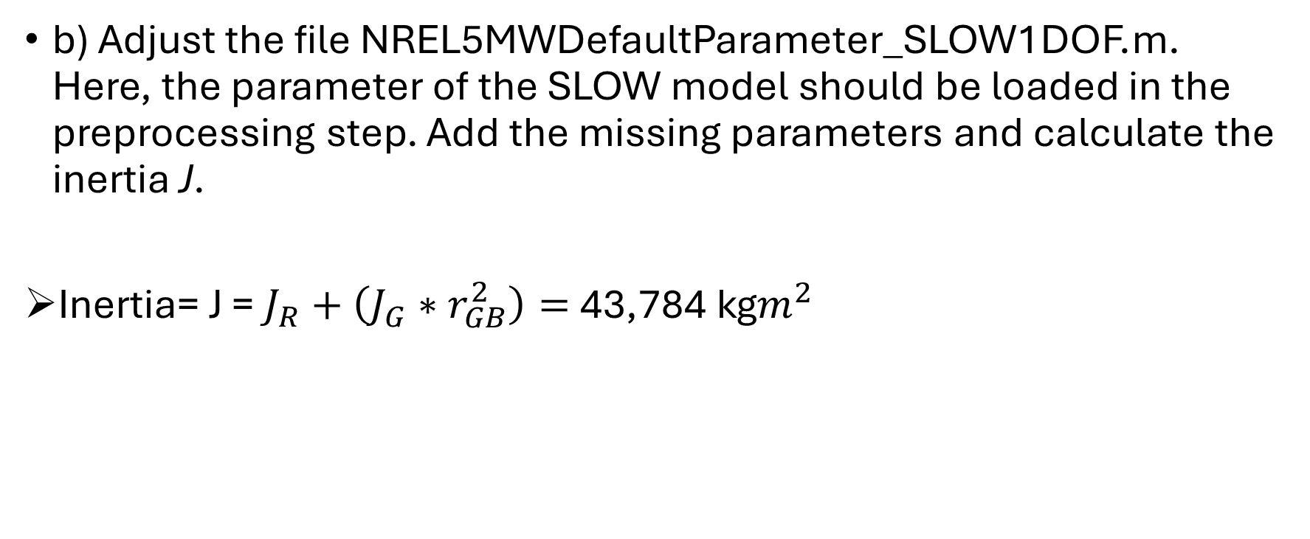
Simulation Exercise Exercise _1.3.b
b) Adjust the file NREL5MWDefaultParameter_SLOW1DOF.m. Here, the parameter of the SLOW model should be loaded in the preprocessing step. Add the missing parameters and calculate the inertia J.
Inertia= J = $J_{R}+\left(J_{G}∗r_{GB}^{2}\right)=$43,784 kg$m^{2}$

Slide 9
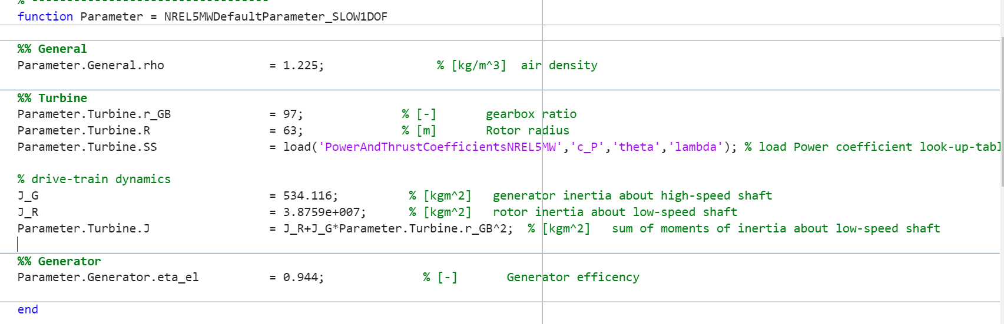
Parameter Adjustment

Slide 10
Simulation Exercise Exercise _1.3.c
c) Adjust the file Exercise01.m by finding useful values for pitch and torque to keep the turbine at rated rotor speed and rated electrical power. Add the calculation of the electrical power in the postprocessing section.
Pitch Angle = 12.05745

Slide 11
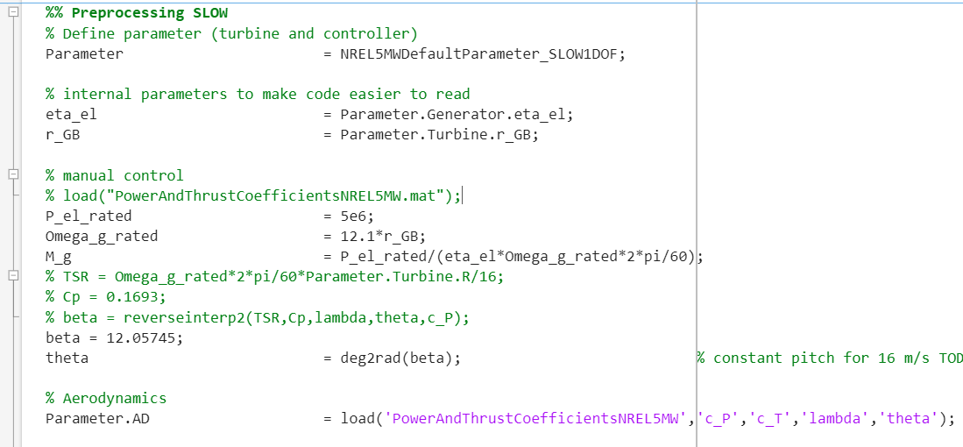
Simulation Exercise

Slide 12
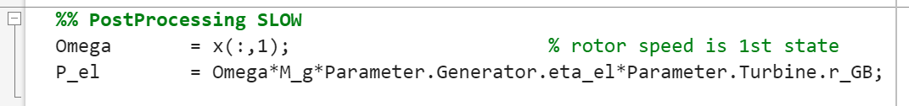
Simulation Exercise

Slide 13
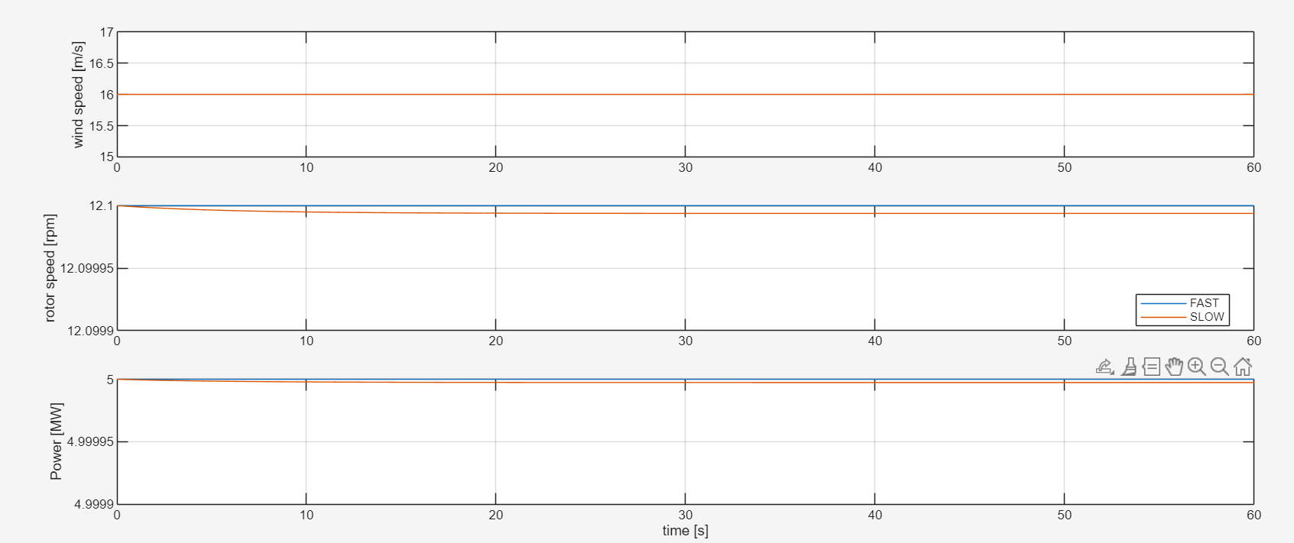
Simulation Exercise

Slide 14
Simulation Exercise Exercise _1.3.d
d) Adjust the FAST and SLOW simulation to 20 m/s to keep the turbine at rated rotor speed and rated electrical power.
Pitch Angle = 17.475

Slide 15
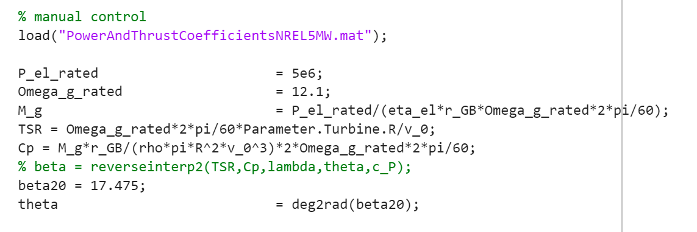
Simulation Exercise

Slide 16
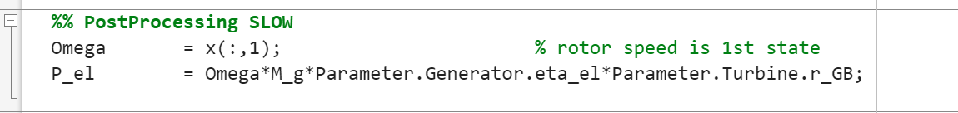
Simulation Exercise

Slide 17
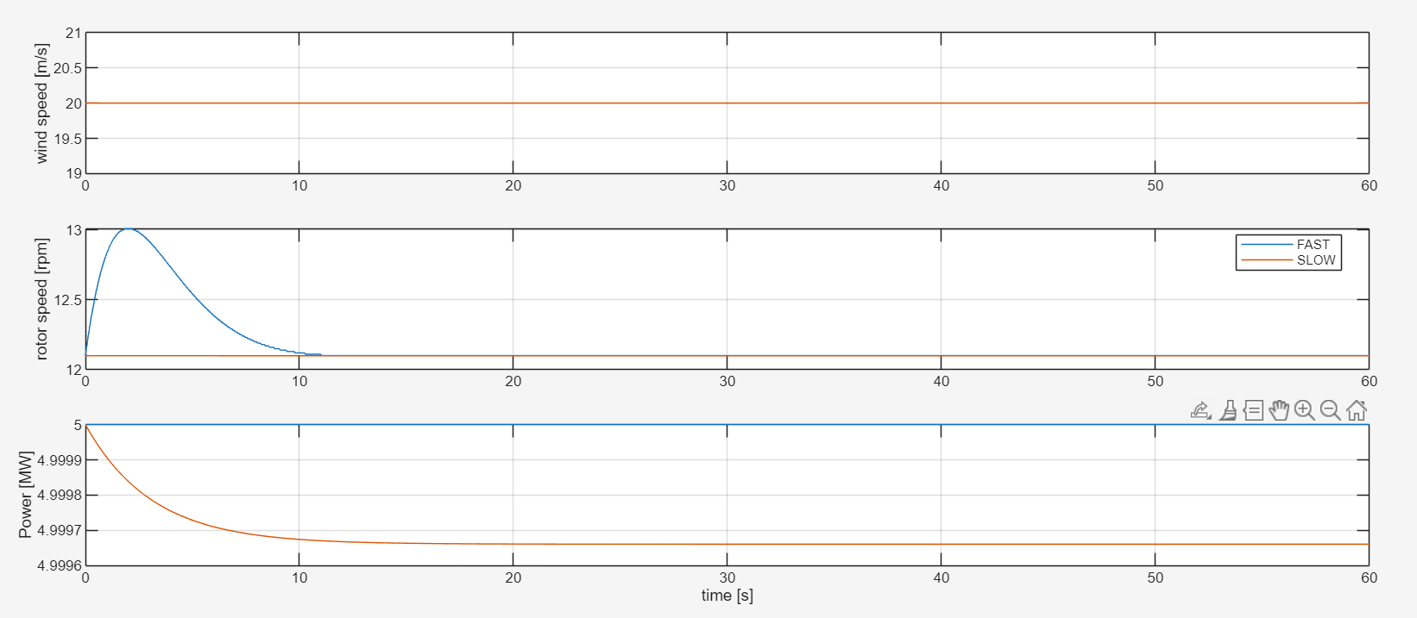
Simulation Exercise

