Slide 1
Image Classification with ResNet
Federico Brandini

Slide 2
Tiny ImageNet
Tiny ImageNet contains 200 disjoint classes of RGB 64x64 images
Training set
Validation set
Test set
100000 images
500 for each class
10000 images
50 for each class
10000 unlabelled images
50 for each class

Slide 3


Objective and Plan
The objective is making a classifier to classify all the images using ResNet architecture
I decided to work with pretrained resnet-18 trying to maximize performance with lower latency, and then increase the depth
During training the model is saved only when there is an improvement on validation set. I also implemented an early-stopping strategy which stop training when the number of non-improvements on validation surpass a specified threshold

Slide 4

First attempts
At first, I decided to finetune complete resnet-18 pretrained on ImageNet
With first layers freezing, there is even a worsening
conv1
layer1
layer2
layer3
layer4
fc
200
51.54 % accuracy
$$η={10}^{−3}$$
$$epochs=50 \\ size_{mb}=16$$
[run_01]
[run_06]

Slide 5


Image resizing
The images used in the pre-training of the network are 224x224 (ImageNet1k), while those of Tiny ImageNet are 64x64
I tried resizing the images to 224x224 for different frozen modules
I choose the second better model, because it showed better results in next step
70.26 %
200
[run_07]
conv1
layer1
layer2
layer3
layer4
fc
71.31 %
200
[run_07b]
conv1
layer1
layer2
layer3
layer4
fc
69.96 %
200
[run_09]
conv1
layer1
layer2
layer3
layer4
fc
67.61 %
conv1
layer1
layer2
layer3
layer4
fc
200
[run_08]
63.57 %
conv1
layer1
layer2
layer3
layer4
fc
200
[run_10]
[run_11b]
[run_12b]

Slide 6
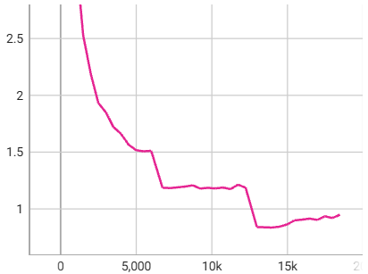
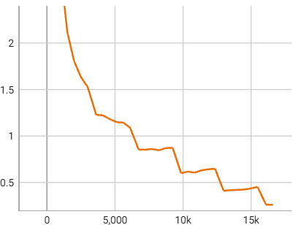
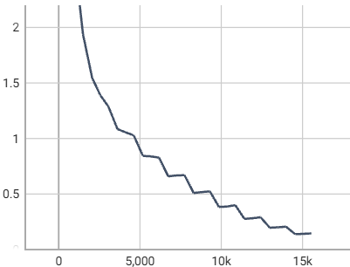



Batch size increasing
Looking at the graph of loss over time, we notice a step-like descent. By increasing the batch size, this behavior breaks down and accuracy increases (with batch size of 128 it gets worse)
[run_13]
$$size_{mb}=16$$
$$size_{mb}=32$$
$$size_{mb}=64$$
70.26 %
72.69 %
73.30 %
[run_07]
[run_11]
[run_12]

Slide 7
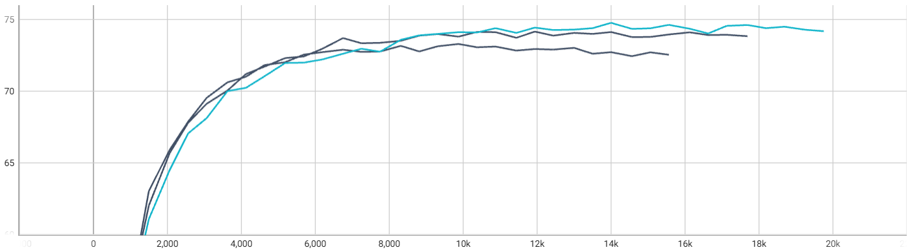
Data augmentation
Random Horizontal Flip with probability of 0.5 and Random Crop 80-100% increase accuracy of the model, but not random rotation or color jitter
[run_16]
[run_17]
Validation accuracy
74.77 %
+ random crop
+ random horizontal flip
[run_15]
the latest best
[run_14]
[run_12]

Slide 8
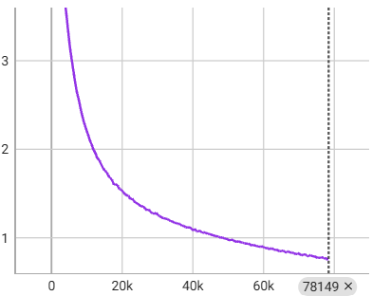
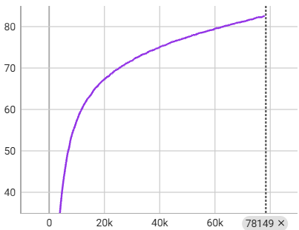
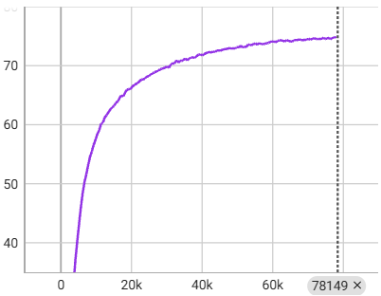
Learning rate decreasing
Decreasing learning rate to ${10}^{−4}$ training becomes slower, but step-like descent behavior breaks down and accuracy increases
Loss
Training accuracy
Validation accuracy
74.84 %
[run_21]
In this case, training was stopped due to reaching the maximum number of epochs; so, we can try to resume this model to continue training…
[run_21_resumed]
75.18 %

Slide 9



High initial learning rate + refine
Training a model with a low learning rate from the beginning can cause convergence towards a local minimum (basin of attraction) even very distant from a global one. So, I tried training it with a higher learning rate (${10}^{−3}$), then refine it with a lower one (${10}^{−4}$)
The weight decay adding doesn’t change accuracy (75.77 %)
$η$ always low
$η$ higher + refine
75.18 %
75.80 %
[run_21_resumed]
[run_15]
[run_15_resumed]
[run_22]
[run_22_refine]

Slide 10
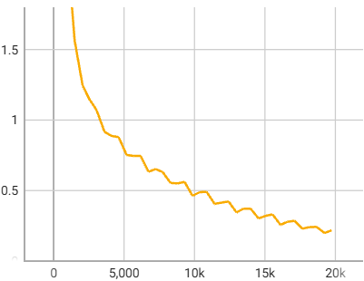
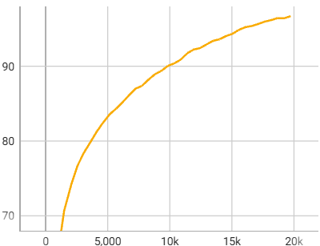
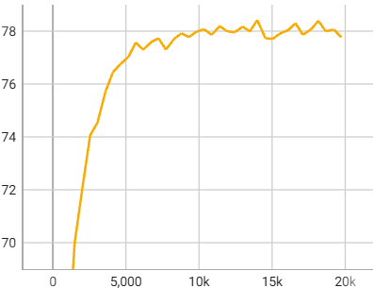

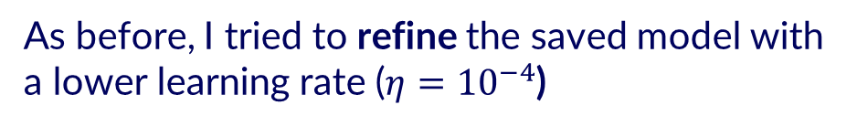
Depth increasing
With the best training methods for the resnet-18, let's now try to fine-tune all layers of a pretrained resnet-34 with $η={10}^{−3}$
Loss
Training accuracy
Validation accuracy
78.42 %
[run_23]
As before, I tried to refine the saved model with a lower learning rate ($η={10}^{−4}$)
79.48 %
[run_23_refine]

Slide 11



















Particular ablation study
In this study, we want evaluate how the specific-class Lemon accuracy varies if the number of classes used in training is 1 (that class) or 10 (that class plus 9 others)
Step A Only Lemon
Step B Lemon + 9 random
Step C Lemon + 9 similar

Slide 12
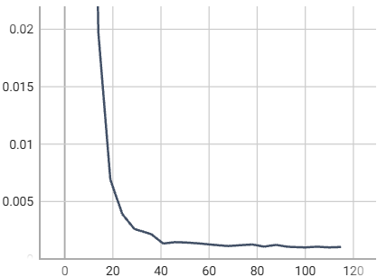
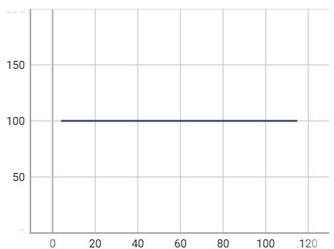
Particular ablation study: step A
[run_A]
In this case let’s use a single output neuron with sigmoid activation function. Training model with only Lemon class, we obtain this…
Yes, but it’s like having a constant-positive classifier; infact, performance on total validation set are very bad: accuracy 0.5 %, balanced accuracy 50.00 %
Loss
Training accuracy
Validation accuracy

Slide 13
Particular ablation study: B and C steps
In this case, the output layer is composed of 10 neuron with shared softmax activation function
Choosing other 9 classes randomly, we obtain these results for Lemon class (4 runs)
Choosing other 9 classes with those more similar to the Lemon one, it’s more difficult for model to recognize Lemon class
Then, it is better to train model with more non-similar classes
90.00 %
[run_B1]
76.00 %
[run_B2]
84.00 %
[run_B3]
86.00 %
[run_B4]
42.00 %
[run_C]

