Slide 1


Warehouse Order Dispatching
Problem
Federico Brandini - Alessandro Mazzocchi

Slide 2







Index
Problem
Problem
Problem
Problem
GP
GP
GP
GP
Results
Results
Results
Results
Machine Learning

Slide 3



Problem
The goal is to see if there is a better policy than traditional ones, taking advantage of the GP and the particularity of the specific case
z₄
z₅
z₆
c₂
H
c₁
c₃
c₄
c₅
policy
order
y
z₁
z₂
z₃
dispatching system
O
x
W
Machine Learning

Slide 4

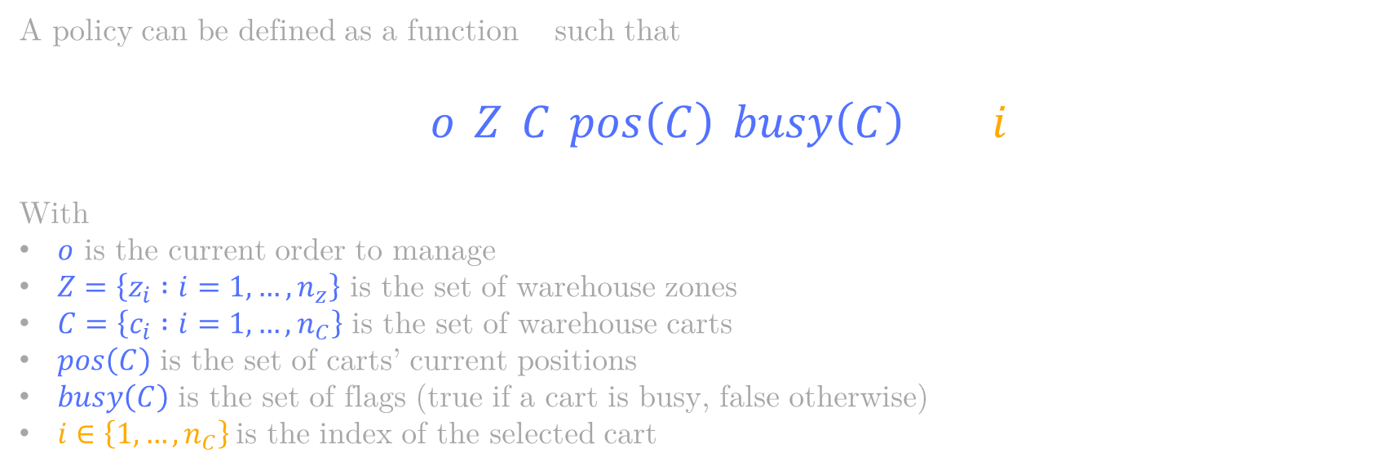
Policy
A policy can be defined as a function $p$ such that
$$p\left(o,Z,C,pos\left(C\right), busy\left(C\right)\right)→i$$
With
$o$ is the current order to manage
$Z=\left\{z_{i} :i=1,…,n_{z}\right\}$ is the set of warehouse zones
$C=\left\{c_{i} :i=1,…,n_{C}\right\}$ is the set of warehouse carts
$pos\left(C\right)$ is the set of carts’ current positions
$busy\left(C\right)$ is the set of flags (true if a cart is busy, false otherwise)
$i∈\left\{1,…,n_{C}\right\}$is the index of the selected cart
Machine Learning

Slide 5




Traditional Policies
In this project we consider these traditional policies
RR
NAF
SPTF
(Round Robin)
(Nearest AGV First)
(Shortest Processing Time First)
Machine Learning

Slide 6




Objectives
The goal is to find a solution which minimizes these different objectives
Time
Distance
Consuption
We want to minimize these objectives on average
Machine Learning

Slide 7
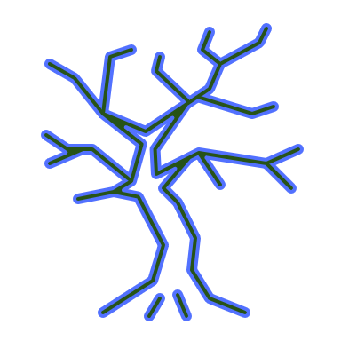
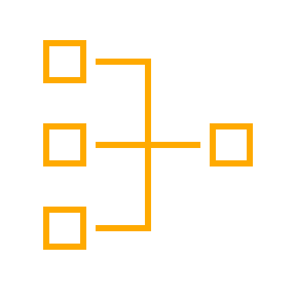
Proposed Solution
Let us introduce a relaxation of the the carts evaluation process
a GP-evolved evaluation function assesses the carts’ goodness to manage the order
a deterministic selection assigns the order to the best free cart
−1.5
c₁
among free
carts
3.6
argmax
2
c₂
4.1
c₃
GP individual
GP Policy
Machine Learning

Slide 8

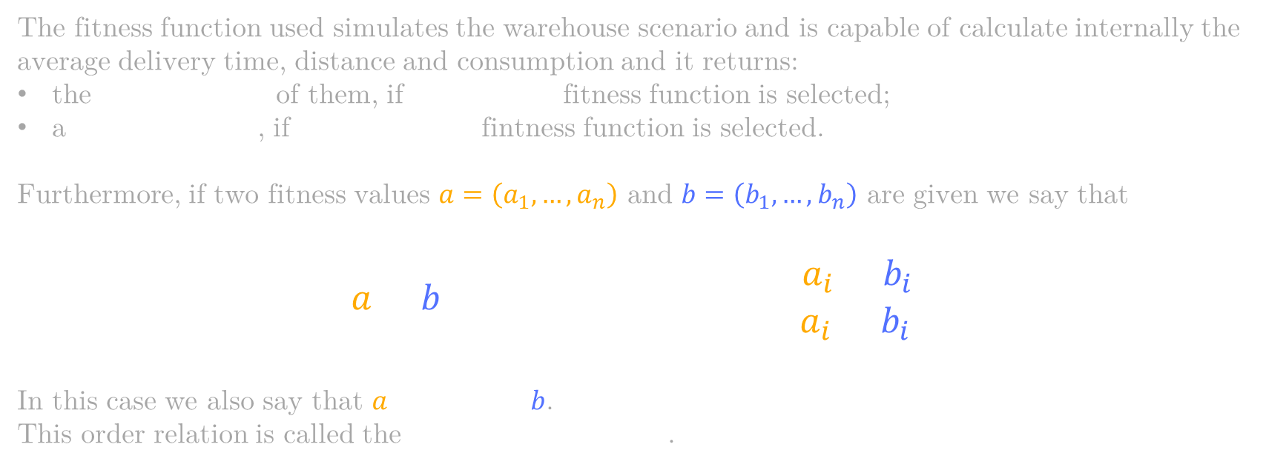
Fitness Function
The fitness function used simulates the warehouse scenario and is capable of calculate internally the average delivery time, distance and consumption and it returns:
the weighted sum of them, if single-value fitness function is selected;
a triple of values, if multiple-value fintness function is selected.
Furthermore, if two fitness values $a=\left(a_{1},…,a_{n}\right)$ and $b=\left(b_{1},…,b_{n}\right)$ are given we say that
$$a>b if\left\{\begin{aligned}&∀i∈\left\{1,…,n\right\}, a_{i}≥b_{i} \\ &∃i∈\left\{1,…,n\right\}: a_{i}>b_{i}\end{aligned}\right.$$
In this case we also say that $a$ dominates $b$.
This order relation is called the Pareto order relation.
Machine Learning

Slide 9
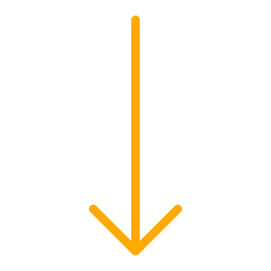

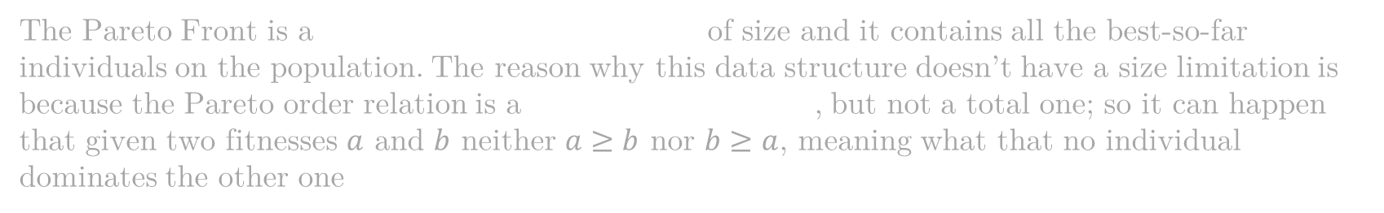
Fitness Function: Pareto Front
Single Objective
Multiple Objectives
HOF[1]
Pareto Front
The Pareto Front is a Hall of Fame without limits of size and it contains all the best-so-far individuals on the population. The reason why this data structure doesn’t have a size limitation is because the Pareto order relation is a partial order relation, but not a total one; so it can happen that given two fitnesses $a$ and $b$ neither $a≥b$ nor $b≥a$, meaning what that no individual dominates the other one
Machine Learning

Slide 10




GP Structure
$$+$$
For each generation, after replacing the population with the new one, we check if all best-so-far individuals belong to the population. If it isn’t true, all deleted individuals are added to the population, replacing the worst ones
To prevent overfitting, every a certain number of generations, the evolution is stopped to evaluate the best-so-far individuals by means of a validation set. After a certain number of consecutives non-improvements in validations, the training stops
Elitism
eaSimple
$$+$$
Early
Stopping
Machine Learning

Slide 11
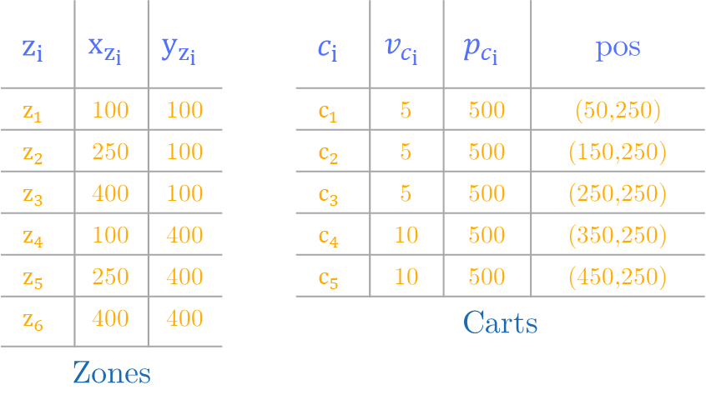
WODP instance
z₄
z₅
z₆
$$z_{i}$$ | $$x_{z_{i}}$$ | $$y_{z_{i}}$$ |  | $$c_{i}$$ | $$v_{c_{i}}$$ | $$p_{c_{i}}$$ | pos
$$z_{1}$$ | 100 | 100 |  | $$c_{1}$$ | 5 | 500 | (50,250)
$$z_{2}$$ | 250 | 100 |  | $$c_{2}$$ | 5 | 500 | (150,250)
$$z_{3}$$ | 400 | 100 |  | $$c_{3}$$ | 5 | 500 | (250,250)
$$z_{4}$$ | 100 | 400 |  | $$c_{4}$$ | 10 | 500 | (350,250)
$$z_{5}$$ | 250 | 400 |  | $$c_{5}$$ | 10 | 500 | (450,250)
$$z_{6}$$ | 400 | 400 |  | Carts
Zones
c₂
H = 500
c₁
c₃
c₄
c₅
y
z₁
z₂
z₃
O
x
W = 500
Machine Learning

Slide 12

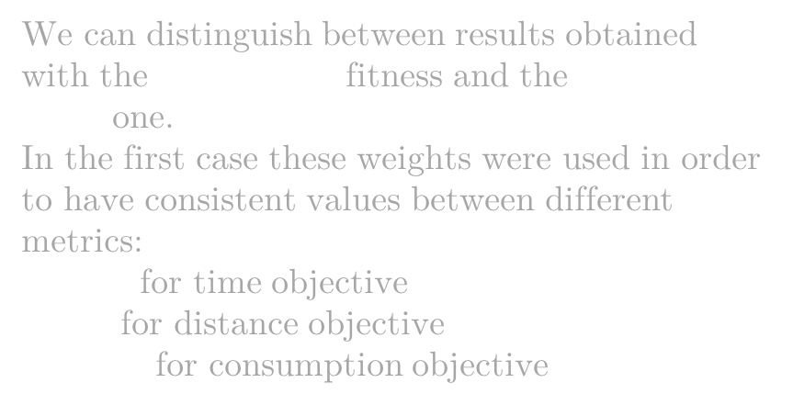
Results on Test Set
We can distinguish between results obtained with the single-value fitness and the multiple-value one.
In the first case these weights were used in order to have consistent values between different metrics:
$−10$ for time objective
$−1$ for distance objective
$−{10}^{2}$ for consumption objective
Seed | Time | Distance | Consuption
5392847103 | 53.34285 | - | -
4728391056 | - | 410.2400 | -
3950182478 | - | - | 26879.65
2847509139 | 55.09515 | 411.3326 | -
1529473807 | - | 422.9373 | 27729.64
8479201530 | 54.27765 | - | 27096.91
5821049738 | 53.37485 | 426.0039 | 26652.06
Machine Learning

Slide 13
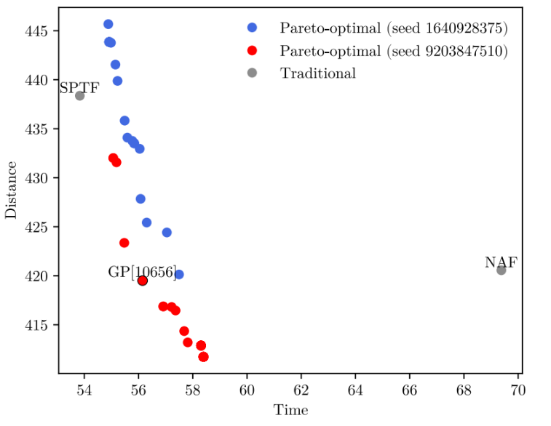
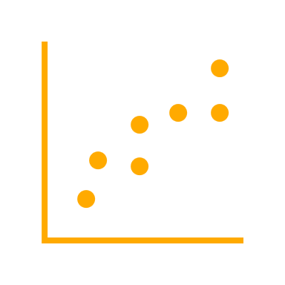
Results on Test Set
If we consider the multiple-value fitness we get multiple optimal solutions following Pareto rules (left image). From this point we can select our best GP (subjective) and the results are shown in the table.
Seed | Choice | Time | Distance | Consumption
9203847510 | GP[10656] | 55.81822 | 416.2828 | -
4938051729 | GP[22] | - | 415.0762 | 28001.76
8204719532 | GP[0] | 55.19450 | - | 27559.59
6074928513 | GP[52] | 55.89215 | 413.9534 | 27916.4
Machine Learning

Slide 14
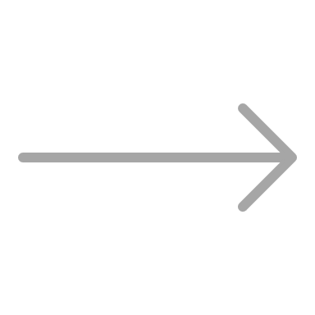


Conclusions
This Project shows that in the specific case the GP aligns with traditional algorithms on the single target but manages to combine the merits of all policies into one
Distance
Consuption
GP
Time
Machine Learning

Slide 15

Thanks for the attention!

