Slide 1
A Robust Fetal ECG Detection Method for Abdominal Recordings
Reproducing and evaluating Martens et al. (2007) on the CinC 2013 dataset
Federico Cerutti - 85644A
Biomedical Signal Processing Project

Slide 2
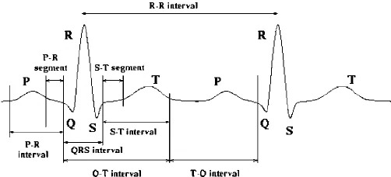
Introduction
Clinical Context
▪ Fetal cardiac activity is a key indicator of fetal well‑being
▪ Routine Doppler ultrasound only provides the Fetal heart rate (FHR), not morphology
▪ Fetal ECG (FECG) carries PR/QRS/ST morphology, which are directly linked to fetal oxygenation
▪ Abdominal FECG is a non‑invasive method usable throughout pregnancy and labour (vs. invasive scalp electrode, labour‑only)
Challenge
▪ FECG amplitude: tiny (tens of µV)
▪ Buried under: baseline wander, power‑line interference, EMG/motion artifacts
▪ Above all: the mother's ECG (MECG) is an order of magnitude larger, same electrodes
▪ Goal: strip away everything that isn't the fetal heartbeat
Figure 0. nomenclature of the ECG.
Robust Fetal ECG Detection -- Sequential Analysis vs. ICA
2

Slide 3
Two paradigms
Blind (ICA / BSS)
Non‑blind (Sequential Analysis)
▪ No prior knowledge assumed
▪ Relies purely on statistical independence of sources
▪ As many independent sources as channels required
▪ Exploits a priori knowledge of each interferer
▪ Uses periodicity, morphology, frequency content
▪ Thesis: more robust, especially at low SNR
vs.
Robust Fetal ECG Detection -- Sequential Analysis vs. ICA
3

Slide 4
Pipeline overview
[Maternal QRS Detector]
[Fetal QRS Detector]
S1
Baseline Wander Remover
S2
PLI Canceller
S3
Sampling‑Rate Increaser
S4
MECG Canceller
S5
FECG Extractor
S6 +FHR
Note: signals were originally sampled at 1000 Hz → upsampled to 2000 Hz for MECG cancellation precision
Robust Fetal ECG Detection -- Sequential Analysis vs. ICA
4

Slide 5
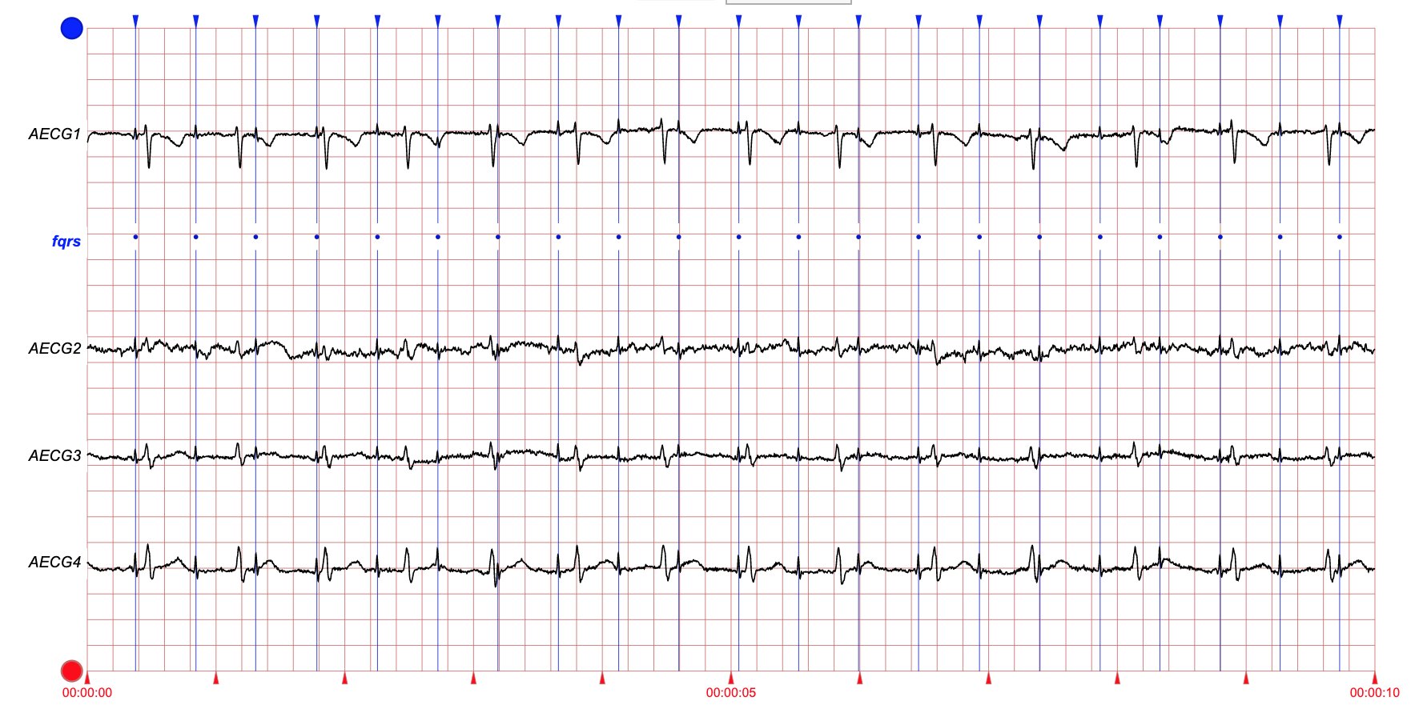
Dataset
▪ Sourced from: The 2013 PhysioNet/CinC Challenge
▪ Data structure: 1 minute recordings, 4 non-invasive addominal channels
▪ Sampling frequency: 1000 Hz
▪ GT annotations: spatial locations of each fetal QRS complex are included
Robust Fetal ECG Detection -- Sequential Analysis vs. ICA
5

Slide 6
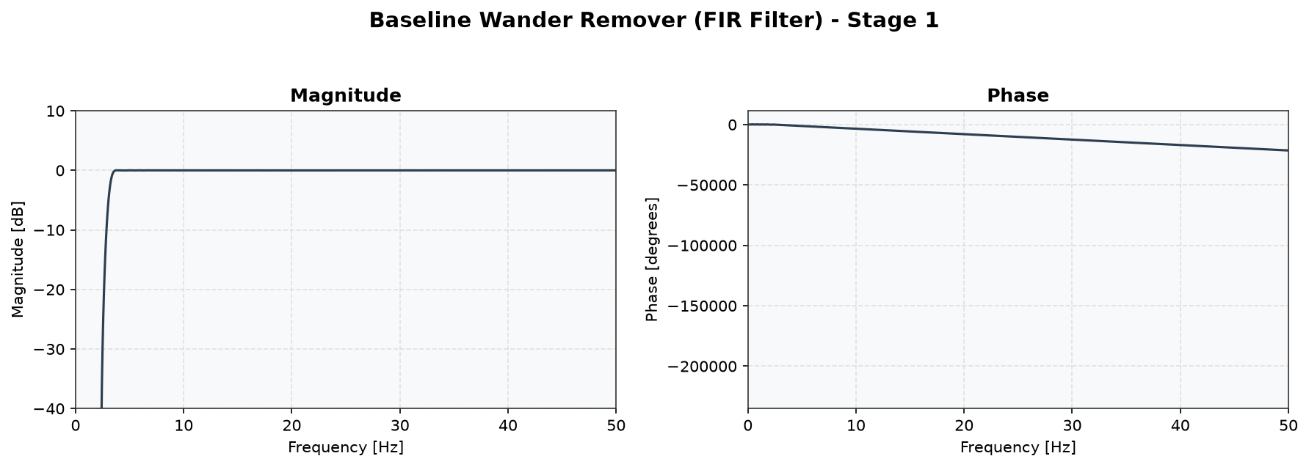
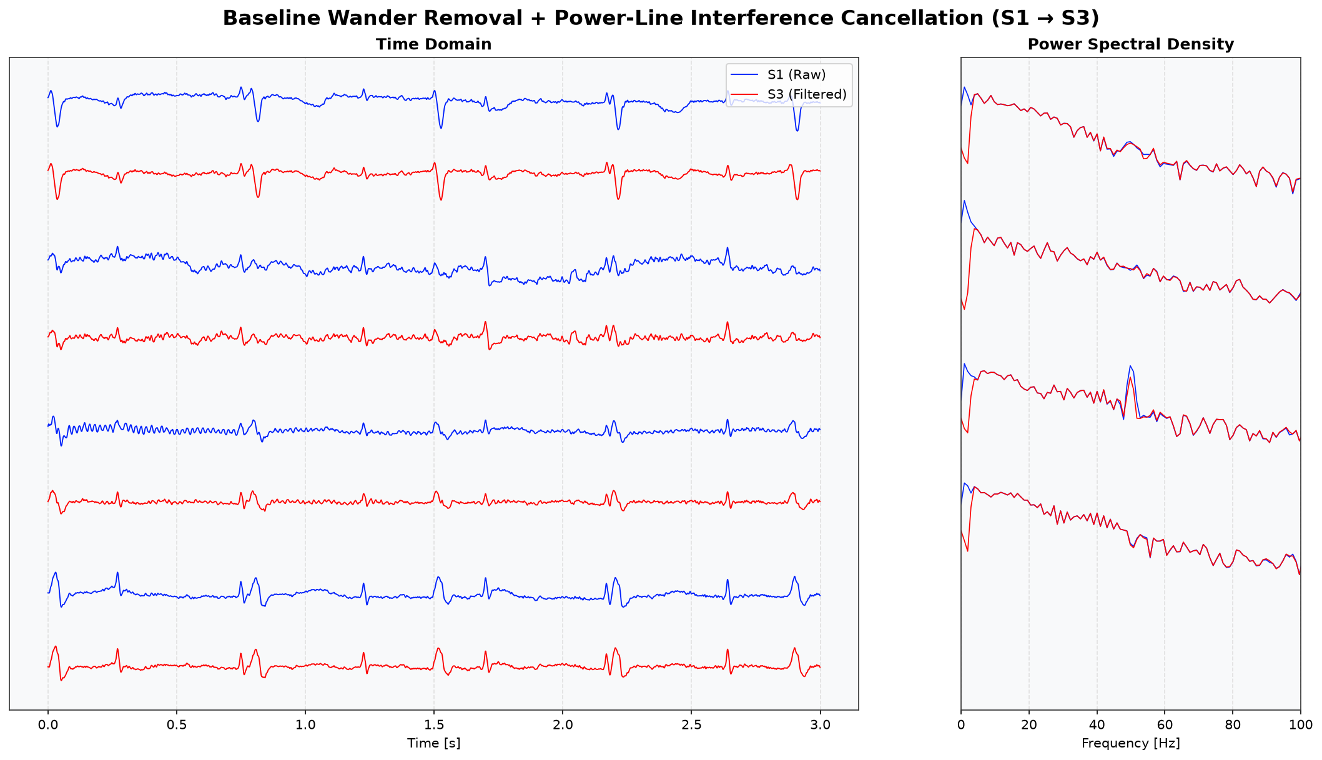
Stage 1–2: BW removal + PLI canceller
▪ Baseline wander removal: linear‑phase FIR high‑pass, 3 Hz cutoff, Hamming window
▪ Power‑line interference canceller: adaptive PLL‑style canceller with a QRS‑blocking mask
▪ Results: baseline flattened and stabilized. Removal of the 50 Hz interference and its harmonics up to 200 Hz.
Figure 1. baseline wander + power-line interference
Robust Fetal ECG Detection -- Sequential Analysis vs. ICA
6

Slide 7
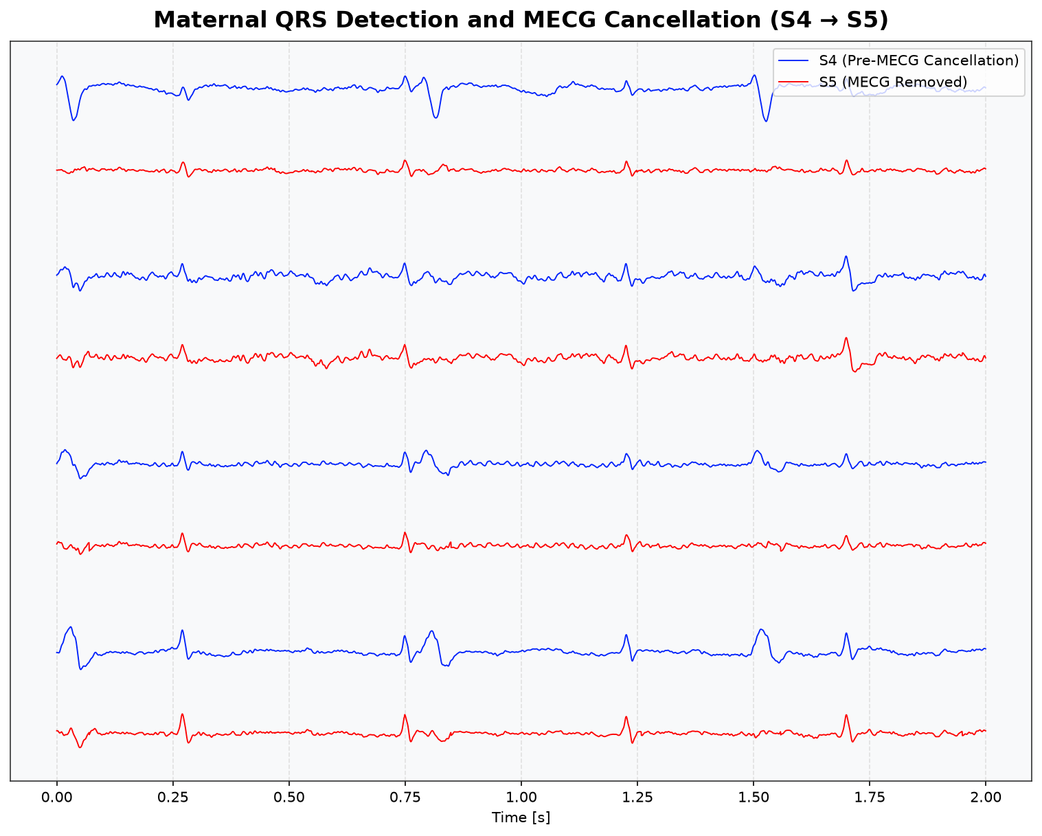
Stage 3–4: maternal QRS detection & MECG cancellation
▪ Maternal QRS detection: PCA channel combination (maximises SNR) + cross‑correlation matched filter
▪ MECG cancellation: average P‑wave/QRS/T‑wave templates, each scaled independently via least squares
▪ Numerical Stability: ridge Tikhonov regularisation applied to the least squares fit
Figure 2. maternal QRS detection & MECG cancellation
Robust Fetal ECG Detection -- Sequential Analysis vs. ICA
7

Slide 8
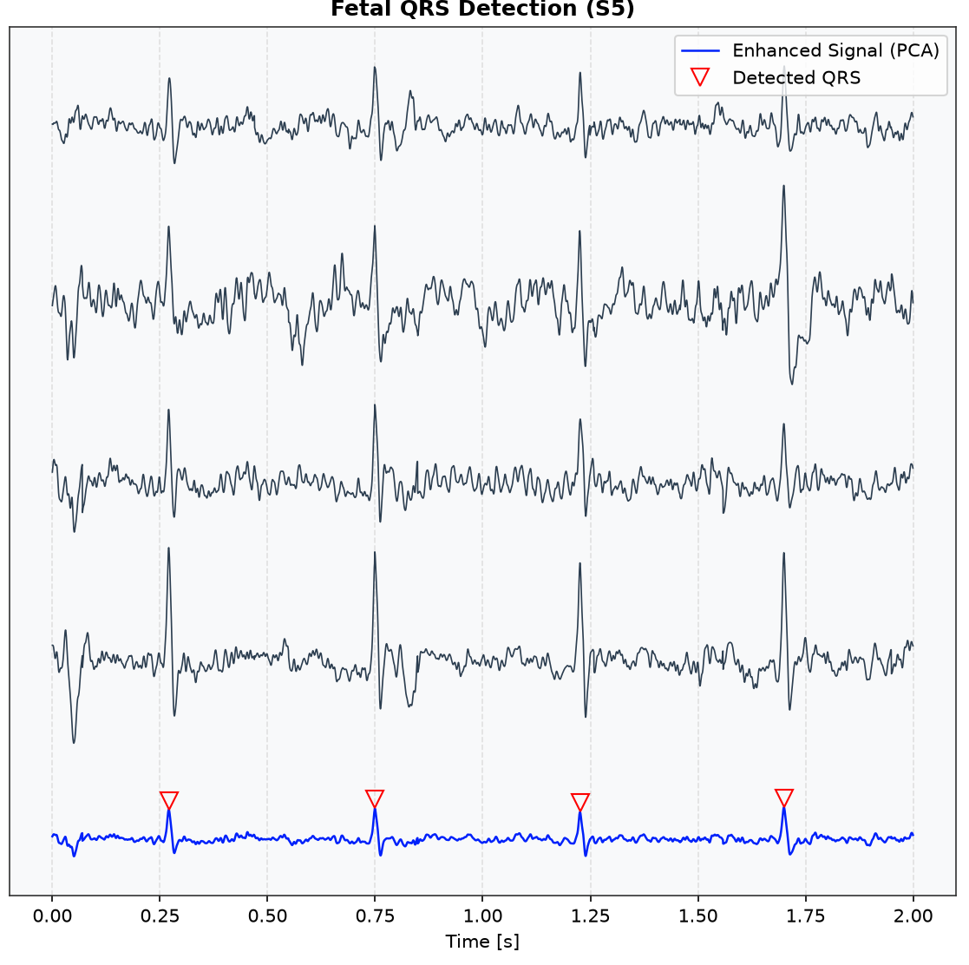
Stage 5: fetal QRS detection & FECG extraction
▪ Signal enhancement: PCA applied to the MECG free signal
▪ Candidate peaks: squared signal energy thresholding
▪ Refinement: cross‑correlation matched filter
▪ Final step: synchronous averaging of ~150 beats to achieve an SNR boost of √N
Figure 3. fetal QRS detection & FECG extraction
Robust Fetal ECG Detection -- Sequential Analysis vs. ICA
8

Slide 9
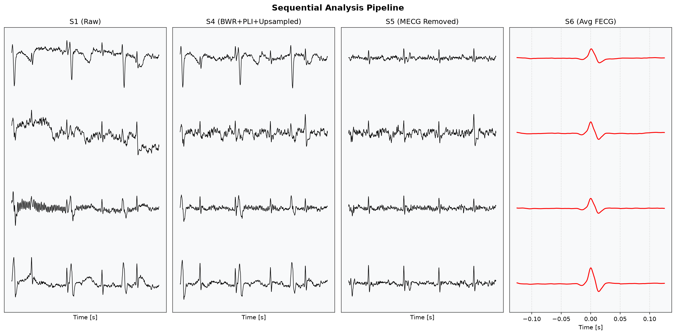
Full pipeline at a glance
▪ Raw → cleaned → MECG removed → clean averaged fetal beat
Figure 4. Full pipeline at a glance
Robust Fetal ECG Detection -- Sequential Analysis vs. ICA
9

Slide 10
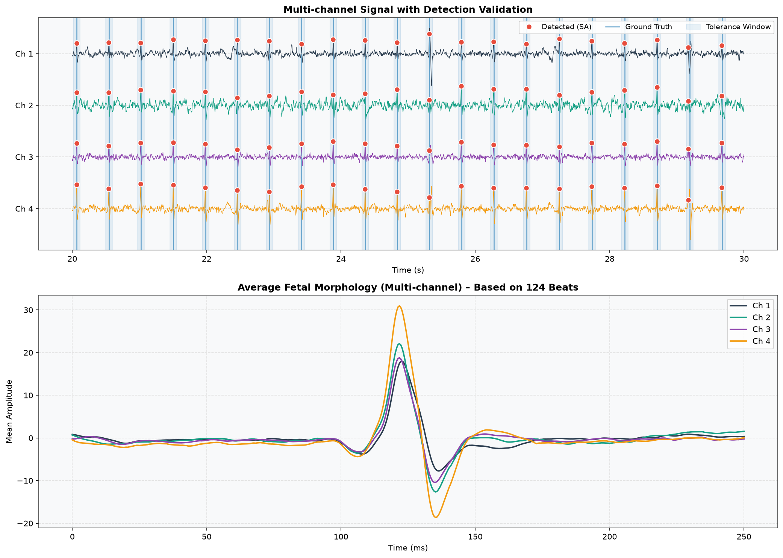
Qualitative validation against ground truth
▪ Detected fetal QRS peaks (red) vs. ground truth annotations (blue), ±50 ms tolerance
▪ 10 second, 4 channel strip
▪ Averaged fetal morphology across 124 ground truth matched beats
Figure 5. Qualitative validation against ground truth
Robust Fetal ECG Detection -- Sequential Analysis vs. ICA
10

Slide 11
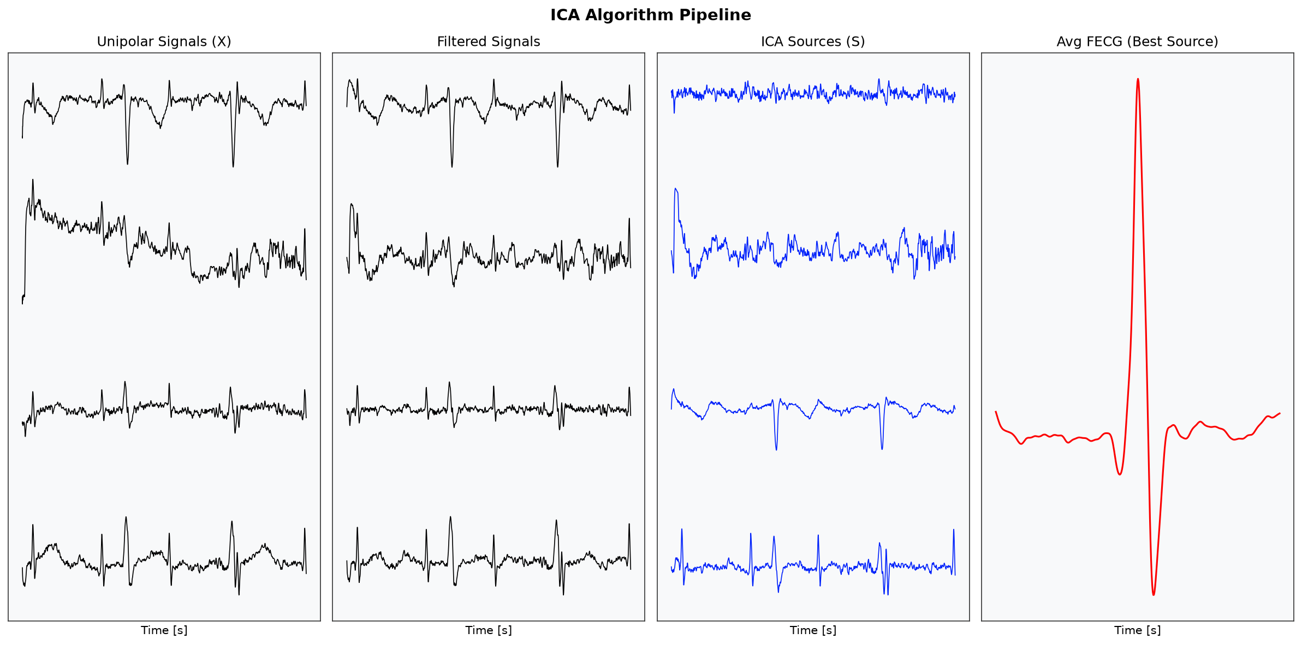
Baseline comparison: the ICA pipeline
▪ FastICA run on the same preprocessed data (baseline wander + PLI removed) as the "blind" alternative
▪ Best independent component auto selected by FHR detection yield
Figure 6. Baseline comparison: the ICA pipeline
Robust Fetal ECG Detection -- Sequential Analysis vs. ICA
11

Slide 12

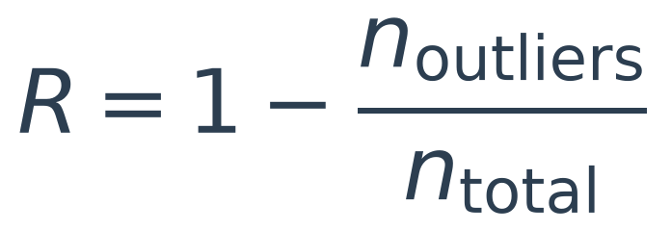

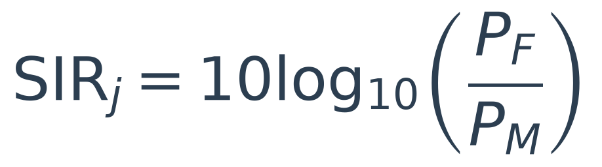
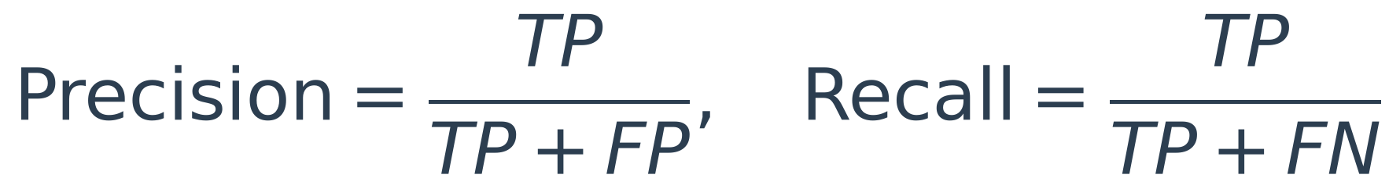
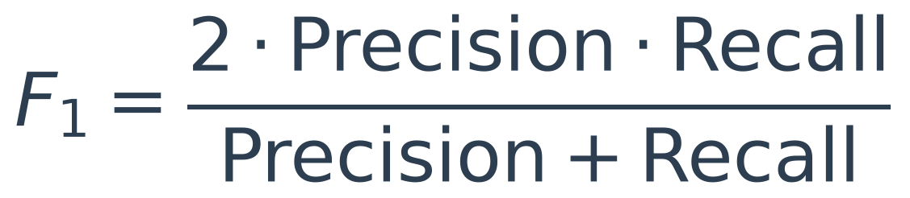
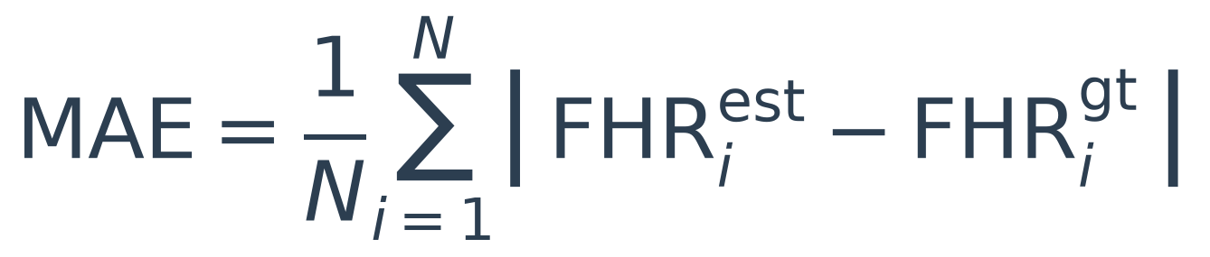
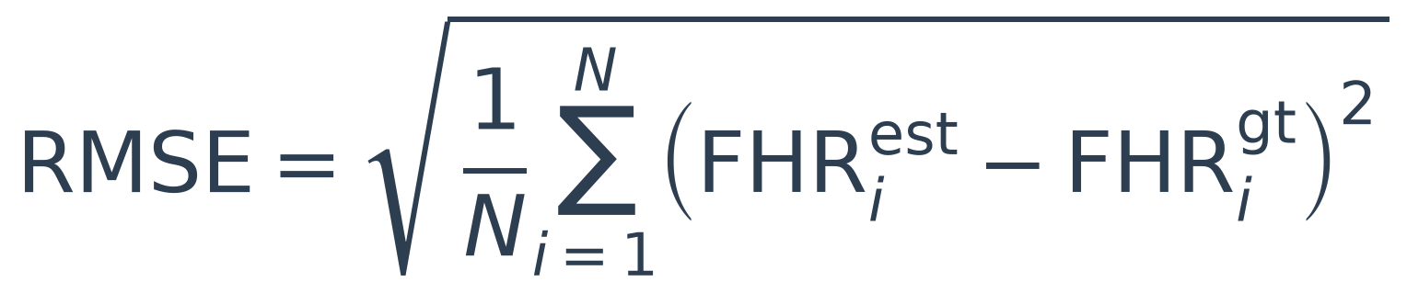
Evaluation metrics
Success
coverage ≥ 60% of the recording
Reliability
outlier: deviates >10 bpm from its 10 s block's median
SNR / SIR (dB, per channel j)
FECG, MECG, and noise power taken from S6, S4−S5, and the residual
Precision / Recall / F1
matched to .fqrs ground truth at ±50 ms tolerance
FHR-value MAE / RMSE (bpm)
estimated vs. ground-truth FHR, common 1 s grid
Robust Fetal ECG Detection -- Sequential Analysis vs. ICA
12

Slide 13
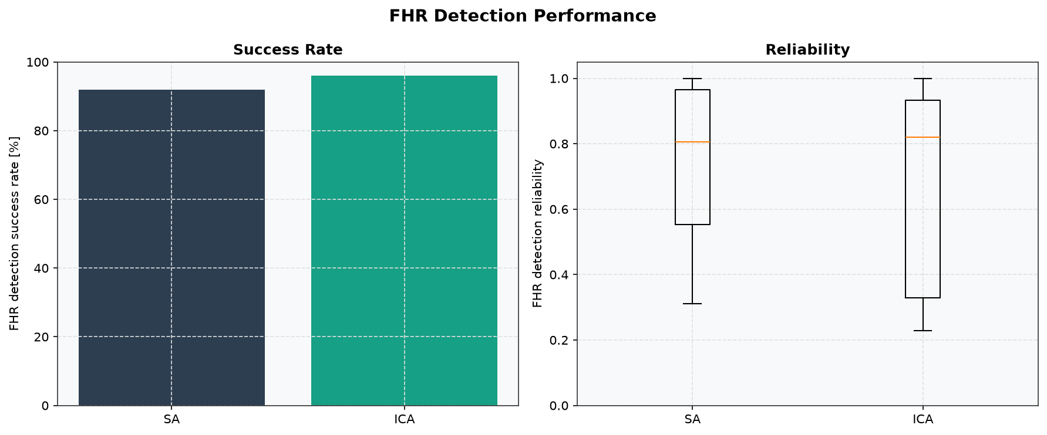
Results I: success rate & reliability
▪ FHR detection success rate: SA 92% vs. ICA 96% (23/25 vs. 24/25 records)
▪ Mean FHR reliability (feasible records only): SA 0.753 vs. ICA 0.684
▪ Box plots: SA's spread is tighter and more consistent — ICA is bimodal (several near perfect records, several collapsed as low as ~0.23)
Figure 7. success rate & reliability
Robust Fetal ECG Detection -- Sequential Analysis vs. ICA
13

Slide 14
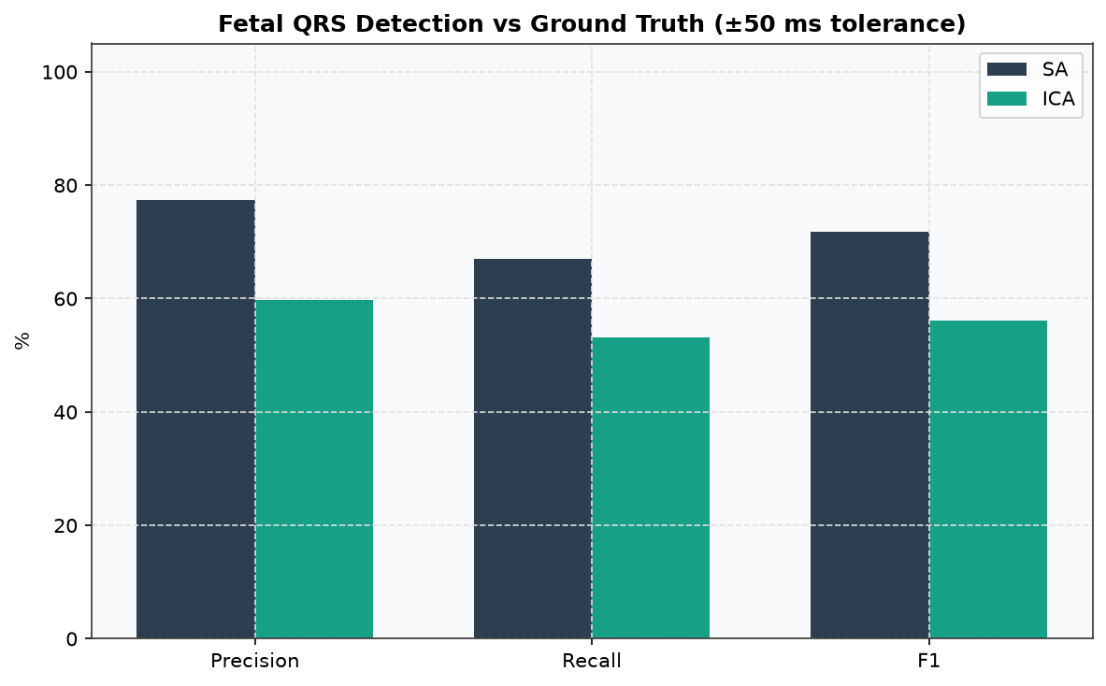
Results II: ground truth precision / recall / F1
▪ SA: 77.4% precision / 67.1% recall / 71.9% F1
▪ ICA: 59.7% precision / 53.1% recall / 56.2% F1
▪ Matched against ground truth annotations, ±50 ms tolerance, all 25 records
Figure 8. ground-truth precision / recall / F1
Robust Fetal ECG Detection -- Sequential Analysis vs. ICA
14

Slide 15
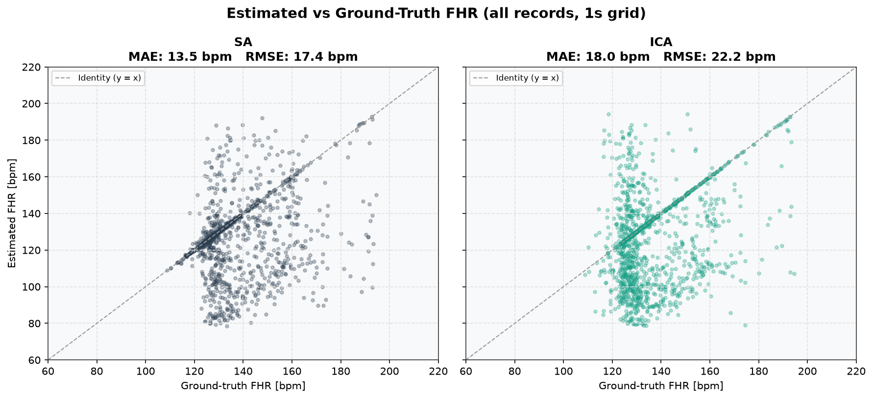
Results III: FHR value accuracy (MAE/RMSE)
▪ SA: MAE 13.5 bpm / RMSE 17.4 bpm
▪ ICA: MAE 18.0 bpm / RMSE 22.2 bpm
Figure 9. FHR-value accuracy
Robust Fetal ECG Detection -- Sequential Analysis vs. ICA
15

Slide 16
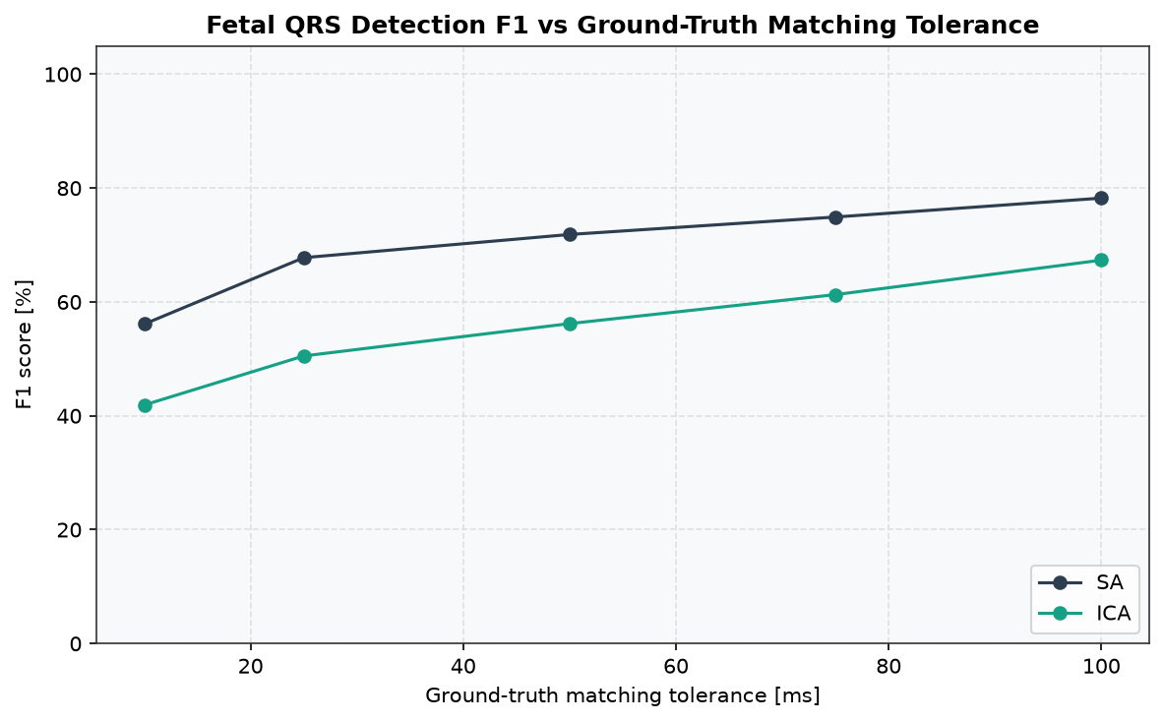
Results IV: robustness to matching tolerance
▪ F1 recomputed at 10 / 25 / 50 / 75 / 100 ms ground truth matching tolerances
▪ SA leads ICA at every tolerance tested
Figure 10. robustness to matching tolerance
Robust Fetal ECG Detection -- Sequential Analysis vs. ICA
16

Slide 17
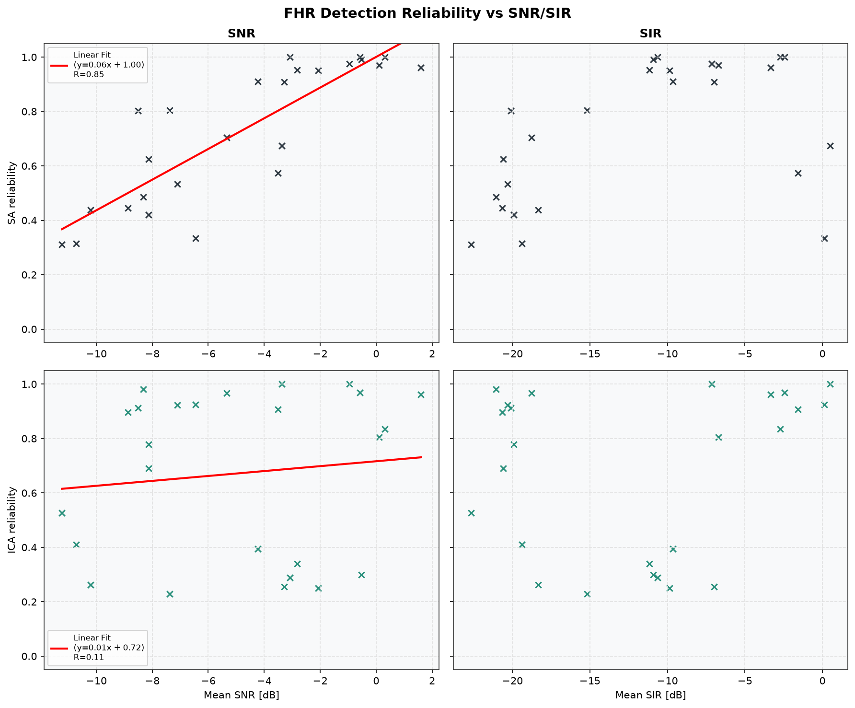
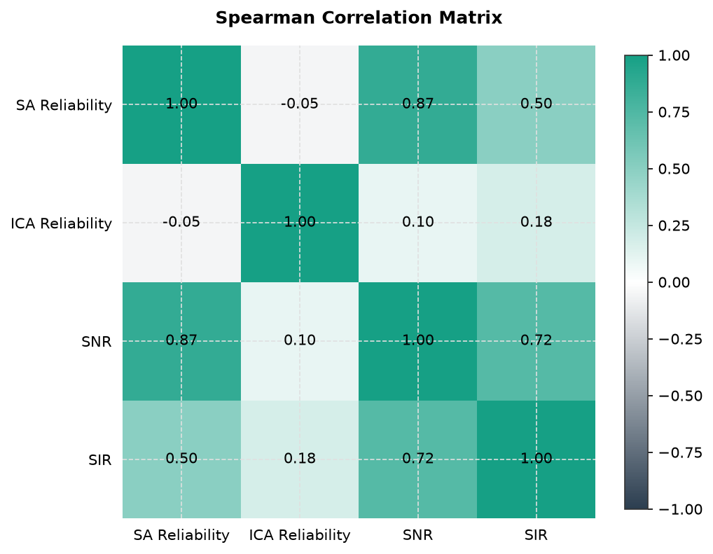
Results V: signal quality drives reliability
▪ Noise conditions: mean SNR ≈ −4.9 dB, mean SIR ≈ −12.0 dB
▪ SA reliability degrades gracefully as SNR/SIR drop; ICA collapses more sharply
▪ Spearman ρ: SA–SNR 0.87 (p<0.001), SA–SIR 0.50 (p=0.012); ICA–SNR 0.10 (p=0.63), ICA–SIR 0.18 (p=0.40)
Figure 11. signal quality drives reliability
Robust Fetal ECG Detection -- Sequential Analysis vs. ICA
17

Slide 18
Discussion & Conclusions
▪ SA outperforms ICA by leveraging known signal structure yielding better accuracy in low SNR conditions,
▪ showing expected lower recall in specific records (a18, a09, a02, a11, a15) consistent with the paper’s gestational age hypothesis,
▪ supporting the practical development of affordable and non-invasive home-based monitoring systems
Robust Fetal ECG Detection -- Sequential Analysis vs. ICA
18

Slide 19
Thank you
Robust Fetal ECG Detection -- Sequential Analysis vs. ICA
19

