Slide 1
GraphSAGE
Inductive Representation Learning on Large Graphs
Reproducing and evaluating Hamilton, Ying & Leskovec (2017) on the PPI dataset
Federico Cerutti — 85644A
ML on Graphs Project
GraphSAGE on PPI – Scaled Reproduction
1

Slide 2
01 · MOTIVATION & PARADIGMS
Transductive vs. inductive
Real-world graph problems need a learned vector per node. The only question is where that vector comes from: a fixed table, or a function.
Transductive
(DeepWalk / node2vec)
● Learns a lookup table, one row per node
● Embedding space can rotate between runs
● Fails on unseen nodes / unseen graphs
Inductive
(GraphSAGE)
● Learns a function over local neighborhoods
● Same function applies to brand-new nodes
● Works on unseen nodes, even unseen graphs
VS
Thesis: an inductive, neighborhood-aggregating function generalizes where a per-node lookup table cannot.
2

Slide 3
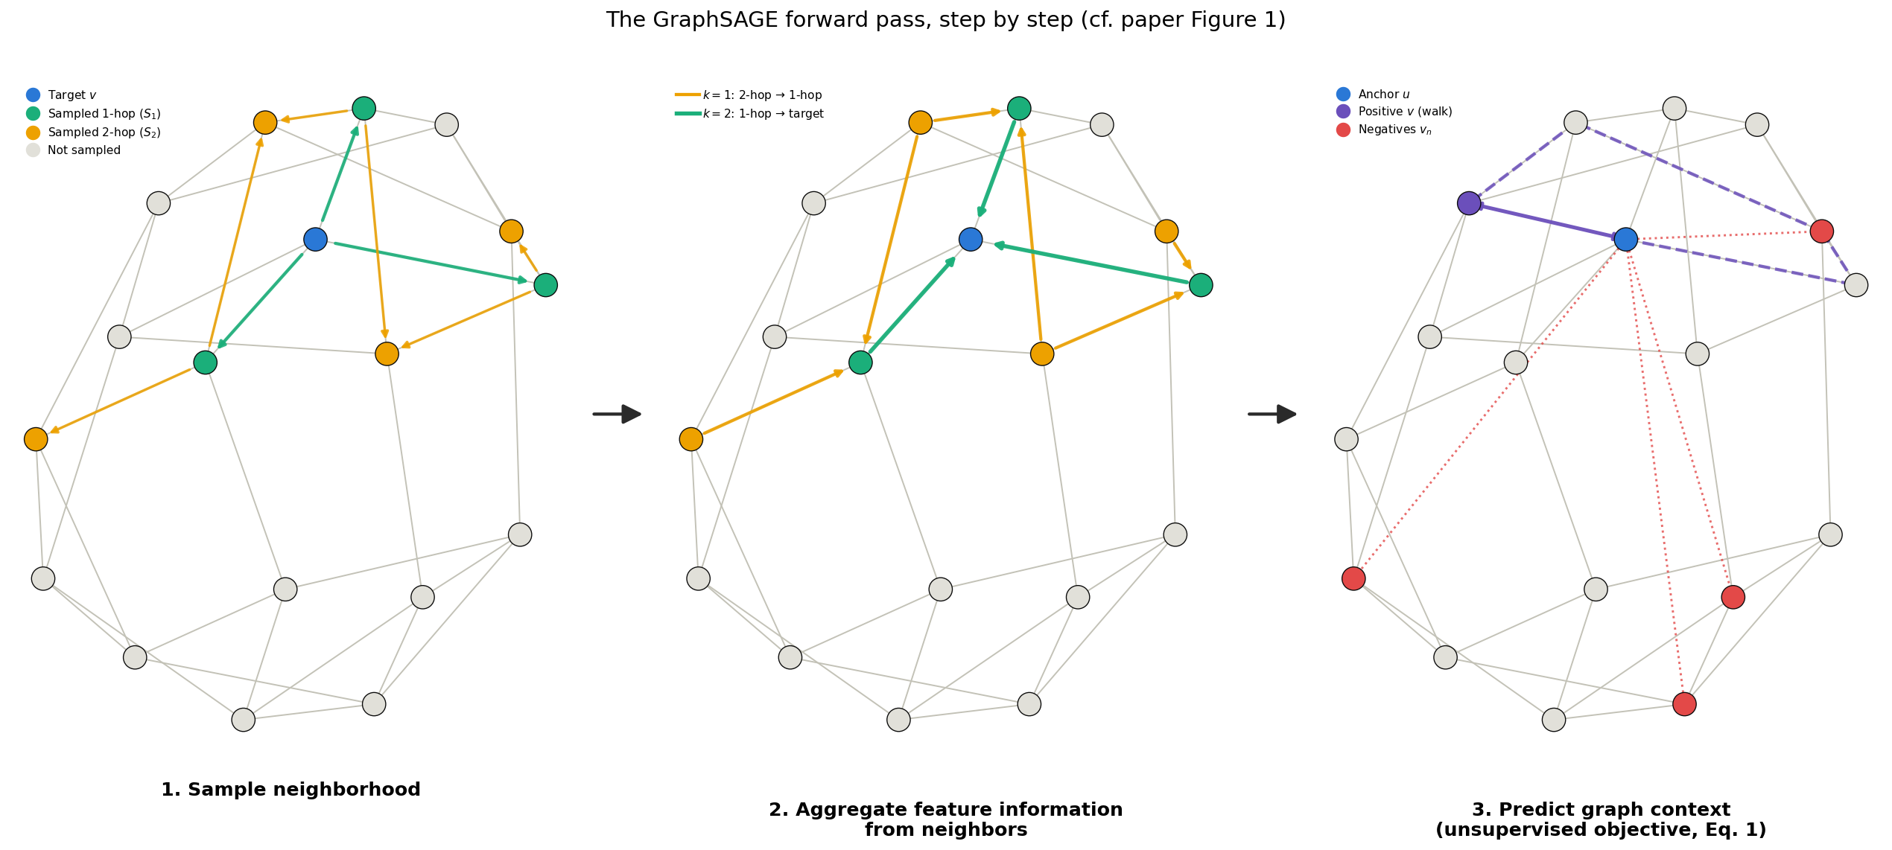
02 · METHOD
Algorithm 1: Sample → Aggregate → Predict
● Sample: fixed size neighborhood N(v), redrawn every iteration
● Aggregate + combine: h_{v}^{k} = σ(W^{k} · CONCAT(h_{v}^{k−1}, h_{N(v)}^{k})), then unit-normalize
● Repeat for k = 1...K hops → final embedding z_{v} = h_{v}^{K} | cost O(∏S_{i}), independent of |V|
3

Slide 4
02 · METHOD
Algorithm 2 — Minibatch Forward Propagation (1/2)
Input: G(V,E), {x_{v}}, depth K, {W^{k}}, σ, {AGGREGATE_{k}}, {N_{k}: v→2^{V}} — for k=1,...,K
Output: embedding z_{u}, ∀u∈B
PHASE 1 — BACKWARD SAMPLING (lines 1–7)
1: B^{K} ← B start from the target minibatch
2: for k = K,...,1 do expand outward, hop by hop
3: B^{k−1} ← B^{k}
4: for u ∈ B^{k} do
5: B^{k−1} ← B^{k−1} ∪ N_{k}(u) add u's sampled neighbors
6: end
7: end
Counterintuitive: indices 1, 2 track Algorithm 1's hop order, not distance from the target.
This project: K=2, S₁=25, S₂=10 → S₂=10 direct neighbors + S₁·S₂=250 two hop neighbors sampled per target
4

Slide 5
02 · METHOD
Algorithm 2 — Minibatch Forward Propagation (2/2)
PHASE 2 — FORWARD AGGREGATION (lines 8–16)
8: h_{u}⁰ ← x_{u}, ∀u ∈ B⁰ leaf nodes start from raw features
9: for k = 1,...,K do now aggregate back inward
10: for u ∈ B^{k} do
11: h_{N(u)}^{k} ← AGGREGATE_{k}({h_{u′}^{k−1} : u′∈N_{k}(u)}) aggregate sampled neighbors
12: h_{u}^{k} ← σ(W^{k}·CONCAT(h_{u}^{k−1}, h_{N(u)}^{k})) combine with self, learned transform
13: end
14: h_{u}^{k} ← h_{u}^{k} / ‖h_{u}^{k}‖₂, ∀u ∈ B^{k} unit-normalize before next hop
15: end
16: z_{u} ← h_{u}^{K}, ∀u ∈ B final embedding after K hops
This project: batch size=512, hidden dim 128 (×2 when concatenated), 20 negative samples (unsupervised)
5

Slide 6
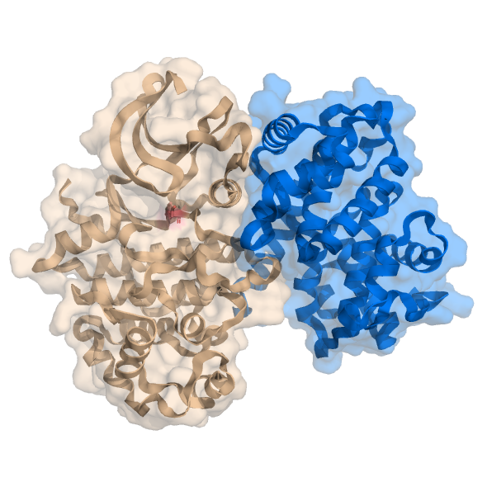
03 · DATASET
PPI — Protein-Protein Interaction
24 graphs
20 train / 2 val / 2 test split: cross-graph generalization
56,944 nodes
total, across all 24 graphs
121 GO terms
multi-label: a protein can have several functions at once
50-dim features
positional/motif gene sets + immunological signatures
Source: PPI dataset, http://snap.stanford.edu/graphsage/ppi.zip — Hamilton, Ying & Leskovec (2017)
6

Slide 7
04 · OBJECTIVE FUNCTIONS
Two ways to train the same encoder
Unsupervised
skip-gram style, Eq. 1
J(z_{u}) = −log σ(z_{u}^{T}z_{v}) − Q·E[log σ(−z_{u}^{T}z_{vn})]
v co-occurs with u on a random walk; negatives sampled from P_{n}
Supervised
PPI is multi-label ⇒ per class sigmoid cross entropy, not softmax
Replaces (or complements) the unsupervised loss for the downstream task
&
7

Slide 8
04 · OBJECTIVE FUNCTIONS
Eq. 1, intuitively: pull together, push apart
v_{n} — negative (×Q)
→
u — target node
→
v — positive
push apart
pull together
− Q·E[log σ(−z_{u}^{T}z_{vn})]
↓ similarity to negative samples. Penalizes random nodes that don’t co-occur with u
−log σ(z_{u}^{T}z_{v})
↑ similarity to the positive. Rewards nodes that co-occur with u on a random walk
Not a lookup table: zᵤ and zᵥ are generated by Algorithm 1 from each node’s local neighborhood and the same aggregator weights are reused for every node.
8

Slide 9
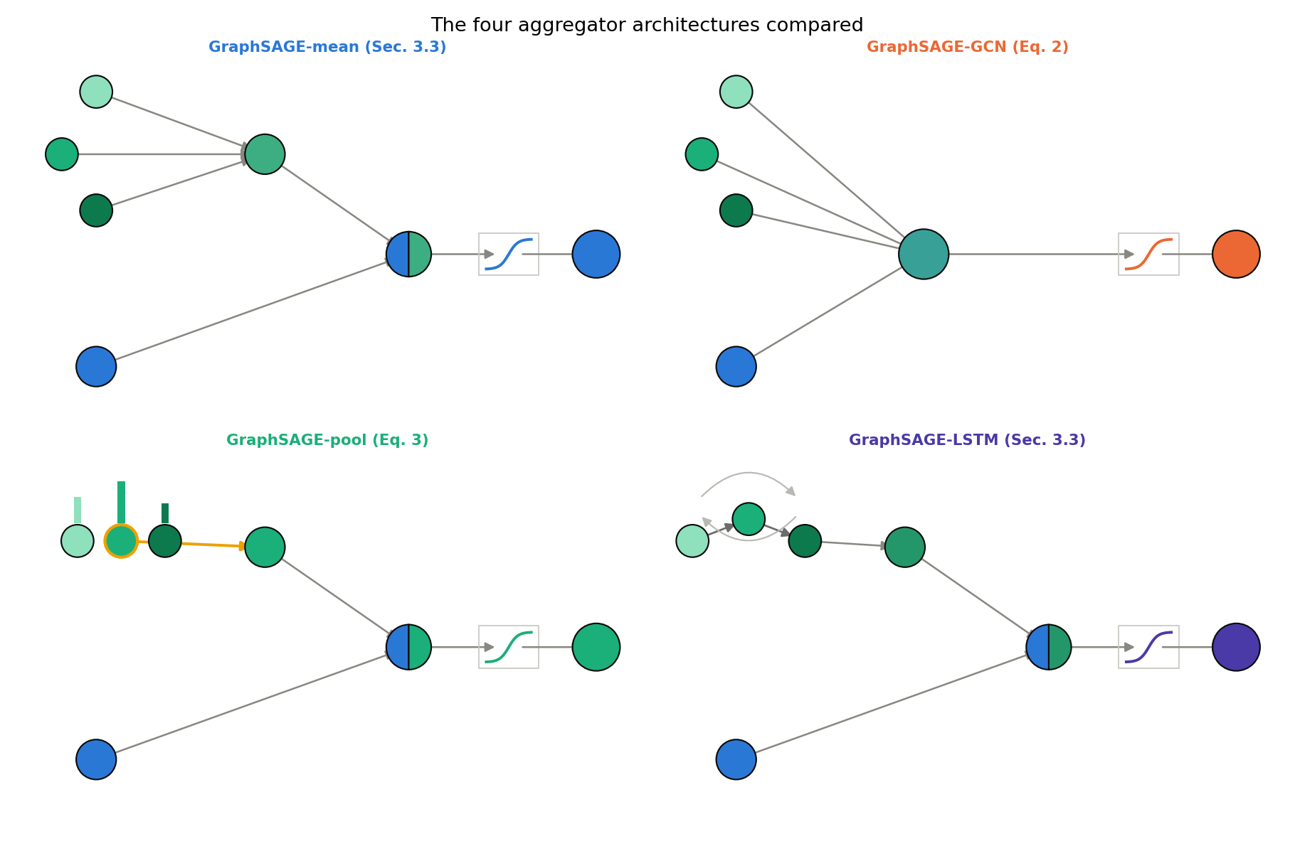
05 · AGGREGATOR ARCHITECTURES
Four ways to combine neighbor features
● Mean / GCN: elementwise average of neighbors; GCN drops the self skip connection
● GCN's width: doubled in code to match parameter counts with the concat aggregators — no skip connection to make up the difference
● Pool: each neighbor through a shared MLP, then elementwise max →
● LSTM: neighbors fed in random order: not permutation invariant in theory, but strong in practice
AGGREGATE_{k}^{pool} = max({σ(W_{pool}h_{ui}^{k} + b), ∀u_{i} ∈ N(v)})
9

Slide 10
06 · THEORETICAL RESULT
Theorem 1
HYPOTHESES
OBJECTIVE
Let x_{v} ∈ U ⊆ R^{d}, ∀v ∈ V (U compact).
Suppose ∃ C ∈ R⁺ such that ‖x_{v} − x_{v′}‖₂ > C for all pairs of nodes.
— every node’s "fingerprint" sits at least C away from every other’s.
Then, ∀ε > 0, ∃ Θ* such that after K = 4 iterations:
|z_{v} − c_{v}| < ε, ∀v ∈ V
z = learned output, c = true clustering coefficient.
How the fingerprint is built: two nodes only need different codes if they could ever meet in the same local neighborhood. Pooling learns the smallest set of one-hot codes that guarantees this, far cheaper than giving every node its own unique label (Lemma 3, next slide).
● Prediction: pool should degrade more gracefully than GCN when features are corrupted (tested empirically; see Results VI).
10

Slide 11
06 · THEORETICAL RESULT
Proof of Theorem 1 — three lemmas, stacked
LEMMA 1
→
LEMMA 2
→
LEMMA 3
A continuous function can be built to fire only near a chosen set of points.
{ g(x) > ε, if ‖x − x_{v}‖₂ = 0 for some v ∈ D
{ g(x) ≤ −ε, if ‖x − x_{v}‖₂ > C, ∀v ∈ D,
“A proximity detector for a specific group of nodes.”
Any such detector is approximable by a 1 hidden layer MLP (Hornik's theorem).
“A neural net can learn that detector.”
≥2-hidden layer pooling maps every node to a unique one hot ID over its 2 hop neighborhood, given distinct enough features.
“Stack enough detectors → every node gets its own ID badge”
→ Theorem 1 stacks four such layers to turn these ID badges into an exact clustering coefficient computation (next slide).
11

Slide 12
06 · THEORETICAL RESULT
Proof of Theorem 1 — the K=4 construction
K=1 — unique ID
→
K=2 — + own links
→
K=3 — + neighbors'
→
K=4 — finish (MLP)
c_{v} = 2(b^{T}c − d_{v}) / (d_{v}(d_{v}−1))
a = unique ID b = v's own connections c = sum of neighbors' connections d_{v} = degree
= (edges among v's neighbors) / (all possible such edges) — exactly the textbook clustering coefficient.
Corollary 2: this holds almost surely for noisy/continuous features — why GraphSAGE-pool keeps working when features are replaced with noise (see Results VI).
12

Slide 13
07 · MY SCALED REPRODUCTION
What was cut, and what wasn't
● Budget: single local consumer GPU (RTX 2060 SUPER)
● Not reduced: the algorithm itself (K=2, S₁=25, S₂=10, all 4 aggregators, both losses)
● Reduced: purely the experimental budget (hyperparameter grid, seed count, epoch/step counts)
Baseline
→
Sweep
→
Multi-seed
→
Sensitivity
→
Noise-robustness
13

Slide 14
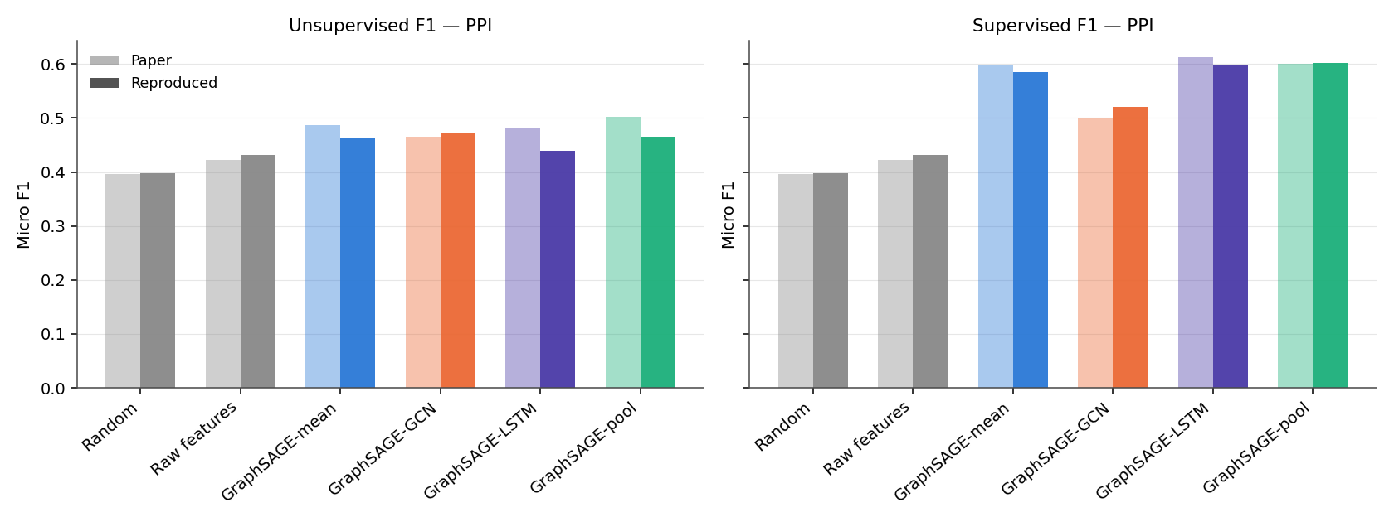
08 · RESULTS I
Accuracy vs. the paper
Same qualitative ordering as the paper: GraphSAGE ≫ Raw features > Random
14

Slide 15
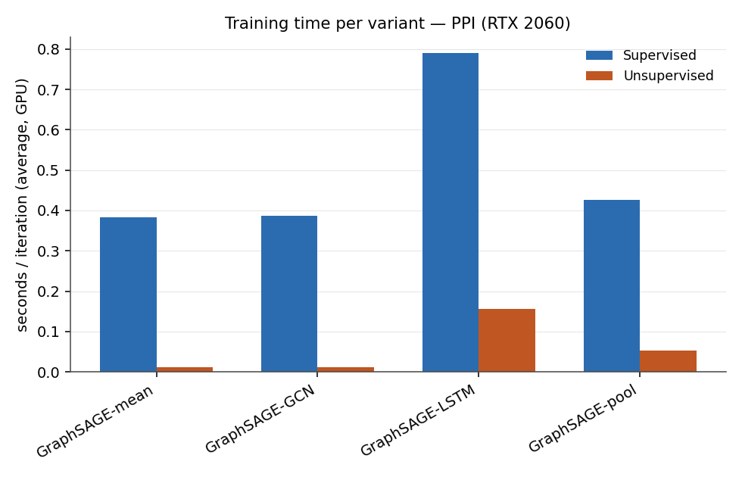
09 · RESULTS II
Training cost
● Seconds/iteration per aggregator
● Supervised vs. unsupervised
● Confirms the paper's own runtime tradeoff intuition across aggregator choices
15

Slide 16
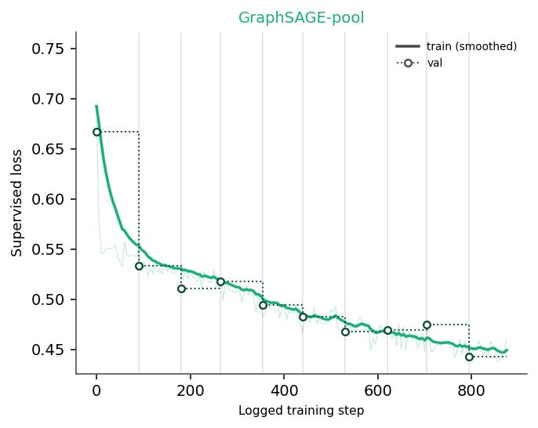
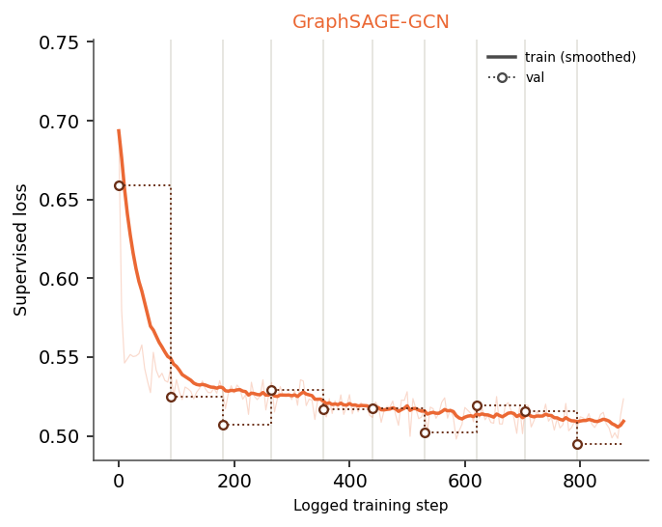
10 · TRAINING DYNAMICS
Loss — supervised
GraphSAGE-pool (strongest) vs. GraphSAGE-GCN (weakest): supervised loss over training
16

Slide 17
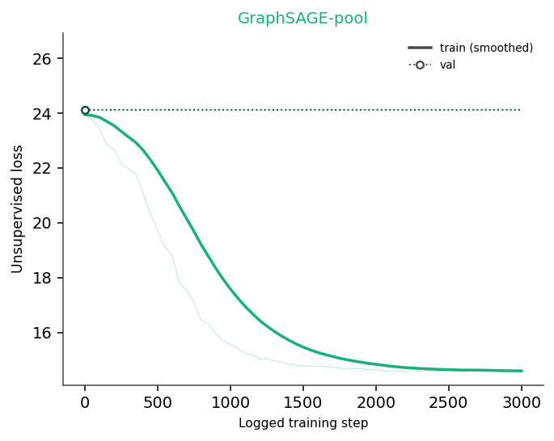
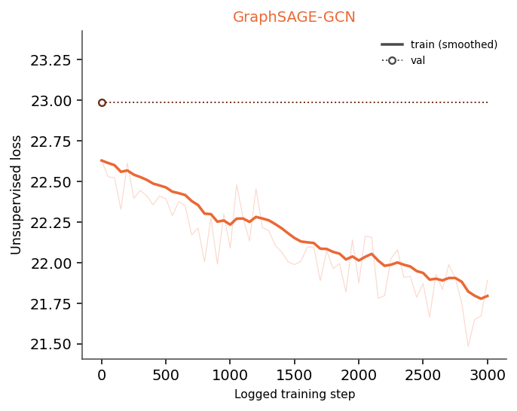
10 · TRAINING DYNAMICS
Loss — unsupervised
GraphSAGE-pool (strongest) vs. GraphSAGE-GCN (weakest): unsupervised loss over training
17

Slide 18
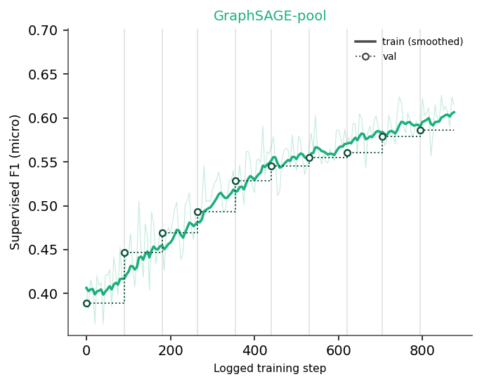
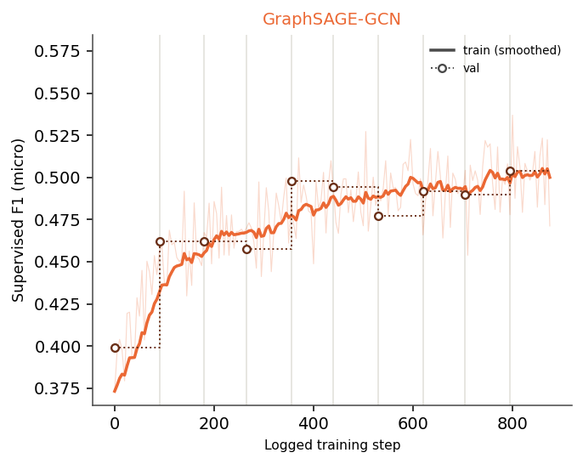
10 · TRAINING DYNAMICS
Performance — supervised
GraphSAGE-pool (strongest) vs. GraphSAGE-GCN (weakest): supervised performance (F1 micro) over training
18

Slide 19
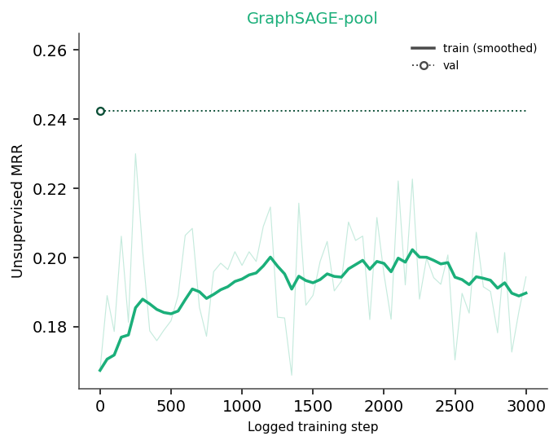
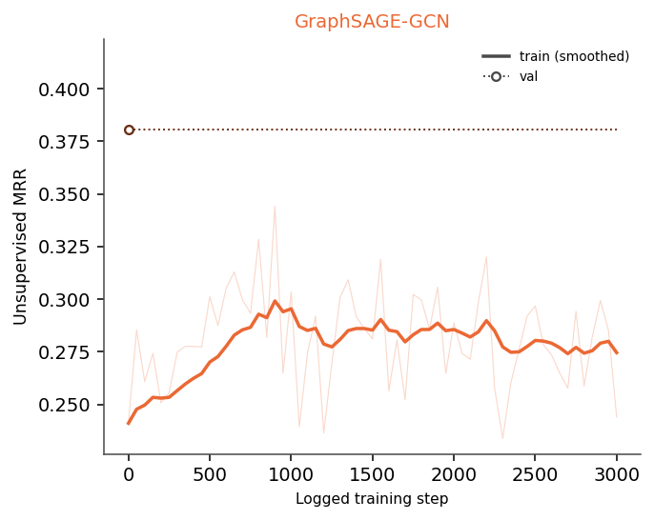
10 · TRAINING DYNAMICS
Performance — unsupervised
GraphSAGE-pool (strongest) vs. GraphSAGE-GCN (weakest): unsupervised performance (MRR) over training
19

Slide 20
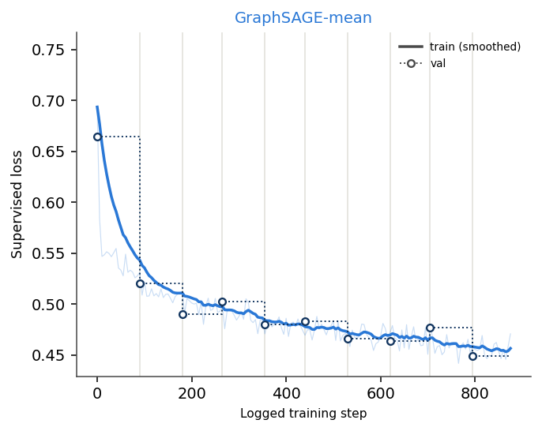
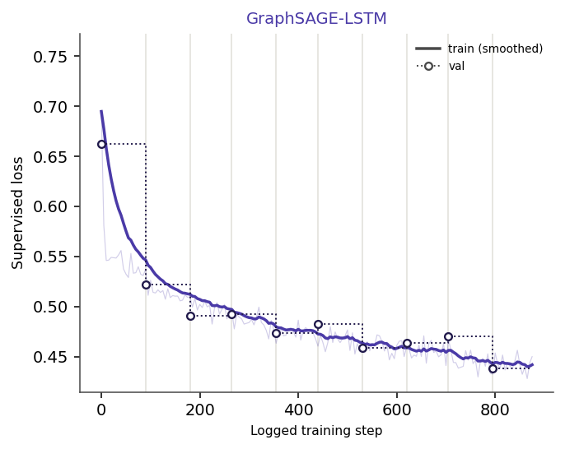
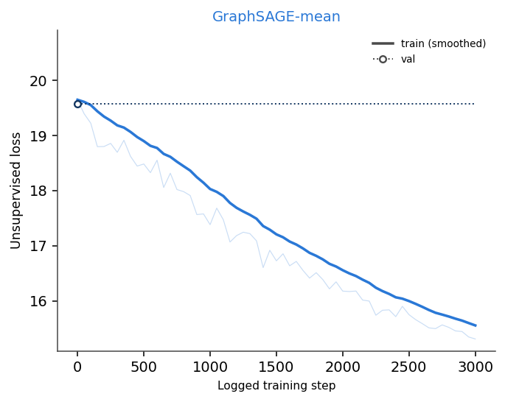
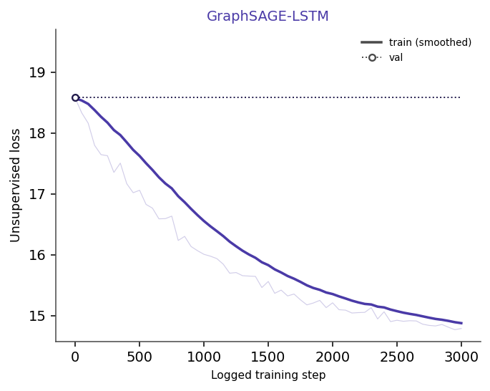
10 · TRAINING DYNAMICS
20

Slide 21
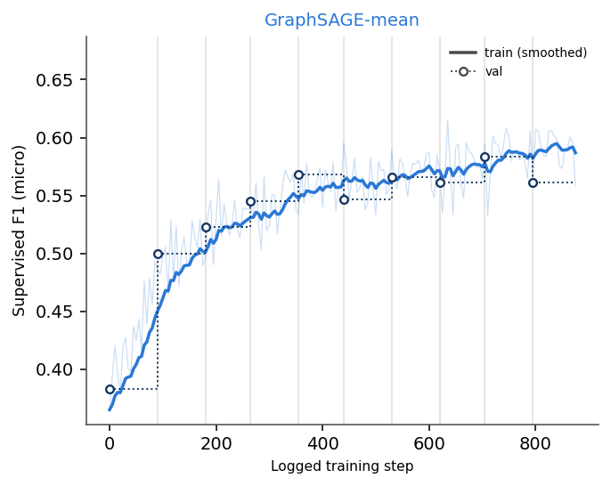
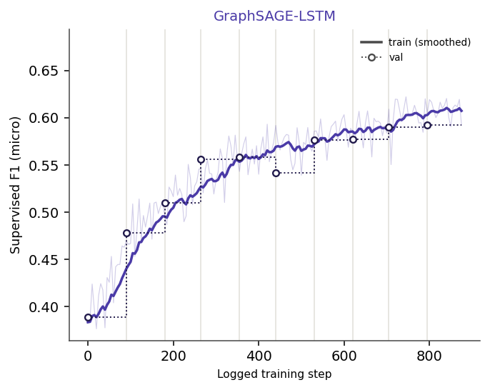
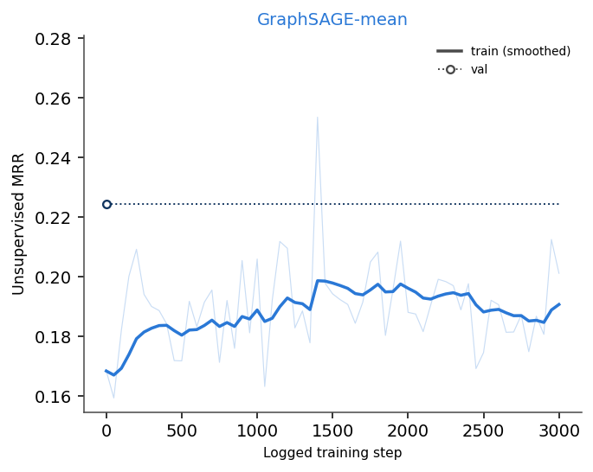
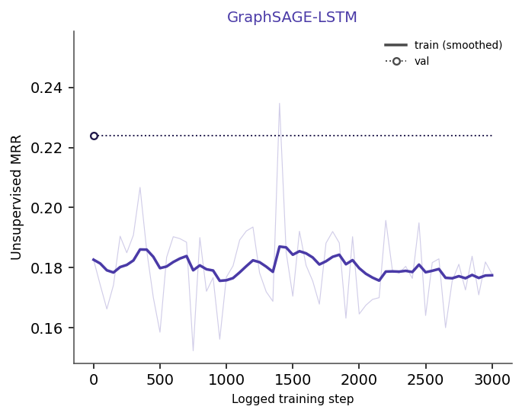
10 · TRAINING DYNAMICS
21

Slide 22
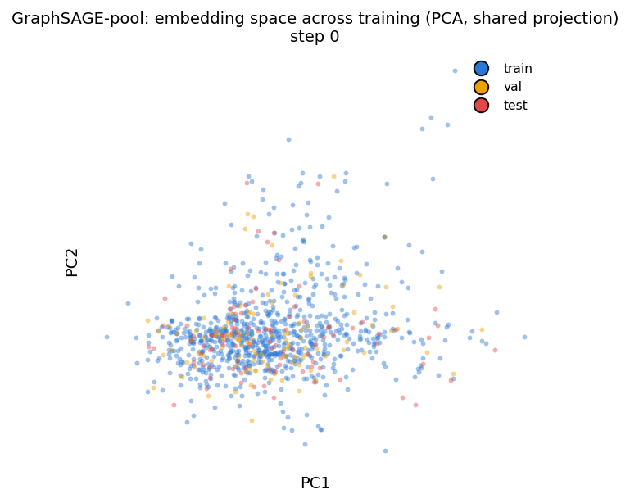
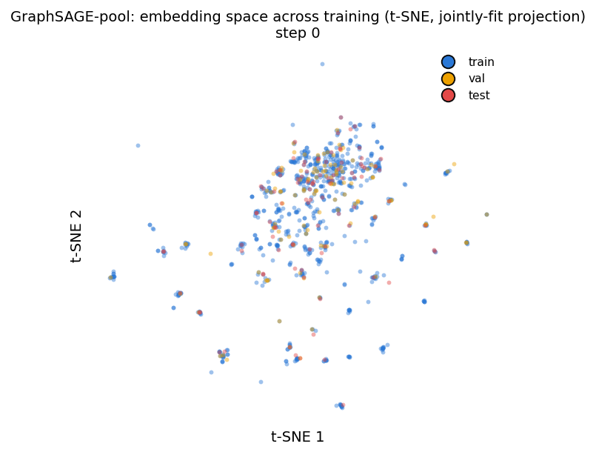
11 · EMBEDDING EVOLUTION
Step 0
Right after initialization: structurally different nodes not yet separated
22

Slide 23
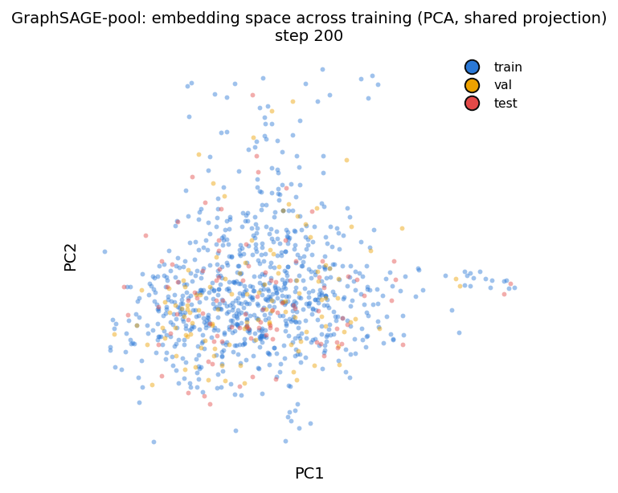
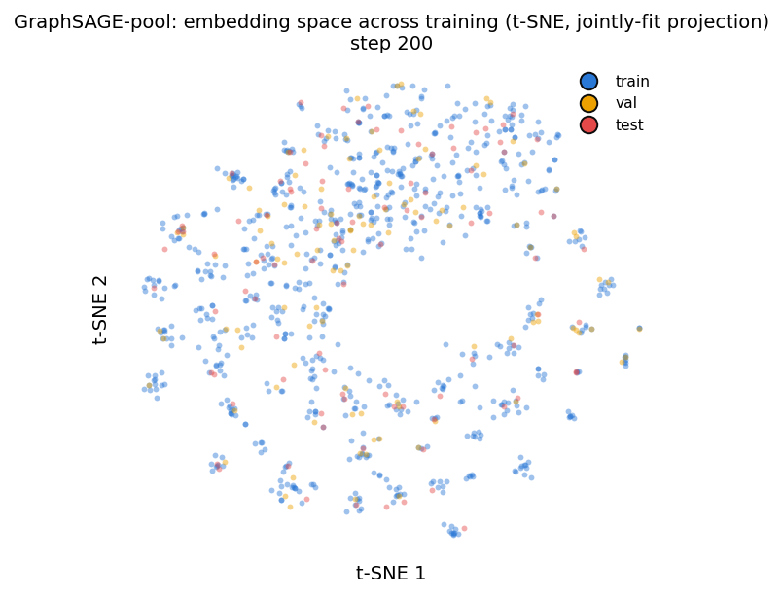
11 · EMBEDDING EVOLUTION
Step 200
Cluster structure already largely in place: ~85× fewer steps than a full epoch
23

Slide 24
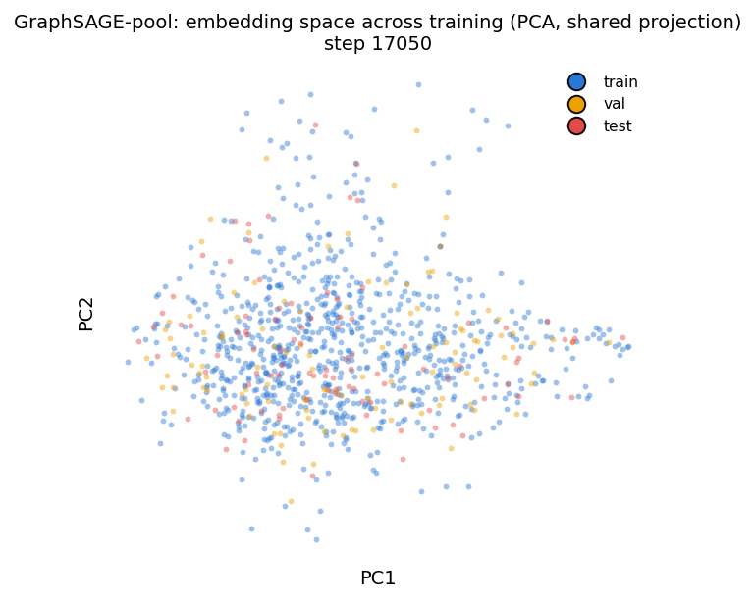
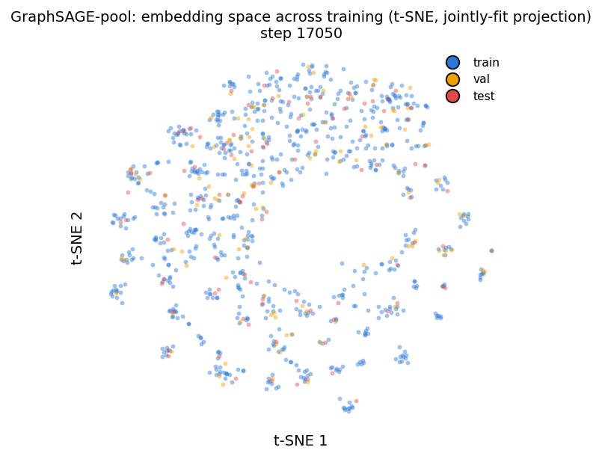
11 · EMBEDDING EVOLUTION
Step 17,050
Final stage (~1 full epoch): training mostly refines distances/density from here
24

Slide 25
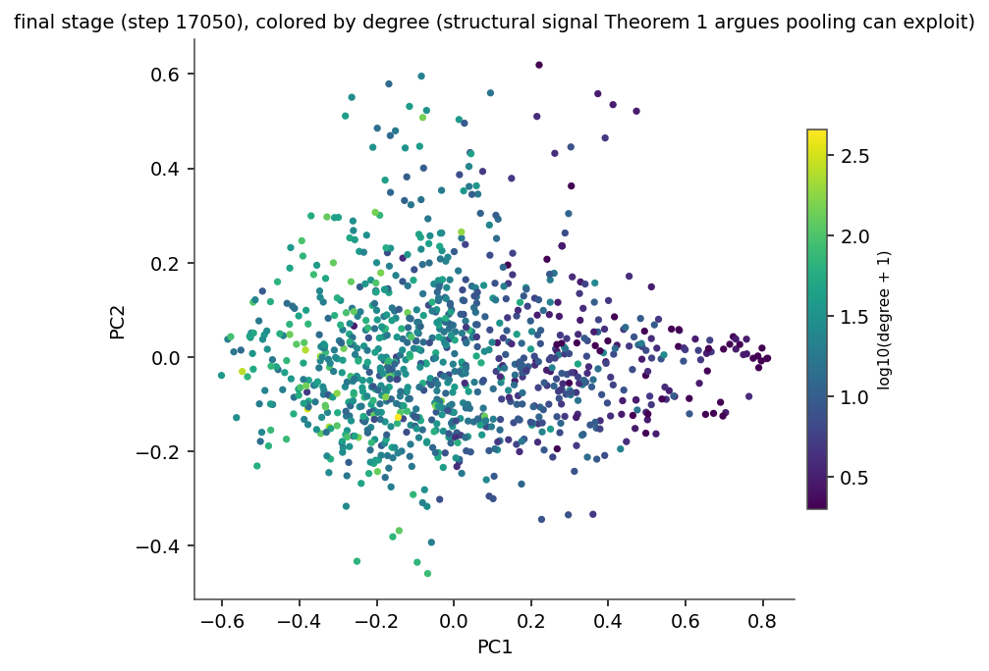
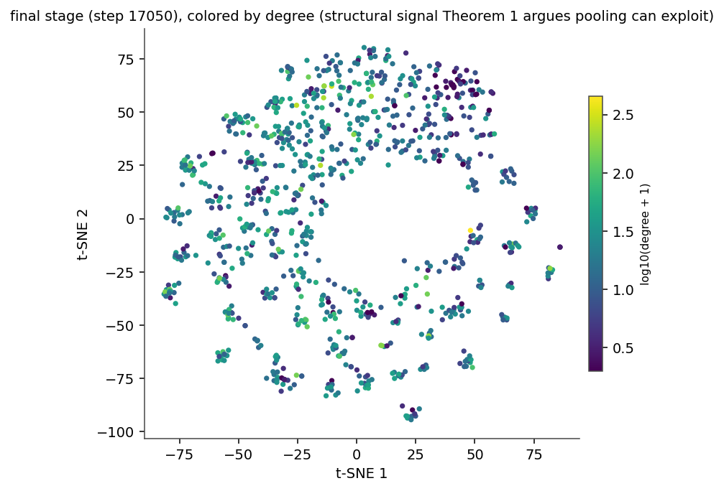
11 · EMBEDDING EVOLUTION
Structural signal
Final stage colored by node degree instead of split: a direct check of Theorem 1's structural signal claim
25

Slide 26
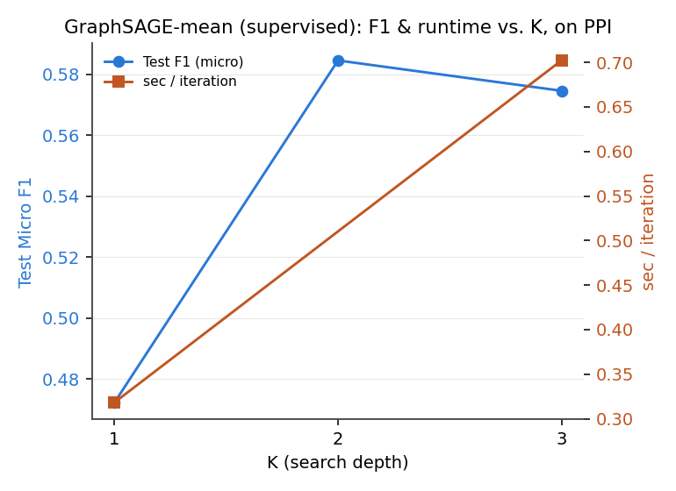
12 · RESULTS V
K-sensitivity
● K=2 beats K=1: 0.585 vs. 0.472 F1
● K=3 no better: 0.575, consistent with the paper's “marginal returns beyond K=2”
● Same panel also shows the runtime cost growing with K
26

Slide 27
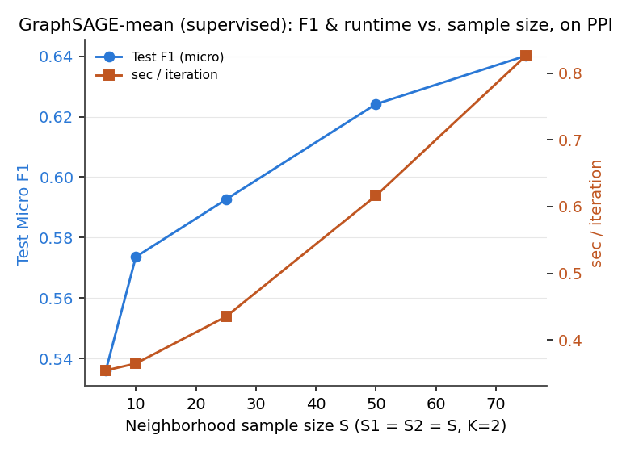
12 · RESULTS V
Sample-size sensitivity
● More neighbors help: 0.536 → 0.640 F1 from S=5 to S=75
● Diminishing returns: most of the gain lands by S=25 (0.593); doubling S again to 75 adds only ~0.05 more
● Same panel also shows the runtime cost growing with S (0.35 → 0.83 sec/iteration)
27

Slide 28
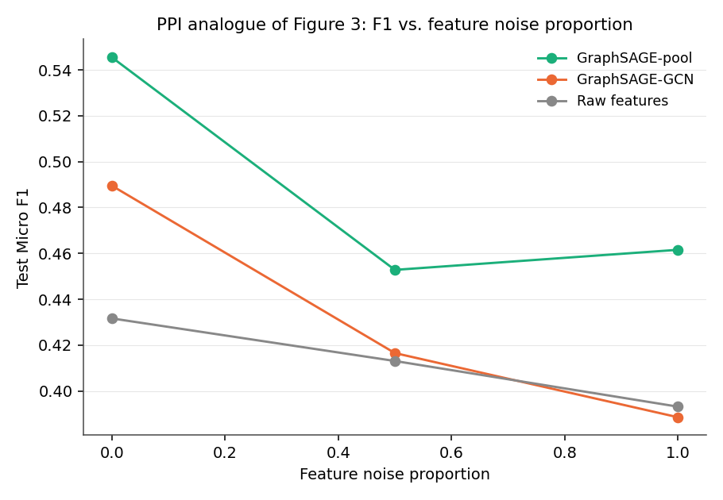
13 · RESULTS VI
Noise robustness (Theorem 1, empirical)
● GraphSAGE-pool stays above both GCN and the raw-features baseline at every noise level
● GCN falls below raw features at full noise (0.389 vs. 0.393)
● Exactly the structural-reliance gap Theorem 1 predicts
28

Slide 29
14 · DISCUSSION & CONCLUSIONS
What this reproduction shows
● Qualitative ordering survives the scale down: GraphSAGE ≫ Raw features > Random, supervised ≥ unsupervised — GCN is weakest in the supervised setting, but is actually the strongest unsupervised GraphSAGE variant reproduced here
● Numerical gaps vs. paper explained by: reduced hyperparameter grid, fewer seeds, TensorFlow version drift, different hardware (1× RTX 2060 SUPER vs. 4× Titan X Pascal)
● Both theoretical claims (K sensitivity and noise robustness) independently verified on PPI, not just asserted from the paper
29

Slide 30
Thank You
GraphSAGE on PPI – Scaled Reproduction
30

