Slide 1
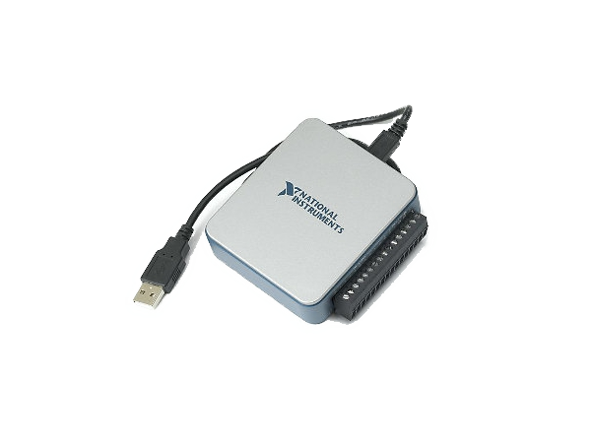
Automated Testing Strategy
Qblox Assignment – Example: NI USB-6000

Slide 2
Introduction
NI USB-6000: a data acquisition device that allows users to measure and analyze analog and digital signals in a variety of applications
Benefits of automated testing:
Consistency
Speed
Coverage
Repeatability
Error Reduction

Slide 3
Test Strategy
The test strategy for the device includes the following:
Unit Testing
Testing of individual analog and digital input/output channels
Verification of proper signal levels
Integration Testing
Testing communication between the device and host software
Compatibility Testing
Testing of the device with different platforms and configurations
Performance Testing
Testing of the device speed, accuracy and responsiveness
Stress Testing
Testing the device under varying input/output loads and its performance under extreme conditions or loads
Regression Testing
Testing that changes made to the device don’t affect existing functionalities

Slide 4
Test System Architecture
The system architecture for automated testing should include the following components/parts:
Hardware
The USB-6000 device, a laptop, power-supply, test fixtures (i.e. breadboard, resistors, …) and data acquisition systems
Software
Host software for device control and data acquisition, device drivers, test scripts and automation software for testing
Environment
Controlled temperature and humidity
Execution
Configuration of hardware and software components, the automation software will run the various tests under different loads and collect data for reporting
Reporting
Collection of test results and aggregation of issues, performance improvements, and so on.

Slide 5
Conclusions
The test strategy illustrated before will ensure the quality of the product before it’s shipped to customers.
Automating tests on a device ensures consistent quality since each device is tested the same way as the previous one.
Automating tests can help with
Reducing costs associated with manual testing
Faster time-to-market
Improved customer satisfaction

