Slide 1
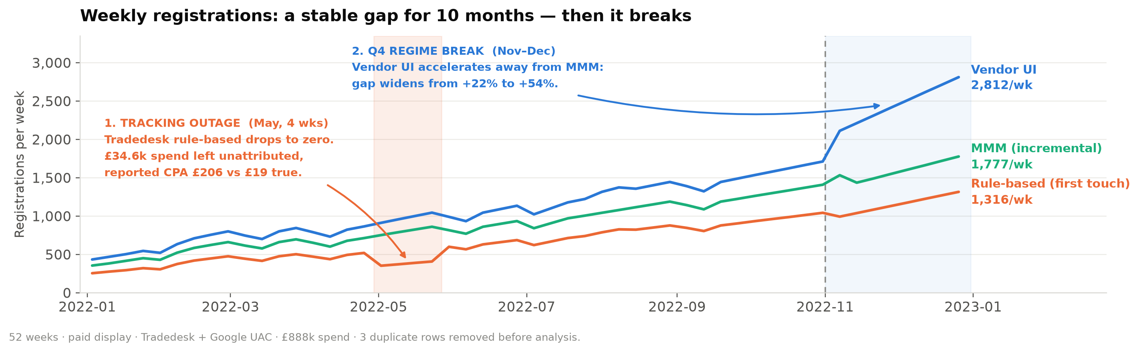
PAID DISPLAY · 52 WEEKS · £888K · TRADEDESK + GOOGLE UAC
Three rulers, three answers — and only one should set the budget
The three systems disagree by −29% to +30% on the same registrations. That gap is structural and stable — and therefore usable — until Q4, when it breaks.
1
The gap is stable — so it is a conversion factor, not a crisis
2
Rule-based structurally breaks programmatic display
3
In Q4 the signals invert — and the vendor UI points the wrong way
For 10 months the ratios barely move: Vendor UI runs +22% above MMM, rule-based −29% below. Per vendor they are near-constant (UI/MMM: Tradedesk 1.17, Google 1.28). A predictable bias can be calibrated away.
First-touch click tracking sees only 47% of Tradedesk’s incremental registrations → reported CPA £44.31 vs £18.77. Governing on it would cut the vendor delivering 57% of incremental growth — and it failed silently for 4 weeks in May.
Vendor UI CPA improves (Google −13%, Tradedesk −22%) while MMM says Google got 23% worse. At identical spend Q4 costs +20% per incremental registration: seasonality, not saturation.
1 / 4
Notes:
Top 3 insights. Data cleaned first: 3 exact duplicate rows removed (2022-09-19 and 2022-10-17 Tradedesk, 2022-10-24 Google UAC); 4 May weeks with rule_based=0 treated as a tag outage, not zero performance.

Slide 2
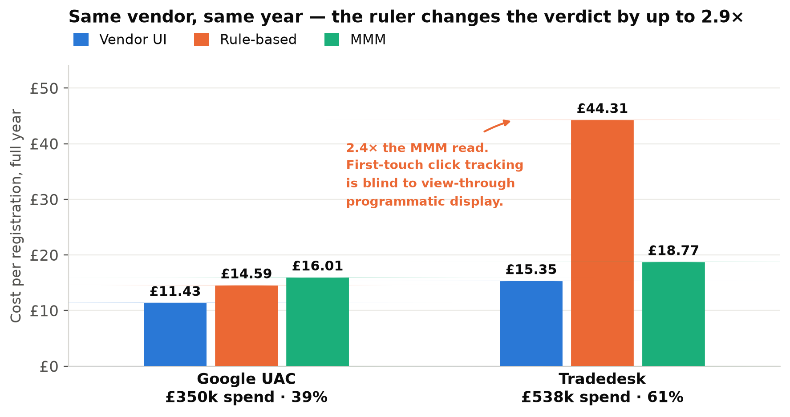
B · WHAT EXPLAINS THE DIFFERENCES, AND WHAT EACH METHOD IS GOOD FOR
They disagree because they answer three different questions
None is “the right one”: each has a different counting rule, field of view and definition of a conversion. The error is comparing them like-for-like.
THREE DRIVERS OF THE GAP
1
Counting rules
Each vendor marks its own homework: self-attributed view-through and cross-device conversions, different lookback windows, and no de-duplication between vendors. Summing two vendor UIs double-counts people both of them touched.
2
Observability
Rule-based tracking only sees clicks it can cookie. That is survivable for in-app UAC (rule-based ≈ 1.06× MMM) and fatal for programmatic display (0.47×). First touch then over-credits whichever tracked channel appeared first.
3
Incrementality
MMM is the only one that subtracts baseline demand. Neither tracking system asks “would this have happened anyway?”, so both inflate exactly when organic demand rises — which is what Q4 shows.
VENDOR UI
RULE-BASED (1ST TOUCH)
MMM
“Did my platform see a conversion after my ad?”
“Which tracked touchpoint came first?”
“What would not have happened without the spend?”
Advantages Daily and granular (campaign, creative, audience, placement). The only signal the bidding algorithm can actually consume. No lag.
Advantages One consistent rule across vendors, de-duplicated, user-level, independent of vendor incentives. Excellent as a tracking-health monitor.
Advantages Covers every channel including TV, OOH and podcast; privacy-durable; captures view-through and halo; separates baseline from incremental.
Limitations Self-reported and self-interested; inconsistent windows; no cross-vendor de-duplication; inflates when demand rises — Q4 premium jumped from +22% to +54%.
Limitations Blind to view-through and to consent/ITP-limited paths; first touch over-credits upper funnel; breaks silently when tags break (May: £34.6k of spend read as zero).
Limitations Weekly and aggregate, 2–4 week latency, wide confidence intervals, cannot optimise creative or audience, and needs real spend variation to identify effects.
2 / 4
Notes:
b) Factors explaining the differences plus advantages and limitations of each approach.

Slide 3
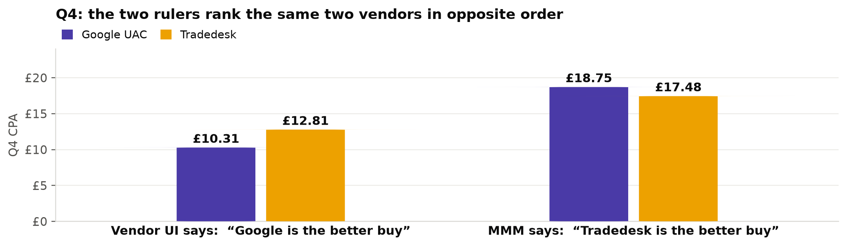
C · HOW THE PAID DISPLAY TEAM SHOULD USE THESE APPROACHES
MMM sets the budget, calibrated platform data steers it
Stop asking which number is right. Give each system the decision it can actually answer, then convert between them with an explicit, refreshed calibration factor.
HOW MUCH?
WHERE & WHAT?
IS IT TRUE?
MMM
Calibrated vendor UI
Experiments
Sets the display budget envelope and the cross-channel split, and owns the one true CPA target. Refreshed quarterly. Never used for in-flight decisions.
Daily optimisation inside a vendor: creative, audience, bidding, pacing. Used at face value only within a vendor — never to compare vendors.
Geo-holdout or PSA tests per vendor, twice a year. Calibrates MMM, validates the k factors and settles disagreements between the other two.
THE CALIBRATION MECHANIC · MULTIPLY THE PLATFORM NUMBER BY k
RULES OF ENGAGEMENT
Vendor | k Jan–Oct | k Nov–Dec | In-platform CPA target to hit an £18 true CPA
Google UAC | 0.78 | 0.55 | £14.09 → £9.90
Tradedesk | 0.86 | 0.73 | £15.39 → £13.19
1
Set one target, translate it.
The business affords one true CPA. Convert it into a per-vendor, per-season in-platform target using k. Re-fit k every quarter on the latest 13 weeks.
2
Never compare vendors on raw platform CPA.
Same nominal in-platform target buys 25–35% less real value in Q4. Applying the Jan–Oct factor to December would overstate incremental registrations by 27% overall — and by 42% on Google UAC.
In Q4 Google looks 20% cheaper than Tradedesk (£10.31 vs £12.81) and is actually 7% more expensive (£18.75 vs £17.48).
3
Demote rule-based to diagnostics.
Keep it as a tag-health monitor, not a budget input. Alert when a vendor’s rule-based/MMM ratio shifts more than 20% week-on-week — that would have caught May’s outage on day one.
4
When the rulers disagree, test — don’t argue.
If MMM and calibrated UI point in opposite directions for two consecutive weeks, that vendor goes into a geo holdout.
3 / 4
Notes:
c) Decision framework. k = MMM registrations / platform-reported registrations, fitted per vendor per period.

Slide 4
D + E · RISKS, OPPORTUNITIES AND WHAT I WOULD BUILD NEXT
The framework is only as good as the calibration behind it
Two risks are specific to this dataset and would bite within a quarter; the biggest opportunity is that display shows no measurable saturation yet.
RISKS
OPPORTUNITIES
WHAT I WOULD BUILD NEXT
Calibration decay
Headroom to scale
1 · Geo-holdout experiments
Q4 proved k is not constant. Using the Jan–Oct factor in December overstates incremental output by 27%. Mitigation: re-fit quarterly, hold out the last 8 weeks, alert on drift.
Spend tripled (£35k → £122k per month) at elasticity 0.96–0.99 with flat MMM CPA. No saturation is visible yet — test where the ceiling is rather than assume one.
Per vendor, 4–6 weeks. The only unbiased read, and the anchor that calibrates everything else. Start now.
2 · A single calibrated KPI
MMM as a single point of failure
One currency for every channel
Replace three competing numbers with one incremental registration figure, raw inputs visible underneath.
Wide confidence intervals, 2–4 week latency, blind to creative. Mitigation: never let it drive in-flight decisions, and always publish the interval next to the point estimate.
One incremental registration lets display compete like-for-like with TV, podcast and OOH — channels that today are argued about rather than measured.
3 · Server-side conversion feed
Co-movement mistaken for causation
Better bidding, not just better reporting
Improve the signal at source (Conversions API, SKAN-resilient tracking) so the gap narrows instead of being corrected afterwards.
Spend and MMM registrations track each other almost perfectly here (elasticity ≈ 1.0, R² > 0.99). That is a shared trend, not proof. Only experiments can validate the level.
Calibrated targets fed back to the platforms change what the algorithms optimise towards, not just what the team reports.
4 · MMM at vendor level, with curves
Cheaper learning over time
Adstock and saturation curves per vendor so budgets are set on marginal, not average, CPA.
Silent data failures
Two vendors with a stable k make future geo tests shorter and smaller — measurement gets cheaper as the framework matures.
3 duplicate rows and 4 zero-rows in a 107-row file. At scale this is invisible. Mitigation: a data contract with automated duplicate, null and ratio-drift checks.
5 · Automated measurement health
Duplicate, zero-row and ratio-drift monitoring as part of the pipeline SLA.
4 / 4
Notes:
d) risks and opportunities of the proposed approach; e) additional approaches recommended, in priority order.

