Slide 1
Predicting Buenos Aires House Prices with Linear Regression

Slide 2
Predicting Buenos Aires House Prices with Linear Regression
The problem posed for this Project is the development of a regression model that allows predicting the price of a real property of the Buenos Aires city
This Project would be very valuable for a real state agent who could make use of the information provided in a daily basis.
In order to carry out the Project, 3 stages are stablished.
Data acquisition
Exploratory analysis and dataset cleaning
Construction of a linear regression model to make predictions about the price of properties.

Slide 3
Data acquisition and cleaning
The Properati real estate company provides us with a dataset of its internal databases corresponding to the first half of 2017
The dataset contains a total of 26 fields/columns and 121200 records. However, for this project I will focus only on the city of Buenos Aires, which result in 32316 records.
I will use the Foursquare API to explore real estates marketed by Properati
After data wrangling tasks, cleaned data contains 283 features.

Slide 4
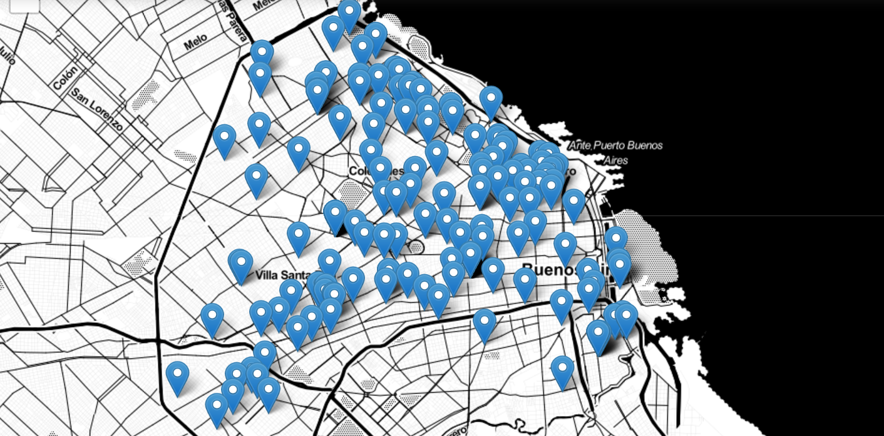
Geolocalization

Slide 5
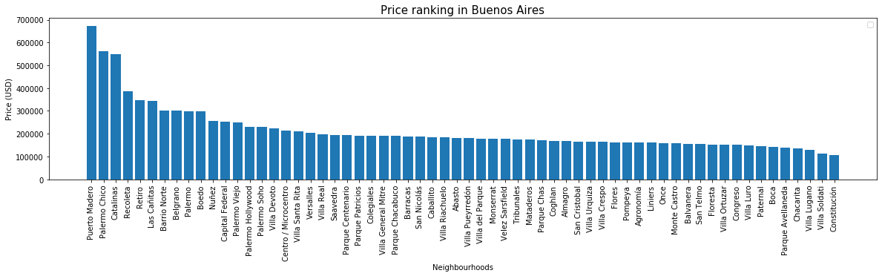
Price ranking per neighbourhoods

Slide 6
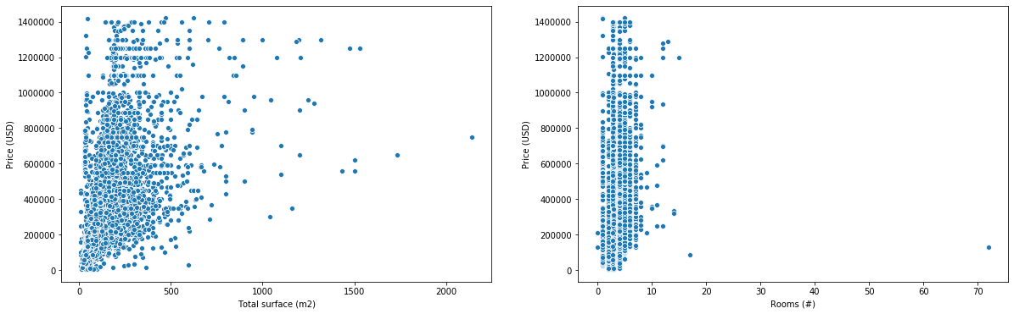
Bivariate Analysis

Slide 7
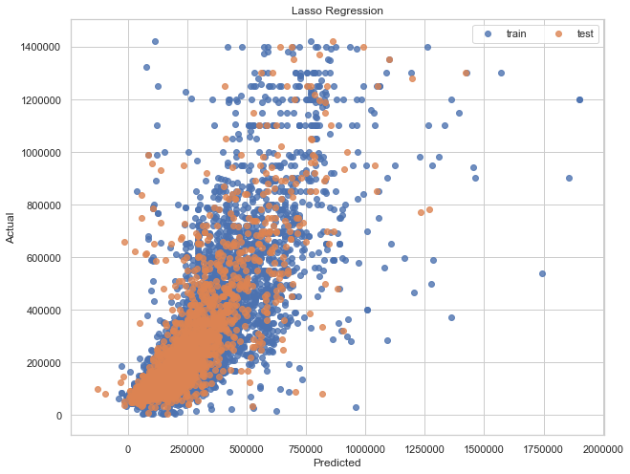
Regression models performance
RMSE: 124379.4
R^2: 0.65

Slide 8
Conclusion and future directions
The use of the Foursquare API served to obtain more information about the surroundings of the houses/departments, thinking that this information could influence in some way the monetary value of them.
It was obtained a performance of the not so good model. However, the accuracy of the model could be improved. Ideas include:
Invest more time in feature extraction task such as on description variable (for example using regular expressions)
Evaluate other regression algorithms
Perform some fine tuning on hyperparameters

