Slide 1
Large-Scale and Multi-Structured Databases Project Design BGNet
Federico Casu
Angelo De Marco
Marco Pardini

Slide 2
Application Highlights
BGNet is an application for all board-games players. People can find here a place in which follow games, users, finding common interests and join tournaments.
Games' pages are the core of the application: a user can follow the page, see posts about the game or a detailed description of it.
In addition, you can participate in tournaments for the game by checking the tournaments section.
Apart that, common social network features like games / users. Suggestions are still present.

Slide 3
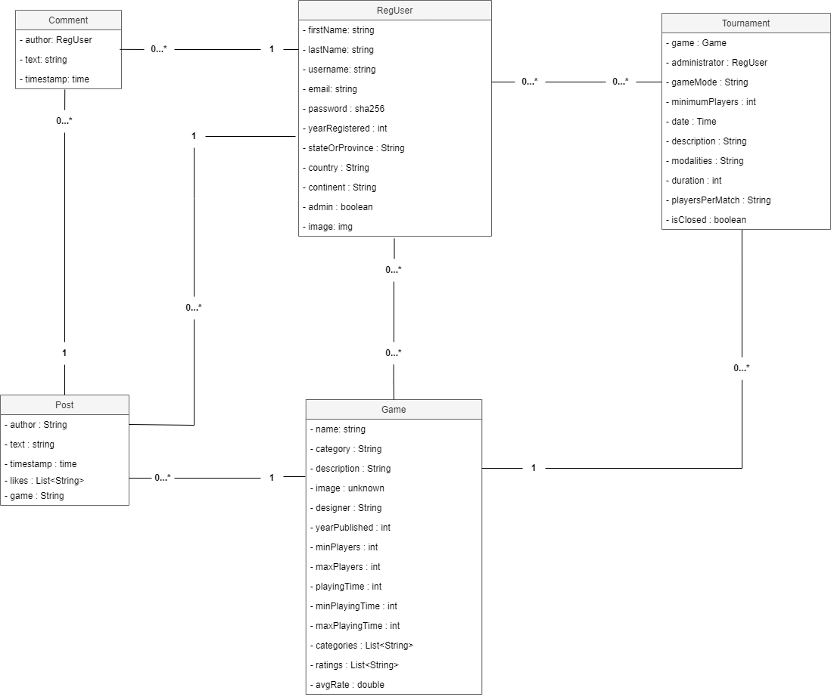
UML Class Diagram

Slide 4
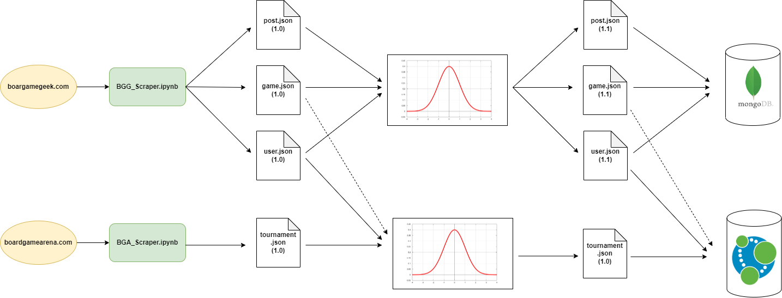
Dataset Description
Volume: 450 / 500 Mb (8.5k users, 150 tournaments, 92 games, 17k posts)

Slide 5
Non-Functional Requirements
The application needs to be available 24/7
The system must be a website application.
Tolerance to the loss of data.
Avoid, if possible, a single point of failure.
High Availability, accepting eventually older versions of data.
The code must be written in a Object Oriented Programming language.

Slide 6
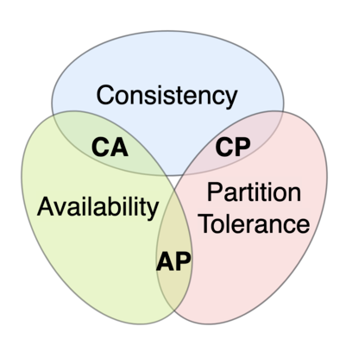
CAP Theorem Issue
The application needs to be available 24/7
We need to avoid a single point of failure.
We accept potentially out-of-date version of data.
WE STAY ON THE AP SIDE OF THE TRIANGLE
Replicas with Primary election
Write Concern = 1
Read Concern = Nearest

Slide 7
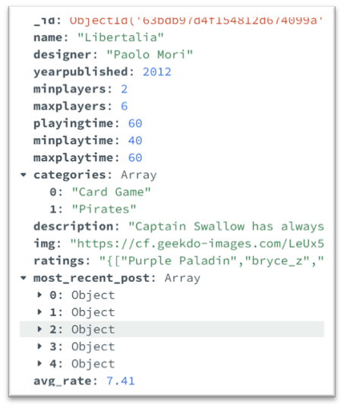
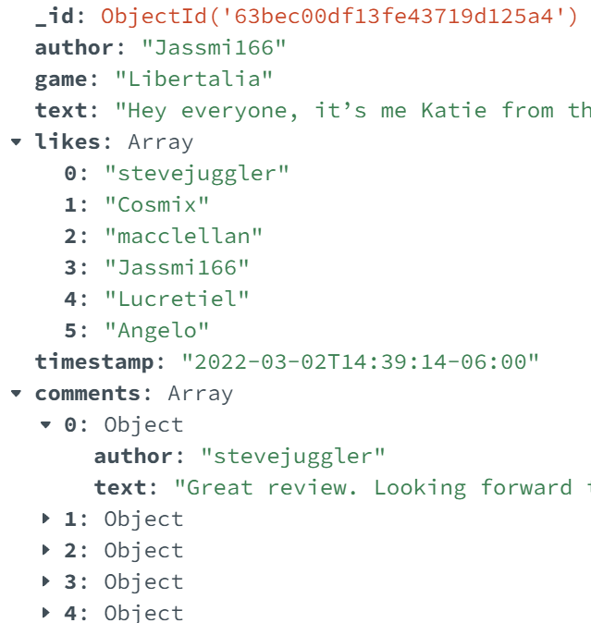
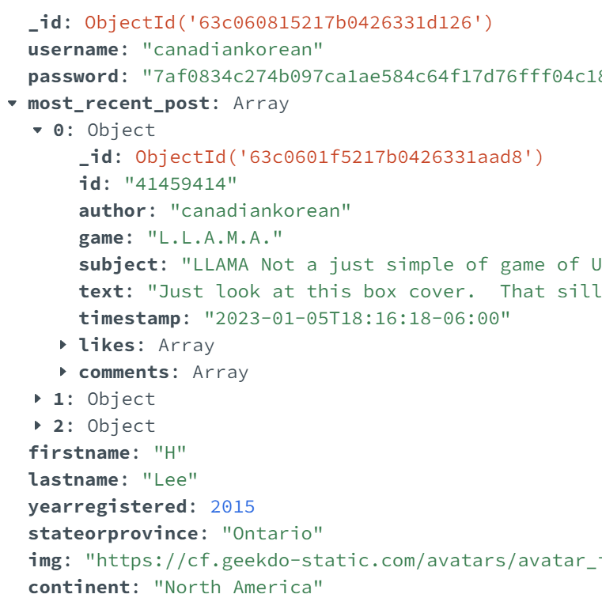
MongoDB design
Game's collection
Post’s collection
User’s collection

Slide 8
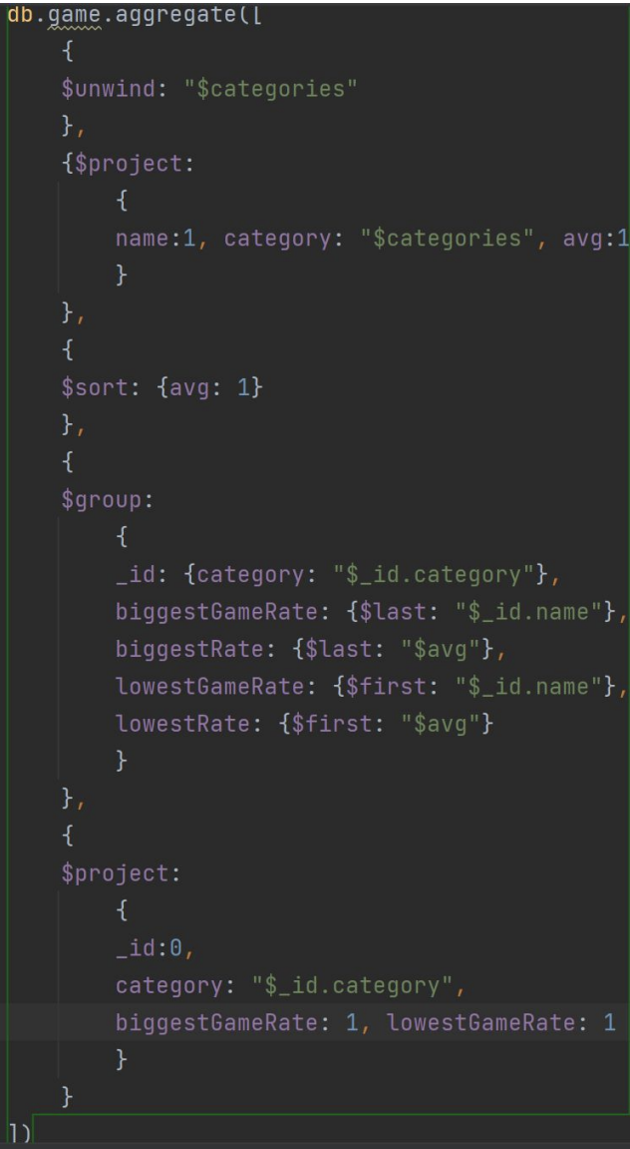
Relevant MongoDB queries
Analytics:
Get the worst rated game and best rated game for each category (MongoDB code in the figure).
Get the distribution of posts and the mean number of comments for each post among each month of the input year.
For each continent get the country with the maximum number of new members in the input year.
Relevant operations:
Loading the game page
Loading the user page
Seeing all posts of a game
Like a post
Comment a post

Slide 9
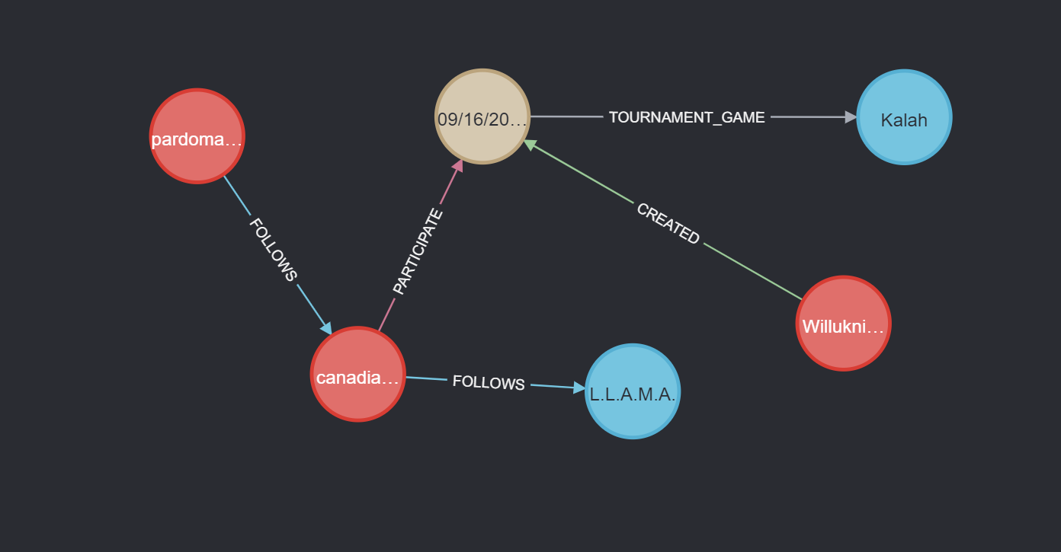
Neo4J design
Snapshot taken from Neo4j Browser
Entities:
Users (username, imgUrl)
Games (gameName, imgUrl, categories
Tournaments (date, duration, maxPlayers, modalities, playersPerMatch, isClosed)
Relationships:
Follows (user – user, user – game)
Participate (user – tournament)
Created (user – tournament)
Tournament_Game (tournament – game)

Slide 10
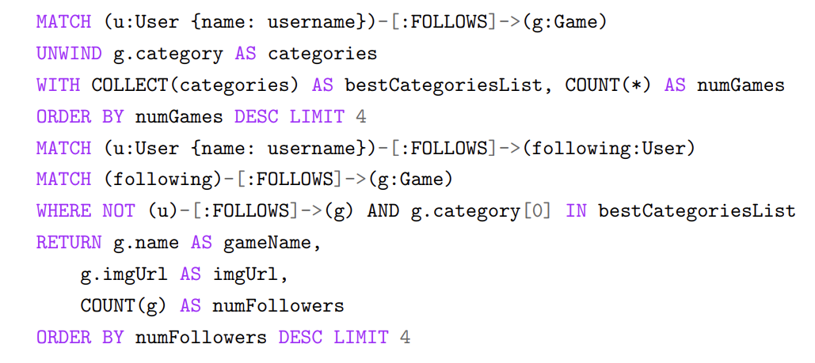
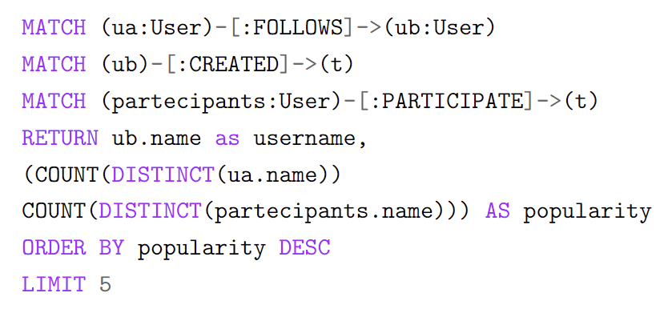
Relevant Neo4j queries
Game suggestion
Suggestions:
Users:
Based on the tournaments played
Based on the users followed
Random suggestion
Games:
Based on favourite categories and friends
Random suggestion
Most popular users analytic
Analytics:
Get the most popular users (popularity defined as number of followers + number of distinct participants to tournaments created)
Get the most popular games (popularity defined as number of followers + number of tournaments multiplied by 10)

Slide 11
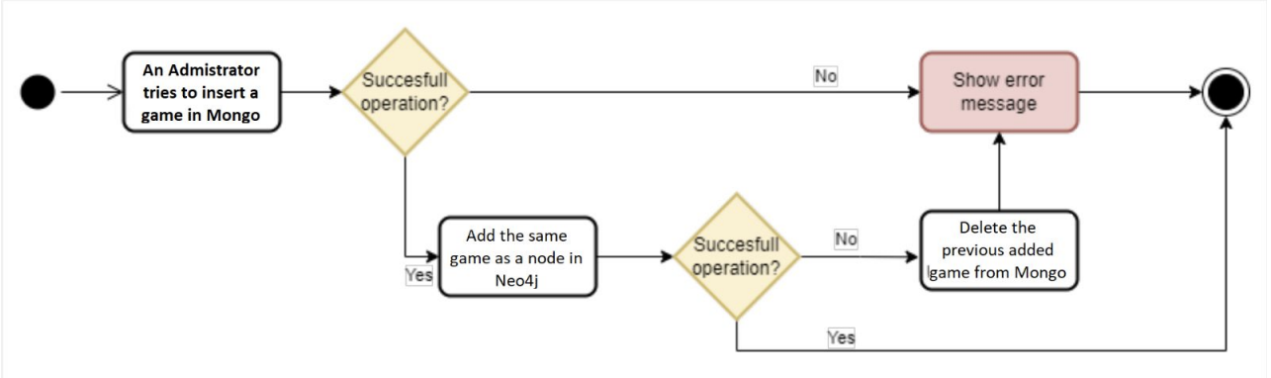
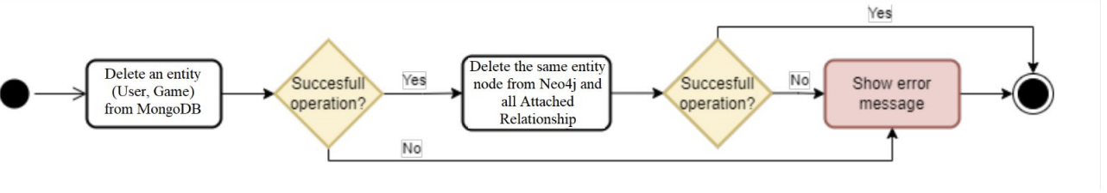
Data Consistency
Case 1 : A new Game or a new User is inserted
Case 2 : A Game or a new User is deleted from the administrator

Slide 12
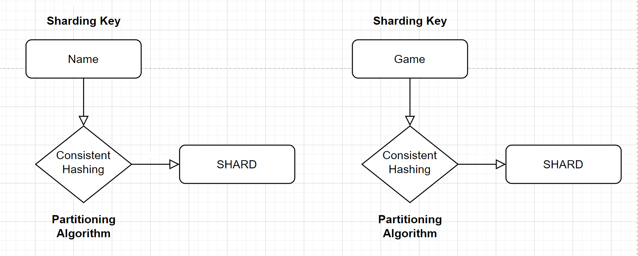
Data Sharding Proposal
Timestamp
Range
Sharding proposal for Games documents
Sharding proposal for Users and Post documents

Slide 13
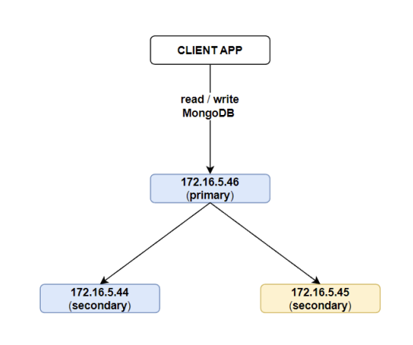


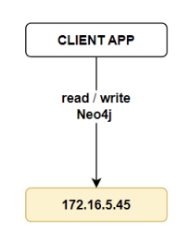

Software and Hardware Architecture
Next primary in case of crashes

