Slide 1
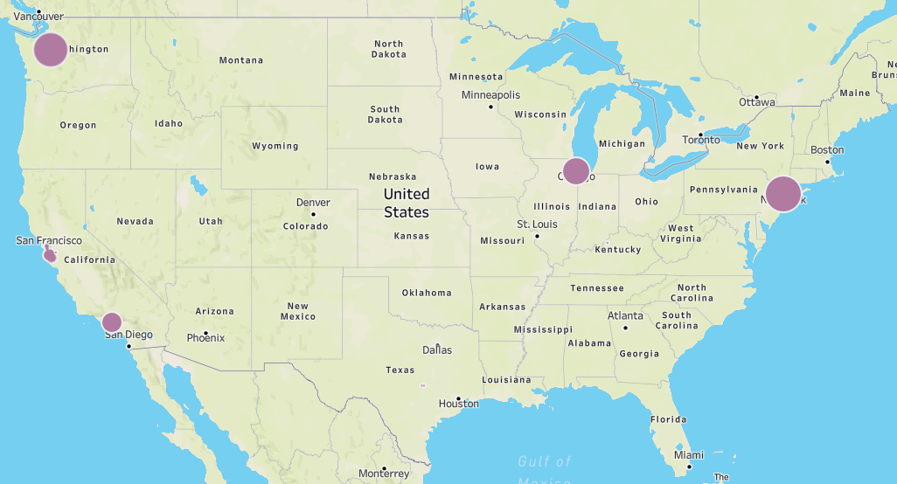
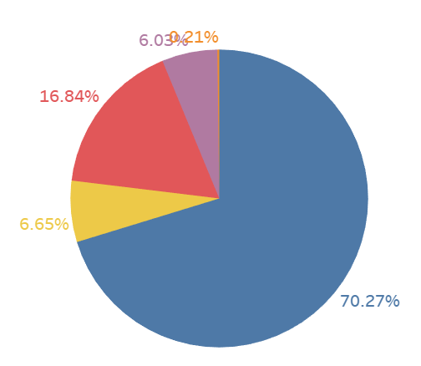
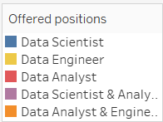
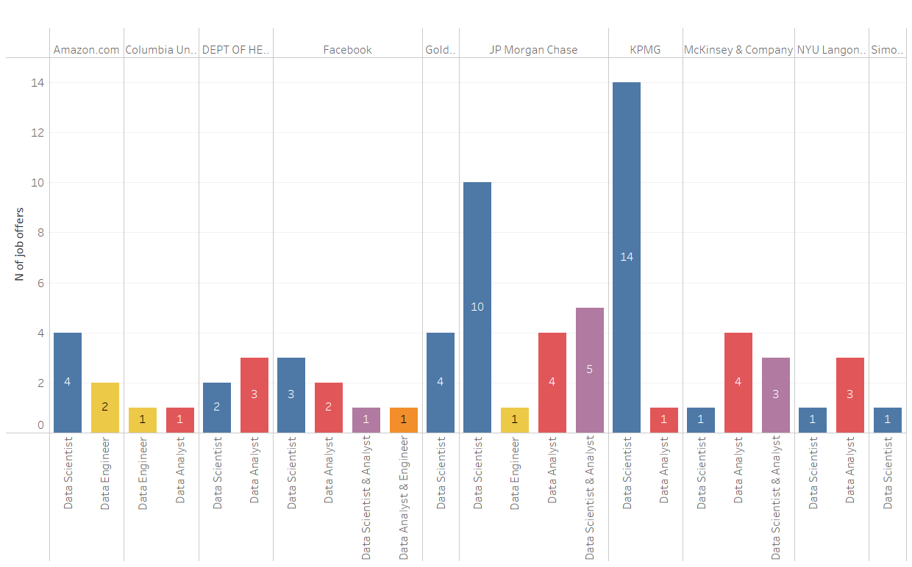
Project: Working with messy data Pau Peracaula & Federica Riva
In the US, where is the majority of job offers in the data analysis field?
NEW YORK
In the state New York, what is the distribution of the data scientist/data analyst/data engineer job offers?
Considering the top ten most offering companies in the state of New York, what is the distribution of the data scientist/data analyst/data engineer job offers?

