Slide 1

Ironhack- Data Analytics bootcamp APR2022 Cohort
Project 1: Messy Data
Pau Peracaula – Federica Riva

Slide 2
Outline
Questions presentation
Data processing steps
Findings
Future steps

Slide 3
Starting questions
Geography
In the US, where is the majority of job offers in the data analysis field?
In the state with the highest number of job offers, what is the distribution of the data scientist/data analyst/data engineer job offers?
Considering the top ten most offering companies in the state with the highest number of job offers, what is the distribution of the data scientist/data analyst/data engineer job offers?
Positions
Companies

Slide 4
Outline
Research questions presentation
Data processing steps
Findings
Future steps

Slide 5
Data processing
Database ‘Alldata’ in Excel:
Separation City/State
Database ‘Alldata’ in Tableau:
Geographical distribution
Database ‘FulltimeNY’ in Python
Answer to the first question

Slide 6
Data processing (FulltimeNY database)
1. check info, NaN, duplicates, empty rows
2. Dataset preparation for second and third questions:
Standardize the entries of the “position” column
Job classification

Slide 7
Job offers classification
Answer to the second question
Based on key words search in the “position” column:
Data scientist
data_scientist, machine_learning, statistician
data_analyst, data_analytics, _analytics, quantitative_analyst
data_engineer, data_science_engineer, quantitative_data_engineer
!
(only) 481 out of 986 job offers were classified
Data analyst
Data engineer
(Some job offers were classified in more than one category)

Slide 8
Outline
Research questions presentation
Data processing steps
Findings
Future steps

Slide 9

Visualization of the dataset in Tableau
Answer to the second and third question

Slide 10
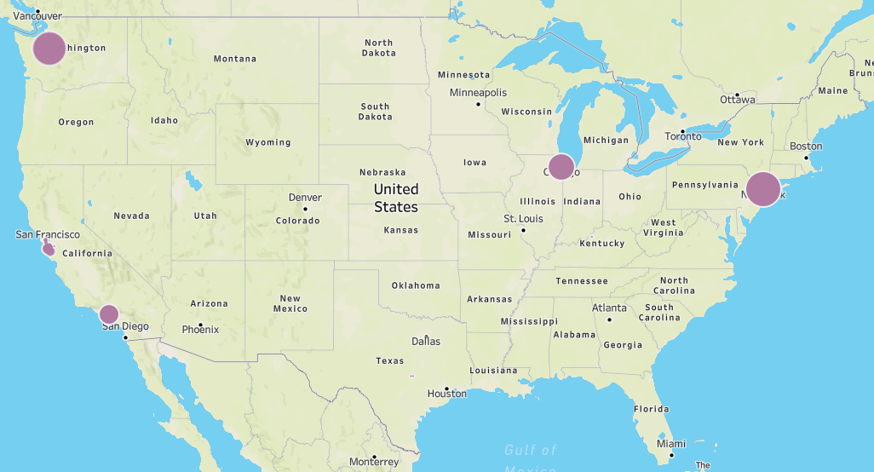
In the US, where is the majority of job offers in the data analysis field?
NEW YORK

Slide 11
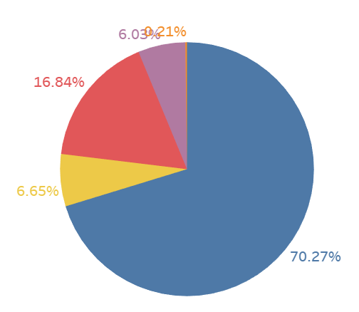
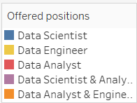
2. Distribution of the data scientist/data analyst/data engineer job offers in the State of New York

Slide 12
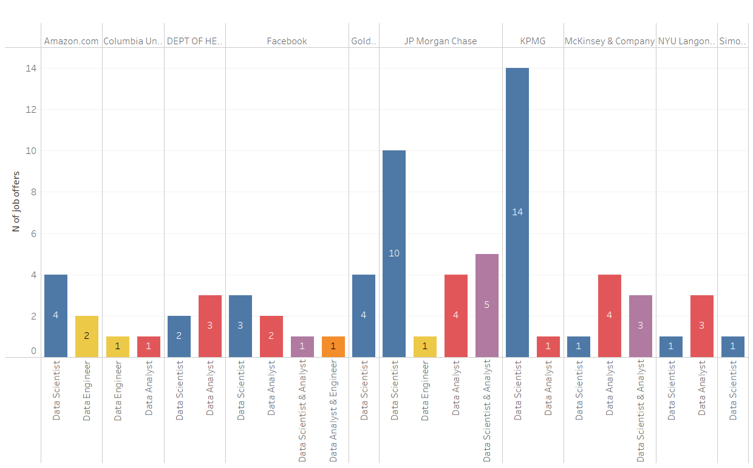
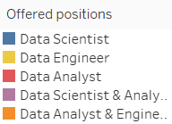
Composition of the offers of the top ten most offering companies

Slide 13
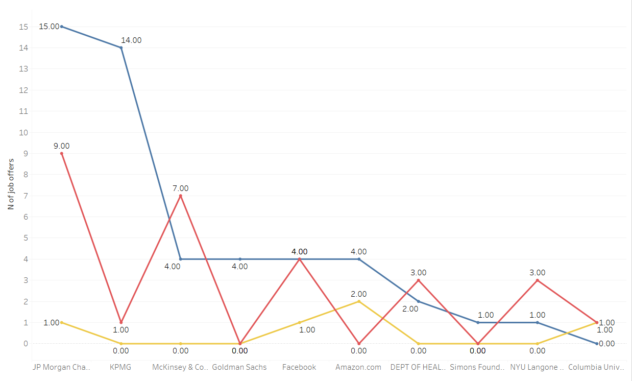

Composition of the offers of the top ten most offering companies

Slide 14
4. Future steps
Create a function to automatize the data cleaning and the job classification to apply to the general file and/or to the “State” files to compare data from different locations.
Explore other insights: e.g.: skills required for each type of position

