Slide 1
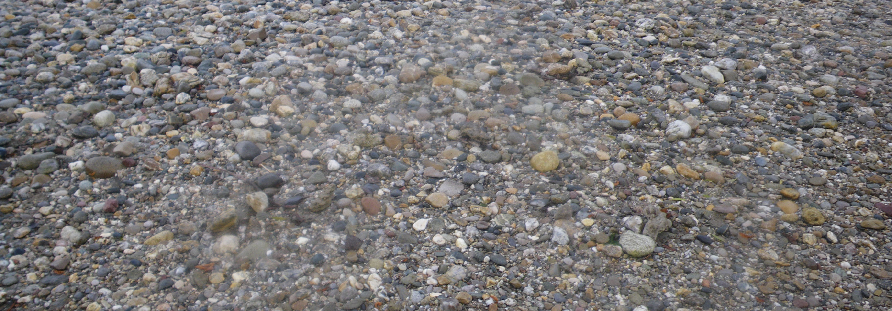
Sediment grain size analyses based on sieving datasets
Python Programming for Water Resources Engineering and Research
Project Framework Presentation
January 12, 2021
Beatriz Negreiros
&
Federica Scolari

Slide 2
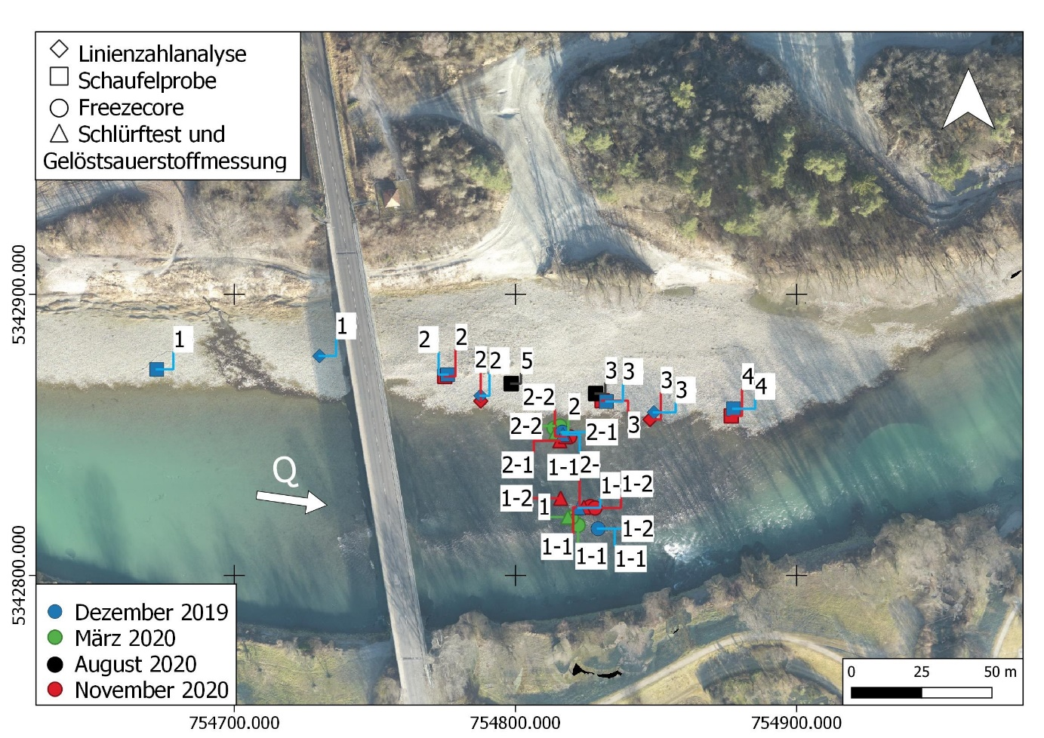
Project Idea
Overview
Field campaigns are characterized by the collection of massive data that has to be analyzed afterwards.
Currently, the department uses an Excel workbook that computes statistical parameters for each collected sample, which results in heavy analysis files, difficult both to share and work with.
In many cases it is challenging to interpret the results for so many sampled locations without any direct spatial visualization.

Slide 3
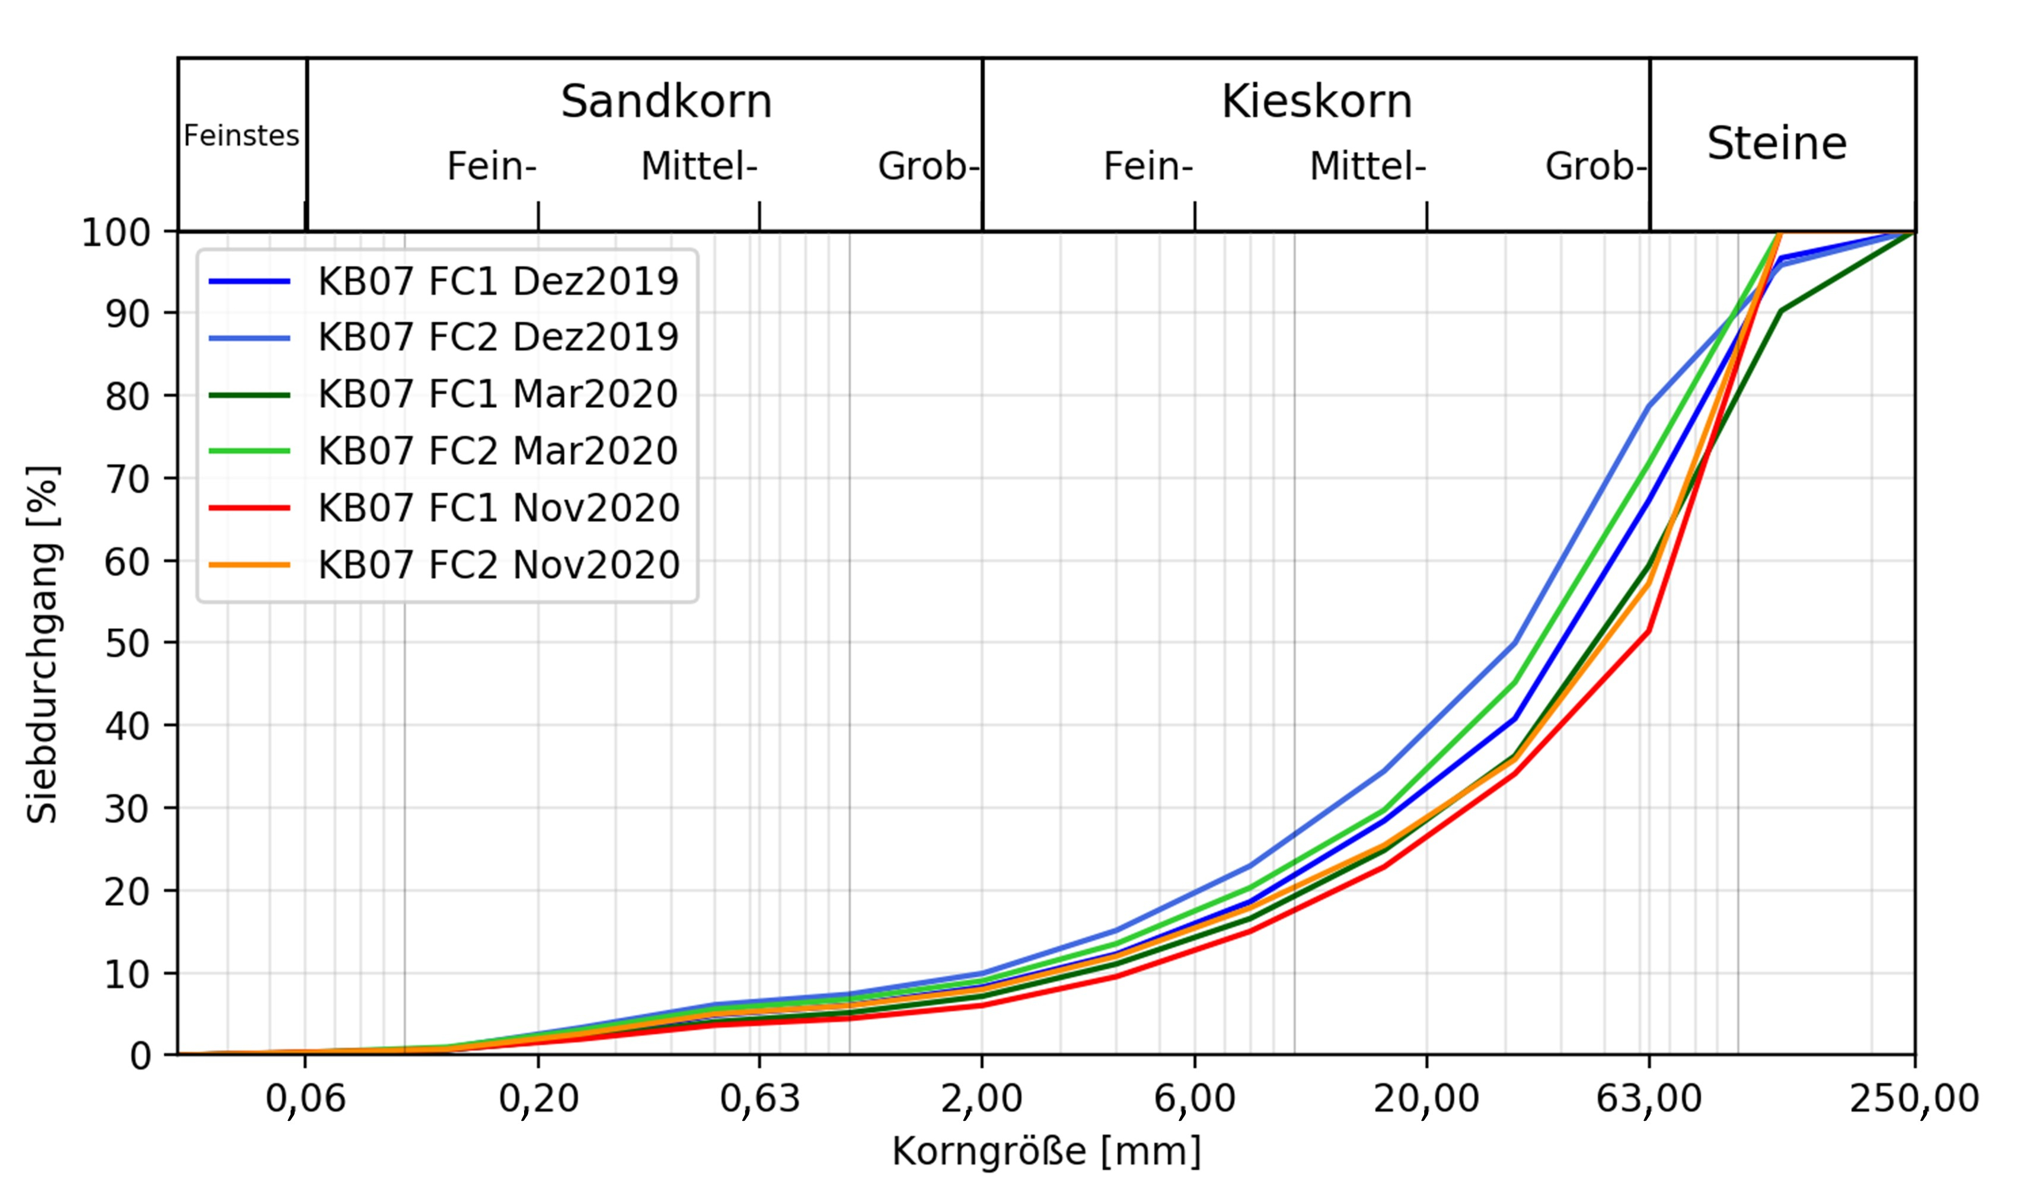
Project Goals
Generate automated codes for grain size analysis using as input sieving datasets:
Computation of the statistical parameters.
Plotting of the summary results per sample.
Interactive visualization of the results:
Definition of the criteria and parameters which can be selected by the user.
Creation of the interactive plots.

Slide 4
Workflow
Read the sieve mesh sizes and corresponding class weights (sieving results).
Interpolate class weights to identify the percentage finer for all remaining grain sizes.
Compute statistical parameters (e.g., d_{m}, sorting index and geometric standard deviation).
Plot and export the results (e.g., cumulative grain size distribution)
Generation of the options and comparison tools (e.g., comparison between samples or of single parameters over time)
Response to the commands of the GUI and creation of the interactive visualization of the results based on their location
Class Statistical Analyzer
Class Static Plotter
Class MainApplication (GUI)
Class Interactive Plotter

Slide 5
Read the sieve mesh sizes and corresponding class weights (sieving results).
Interpolate class weights to identify the percentage finer for all remaining grain sizes.
Compute statistical parameters (e.g., d_{m}, sorting index and geometric standard deviation).
Plot and export the results (e.g., cumulative grain size distribution)
Generation of the options and comparison tools (e.g., comparison between samples or of single parameters over time)
Response to the commands of the GUI and creation of the interactive visualization of the results based on their location

Slide 6
Resource Allocation
Class Statistical Analyzer
Class Static Plotter
Class MainApplication (GUI)
Class Interactive Plotter

Slide 7
e-mail
phone +49 (0) 711 685-
www.
University of Stuttgart

