Slide 1
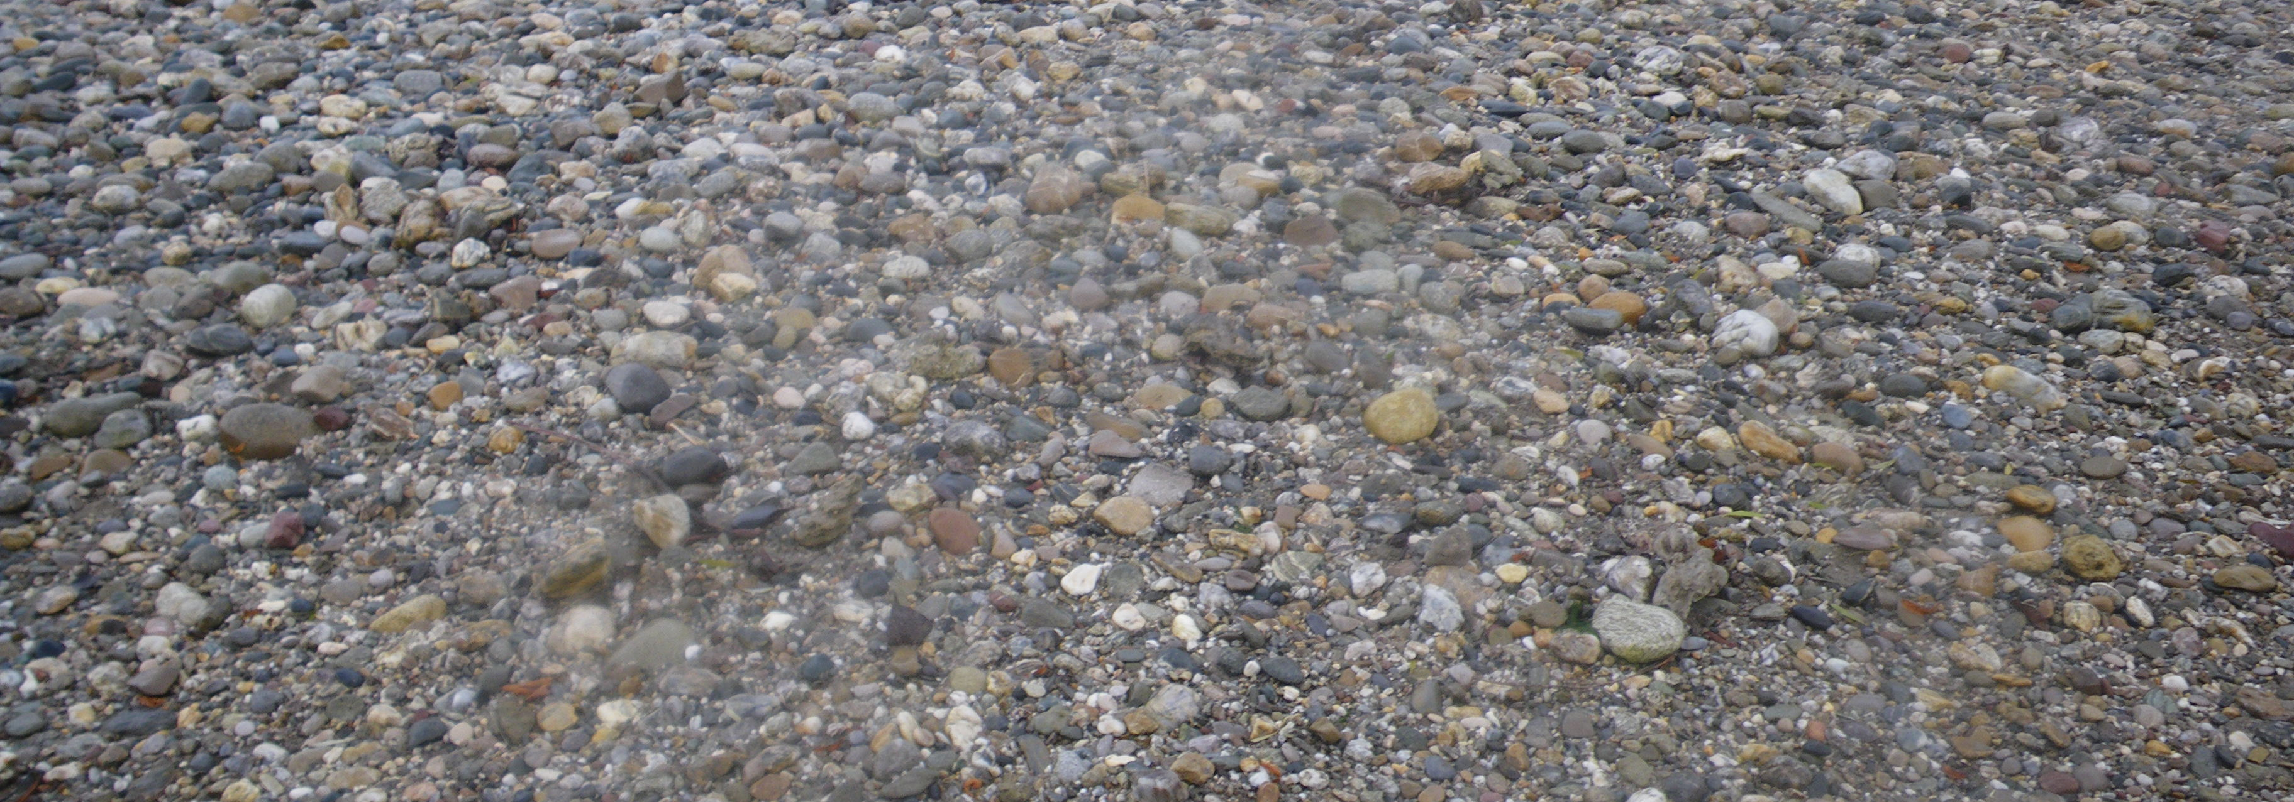
Sediment grain size analyses based on sieving datasets
Python Programming for Water Resources Engineering and Research
Project Framework Presentation
January 12, 2021
Beatriz Negreiros
&
Federica Scolari

Slide 2
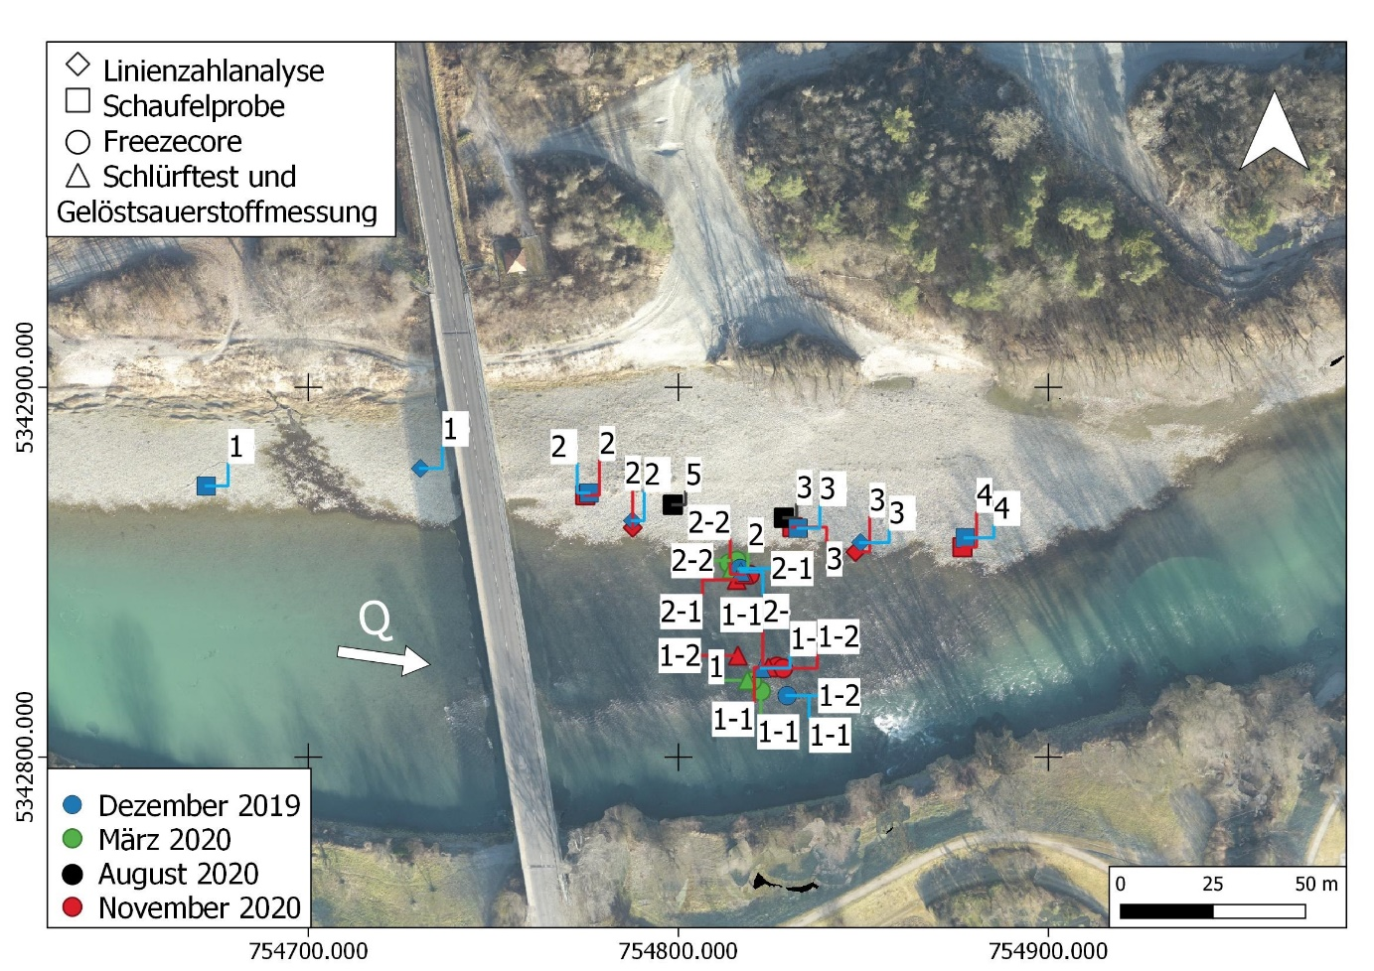
Project Idea
Overview
Field campaigns are characterized by the collection of massive data that has to be analyzed afterwards.
Currently, the department uses an Excel workbook that computes statistical parameters for each collected sample, which results in heavy analysis files, difficult both to share and work with.
In many cases it is challenging to interpret the results for so many sampled locations without any direct spatial visualization.

Slide 3
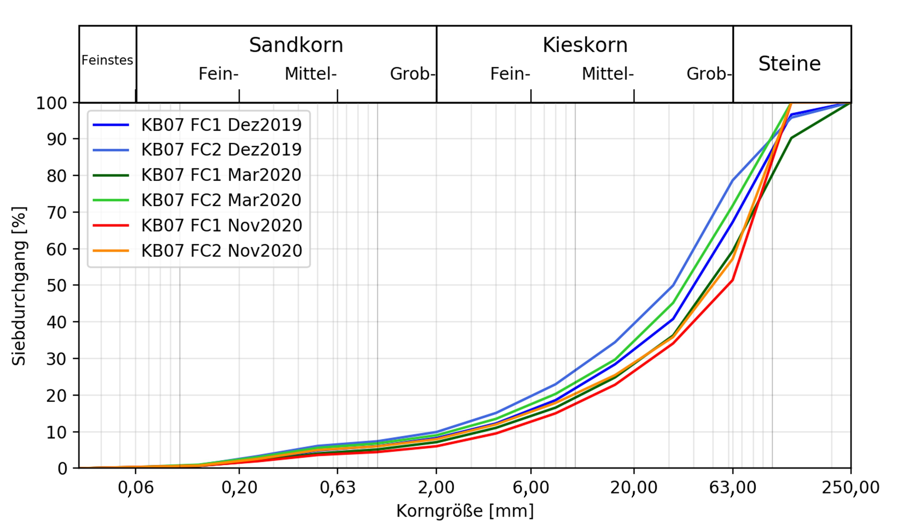
Project Goals
Generate automated codes for grain size analysis using as input sieving datasets:
Computation of the statistical parameters.
Plotting of the summary results per sample.
Interactive visualization of the results:
Definition of the criteria and parameters which can be selected by the user.
Creation of the interactive plots.

Slide 4
Workflow
Read the sieve mesh sizes and corresponding class weights (sieving results).
Interpolation class weights to identify the percentage finer for all remaining grain sizes.
Computation of the statistical parameters (e.g., d_{m}, sorting index and geometric standard deviation).
Plotting and exporting of the results (e.g., cumulative grain size distribution)
Generation the options and comparison tools (e.g., comparison between samples or of single parameters over time)
Response to the commands of the GUI and creation of the interactive visualization of the results based on their location
Class Statistical Analyzer
Class Static Plotter
Class Main Application (GUI)
Class Interactive Plotter

Slide 5
Timeline
Week 1
Creation of the Statistical Analyzer and Static Plotter Classes
Week 2-3
Creation of the Main Application and Interactive Plotter Classes
Week 4
Main Script and preparation of the presentation
Week 5
Code design: finalization of the diagram and debugging
Week 6
Finalization of the code and README file
Week 7
Final check and correction

Slide 6
Resource Allocation
Beatriz
Federica
Static Plotter Class
Interactive Plotter Class
Main Script
Statistical Analyzer Class
Class MainApplication (GUI)
Together
Code design
README file
Presentation
Class MainApplication (GUI)

Slide 7
Sediment grain size analyses based on sieving datasets
Thank you for your attention!
Project Framework Presentation
January 12, 2021
Beatriz Negreiros
&
Federica Scolari

