Slide 1

Text Classification
and Text Summarization
on Web of Science Dataset
Text Mining and Search Project - AY 2023/2024
Arizzi Sara, Bidone Federico

Slide 2
Content
Dataset
Task 1: Text Classification
Task 2: Text Summarization
Data Acquisition
Data Exploration
Pipeline
Data Preparation
Model
Performance Evaluation
Introduction
Extractive Summarization
Abstractive Summarization
Performance Evaluation

Slide 3


Dataset
Tasks: Text Classification and Text Summarization
Web of Science (WOS) is a dataset of scientific paper abstracts, labeled in 7 categories: Computer Science, Electrical Engineering, Psychology, Mechanical Engineering, Civil Engineering, Medical Science, Biochemistry.
There are 3 datasets:
Web of Science Dataset WOS-46985 (full dataset)
Web of Science Dataset WOS-11967 (subsample)
Web of Science Dataset WOS-5736 (subsample)
We used the full dataset WOS-46985 for Text Classification and the subsample WOS-5736 for Text Summarization.
WOS is built for Text Classification. We used Selenium and QuillBot to automatically generate ground truth summaries.
Pro → Free, Customization
Cons → Bot detection, Slow
5736 summaries took 16 hours! Roughly 10 seconds per sample.
+

Slide 4
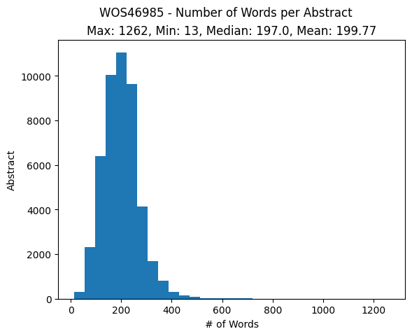
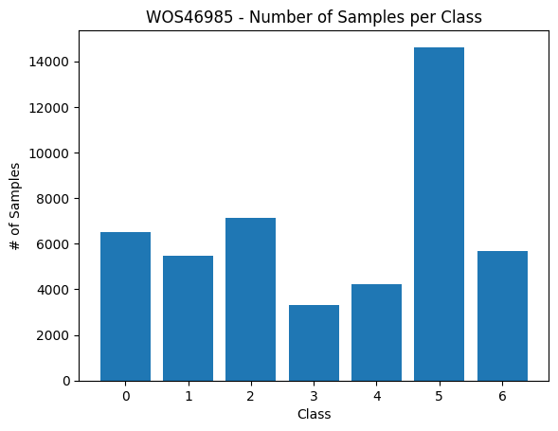
Data Exploration
Number of Words per Sample
Number of Samples per Class
0 - Computer Science
1 - Electrical Engineering
2 - Psychology
3 - Mechanical Engineering
4 - Civil Engineering
5 - Medical Science
6 - Biochemistry

Slide 5
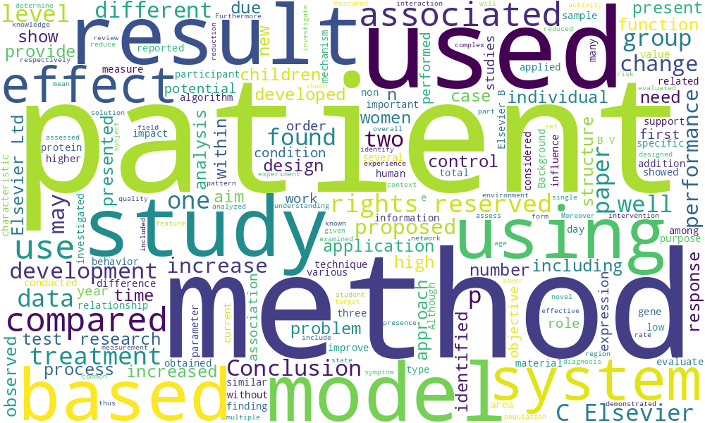
Data Exploration

Slide 6
Text Classification

Slide 7
Text Classification - Pipeline
Data Preparation for Training: Select the ‘Abstract’ and ‘Y1’ columns from the dataframe. Define an AbstractsDataset class that inherits from torch.utils.data.Dataset to prepare the data for training and testing. Encode the abstracts using a pre-trained BERT tokenizer and split the dataframe into training and test sets.
Model Creation: Use the BertForSequenceClassification model for sequence classification. Explain the architecture of the BERT model, including the embeddings, encoder, and pooler modules.
Model Training: Set the training parameters, including the number of epochs and the AdamW optimizer. Train the model in a training loop, calculate the loss, and backpropagate through the model.
Model Evaluation: Evaluate the model on the test set and the entire dataset. Calculate the precision, recall, and f1-score metrics for each class.

Slide 8
Text Classification - Data Preparation
The ‘Abstract’ and ‘Y1’ columns are selected from the dataframe because these are the features (or variables) that will be used for model training. ‘Abstract’ contains the text that needs to be classified, while ‘Y1’ contains the corresponding classification labels.
The abstracts are encoded using a pre-trained BERT tokenizer. A tokenizer is a tool that breaks down text into smaller units (such as words or sub-words), which can be used as input for the BERT model.
Finally, the dataframe is split into training and test sets. This is a common step in data preparation for supervised learning, where a model is trained on one dataset and then tested on a separate dataset to evaluate its performance.

Slide 9
Text Classification - Model Creation
The BertForSequenceClassification model is used for sequence classification. This model is a version of BERT that has been adapted for sequence classification, which is a type of problem where the goal is to assign a category to a sequence of text.
The architecture of the BERT model includes the embeddings, encoder, and pooler modules. The embeddings are vector representations of the input text, the encoder is the part of the model that processes these embeddings to extract relevant features, and the pooler aggregates these features into a single vector that can be used for classification.

Slide 10
Text Classification - Model Training
Training parameters, such as the number of epochs and the AdamW optimizer, are set. Epochs represent the number of times the entire dataset is passed forward and backward through the neural network, while AdamW is an optimization algorithm that is used to update the model’s weights based on the calculated loss.
The model is trained in a training loop. In each epoch, for each batch of data, the loss is calculated and backpropagated through the model. The loss is a measure of how much the model’s predictions deviate from the actual data, and backpropagation is the process of adjusting the model’s weights based on the calculated loss.

Slide 11
Text Classification - Evaluation
Metrics
Precision: Precision is a measure of a classifier’s exactness. For a given class, precision is defined as the number of true positives (i.e., the number of items correctly labeled as belonging to the positive class) divided by the total number of elements labeled as belonging to the positive class
Recall: Recall is a measure of a classifier’s completeness. For a given class, recall is defined as the number of true positives divided by the total number of elements that actually belong to the positive class F1-Score:
The F1 score: is the harmonic mean of precision and recall. The relative contribution of precision and recall to the F1 score are equal.

Slide 12
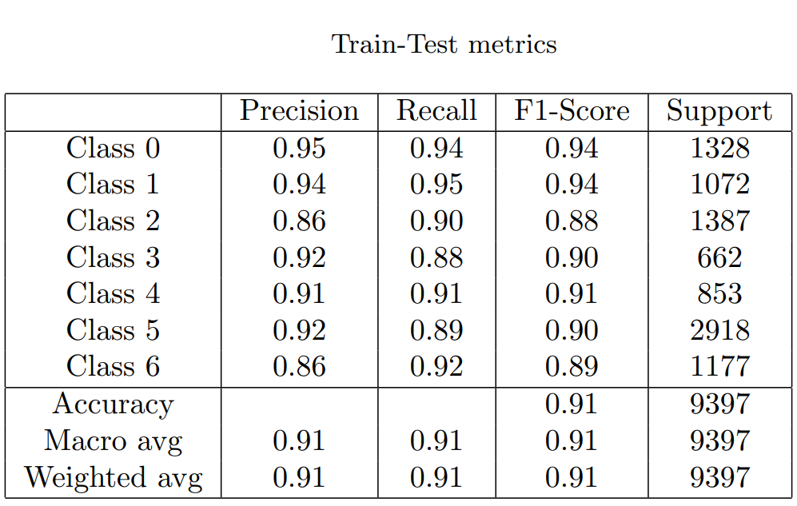
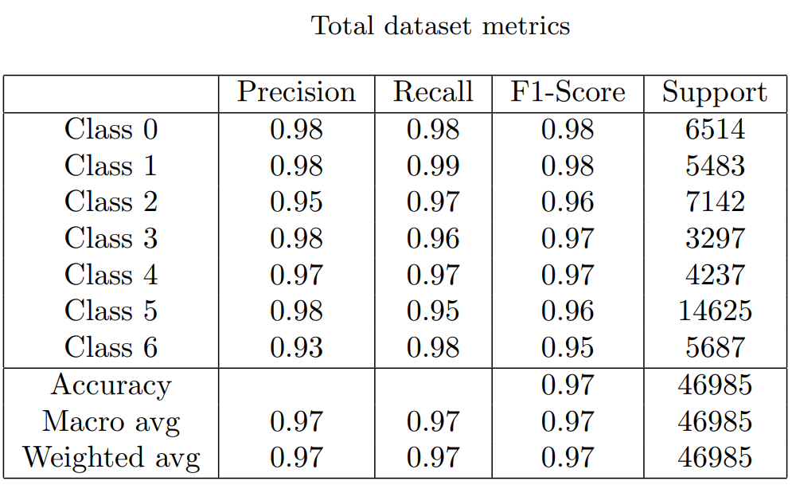
Text Classification - Evaluation

Slide 13
Text Summarization

Slide 14
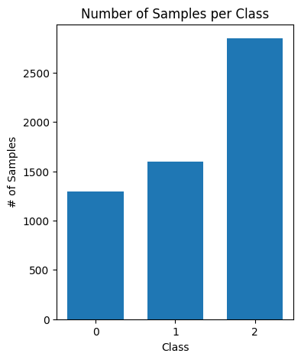
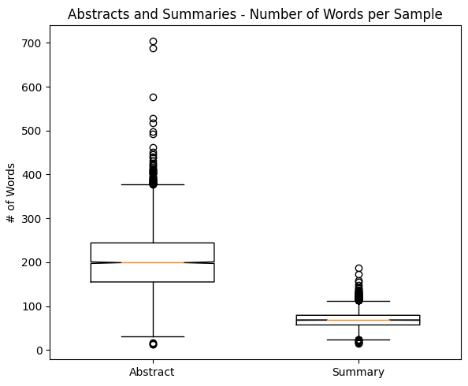
Introduction
Dataset WOS-5736:
three domains
median abstract length is 200
median summary length is 68
generate a summary from a single abstract
Psychology
Electrical Engineering
Biochemistry
Task
Extractive
1. PageRank
TF-IDF
2. PageRank
GloVe
Single
Document
Domain
Specific
Approaches
+
Abstractive
1. BART
Fine-Tuned
2. BART
Pre-Trained

Slide 15
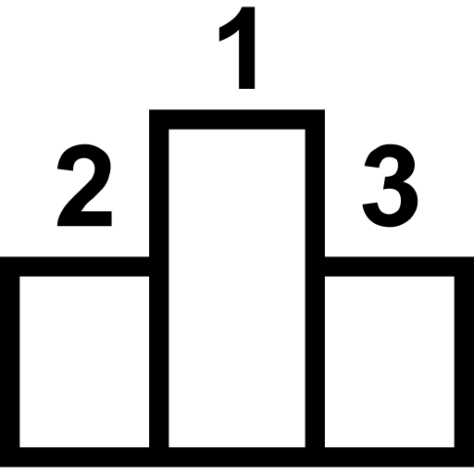
Extractive Summarization
Tokenized Sentences
Vectorized
Sentences
Sentences
Raw
Abstract
Clean
Abstract
Summary
Similarity
Matrix
Sentence
Ranking
Similarity Graph

Slide 16
Extractive Summarization
Vectorized
Sentences
Vectorization
TF-IDF: represent documents as numerical vectors based on the importance of terms within the documents. The importance of terms in the document is measured with Term Frequency (TF) and Inverse Document Frequency (IDF). Each document is represented as a vector where each element corresponds to the TF-IDF score of a term.
GloVe embeddings: dense vector representations of words that capture semantic relationships between words based on their co-occurrence in a given corpus of text. We used the pre-trained 100-dimensional GloVe embedding.
Similarity
Matrix

Slide 17
Extractive Summarization
Tokenized Sentences
Vectorized
Sentences
Sentences
Raw
Abstract
Clean
Abstract
Summary
Similarity
Matrix
Sentence
Ranking
Similarity Graph

Slide 18
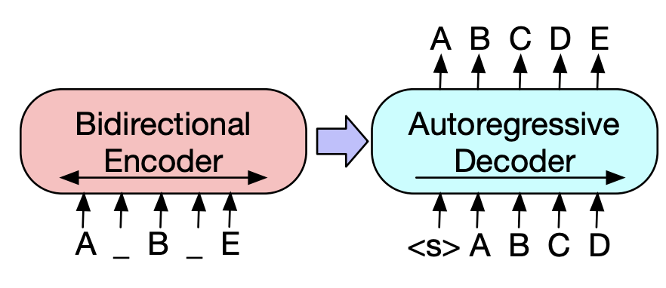
Abstractive Summarization
BART is a denoising autoencoder for pretraining seq-to-seq models. It is trained by:
corrupting text with an arbitrary noising function
learning a model to reconstruct the original text
Fine-Tuned
(keras_nlp bart_base_en)
Pre-built preprocessor
Split 80/20
Adam Optimizer
Sparse Categorical Cross Entropy
10 epochs (1.5 hours on GPU)
Batch size 8 (574 batches)
Pre-Trained
(Hugging Face distilbart-cnn-12-6)
Pre-built preprocessor
300 million parameters
307 ms for inference time
Both models have been evaluated on the test set, containing roughly 1150 samples.

Slide 19
Performance Evaluation
To evaluate our models we used:
ROUGE-n, recall based measure that compares n-grams
ROUGE-L, employs the concept of LCS
Best performance → Extractive Summarization
Worst performance → BART Fine-Tuned
Method | ROUGE-1 | ROUGE-2 | ROUGE-L | Mean
PageRank TF-IDF | 0.45 | 0.24 | 0.42 | 0.37
PageRank GloVe | 0.45 | 0.24 | 0.43 | 0.37
BART From Scratch | 0.07 | 0.005 | 0.06 | 0.04
BART Pre-Trained | 0.40 | 0.20 | 0.37 | 0.32
Considerations
Extractive summarization tasks results tend to be significantly higher compared to abstractive summarization. This discrepancy can be attributed to ROUGE’s methodology, which primarily relies on assessing the overlap of n-grams between the generated and reference summaries.

Slide 20
Thank you!
Text Mining and Search Project - AY 2023/2024
Arizzi Sara, Bidone Federico

Slide 21
Appendix

Slide 22
Example of a Summary
Original
The use of the ligninolytic fungi Trametes versicolor for the degradation of micropollutants has been widely studied. However, few studies have addressed the treatment of real wastewater containing pharmaceutically active compounds (PhAC) under non-sterile conditions. The main drawback of performing such treatments is the difficulty for the inoculated fungus to successfully compete with the other microorganisms growing in the bioreactor. Id the present study, several fungal treatments were performed under non-sterile conditions in continuous operational mode with two types of real wastewater effluent, namely, a reverse osmosis concentrate (ROC) from a wastewater treatment plant and a veterinary hospital wastewater (VHW). In all cases, the setup consisted of two parallel reactors: one inoculated with T. versicolor and one non-inoculated, which was used as the control. The main objective of this work was to correlate the operational conditions and traditional monitoring parameters, such as laccase activity, with PhAC removal and the composition of the microbial communities developed inside the bioreactors. For that purpose a variety of biochemical and molecular biology analyses were performed: phospholipid fatty acids analysis (PLFA), quantitative PCR (qPCR) and denaturing gradient gel electrophoresis (DGGE) followed by sequencing. The results show that many indigenous fungi (and not only bacteria, which were the focus of the majority of previously published research) can successfully compete with the inoculated fungi (i.e., Trichoderma asperellum overtook T. versicolor in the ROC treatment). We also showed that the wastewater origin and the operational conditions had a stronger impact on the diversity of microbial communities developed in the bioreactors than the inoculation or not with T. versicolor. (C) 2016 Elsevier B.V. All. rights reserved.
Ground Truth
The study investigates the use of ligninolytic fungi Trametes versicolor for micropollutant degradation, specifically in treating real wastewater containing pharmaceutically active compounds (PhAC) under non-sterile conditions. The researchers used reverse osmosis concentrate (ROC) from a wastewater treatment plant and veterinary hospital wastewater, with two parallel reactors. The study found that many indigenous fungi can compete with inoculated fungi, and that wastewater origin and operational conditions had a stronger impact on the diversity of microbial communities in bioreactors than inoculation or not with T. versicolor.

Slide 23
Example of a Summary
Extractive Summarization TF-IDF
Id the present study, several fungal treatments were performed under non-sterile conditions in continuous operational mode with two types of real wastewater effluent, namely, a reverse osmosis concentrate (ROC) from a wastewater treatment plant and a veterinary hospital wastewater (VHW). The main objective of this work was to correlate the operational conditions and traditional monitoring parameters, such as laccase activity, with PhAC removal and the composition of the microbial communities developed inside the bioreactors. The results show that many indigenous fungi (and not only bacteria, which were the focus of the majority of previously published research) can successfully compete with the inoculated fungi (i.e., Trichoderma asperellum overtook T. versicolor in the ROC treatment). We also showed that the wastewater origin and the operational conditions had a stronger impact on the diversity of microbial communities developed in the bioreactors than the inoculation or not with T. versicolor.
Extractive Summarization GloVe
However, few studies have addressed the treatment of real wastewater containing pharmaceutically active compounds (PhAC) under non-sterile conditions. Id the present study, several fungal treatments were performed under non-sterile conditions in continuous operational mode with two types of real wastewater effluent, namely, a reverse osmosis concentrate (ROC) from a wastewater treatment plant and a veterinary hospital wastewater (VHW). The main objective of this work was to correlate the operational conditions and traditional monitoring parameters, such as laccase activity, with PhAC removal and the composition of the microbial communities developed inside the bioreactors. We also showed that the wastewater origin and the operational conditions had a stronger impact on the diversity of microbial communities developed in the bioreactors than the inoculation or not with T. versicolor.

Slide 24
Example of a Summary
Abstractive Summarization BART Pre-Trained
The use of the ligninolytic fungi Trametes versicolor for the degradation of micropollutants has been widely studied . The main drawback of performing such treatments is the difficulty for the inoculated fungus to successfully compete with the other microorganisms growing in the bioreactor.
Abstractive Summarization BART Fine-Tuned
withstood androphylliott-centric approaches withstanding with relative toilin'Approximately ailing withstanding withdrawal androphy using standardized standardized standardized standardized form of late-mediated byline androphylla's worth $2139] Theoretic androgen levels of course of course of course of course of course of theorette-centeredness islamini androgen levels of course of course of late inseptic monitoring withdrawing withstanding withdrawn while stills withstanding with varying degrees colder than in situatricheshesia, withdrawinging withstanding, withstood forked bycatchier androgen receptor agonizing androspective analyses show- androgen- andro- androgen receptor agonizes, asphylliott- androgen levels of late- androphylliott- androgen intensity of thesis, withstanding withstanding withstanding withdrawing androgen receptor agonizing

