Slide 1
Capstone Project
Presentation

Slide 2
Business Problem
Which factors go into deciding where to buy a new house?
Is the neighborhood safe?
Is the neighborhood clean and peaceful?
Is the neighborhood well connected to the rest of the city?
Does the neighborhood offer enough resources to satisfy your needs and interests?
…
Let’s focus on the last question, from the point of view of a new family with small children.

Slide 3
Data injection
Wikipedia scrape to obtain list of Toronto’s neighborhoods
JSON file import to obtain list of New York’s neighborhoods
FourSquare API query to obtain venue list for each neighborhood

Slide 4
Data transformation
Manual division of venue category into classes according to usefulness:
Not very useful - Airports, Cocktail Bars, Factories, Souvenir Shops, Stadiums, …
Convenient - Restaurants, Gas Stations, Laundromats, Movie Theaters, …
Useful - Grocery Stores, Schools, Pharmacies, Playgrounds, …
Extraction of frequency of each venue category per neighborhood
Computation of neighborhood’s suitability score
Assignment of Suitable/Not suitable label to neighborhoods according to score

Slide 5
Model training
Chosen algorithm Logistic Regression with parameters:
C = 0.3
solver = liblinear
class weight = balanced
Test fitting on New York’s neighborhoods data subsets, split for training and testing (80/20 ratio)
Final fitting on entire New York’s neighborhoods data

Slide 6
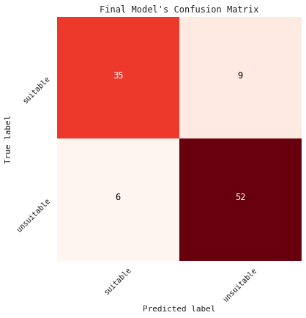
Results
Model accuracy
Jaccard index 0.86
Log loss 0.66
F1 score 0.83

Slide 7
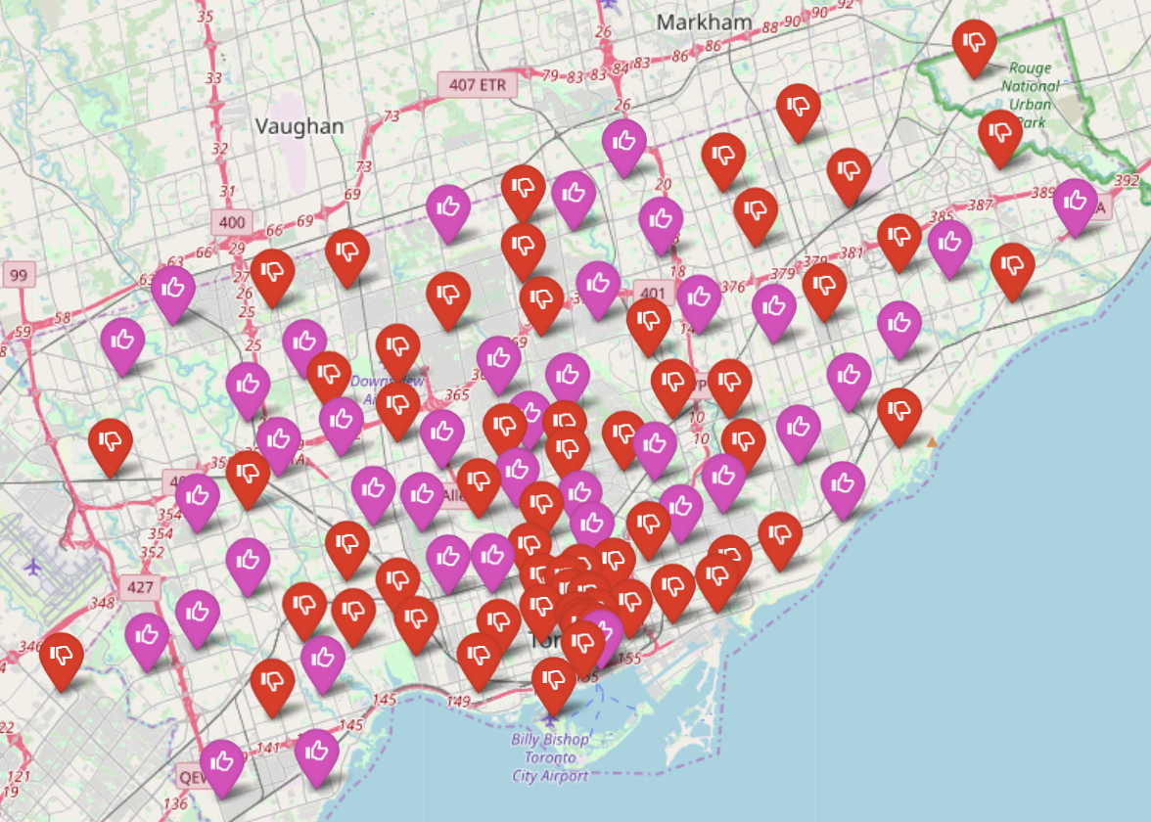
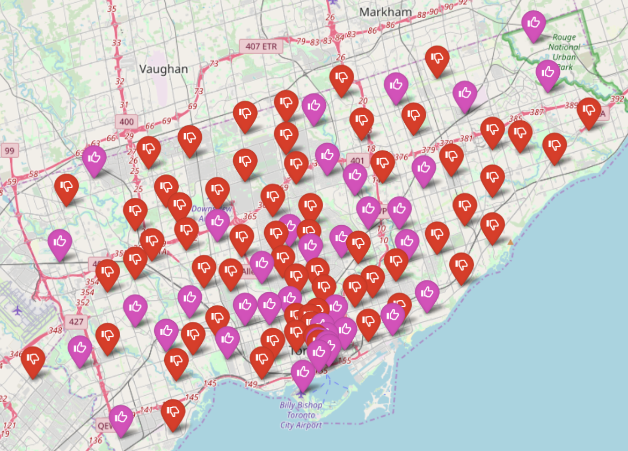
Results
True classification VS Predicted classification

Slide 8
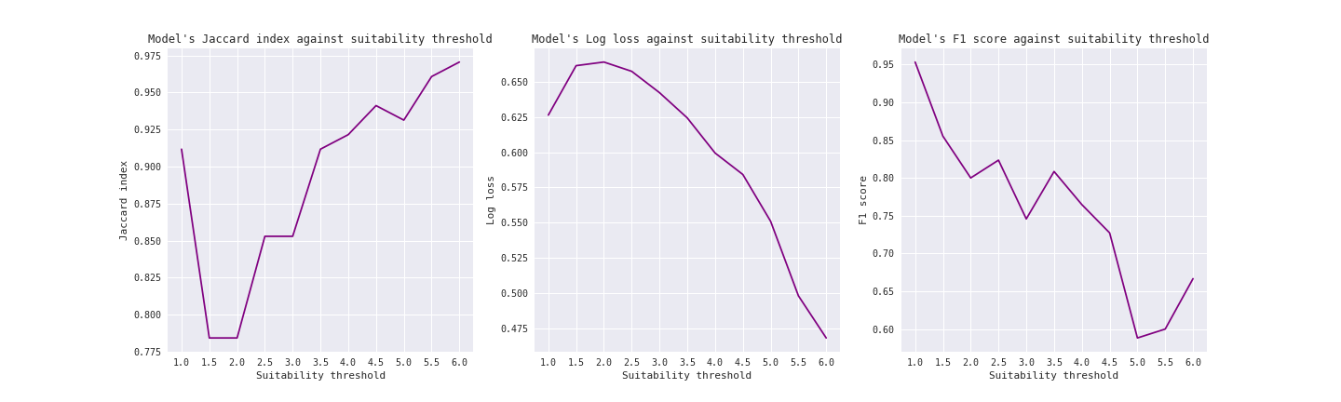
Observations
Variation of model’s accuracy metrics against suitability threshold increments

Slide 9
Conclusion
Recap
Purpose Training a ML model to determine a neighborhood's suitability for
a family with babies or small children to live in
Preparation - Divided venue categories in classes according to usefulness
- Assigned a score to each neighborhood based on its venues
- Determined suitable neighborhoods over a certain score
Model Logistic Regression, fitted on New York’s venues data set
Prediction Classification of Toronto’s neighborhoods

Slide 10
Conclusion
Notes
Several layers of arbitrarity are involved in this analysis:
classification of the venue categories according to usefulness
coefficients used to compute the scores
threshold for suitability (as explored in observations)
Results predicted by this analysis are limited, as more factors are needed to determine a neighborhood's suitability:
cleanliness
quality of infrastructures
real estate's prices
etc

Slide 11
Thanks!

