Slide 1
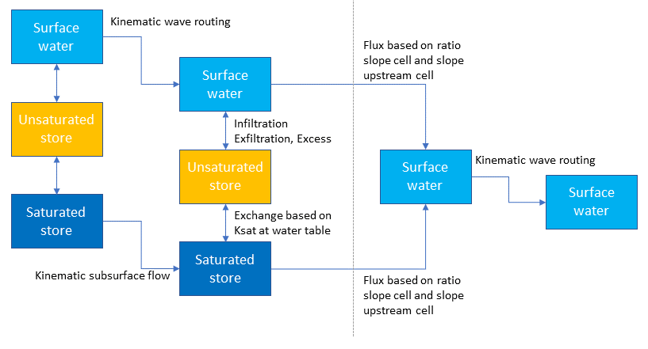

Reservoir
routing

Slide 2
