Slide 1
Exploratory analysis on suicide data
Alfredo Espana
Federico Cestau
Catherine Diagama-Pedroza

Slide 2

Introduction
It was decided to study a data set of suicide ranges between the years of 1985 to 2016 in order to find trends and understand the suicide rates around the world.
The data set contains data about all the countries of the world.
The data was retrieved from the website:https://www.kaggle.com/russellyates88/suicide-rates-overview-1985-to-2016
It was chosen five countries to analyze

Slide 3
Data clean
A verification was done to confirm the type of variables that were used and some of the variables were transform
Null values were dropped from the data set.
Two columns, the spaces and comas were removed.
The Data Frame was retrieved

Slide 4
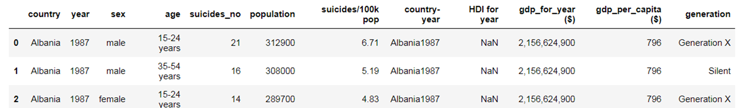
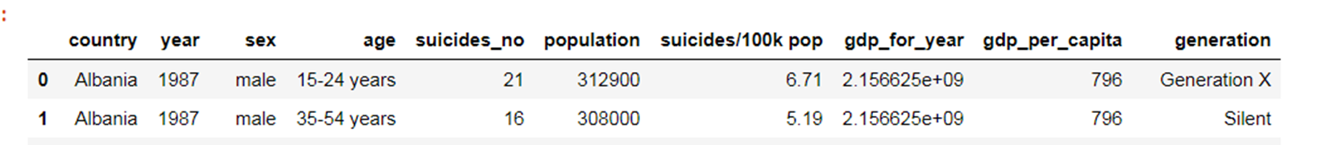
Data clean

Slide 5
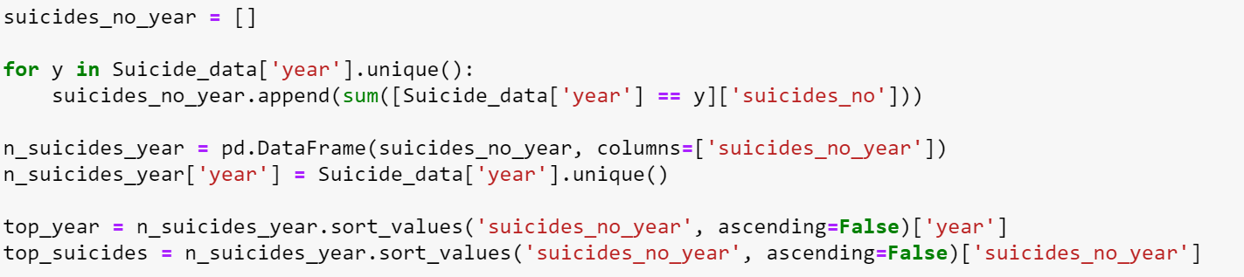
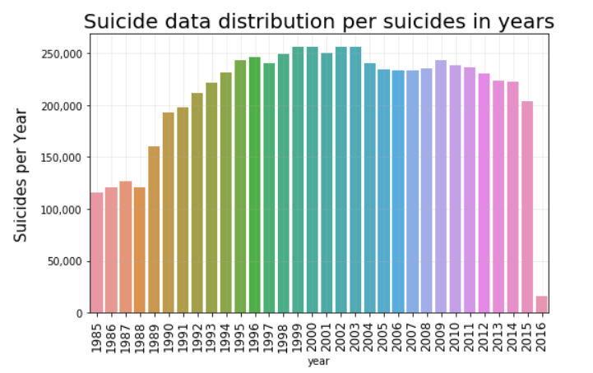
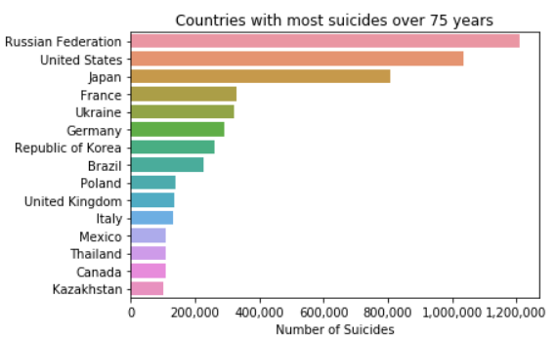
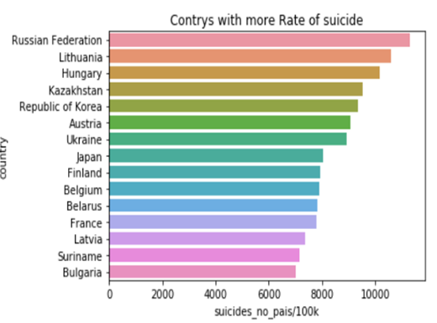
exploration
Over the years , has the number of suicides increased?
Which are the countries that commit more suicides?
Does the distribution of suicides vary when we change countries?

Slide 6
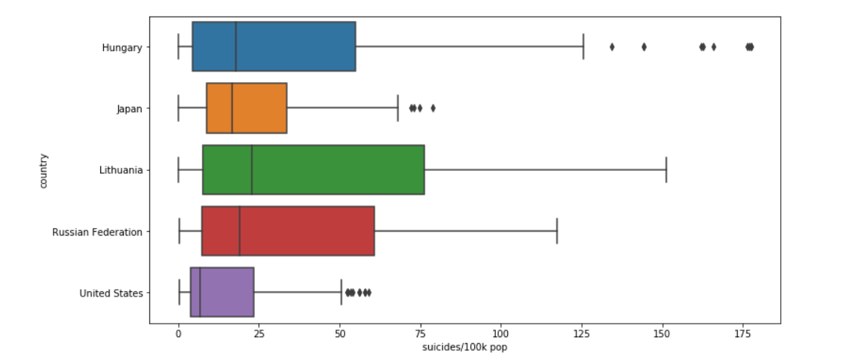
Exploration how the suicide's range varies when is compared between the 5 countries selected ?

Slide 7
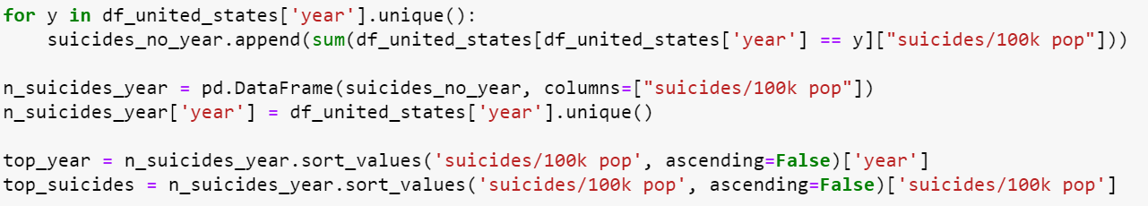
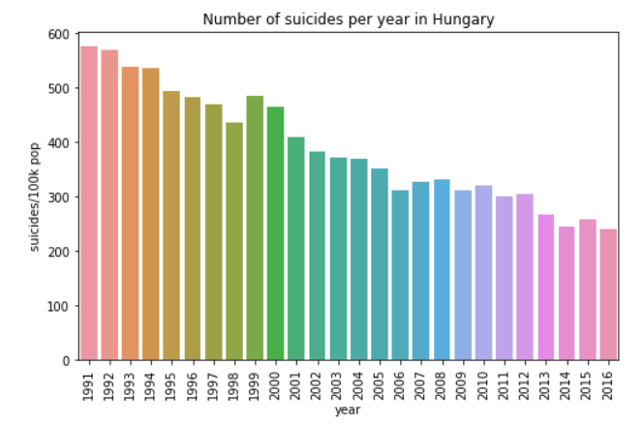
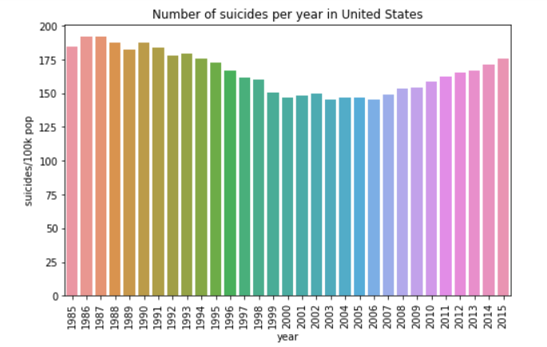
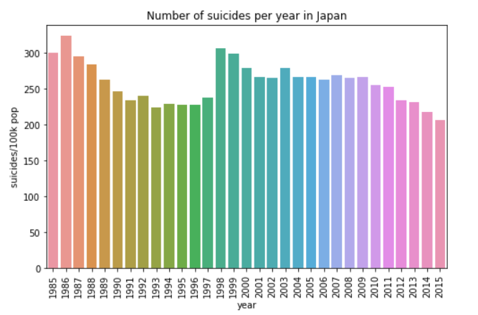
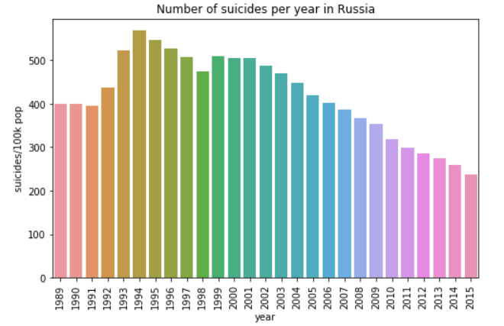
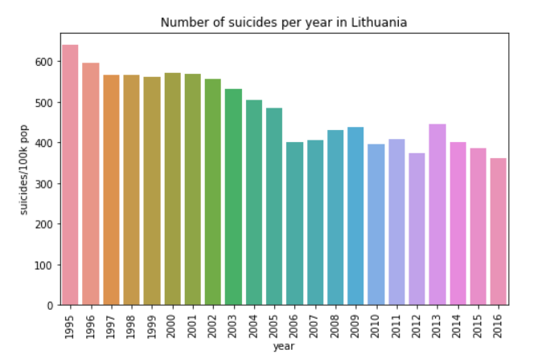
ANALYSIS How does the number of suicides vary over time?

Slide 8
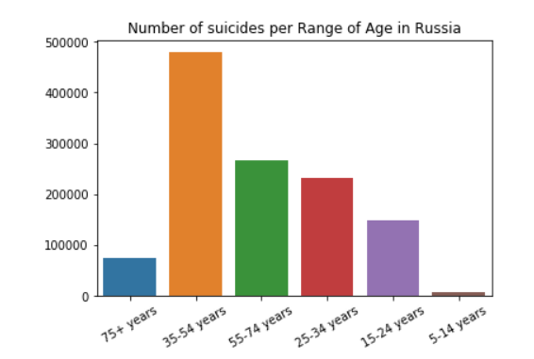
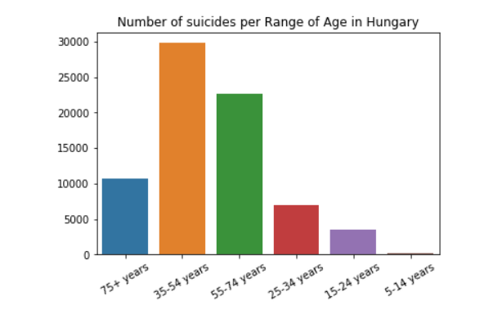
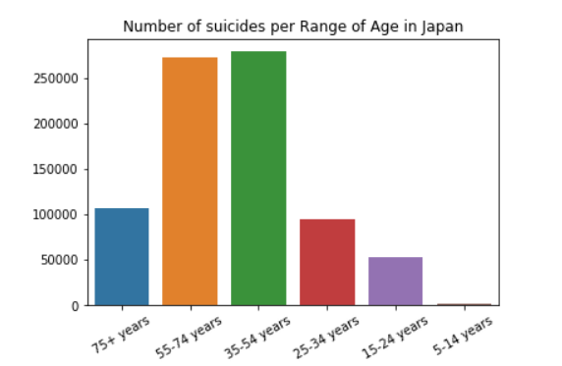
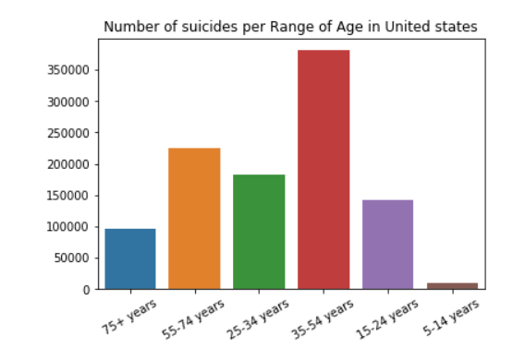
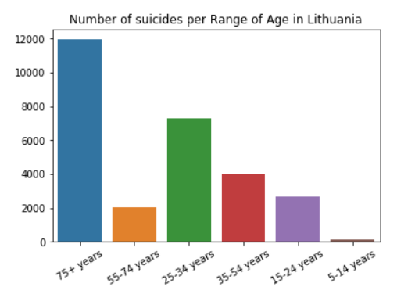
ANALYSIS Who tend to commit suicide more? Teens? Adults? elders?

Slide 9
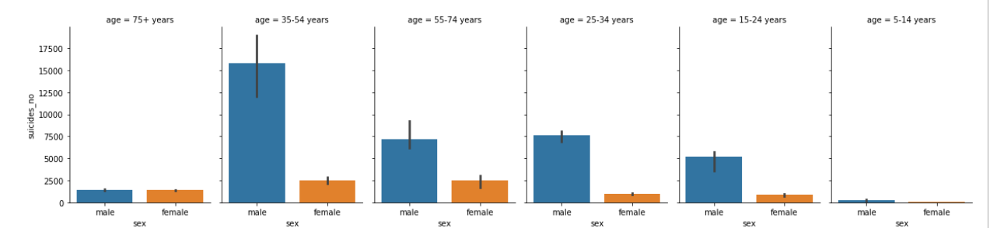
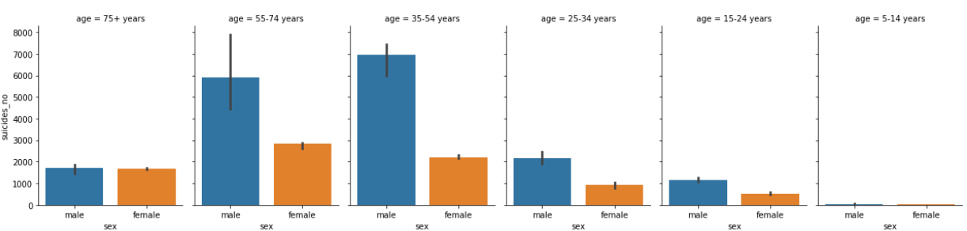
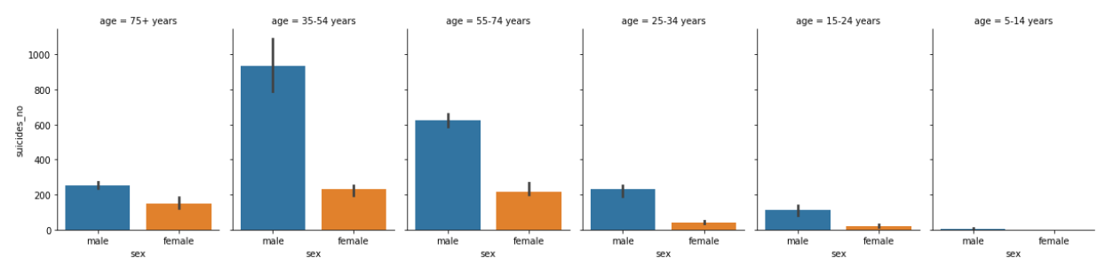
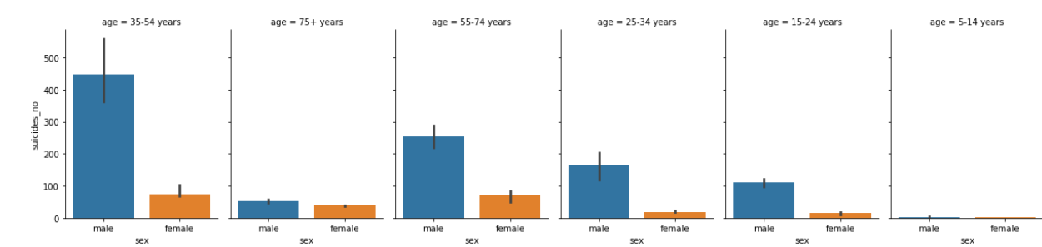
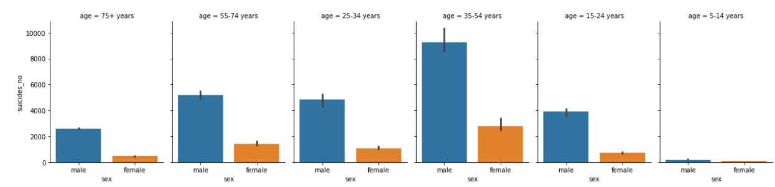
ANALYSIS What about sex? Who commits more suicide, men or women?

Slide 10
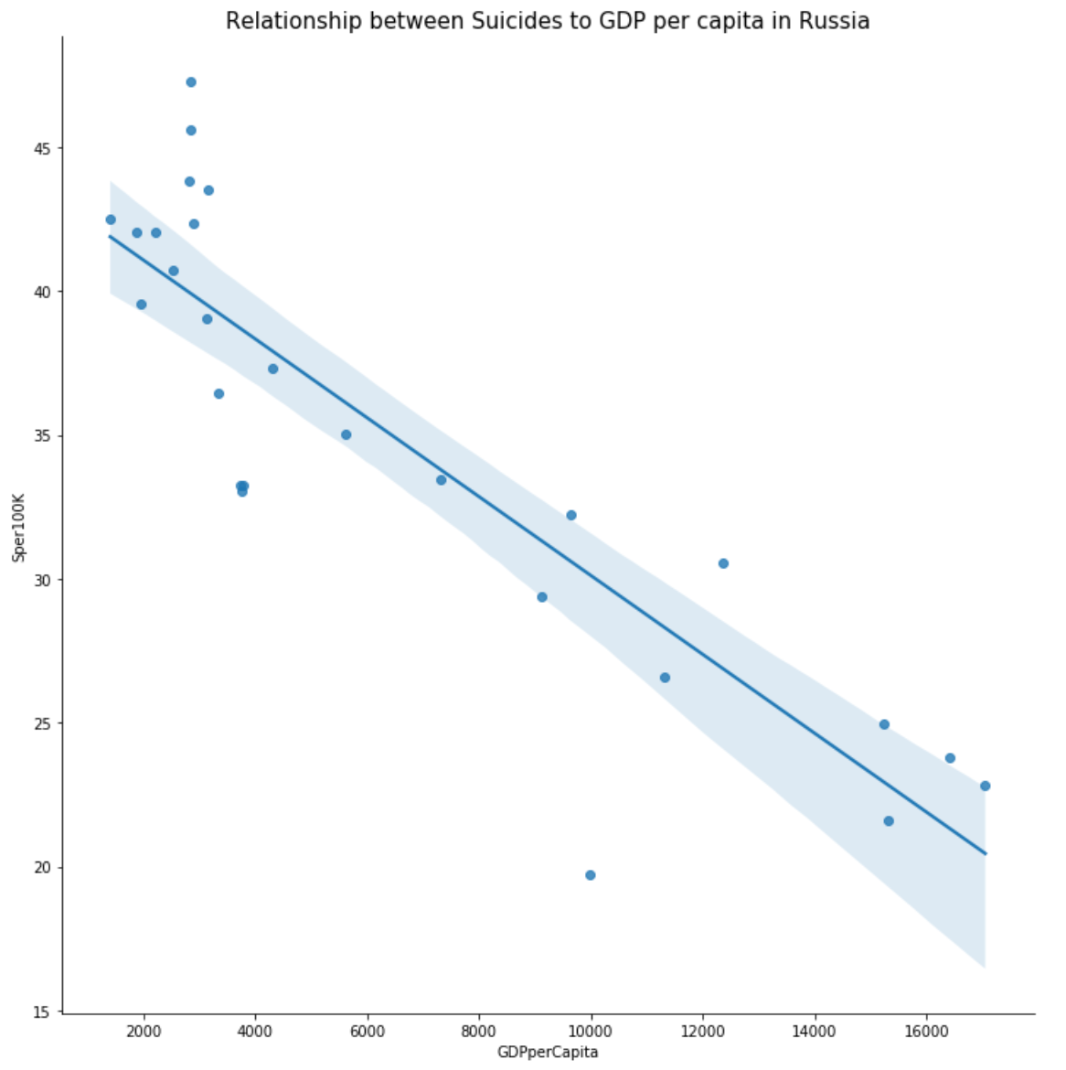
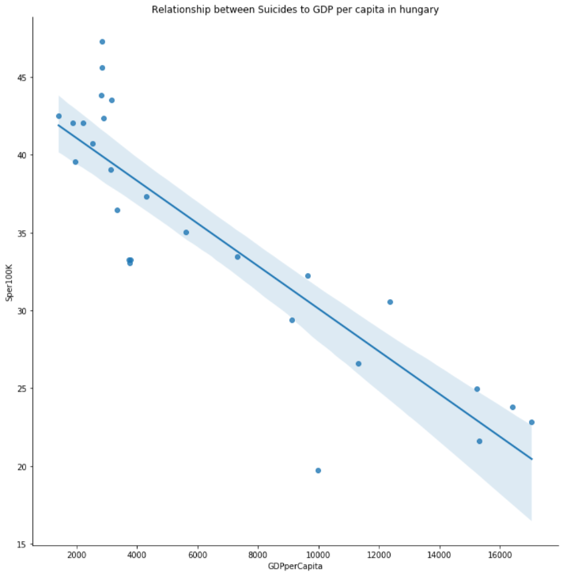
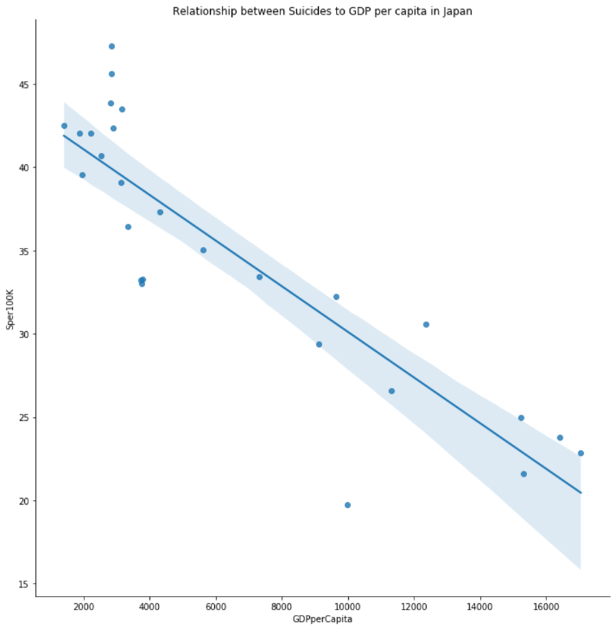

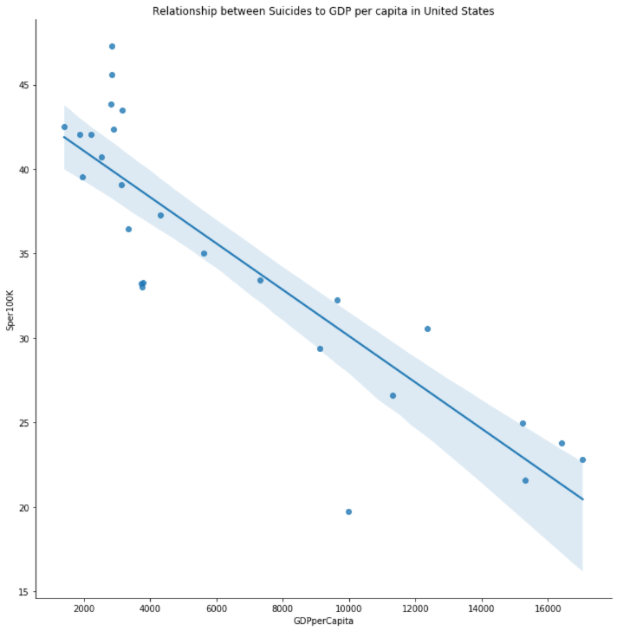
ANALYSIS As for the GDP per capita, is there influence?

Slide 11
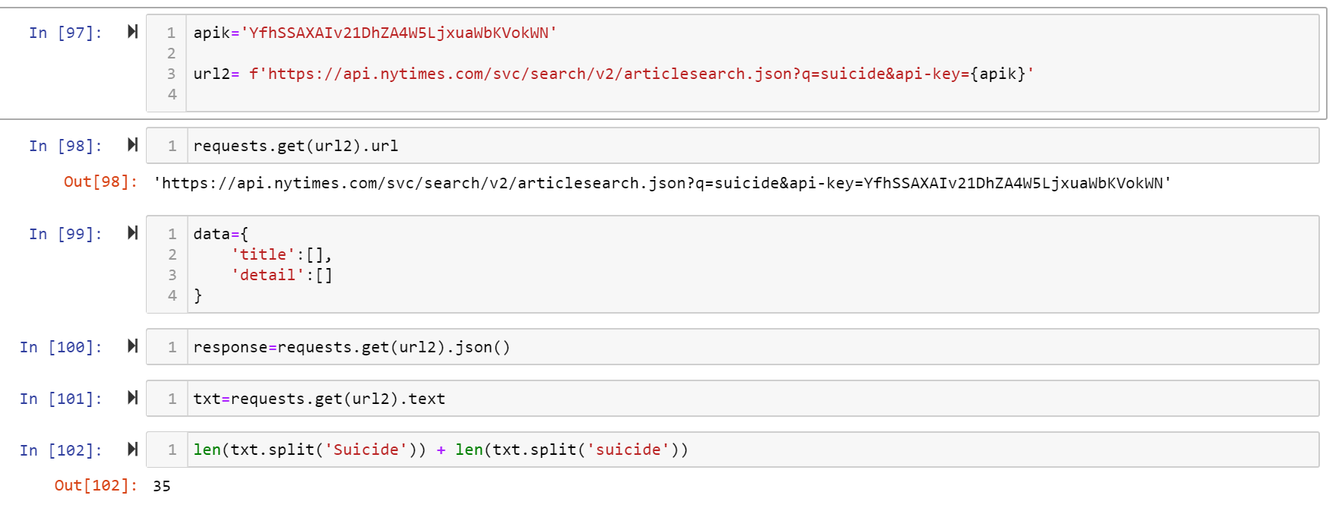
ANALYSIS is the suicide a popular trend in USA?
It was observed that the suicide rate doesn’t decrease in the United States, a New York times API was used to confirm if this was an important topic in the news.
.

Slide 12
CONCLUSIONS
The trends that were found
The peak of the rate was found in the range of 1987- 1995
The highest suicide rate was during the range of 35-54 years old
The gender with the highest rate was male
When the GDP is lower, there are more prone to negative biases.
If the country has a lower temperature the rate of suicides increases
It was found 35 articles related to suicide in less than 3 months.

Slide 13


Questions??

Slide 14
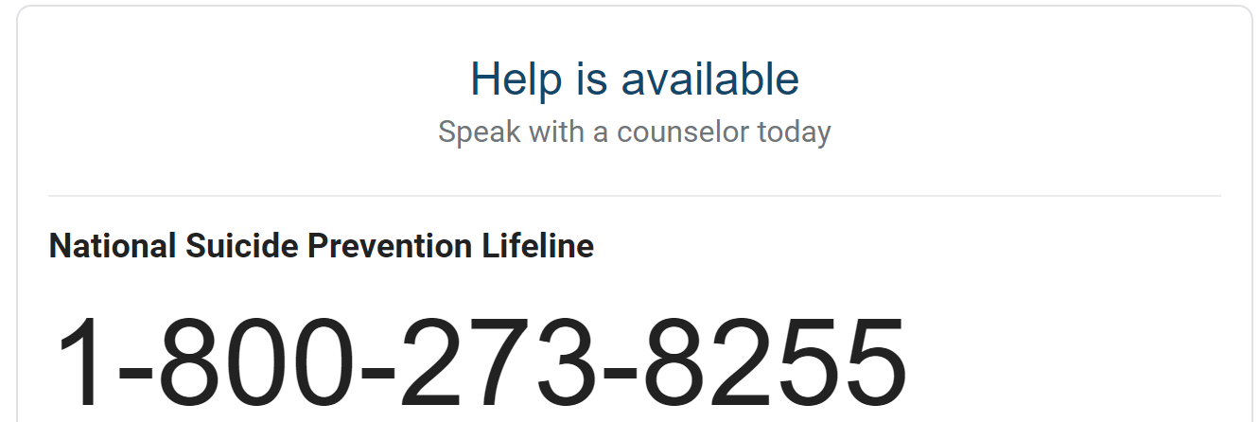
https://suicidepreventionlifeline.org/

