Slide 1
Before launching Interface.ipynb
Ensure Cython is installed (required dependency for py_stringsimjoin library)
Place “tracks_feature_df.csv” and “logo.png” in the same folder as “Interface.ipynb”
Re-running Spotify Extraction might take a while, we recommend only running the “Interface.ipynb” file.

Slide 2
Submission Files
File Name | File Type | Content
ReadMe.pptx | PowerPoint | Overview of the project
Spotify_DataExtraction.ipynb | Python | Extract and clean data for the app use.
tracks_feature_df.csv | text | Cleaned data to be used in the app
tracks_feature_df_phase1.csv | text | Data Extracted from Spotify before further EDA
Interface.ipynb | Python | User interface used to interact with tracks_feature_df
logo.png | png | Logo used in the application

Slide 3


Framework: Discover your New Favorite
List of Tracks and its features
Tracks in Clusters
Spotipy
scikit-learn
EDA
Remove duplicates
Correlation Between features
Remove highly correlated columns
Clustering
Standard Scaler
PCA to reduce dimension
K-Means Clustering
twkinter
Filter User Input
Use Jaccard Similarity to auto correct user song title
Filter potential songs based on selected song’s cluster
Further filter songs based on various features of user’s preferences
Display list of 10 recommended songs based on popularity
Discover your
next favorite
Filter songs based on user inputs

Slide 4
Spotify Data Extraction
Leverage Spotipy library to connect to Spotify Web API to extract songs and their features.
Clean and merge data using Pandas library
Run PCA to reduce dimensions to 2 using scikit-learn library
Run k-means algorithm using scikit-learn library to group 2,000+ songs into 6 clusters

Slide 5
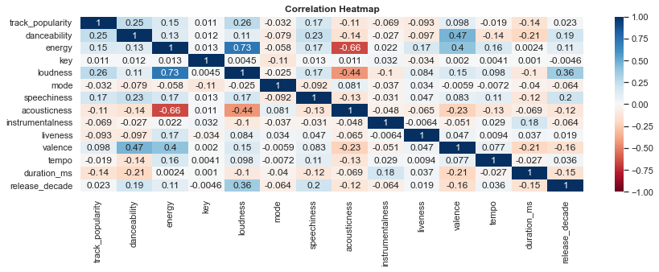
Spotify Data Extraction: Correlation Matrix
The matrix below was used to determine that [loudness] and [acousticness] are highly correlated with energy, therefore it’s removed from the main dataframe for further analysis.

Slide 6
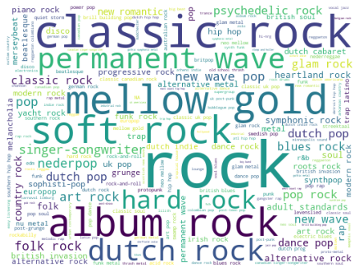
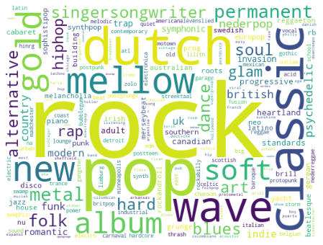
Spotify Data Extraction: Correlation Matrix
The word clouds below are generated from the two methods we used to obtain the most used terms for the genres dropdown list.

Slide 7
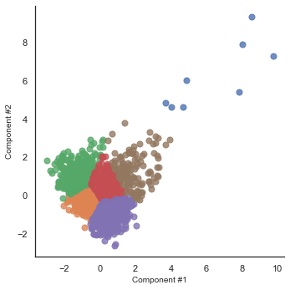
Spotify Data Extraction: Clusters
The graph shows the distribution of our songs among the 6 clusters obtained from k-means algorithm. (with PCA of dimension 2)

Slide 8
Interface
Build user interface using Tk interface (tkinter) library
Recommend potential titles if user does not provide exact title of the song. This is done through leveraging string similarity method Jaccard Similarity achieved through py_stringsimjoin library.

Slide 9
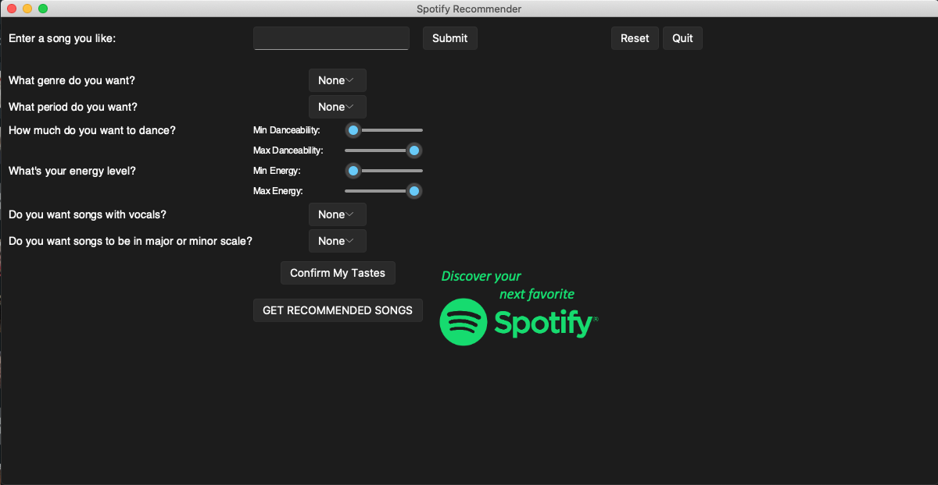
Interface: Default

Slide 10
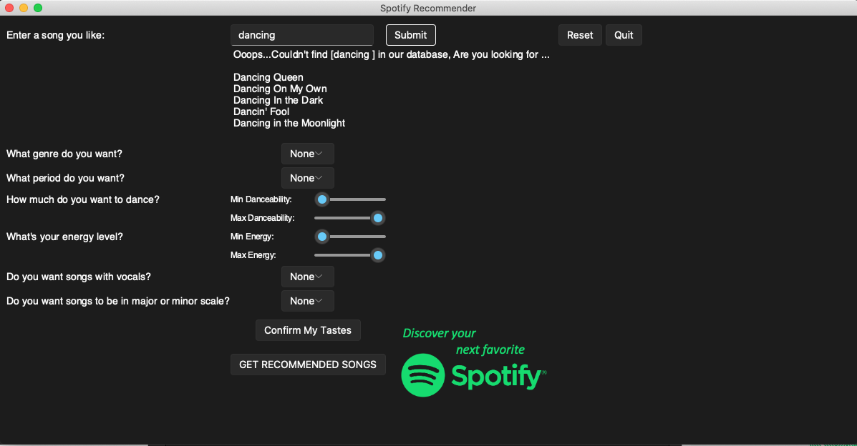
Interface: Song title search

Slide 11
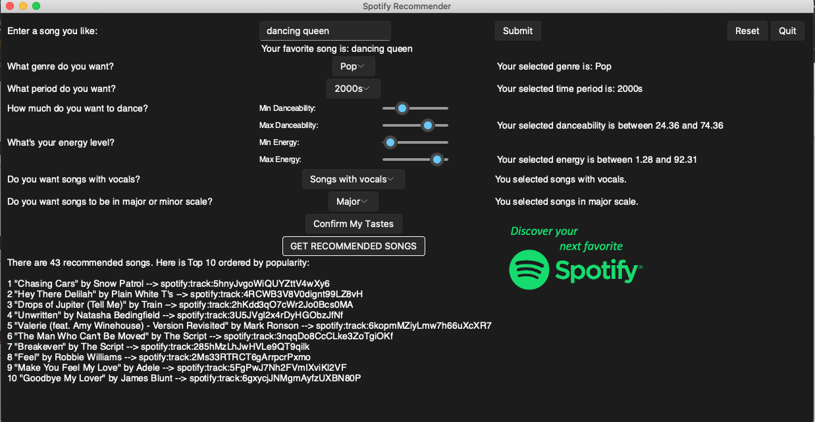
Interface: Recommendation Results

