Slide 1

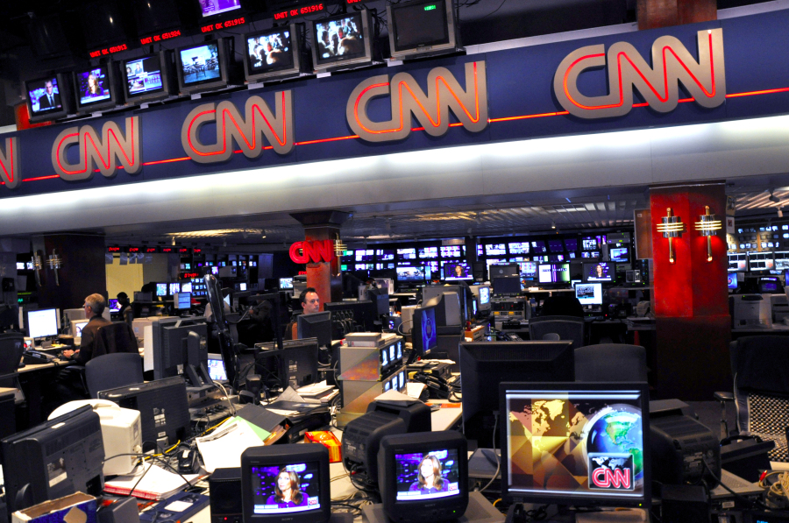
CNN STORY
SUMMARIZATION
Christian Uccheddu - 800428
Federico De Servi - 812166

Slide 2

Objective
Create summaries from the CNN stories dataset
Image from cnn.com

Slide 3
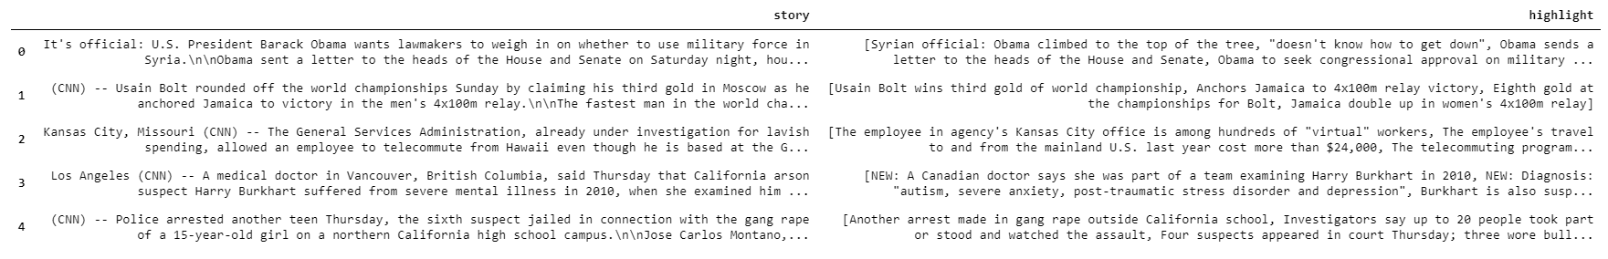
Original dataset
The dataset was taken from the DeepMind Q&A Dataset and can be found at this link. The dataset presented some issues that had to be solved before applying our models:
Each story presented more than one summary
The text was taken from the CNN website, so it contained abbreviations, html symbols, contractions, non alphabetic characters, etc… and was not suitable as input for our Summarization model
Only a subset of stories had to be selected for computational costraints

Slide 4
Solutions
The solutions that had been applied were:
Each row now contained one story and one summary. This meant repeating the stories where necessary.
Normalization
Lemmatization
Tokenization
10,000 stories are selected
Additional steps
Additional preprocessing steps required by the nature of the problem and of the model used are applied, like:
Adding start and stop tokens at the beginning and at the end of each summary
Non-ascii characters removal
All to lowercase
Punctuation removal
Numbers removal
Contractions mapping
Stop-words removal

Slide 5
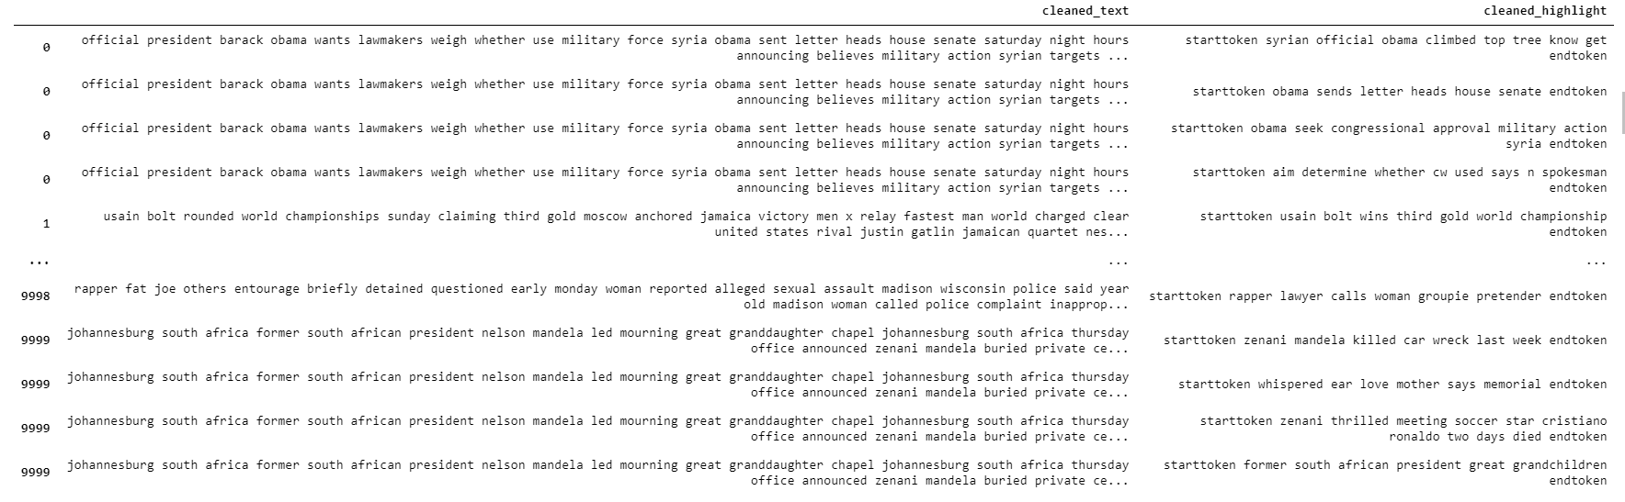
Resulting dataset
Here is the resulting dataset after all the preprocessing steps:

Slide 6
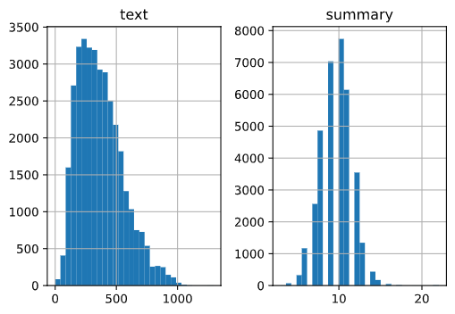
Methodological approach and evaluation
First, we selected a max length of text (300) to take and a max summary length (12) based on the distribution of the data.
Then we implemented an Abstractive Summarization model.
Structure:
Encoder
Decoder
Attention Layer

Slide 7
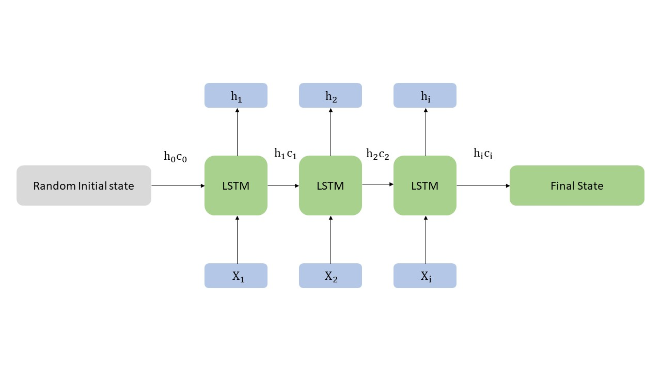
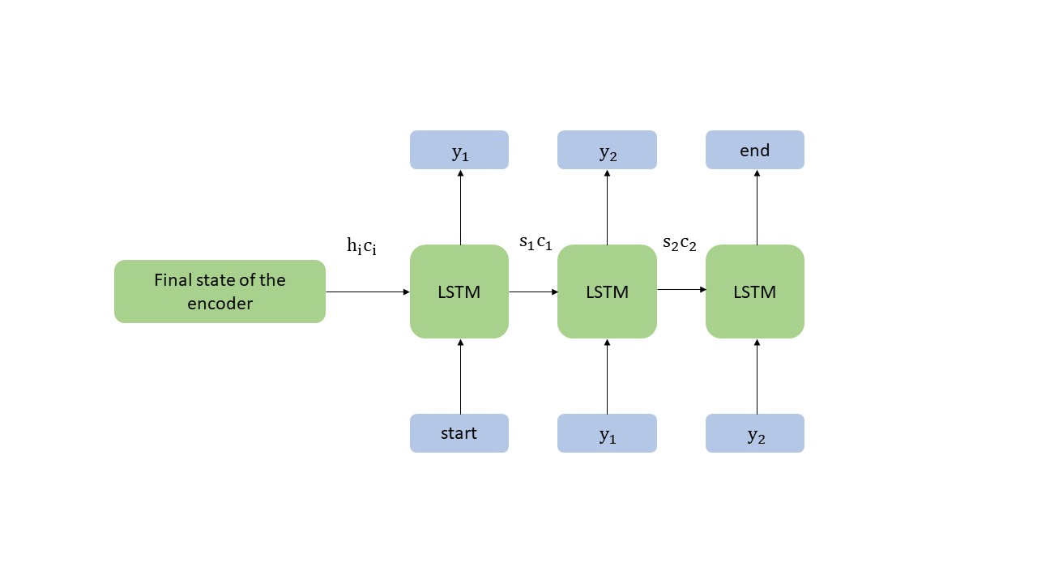
The first model
The model used is structurally simple.
The encoder is composed of an Embedding layer followed by a single LSTM layer.
The decoder is composed similarly to the encoder, with one Embedding and one LSTM layer.
Between the two, an Attention layer is placed.
Then, a Time-distributed Dense layer is added at the end.
Although the relatively simple structure, this model contained more than 10 Million parameters that had to be trained locally on our machines.
This explains why only 20 epochs has been used to train the model. Each epoch took approximately 1 hour.

Slide 8
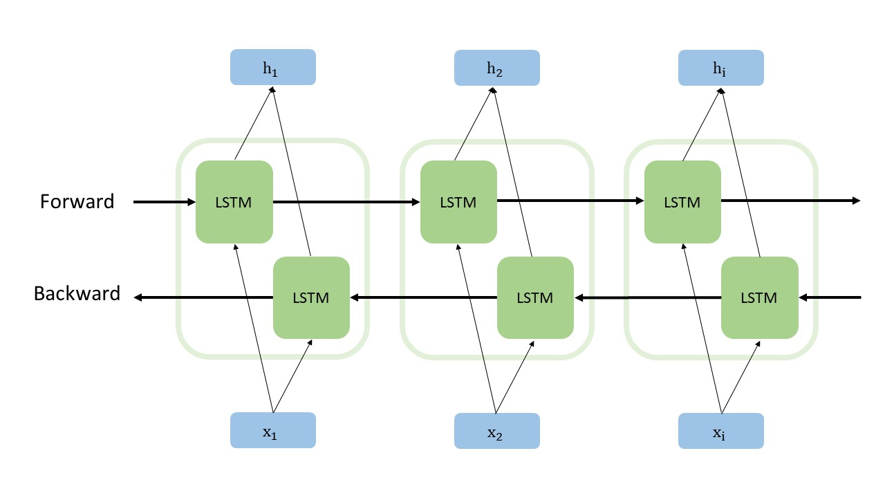
The second model
The second model improved from the first model by implementing a bidirectional LSTM encoder,
while maintaining a unidirectional decoder.
The forward and reverse hidden states of the bidirectional encoder are then concatenated two by two and then fed as initial states to the unidirectional decoder.
This should give the model better understanding of the patterns in the text.

Slide 9
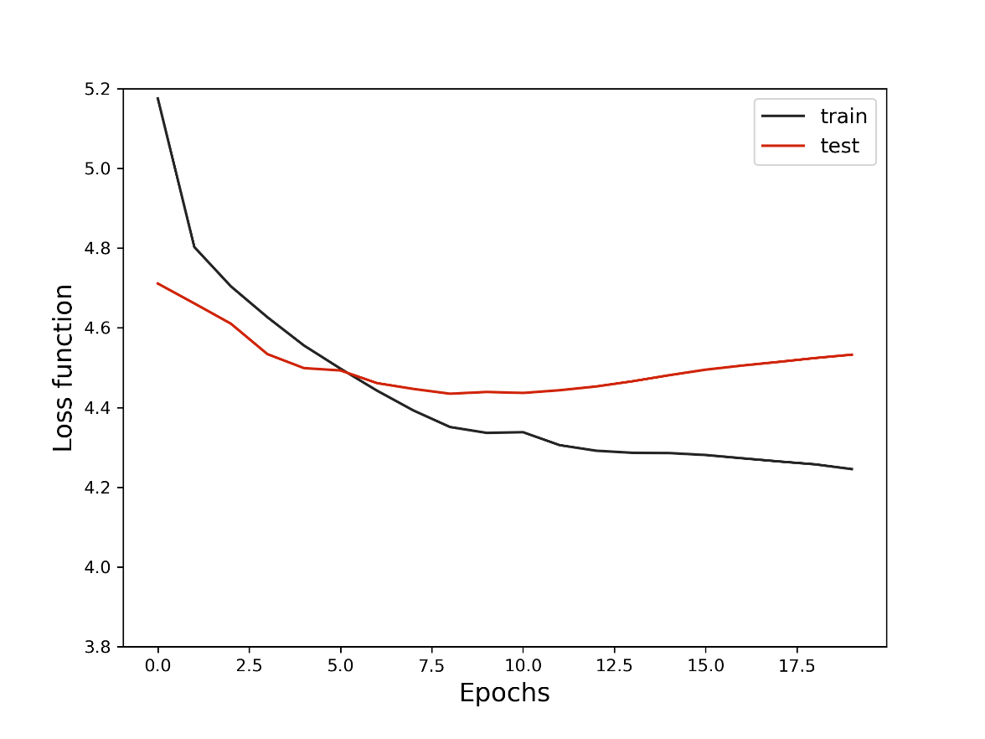
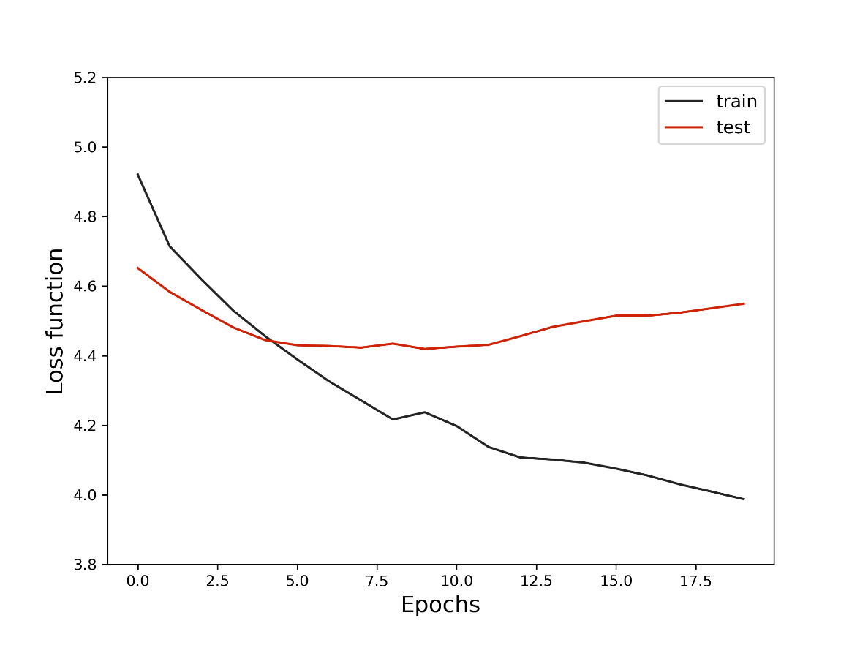
Results
The following graphs represent the loss function of the two models
Monodirectional model
Bidirectional model

Slide 10

Results
Monodirectional model
Bidirectional model
ROUGE-1: 7.56%
ROUGE-2: 0.80%
ROUGE-1: 6.62%
ROUGE-2: 0.66%
Example

Slide 11
The two pre-trained models
BART
T5
This model uses a standard seq2seq/machine translation architecture with a bidirectional
encoder (like BERT) and a left-to-right
decoder (like GPT).
This model partially reflects the
structure of the model built by us.
T5 is a Google pre-trained model, which propose reframing all NLP tasks into a unified text-to-text format where the input and output are always text strings, in contrast to BERT-style models
that can only output either a class label or a span of the input.

Slide 12
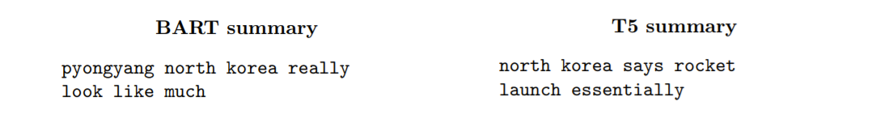
Results
BART model
T5 model
ROUGE-1: 17.46%
ROUGE-2: 7.23%
ROUGE-1: 20.51%
ROUGE-2: 8.81%
Example

Slide 13
Conclusions
It is clear how these Seq2Seq models need more training time and far more computational power than what is available to a normal developer/consumer.
However, what stood out the most is that they were capable to produce a few summaries that impressed, given the limited resources that we had to deal with.
In particular, the model that made use of the bidirectional LSTM, although presenting lower ROUGE scores, generated more complex and fluent outputs, and confirms its greater capacity in recognizing patterns in text.

Slide 14
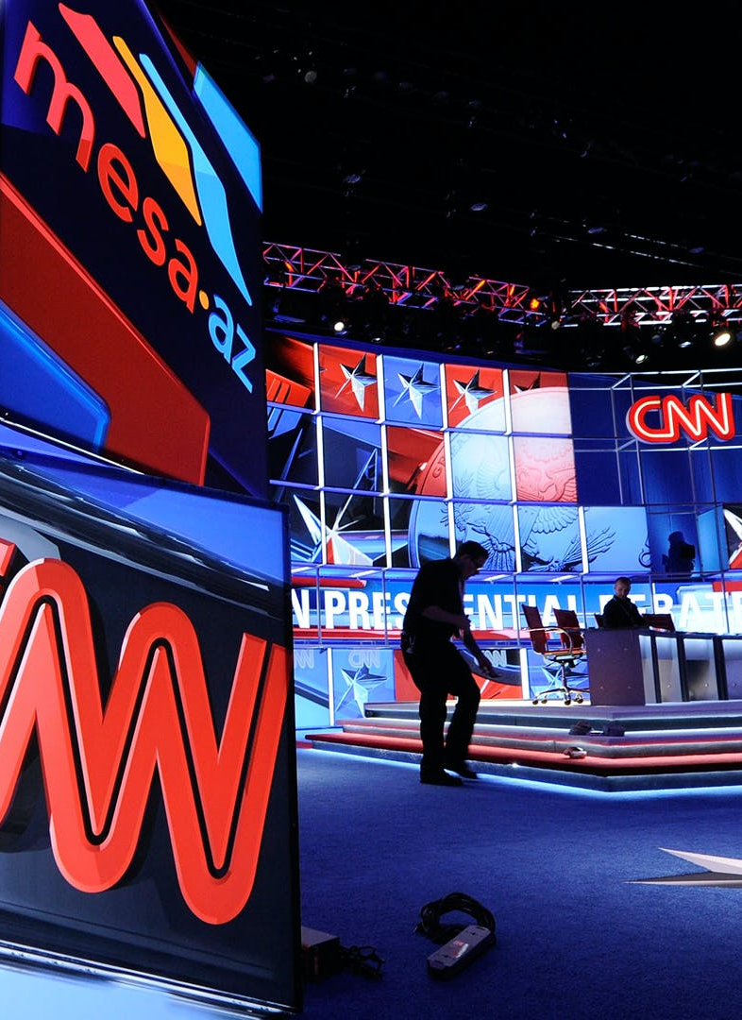
Thank You
Christian Uccheddu - 800428
Federico De Servi - 812166
Image taken from CNN twitter profile

