Slide 1

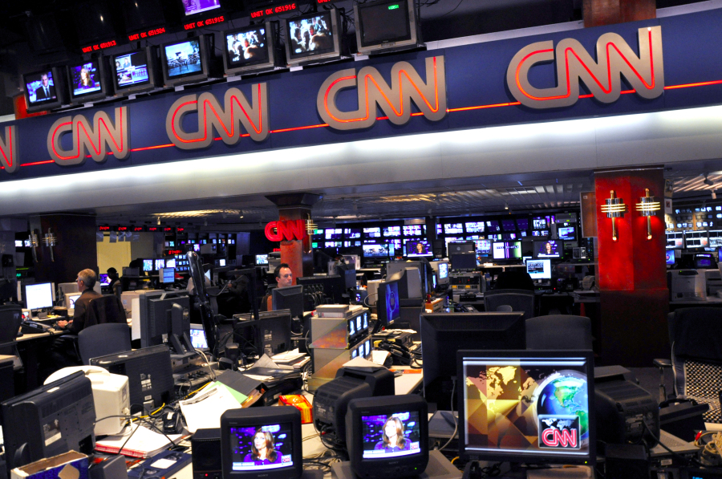
CNN STORY
SUMMARIZATION
Christian Uccheddu - 800428
Federico De Servi - 812166

Slide 2

Objective
Create summaries from the CNN stories dataset
Image from cnn.com

Slide 3
Original dataset
The dataset was taken from the DeepMind Q&A Dataset and can be found at this link. The dataset presented some issues that had to be solved before applying our models:
Each story presented more than one summary
The text was taken from the cnn website, so preprocessing steps were needed:
Normalization
Lemmatization
Tokenization

Slide 4
Solutions
The solutions that had been applied were:
Normalization
Lemmatization
Tokenization

Slide 5
Methodological approach and evaluation
Given the large number of records, it was decided to use neural networks to solve the problem of predicting the taxi trip duration. The choice of the model and the hyperparameters was made after several empirical tests.

Slide 6
The model
This

Slide 7
Results
The following graphs represent the loss function of the model and the scatter plot of the prediction against the real duration.

Slide 8
Results
The following graphs represent the loss function of the model and the scatter plot of the prediction against the real duration.

Slide 9
The approach applied gives good results.
In particular,
Conclusions

Slide 10

Thank You
Christian Uccheddu - 800428
Federico De Servi - 812166
Image taken from CNN twitter profile

