Slide 1

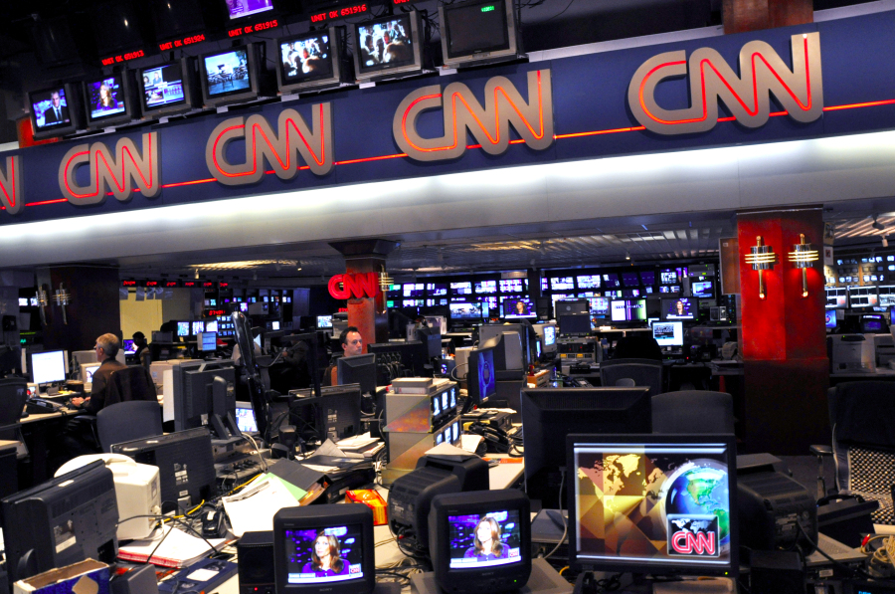
CNN STORY
SUMMARIZATION
Christian Uccheddu - 800428
Federico De Servi - 812166

Slide 2
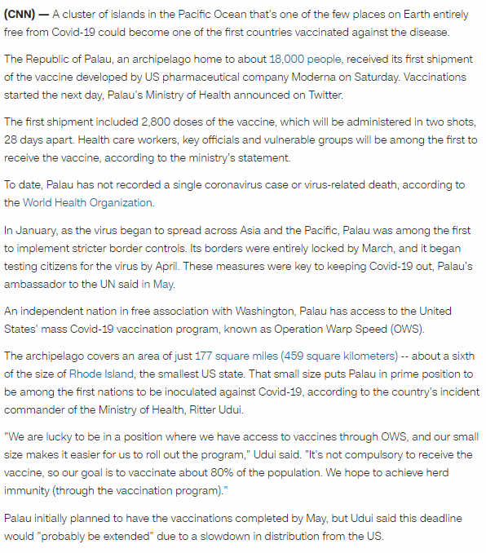
Objective
Create summaries from the CNN stories dataset
Image from cnn.com

Slide 3
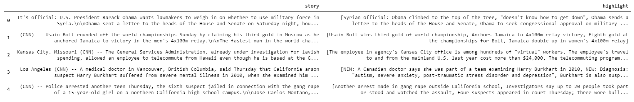
Original dataset
The dataset was taken from the DeepMind Q&A Dataset and can be found at this link. The dataset presented some issues that had to be solved before applying our models:
Each story presented more than one summary
The text was taken from the CNN website, so it contained abbreviations, html symbols, contractions, non alphabetic characters, etc… and was not suitable as input for our Summarization model

Slide 4
Solutions
The solutions that had been applied were:
Each row now contained one story and one summary. This meant repeating the stories where necessary.
Normalization
Lemmatization
Tokenization
Additional steps
Additional preprocessing steps required by the nature of the problem and of the model used are applied, like:
Adding start and stop tokens at the beginning and at the end of each summary
Non-ascii characters removal
All to lowercase
Punctuation removal
Numbers removal
Contractions mapping
Stop-words removal

Slide 5
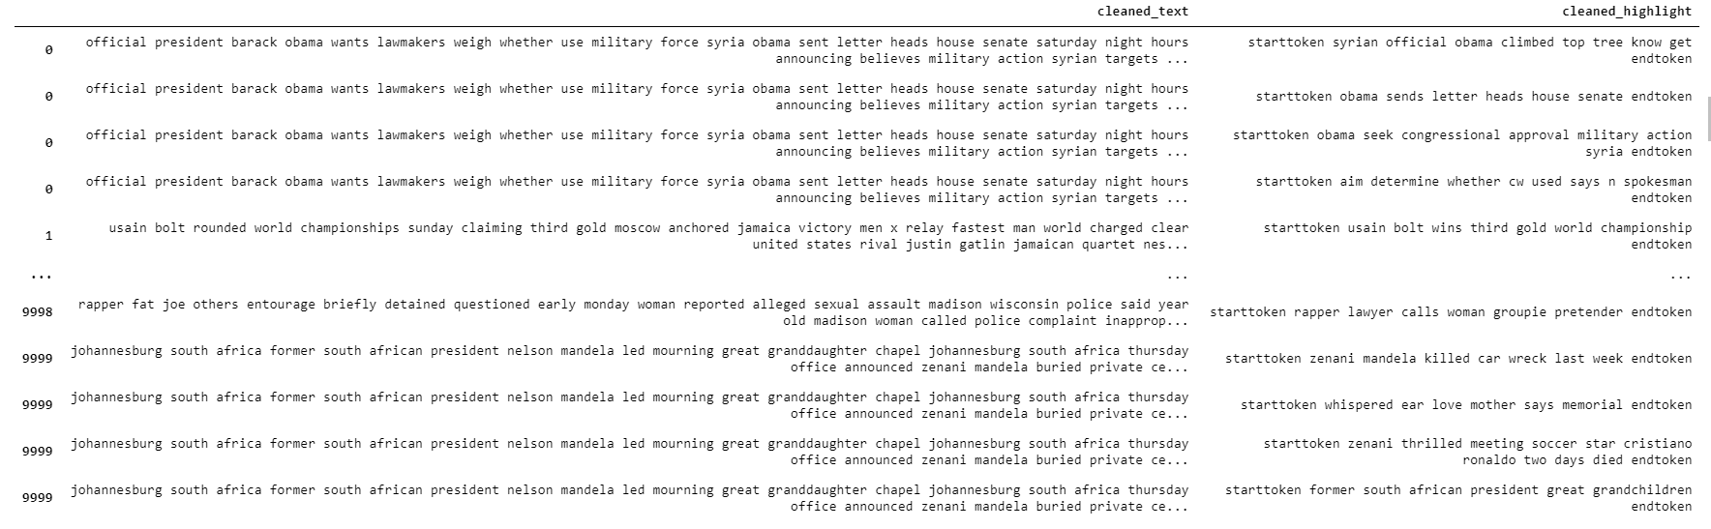
Resulting dataset
Here is the resulting dataset after all the preprocessing steps:

Slide 6
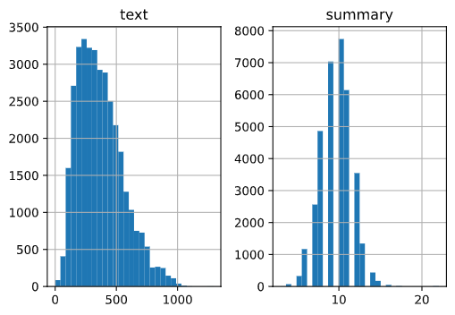
Methodological approach and evaluation
Then we implemented an Abstractive Summarization model. DESCRIZIONE QUA
First, we selected a max length of text to take and a max summary length based on the distribution of the data.

Slide 7
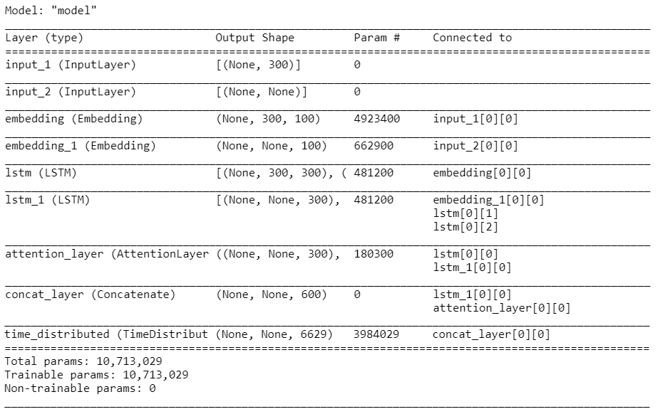
The model
The model used is structurally simple.
The encoder is composed of an Embedding layer followed by a single LSTM layer.
The decoder is composed similarly to the encoder, with one Embedding and one LSTM layer.
Between the two, an Attention layer is placed.
Then, a Time-distributed Dense layer is added at the end.
Although the relatively simple structure, this model contained more than 10 Million parameters that had to be trained locally on our machines. This explaines why only 10 epochs has been used to train the model.

Slide 8
Results
The following graphs represent the loss function of the model

Slide 9
Results

Slide 10
The approach applied gives good results.
In particular,
Conclusions

Slide 11

Thank You
Christian Uccheddu - 800428
Federico De Servi - 812166
Image taken from CNN twitter profile

