Slide 1


CNN STORY
SUMMARIZATION
Christian Uccheddu - 800428
Federico De Servi - 812166

Slide 2

Objective
Predict the taxi trip duration given the attributes in the dataset available on Kaggle
Image from cnn.com

Slide 3
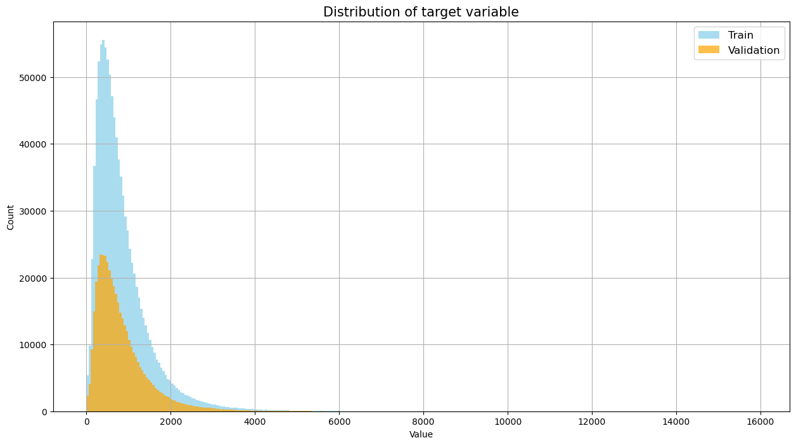
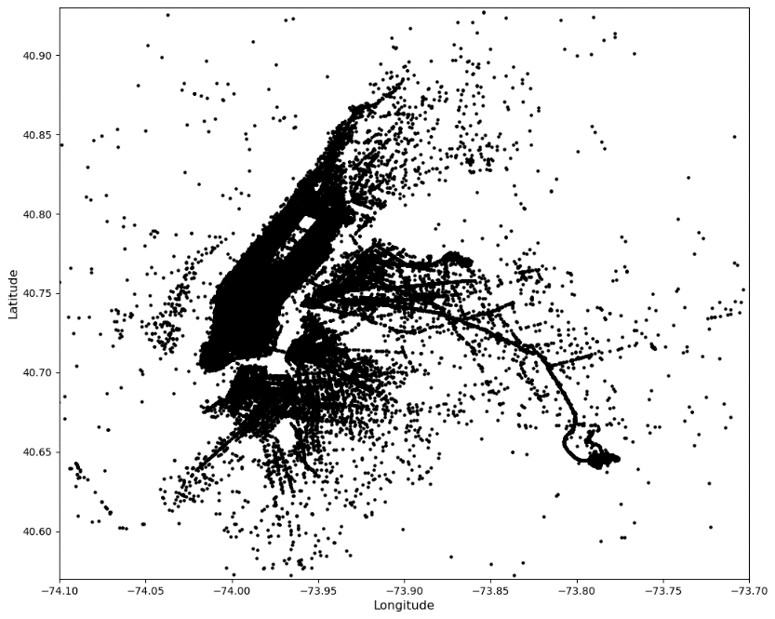
Original dataset
The dataset was taken from Kaggle and can be found at this link. The dataset presented some issues that had to be solved before applying our models:
Some records contained presumably wrong information regarding the trip duration. (i.e. trips whose distance was 700 or more km completed in less than an hour)
Trips that presented a trip duration less than 10 seconds.
Geopositional data encoded in latitude and longitude. This Is not the ideal format to feed to the models
Datetime attribute contained more than one information (day, time, weekday or not, etc)
No distance between the points is given. This had to be calculated.
No aggregate geographical info (county/block) was given.

Slide 4
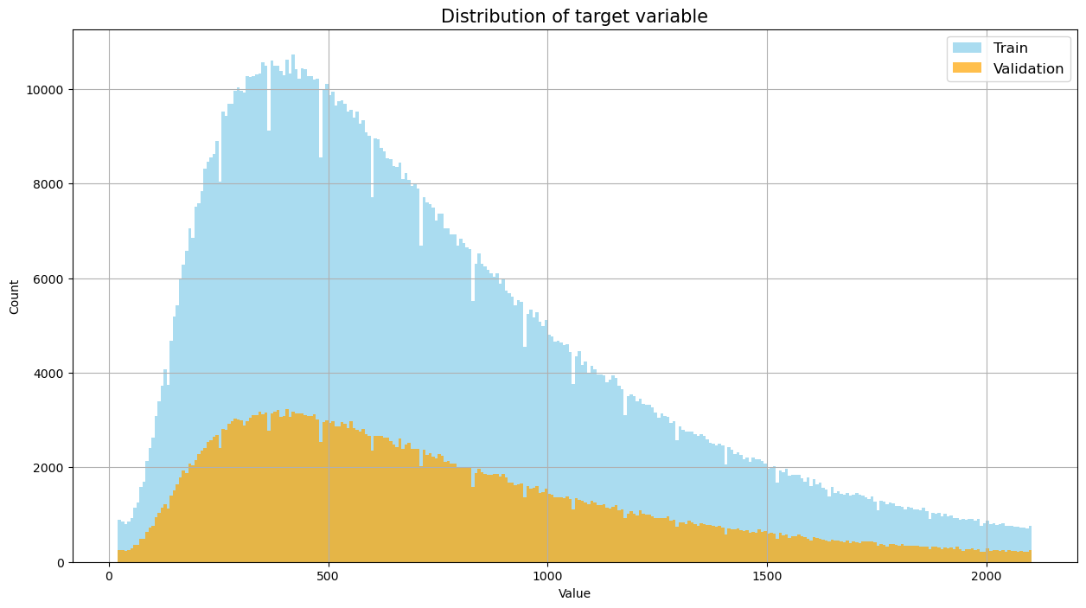
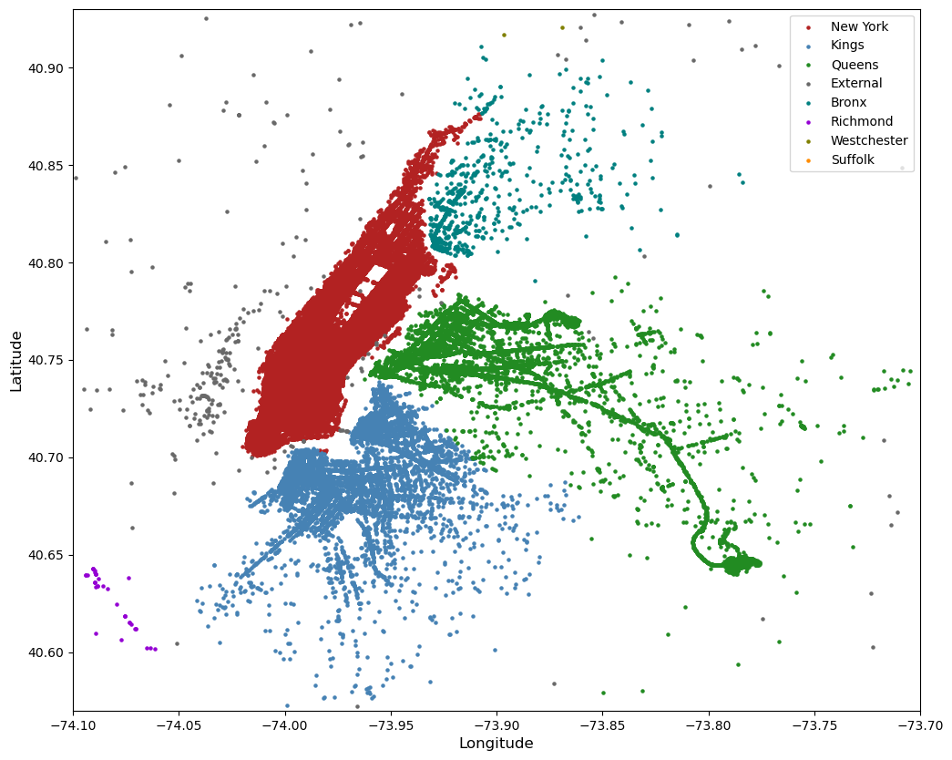
Solutions
The solutions that had been applied were:
Records that contained presumably wrong information regarding the trip duration have been removed.
Trips that presented a trip duration less than 10 seconds have been removed.
Geopositional data encoded in latitude and longitude have been converted to x,y,z format.
Datetime attribute has been used to extract other attributes like hour, weekday or not.
The distance between points has been calculated using the Manhattan distance.
Geospatial information regarding Counties has been incorporated in our Kaggle dataset.

Slide 5
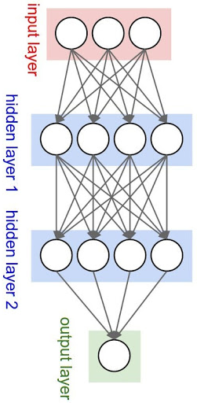
Methodological approach and evaluation
Given the large number of records, it was decided to use neural networks to solve the problem of predicting the taxi trip duration. The choice of the model and the hyperparameters was made after several empirical tests.

Slide 6
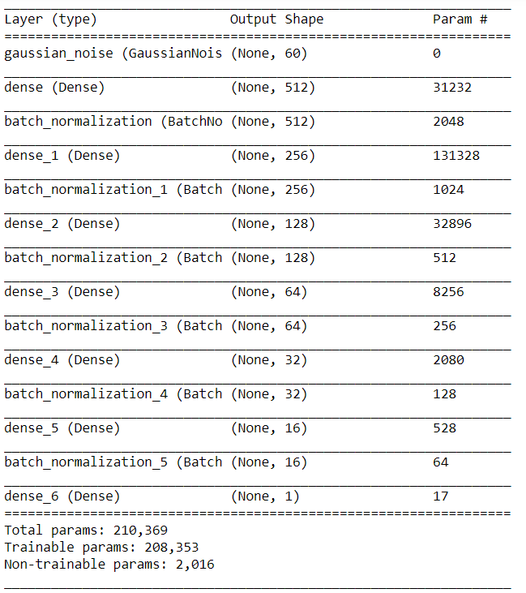
Best model: Model 1
This is model that resulted to be the best, in the end. It uses Dense layers, each with decreasing number of units and with the ReLU activation function, each followed by a BatchNormalization layer. This layer normalizes the results obtained from the previous dense layer, resulting in better and faster learning, and less overfitting.
This layers all follows a Gaussian Noise layer, with very small hyperparameter. This is because adding noise to an underconstrained neural network model can have a regularizing effect and reduce overfitting.

Slide 7
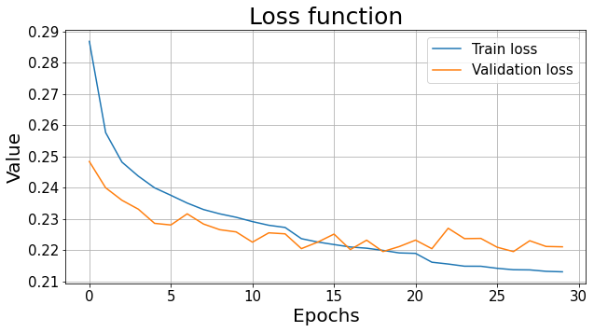
Results
The following graphs represent the loss function of the model and the scatter plot of the prediction against the real duration.

Slide 8
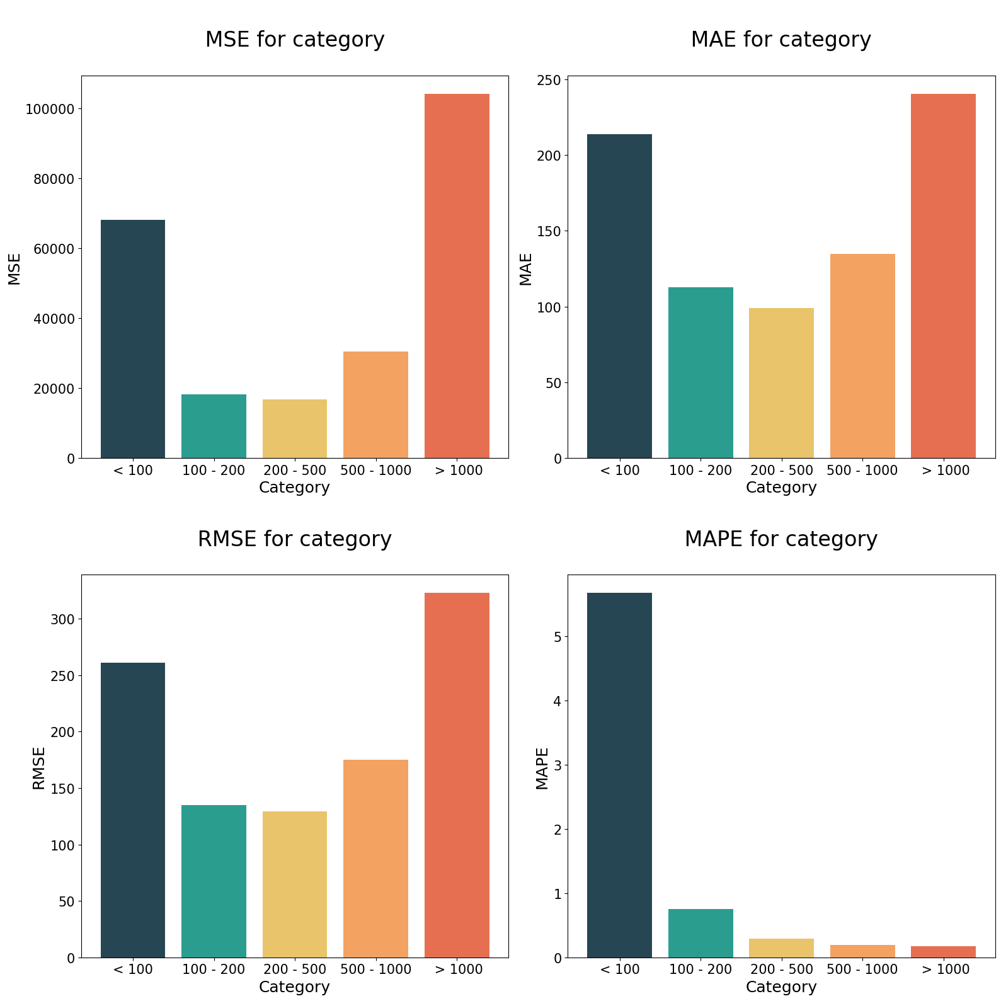
Results
The following graph shows the error divided by trip duration’s bin category

Slide 9
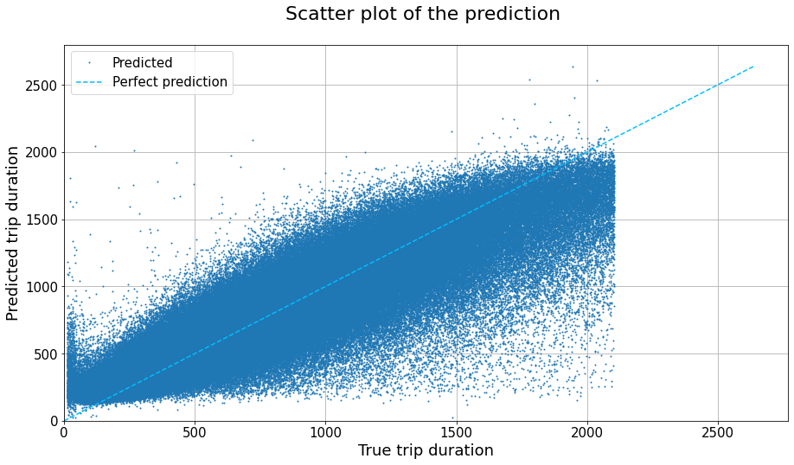
Results
The following graphs represent the loss function of the model and the scatter plot of the prediction against the real duration.

Slide 10
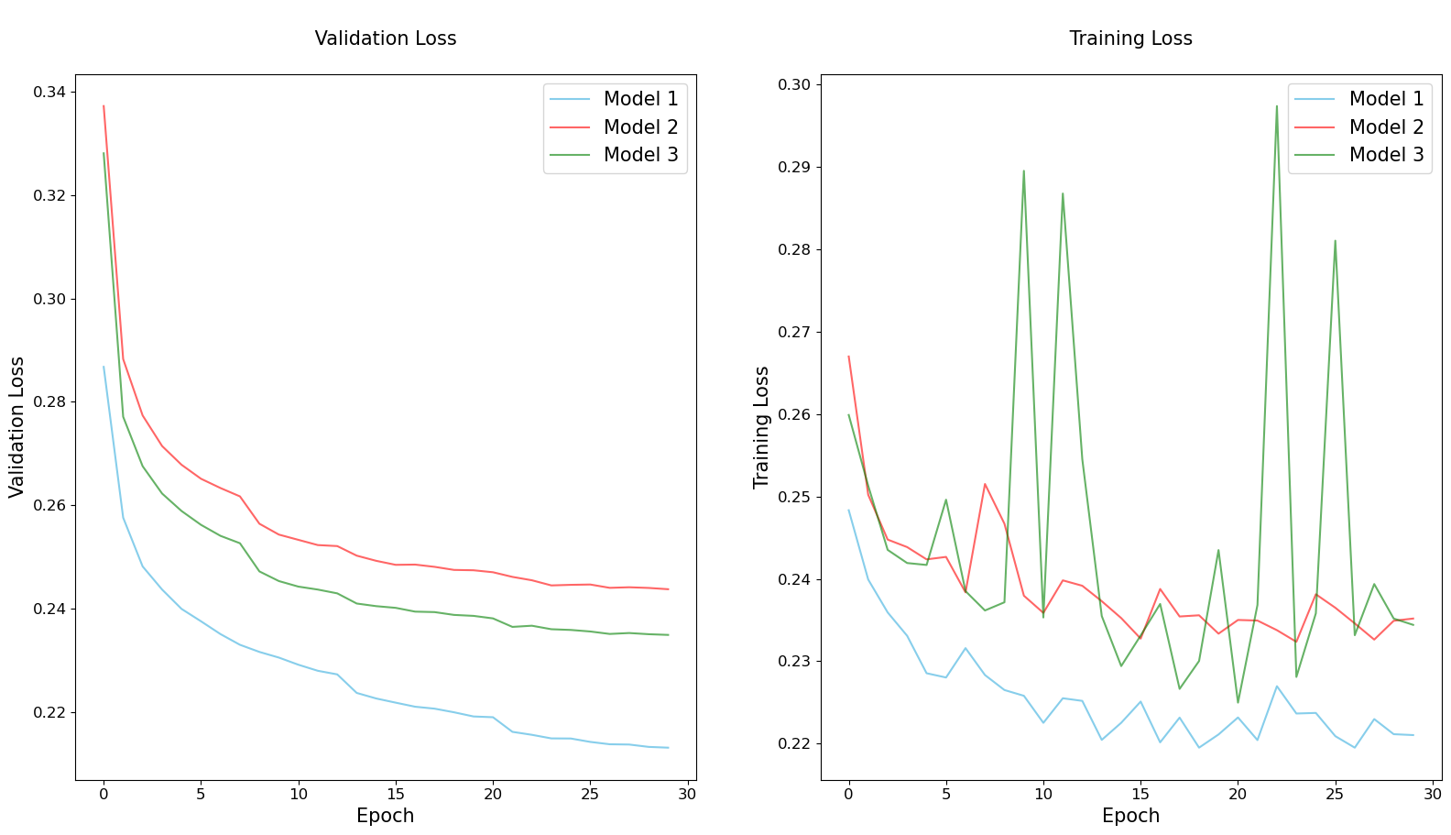
Comparison
The following graphs visualize the comparison between out top N models.

Slide 11
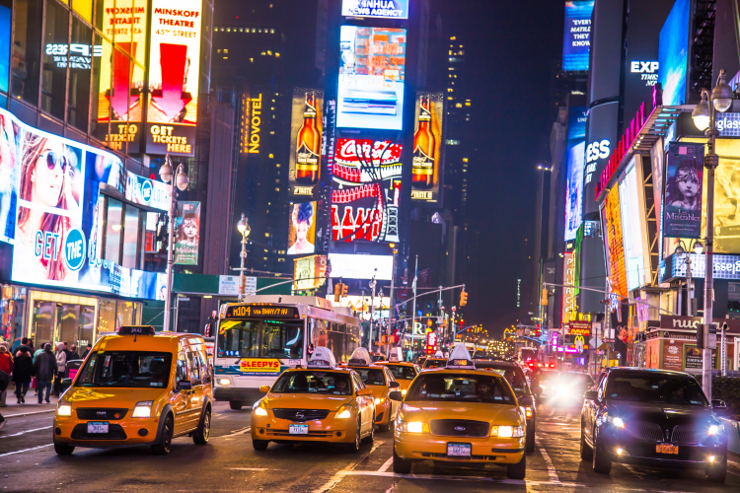
The approach applied gives good results.
In particular, the integration with geo-spatial data is important in order to consider different types of trips and also the outlier cut of too long trips and too short to be meaningful.
The models tried are quite complex but the best is the simplest one (5 layers instead of 7 layers),usually a simpler model avoids overfitting and is more robust.
The project could be improved in the future by adding some traffic information or based on this model bring a real-time one, that can be much more useful.
Conclusions
Image from https://fortune.com/2016/07/13/study-nyc-taxi-outperforming-uber/

Slide 12
Thank You
Christian Uccheddu - 800428
Federico De Servi - 812166
Image from https://fortune.com/2016/07/13/study-nyc-taxi-outperforming-uber/

