Slide 1

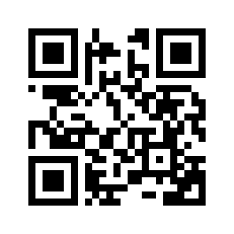
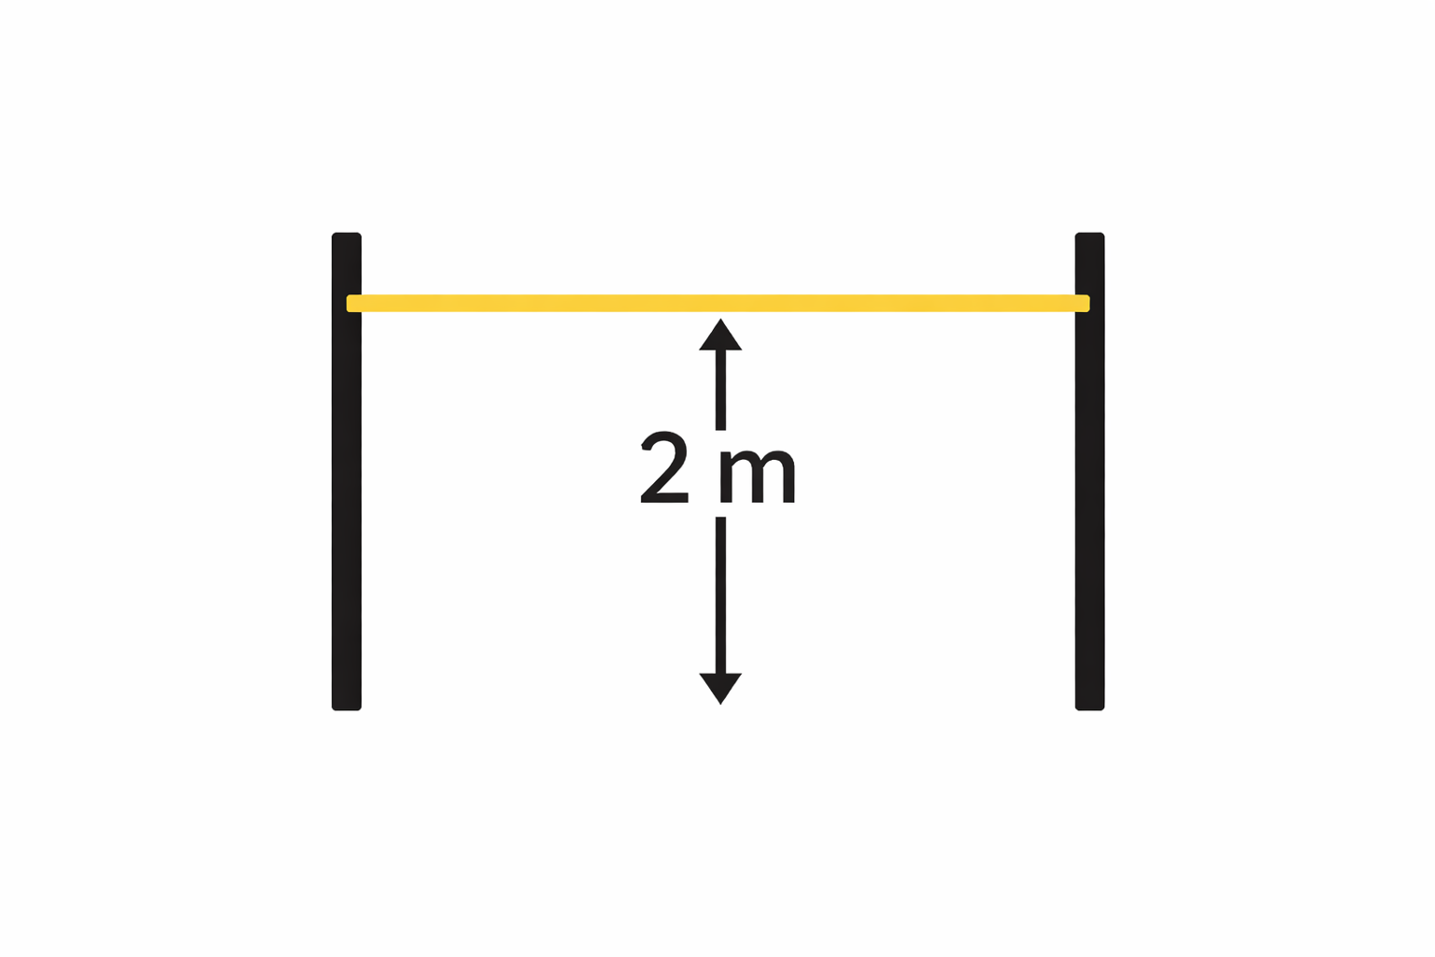
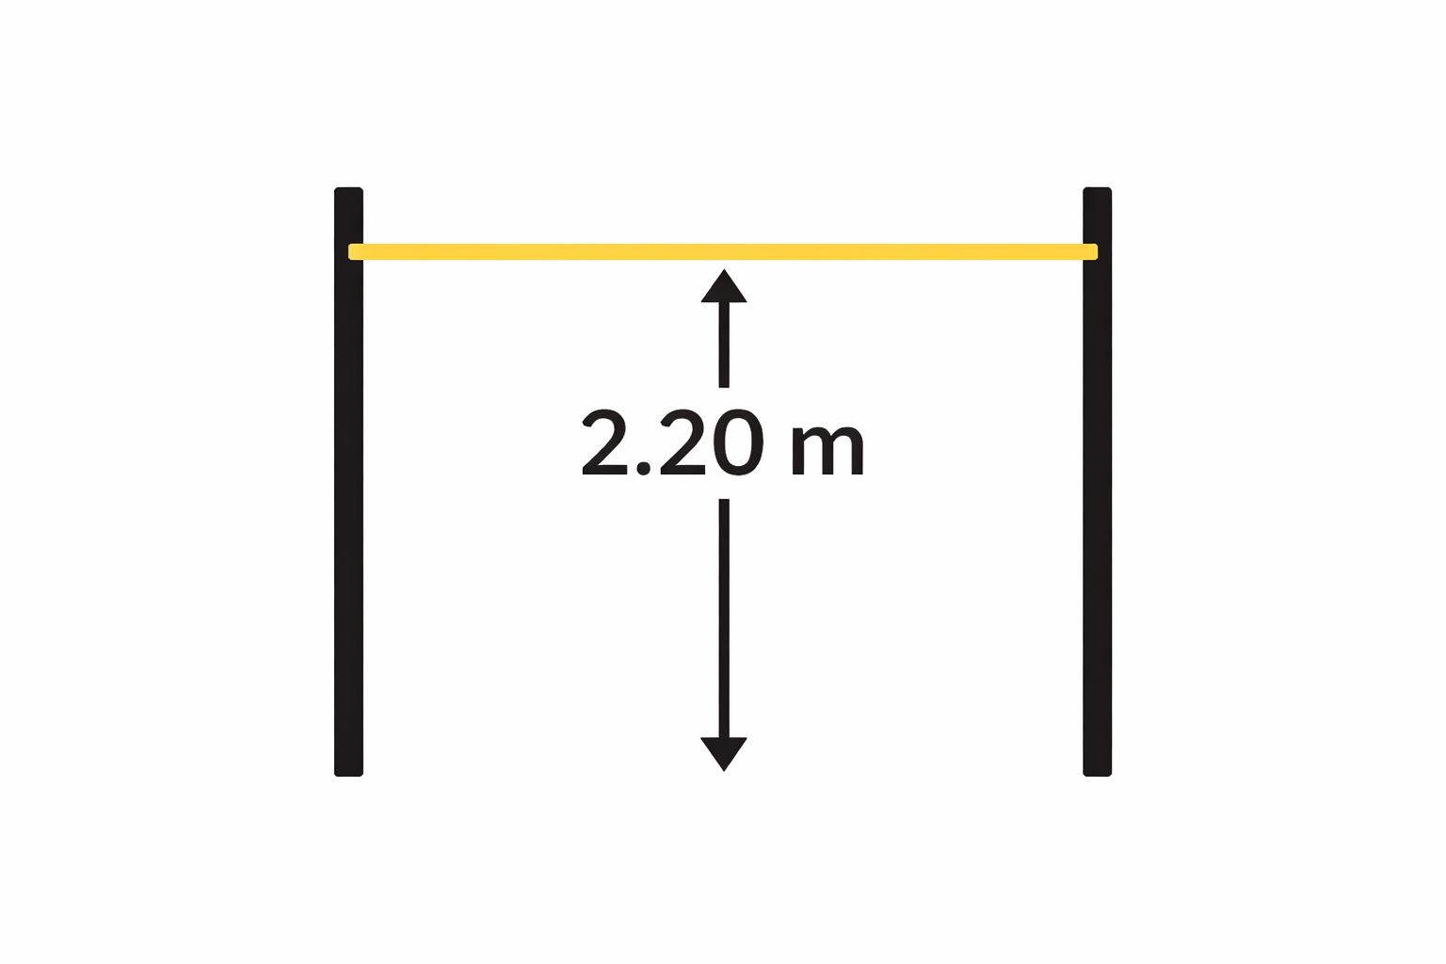

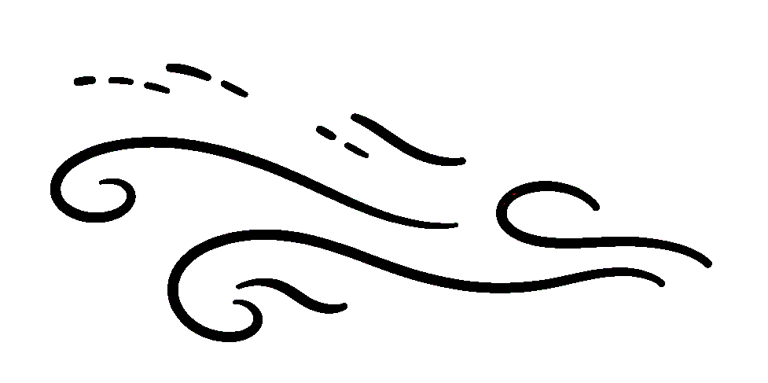


Tracking Adaptation Time:
Metrics for Temporal Distribution Shift
Seen this before
I can do it!
What is happening?
Consistent Out-Of-Distribution Test
Harder Out-Of-Distribution Test
Train
Lorenzo Iovine
lorenzo.iovine@polimi.it
Giacomo Ziffer
giacomo.ziffer@polimi.it
Emanuele Della Valle
emanuele.dellavalle@polimi.it
Streaming Continual Learning AAAI Bridge Singapore, January 21, 2026
Notes:
Let me start with an example.
Here we train a model on a given distribution, and then we evaluate in on data that are OOD. The key point is that not all OOD scenarios are the same.
In some cases, the OOD data are consistent with what the model has seen before: the distribution has shifted, but the model can reasonably adapt over time.
In other cases, the OOD data are harder: not only the distribution changes, but the problem itself has become more complex. In this scenarios, even a well-adapting model will struggle.
The issue is that, today, we usually treat all these cases simply as OOD, without distinguishing between them.

Slide 2
Tracking Adaptation Time:
Metrics for Temporal Distribution Shift
Existing evaluation metrics are unable to distinguish whether performance degradation over time is caused by increasing data difficulty or by insufficient model adaptation. This ambiguity limits our understanding of model behavior under temporal shift and hinders the design of adaptive learning algorithms.
Lorenzo Iovine
lorenzo.iovine@polimi.it
Giacomo Ziffer
giacomo.ziffer@polimi.it
Emanuele Della Valle
emanuele.dellavalle@polimi.it
Streaming Continual Learning AAAI Bridge Singapore, January 21, 2026
Notes:
This distinction is not just conceptual, but it clearly appears in real-world data.
Here, for example, we show a UMAP projection of the Yearbook dataset across different time period.
As time progresses, you can see that the feature representations of the classes start to overlap and intertwine much more.
This measn that the classification problem itself becomes harder over time: class are less separable, and the decision boundaries are more complex.
However, standard evaluation metrics such as ID and OOD accuracy cannot tell us why performance is decreasing, they only tell us that performance dropped.

Slide 3
Tracking Adaptation Time:
Metrics for Temporal Distribution Shift
Around 1970, a large apparent ID–OOD gap (99% vs. 77%) corresponds to a TAS of about 90%, indicating that the performance drop is largely due to intrinsic data difficulty rather than failure to adapt.
Lorenzo Iovine
lorenzo.iovine@polimi.it
Giacomo Ziffer
giacomo.ziffer@polimi.it
Emanuele Della Valle
emanuele.dellavalle@polimi.it
Streaming Continual Learning AAAI Bridge Singapore, January 21, 2026
Notes:
To address this ambiguity, we propose a set of post-hoc metrics that explicitly disentangle these two effects.
In this slide you can see one of them, called Temporal Adaptation Score.
It measures how much the performance gap to future data is recovered through adaptation, relative to what would be achievable if the model were trained directly on that future data.
On yearbook, around the 1970s, we observe a large gap between ID and OOD accuracy, about a 22% drop. However, the TAS in that period is still around 90%.
It means that the model does lose some perforamnce due to imperfect adaptation (around 10%), but a large part of the drop is actually due to the fact that the task itself has become much harder in those years.
If you are interested, I’ll be happy to discuss this in more detail during the poster session, where we can also show additional results and the other proposed metrics.

