Slide 1
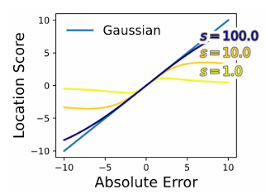
Online Continual Learning for Time Series: a Natural Score-driven Approach
Edoardo Urettini, Daniele Atzeni, Ioanna-Yvonni Tsaknaki , Antonio Carta
Online Time Series Forecasting (OTSF) requires
fast adaptation + long-term memory
Our contributions:
We prove optimality of natural gradient in non-stationary settings
We prove noise robustness with Student’s t likelihood
We propose NatSR
Natural Score-Driven Replay (NatSR)
1. Natural gradient (Fisher preconditioning)
2. Student’s t loss (bounded updates)
3. Experience Replay (stability)
4. Dynamic scale adaptation (plasticity)

