Slide 1
BIOINFORMATICS LAB
Episode I - Unix
Federico M. Giorgi, PhD
Department of Pharmacy and Biotechnology First Cycle Degree in Genomics

Slide 2

Course Layout
CFUs: 4
Hours: 60
Lessons: 15
Part I (~Days 1-8): Bioinformatics on Linux
Part II (~Days 9-15): Bioinformatics on R
TA: Chiara Cabrelle
Oral Exam

Slide 3
What is Bioinformatics?
Theory Course should Have taught you
Definition is not clear
My definition

Slide 4
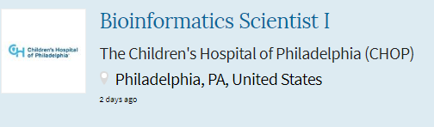
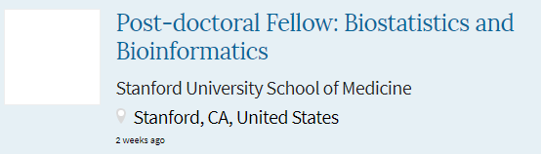
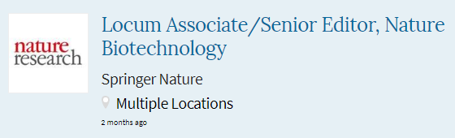
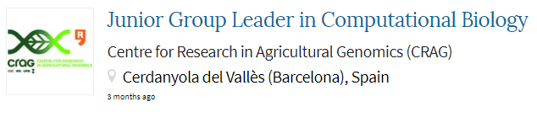

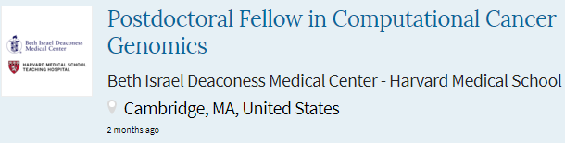
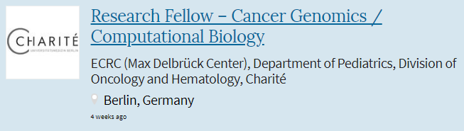
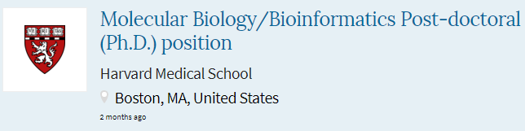
Purpose of this course
To turn you guys into hardcore hands-on Bioinformaticians
Biologists give you a task that requires computational skills? You can solve it.
You are a rock star. Get the show on. Get paid.
This is not about “classic” Bioinformatics (e.g. alignment algorithms from the 70s)
You will learn cutting edge tools that are used today in every Bioinformatics Labs in the World
Search for “Bioinformatics” found 950 jobs

Slide 5
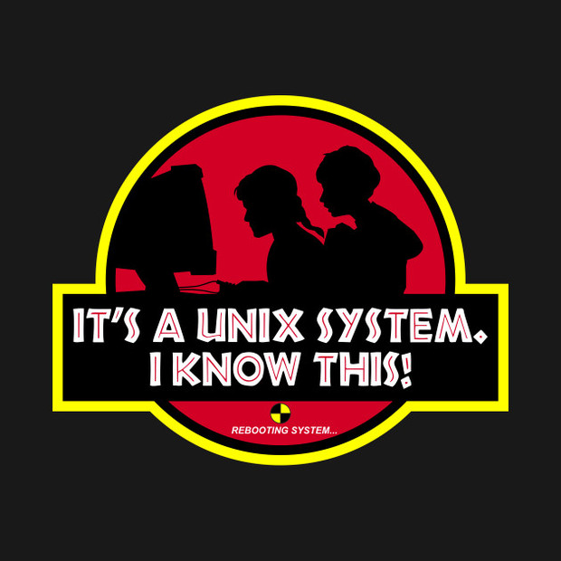

Slide 6

Unix
Why is Unix important for Bioinformatics?
Work on huge (>1GB) files
peek at them (head, tail, less, wc)
modify them (sed, vim)
mangle them (sort, cut)
Build simple and complex pipelines ( | )
Repeat custom analysis with one click
Most everyday bioinfo programs run only on Unix (samtools, hisat, blast)

Slide 7


Some History on Unix
Invented in 1969 by the Bell Labs research center
It comes from “Unics”
Uniplexed Information and Computing Service
Unix invented
Multi-tasking
Multi-Users
Hierarchical file system (directories)
Multi-platform
Linux is Unix
Linux is a modified highly successful Unix developed by Linus Torvalds
Several Unix distributions:

Slide 8




Some History on Unix
Invented in 1969 by the Bell Labs research center
It comes from “Unics”
Uniplexed Information and Computing Service
Unix invented
Multi-tasking
Multi-Users
Hierarchical file system (directories)
Multi-platform
Linux is Unix
Linux is a modified highly successful Unix developed by Linus Torvalds
Several Unix distributions:

Slide 9





Some History on Unix
Invented in 1969 by the Bell Labs research center
It comes from “Unics”
Uniplexed Information and Computing Service
Unix invented
Multi-tasking
Multi-Users
Hierarchical file system (directories)
Multi-platform
Linux is Unix
Linux is a modified highly successful Unix developed by Linus Torvalds
Several Unix distributions:

Slide 10




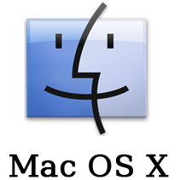

Some History on Unix
Invented in 1969 by the Bell Labs research center
It comes from “Unics”
Uniplexed Information and Computing Service
Unix invented
Multi-tasking
Multi-Users
Hierarchical file system (directories)
Multi-platform
Linux is Unix
Linux is a modified highly successful Unix developed by Linus Torvalds
Several Unix distributions:

Slide 11
Let’s try Unix
Some ways to run Unix:
Install it on your PC or server (hardcore)
Install it on your PC alongside Windows (dual-boot)
Mac-OS X is a Unix-like system, most commands will work in its terminal
Install it inside Windows (Microsoft Store introduced it in 2018)
Virtualization (VMWare, VirtualBox)

Slide 12
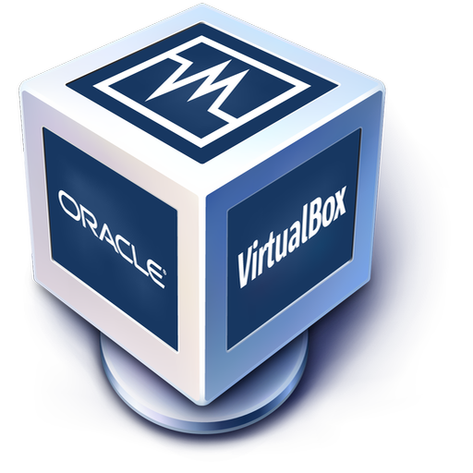
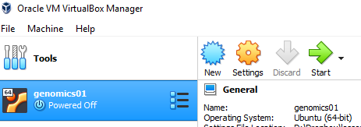
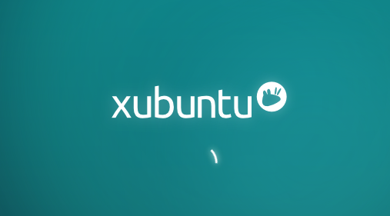
Let’s turn Unix On
Click on Oracle VM VirtualBox Manager
Start it!
Ignore warnings!
You should see this:

Slide 13
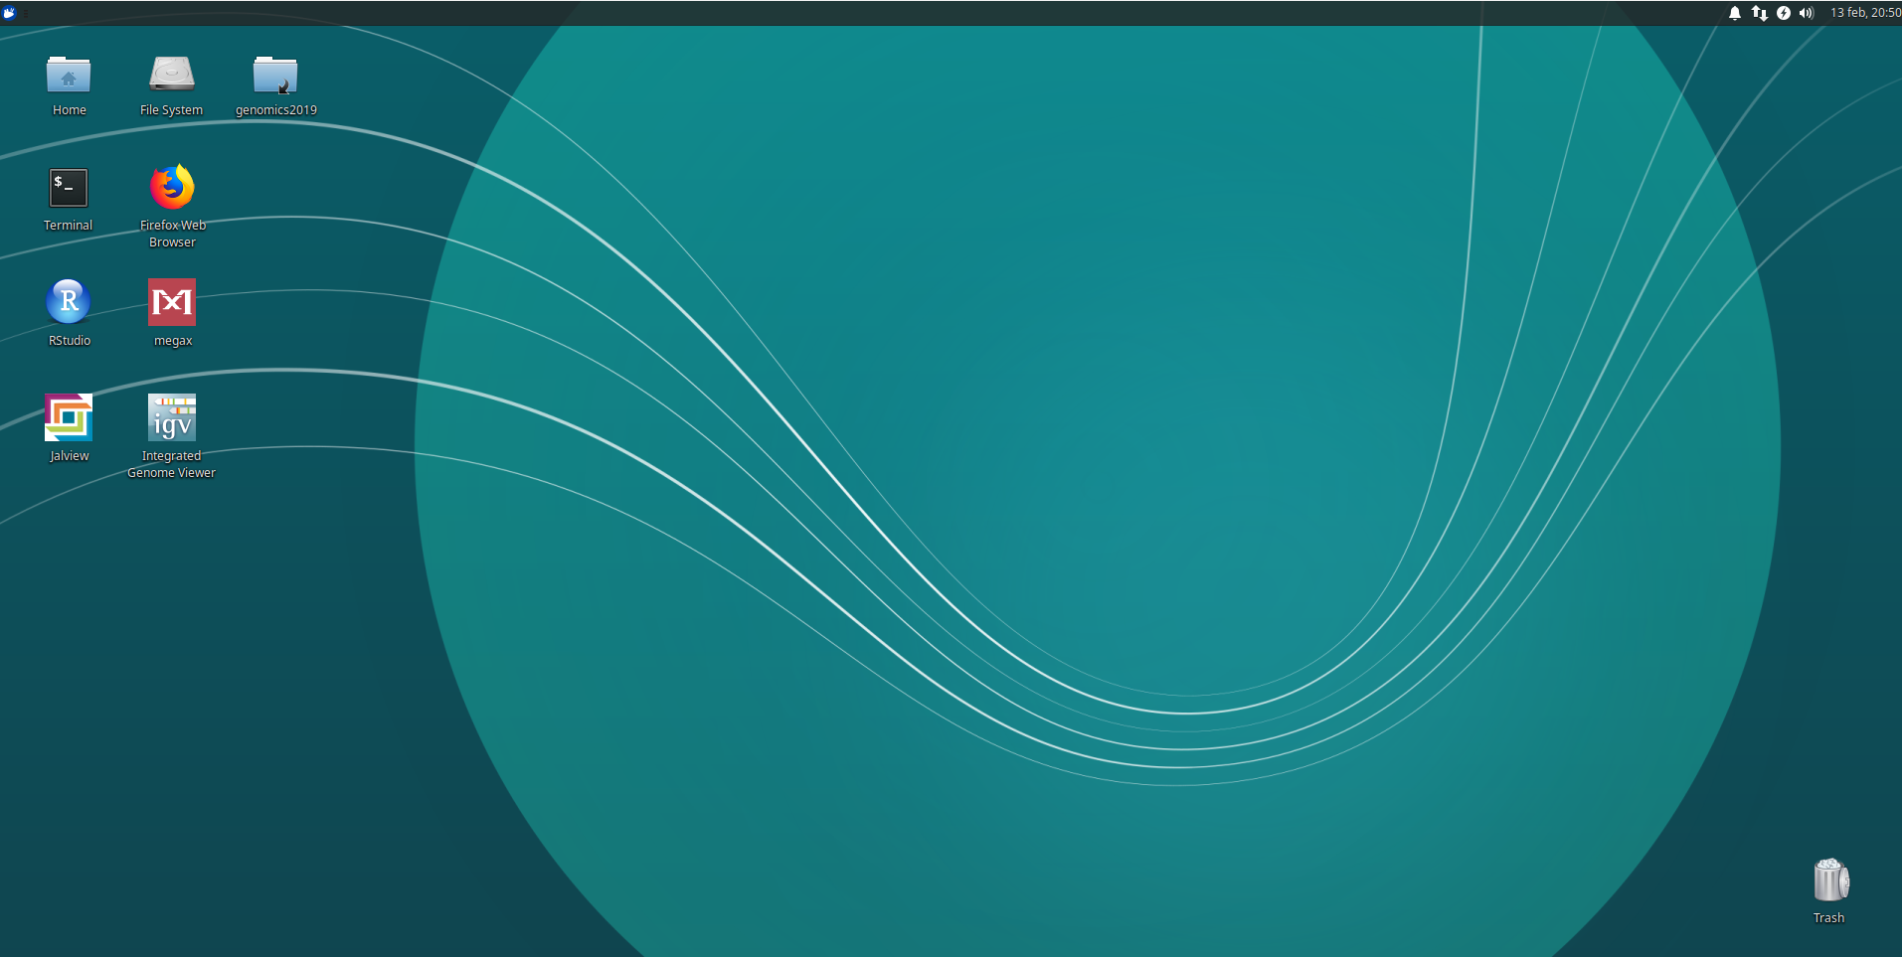
Welcome to Unix!

Slide 14
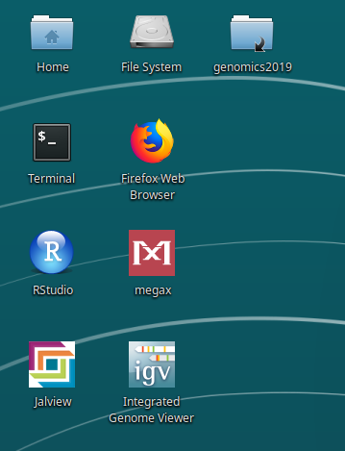
Your Unix Environment
The whole file system
Tech Guru Info
Xubuntu 18.04.1 with Guest Additions
running onVirtualBox 6.4.0
userid student
password 4genomics4
You can break it, but please don’t

Slide 15
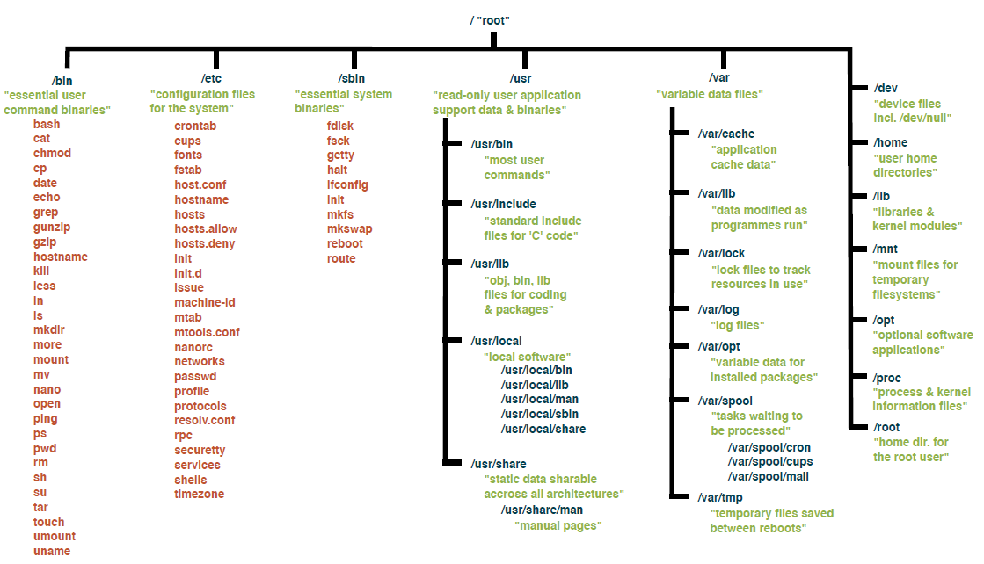
Your Unix File System

Slide 16
Your Unix Environment
Your personal space, the Home File System
Tech Guru Info
Xubuntu 18.04.1 with Guest Additions
running onVirtualBox 6.4.0
userid student
password 4genomics4
You can break it, but please don’t

Slide 17
Your Unix Environment
The Course Folder
Tech Guru Info
Xubuntu 18.04.1 with Guest Additions
running onVirtualBox 6.4.0
userid student
password 4genomics4
You can break it, but please don’t

Slide 18
Your Unix Environment
Tools we will use in the next days
Tech Guru Info
Xubuntu 18.04.1 with Guest Additions
running onVirtualBox 6.4.0
userid student
password 4genomics4
You can break it, but please don’t

Slide 19
Your Unix Environment
The Terminal
The Terminal is a Unix shell
Command-line environment
Not a Graphical User Interface Environment
Double click on it!
Tech Guru Info
Xubuntu 18.04.1 with Guest Additions
running onVirtualBox 6.4.0
userid student
password 4genomics4
You can break it, but please don’t

Slide 20
Basic UNIX Commands
cd
Ls

Slide 21
Play with files
cd
ls

Slide 22
Turn Unix off CORRECTLY
Please
Please turn it off nicely

Slide 23
Federico M. Giorgi, PhD
Department of Pharmacy and Biotechnology
federico.giorgi@unibo.it

