Slide 1
Correctness of LSTM BPTT
MNIST time steps – input dim – update counts | My code | Pytorch
28 – 28 – 1 | 94% | 98%
784 – 1 – 28 | 78% | 96%

Slide 2
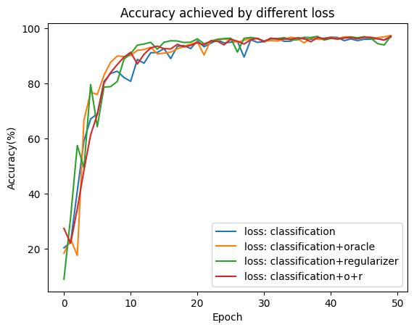
Effect of FPTT
(by the code of Kag at el)
Removed techniques: Dropout, weight_norm_clip
S-MNIST

Slide 3
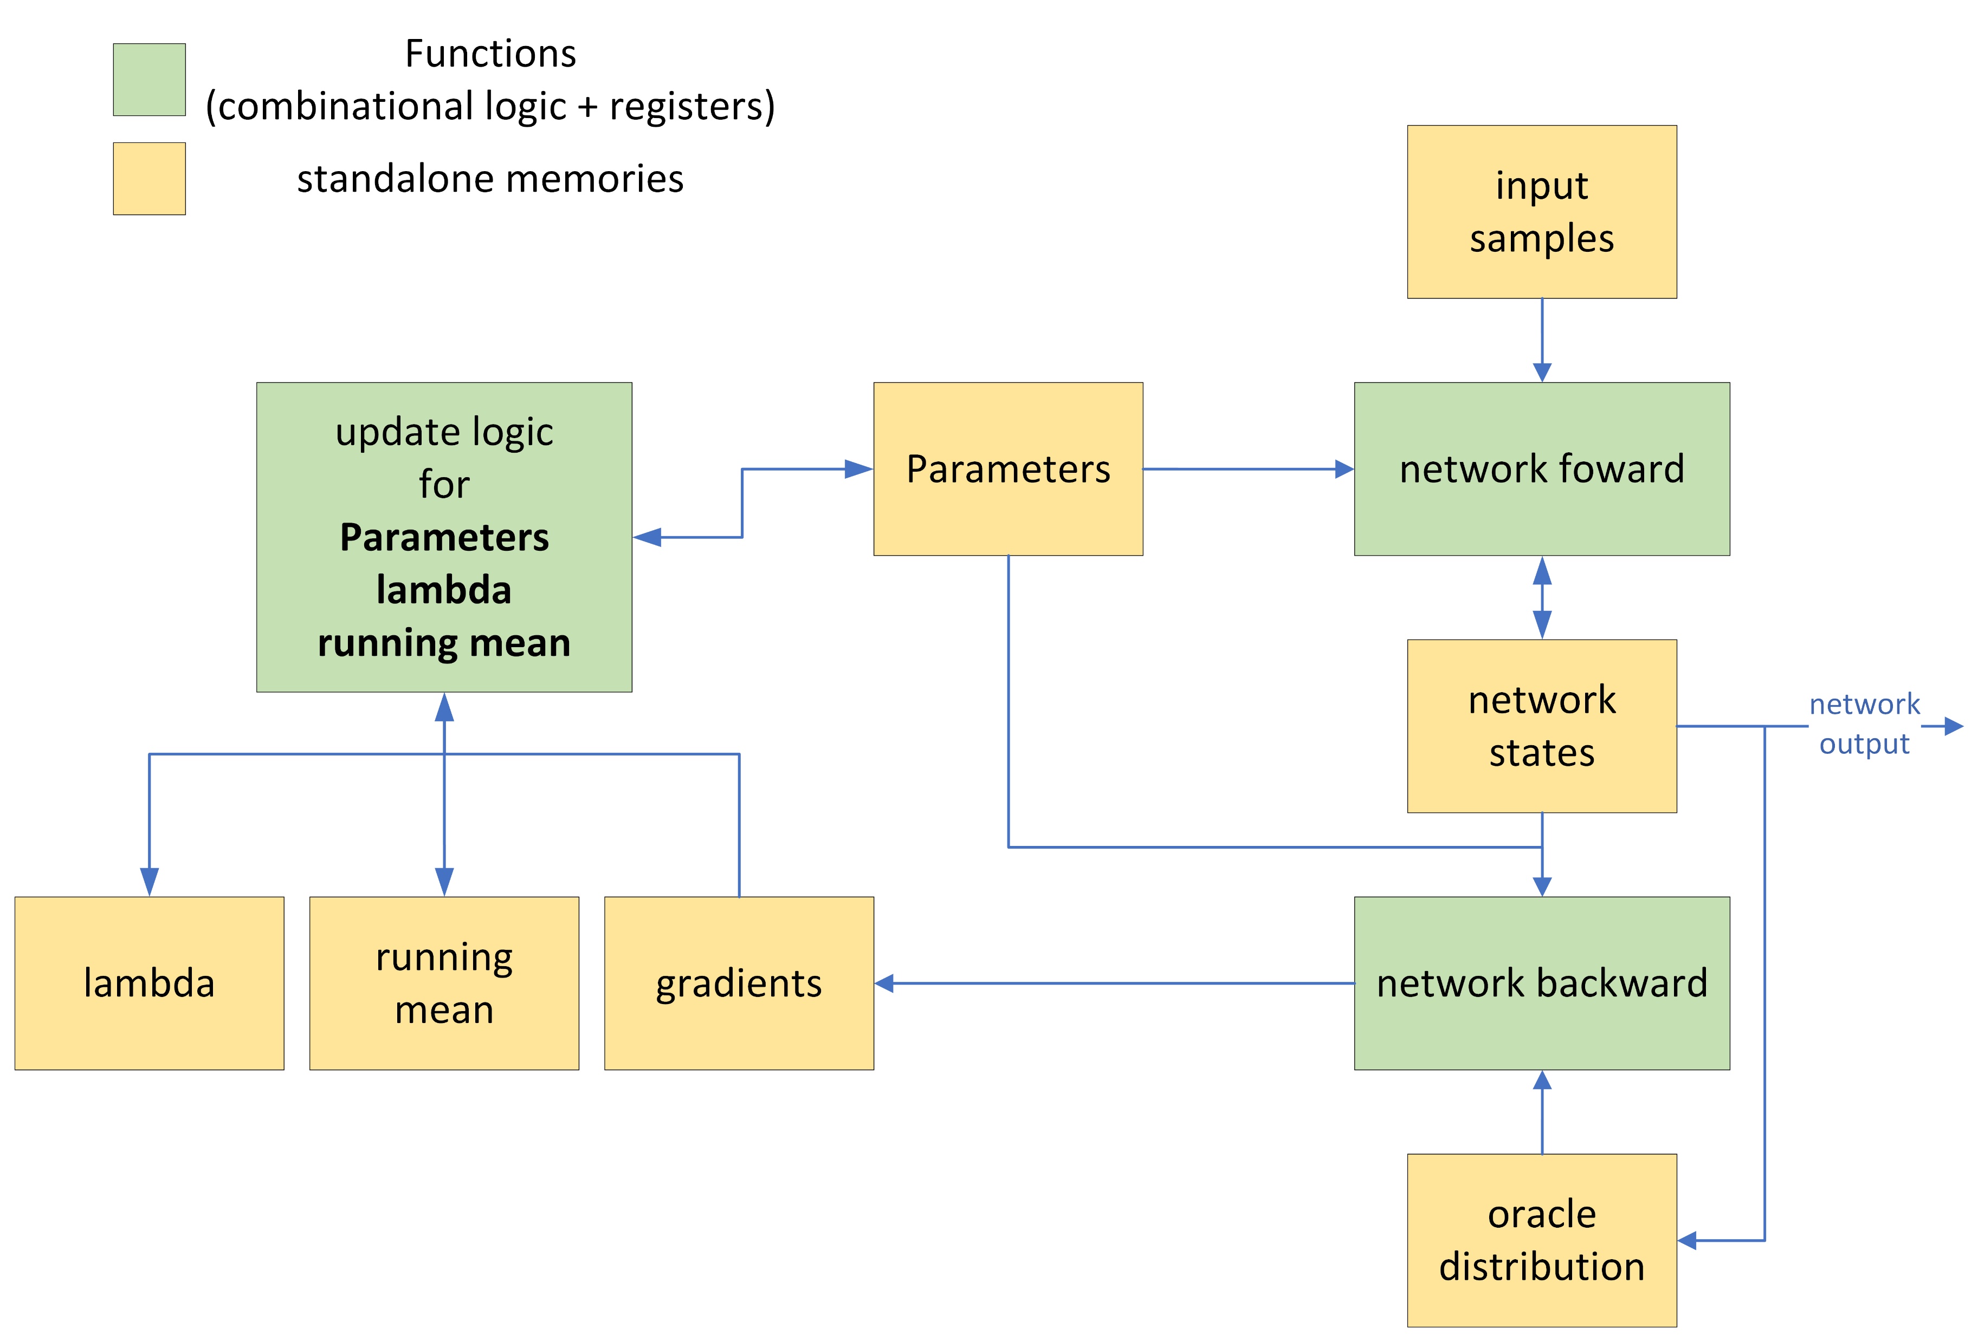
Generic Block Diagram
(tentative)
Training Flow
(Scheduler)
Forward
Backward: clf + oracle
Update parameters
Update lambda
Update running mean

Slide 4
Memory Estimation
Assumption:
LSTM on fully flattened MNIST
FPTT-28 (save states of 28 time steps)
Batch size is 1
each element is float32 (4 Bytes)
Name | Size | Note
Parameters Memory | 265 KB | ((128*1+128*128+128)*4+(10*128+10))*4B
Lambda Memory | 265 KB
Running Mean Memory | 265 KB
Gradients Memory | 265 KB
Input Sample Memory | 4 B | One pixel
Oracle Label Memory | 400 B | N_classes*N_classes*4Bytes
Forward Registers | 142 KB | Depends on how pipeline is designed 28 *(128*10+10*2)*4 Bytes
Backward Registers | 5 KB | Depends on how pipeline is designed (128*10 + 10*1)*4Bytes
Total | ~ 1.2 MB

Slide 5

Recap: FPTT calculation
Parameters -= lr * (gradient – Lambda + α *(Parameter – RunningMean))
Lambda -= α * (Parameter – RunningMean)
RunningMean = ½(RunningMean + Parameter) – 1/(2 α) * Lambda
Main Point: operations are done locally -> huge parallelization to be used
Parameter, Lambda, Running Mean, and Gradient are of the same size
All operations between matrices are element-wise (Hadamard product)
Element-wise operations enables Locality

Slide 6
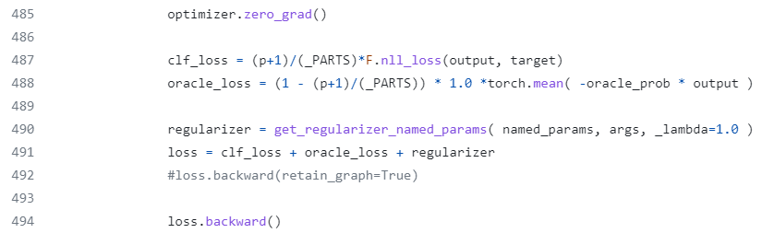
The effect of oracle loss and regularizer (running mean)
Check the effect of each loss component: Try different combinations in line 491
loss = clf_loss
loss = clf_loss + oracle_loss
loss = clf_loss + regularizer
loss = clf_loss + oracle_loss + regularizer

Slide 7
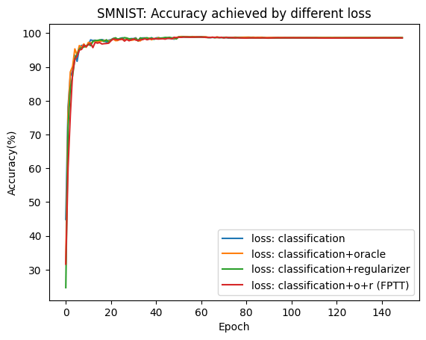
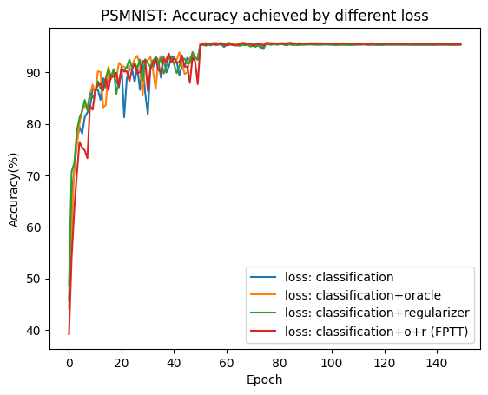
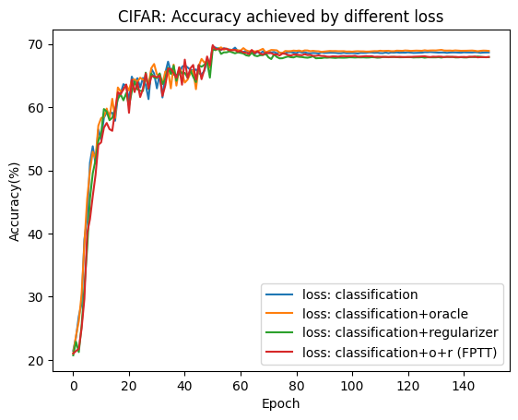
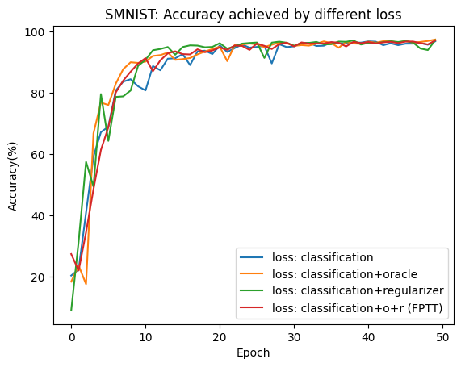
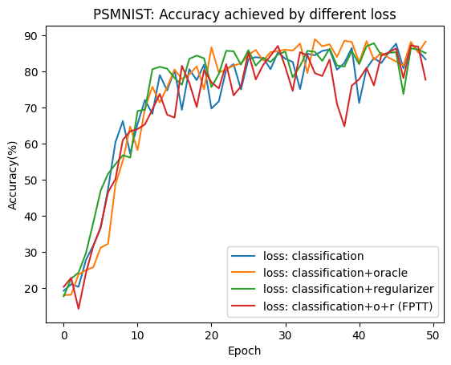
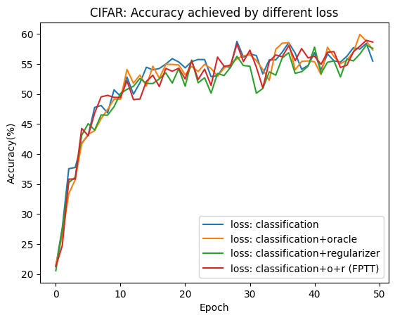
The effect of oracle loss and regularizer (running mean) -- result
SMNIST 784 (28x28)
PSMNIST 784 (28x28)
CIFAR 1024 (32x32)
K=10
150 epochs
K=28/32
50 epochs
Larger K means more frequent weight update (memory access) -> takes more time (seconds per epoch)

Slide 8
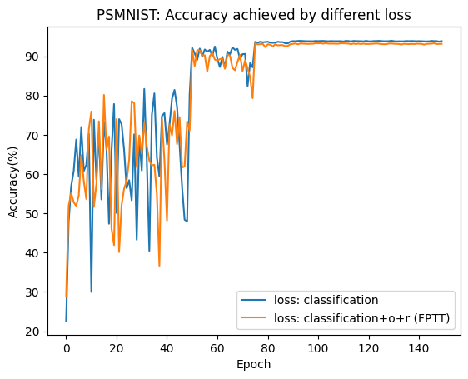
The effect of oracle loss and regularizer (running mean) -- result
K=56
150 epochs

Slide 9
Changes on plan
FPTT: online formulation + extra constraint
Online formulation:
Break the long sequence into smaller ones, update the weights after BPTT on each sub-sequence
Straightforward and intuitive idea, no hard mathematics involved
Main contributor in the FPTT theory
Extra constraint:
Is expected to be a further correction/improvement on the plain online formulation
Built with fancy math foundation
Seems not working (to be confirmed further)
If regularizer (running mean) is indeed useless, it becomes simpler but less interesting
Hardware acceleration of forward (plenty of examples)
Hardware acceleration of backward (next slide)
BPTT online is essentially BPTT, though with shorter sequences

Slide 10
Can online formulation make BPTT suitable with hardware acceleration?
 | BPTT online vs BPTT
Computation | Close
Memory requirement | Much smaller
Energy | Much more because of frequent data moving (weight update)
Logic Area | same
Accuracy | Can be improved if the sequence length is long

Slide 11
TTA (Transport Triggered Architecture)
Flexible with cost like instruction pipeline
Stands somewhere between fixed data path and general purpose architecture
User can develop and integrate any function units
TTA-based Co-design Environment (TCE)
Design hardware block, add support in compiler, and then design program

