Slide 1
Intrusion Detection Sytems
What is an IDS?
  Definition
  Characteristics
  Examples of existing IDS
Strengths/weaknesses of IDS

Slide 2
What is an IDS?
Definition:
  A piece of software
  Monitors a computer system to detect:
    Intrusion: unauthorized attempts to use the system
    Misuse: abuse of existing privileges
  Responds:
    Log activity
    Notify a designated authority
    Take appropriate countermeasures

Slide 3
Why Use an IDS?
Security is often expensive/cumbersome:
  Cost
  Restrictions on users/functionality
Designers try to offer users “reasonable” levels of security
Security breaches will still occur
Detection allows:
  Finding and fixing the most serious security holes
  Perhaps holding intruders responsible for their actions
  Limiting the amount of damage an attacker can do

Slide 4
Goals of an IDS
Run continually
Be fault tolerant
Resist subversion
Minimize overhead
Be easily configurable
Cope with changing system behavior
Be difficult to fool
  Minimize false positives and false negatives

Slide 5
IDS Characteristics
Detection Model
  Misuse detection vs. anomaly detection
Scope
  Host based, multihost based, network based
Operation
  Off-line vs. real-time
Architecture
  Centralized vs. distributed

Slide 6
IDS Detection Model
Misuse detection - recognize known attacks
  Define a set of attack signatures
  Detect actions that match a signature
  Add new signatures often
  Examples: ARMD, ASIM, Bro, CSM, CyberCop, GRIDS, Stalker, Tripwire
Anomaly detection - recognize atypical behavior
  Define a set of metrics for the system
  Build a statistical model for those metrics during “normal” operation
  Detect when metrics differ significantly from normal
  Examples: AAFID, MIDAS, NADIR, UNICORN
Hybrid
  Examples: CMDS, DIDS, EMERALD, INBOUNDS, NIDES, RealSecure

Slide 7
IDS Scope
Host based
  Scrutinize data from a single host
  Examples: ARMD, MIDAS, Tripwire
Multihost based
  Analyze data from multiple hosts
  Examples: AAFID, DIDS, CMDS, CSM, NIDES, Stalker
Network based
  Examine network traffic (and possibly data from the connected hosts)
  Examples: ASIM, Bro, CyberCop, EMERALD, GRIDS, INBOUNDS, NADIR, RealSecure, UNICORN

Slide 8
IDS Operation
Off-line
  Inspect system logs at set intervals
  Report any suspicious activity that was logged
  Examples: ASIM, NADIR, Stalker, Tripwire
Real-time
  Monitor the system continuously
  Report suspicious activity as soon as it is detected
  Examples: AAFID, ARMD, Bro, CMDS, CSM, CyberCop, DIDS, EMERALD, GRIDS, INBOUNDS, MIDAS, NIDES, RealSecure, UNICORN

Slide 9
IDS Architecture
Centralized
  Data collected from single or multiple hosts
  All data shipped to a central location for analysis
  Examples: ARMD, ASIM, Bro, CMDS, CSM, CyberCop, DIDS,
  MIDAS, NADIR, NIDES, RealSecure, Stalker, Tripwire, UNICORN
Hierarchical
  Data collected from multiple hosts
  Data is analyzed as it is passed up through the layers
  Examples: EMERALD, INBOUNDS
Distributed
  Data collected at each host
  Distributed analysis of the data
  Examples: AAFID, CSM, GRIDS

Slide 10
Case Study: Tripwire
A file integrity-checking tool
  Developed at Purdue university (released in 1993)
  Off-line, centralized, host-based, misuse detection
  Utilizes digital signatures to check for added, deleted, modified files
  Popular
    Portable
    Configurable
    Scalable
    Manageable
    Automated
    Secure

Slide 11
Background – File Systems
Provide long-term storage for:
  User data and programs
  System programs and databases
A popular target for attackers:
  Unauthorized access to user or system files to uncover private information
  Modify system databases to allow future entry (e.g. /etc/passwd)
  Modify system programs to allow future entry (e.g. back doors)
  Cleansing of system logs to thwart detection

Slide 12
Tripwire - Overview
A checklist is created which contains one entry for each file being monitored
Checklist should:
  Be secure against unauthorized modifications
Each entry in the checklist is a fingerprint for the corresponding file
Fingerprints should:
  Be efficient to compute
  Be hard to invert
  Depend on the entire contents of the file
  Be very likely to change if the file changes
  Be very unlikely to match fingerprints from other files

Slide 13
Tripwire – Overview (cont)
generate
New database
compare
Apply masks
Report
Config file
Old database
Files residing on file system

Slide 14
Tripwire Database
Unencrypted and world-readable
To prevent the database from being tampered with, it is recommended it be:
  Installed and updated in a secure manner (e.g. single-user mode)
  Stored either:
    On a read-only media
    On a write-protected disk
    On a “secure server” (e.g. read-only NFS)

Slide 15
Tripwire Configuration Files
Contains:
  A list of directories (or files) to be monitored
  A mask for each that describes which attributes can change without being reported
Mask bits (all fields stored in a file’s inode):
  p: permissions
  i: inode number
  n: number of links
  u: user id
  g: group id
  s: size of file
  m: modification timestamp
  a: access timestamp
  [1-10]: signature #1, signature #2, etc.
    Signature algorithms supported (MD5, MD4, MD2, Snefru, SHA, CRC-32, CRC-16)

Slide 16
Tripwire Configuration Files (cont)
Using masks:
  Fields can be added (“+”) or subtracted (“-”) from the set of items to be examined for a file
  Example: +pinugsm12-a = report changes to all fields except access timestamp
Mask templates:
  R = +pinugsm12-a = read-only files; only access timestamp is ignored
  L = +pinug-sma12 = log files; changes to file size, access time, modification time, and signatures are ignored
  N = +pinugsma12 = ignore nothing
  E = -pinugsma12 = ignore everything

Slide 17
Tripwire Configuration File - Example
# file/dir mask
/etc R # all files under /etc are read-only
@@ifhost solaria.cs.purdue.edu
!/etc/lp # except for printer logs
@@endif
/etc/passwd N # ignore nothing
/etc/motd L # log file
=/var/tmp R # only the directory, not its contents

Slide 18
Tripwire - Overview
generate
New database
compare
Apply masks
Report
Config file
Old database
Files residing on file system

Slide 19
Tripwire Reports
New database is computed and compared with the old one
Any differences are passed through the masks in the configuration file
If not masked out differences are written to a report:
Changed: -rw-r—r– root 20 Sep 17 13:46:43 1993 /.rhosts
### Attr Observed Expected
### === ======= =======
m Fri Sep 17 13:46:43 1993 Tue Sep 14 20:05:10 1993
a Fri Sep 17 13:46:43 1993 Tue Sep 14 20:05:10 1993

Slide 20
Limitations of Host Based Intrusion Detection
No global knowledge or context information
Must run IDS on host being monitored
  Overhead
  Host compromise = IDS compromise
Recovery options are limited

Slide 21
NIDES
A collection of target hosts collect system audit data and transfer it to a NIDES host for analysis and intrusion detection
Developed at SRI International (released in 1994)
Real-time, centralized, multihost-based anomaly and misuse detection
Next-generation Intrusion Detection Expert System (NIDES) – a follow-on to SRI’s Intrusion Detection Expert System (IDES)

Slide 22
NIDES - Overview
Data collection is performed by target hosts connected by a network
  Agend daemon started on each target host a boot time
    Receives requests to start and stop the agen process on that host
  Agen process:
    Collects system audit data
    Converts it into a system-independent format
    Sends it to the arpool process on the NIDES host
Data analysis is performed on a NIDES host (which is not monitored)
The arpool process collects audit data from the target hosts and provides it to the analysis components
  Statistical analysis component (anomaly)
  Rulebased analysis component (misuse)

Slide 23
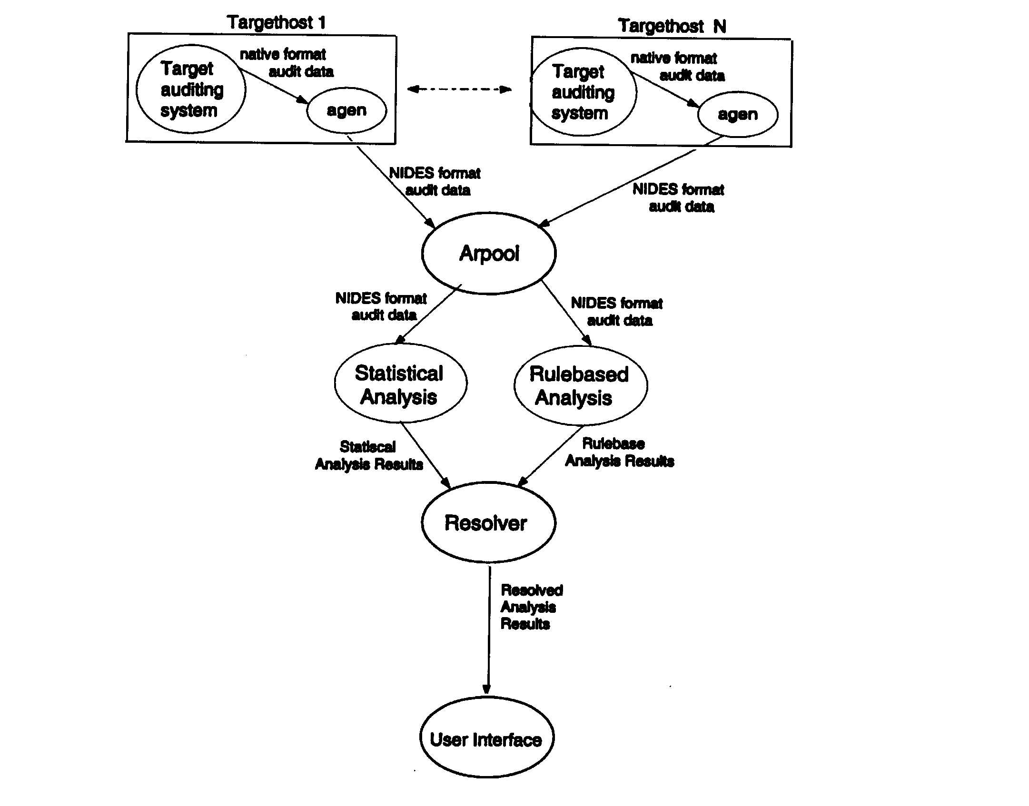
NIDES – Overview (cont)

Slide 24
NIDES – Statistical Analysis
Adaptive historical profiles for each “user” are maintained
  Updated regularly
  Old data “aged” out during profile updates
Alert raised whenever observed behavior differs significantly from established patterns
  Parameters and thresholds can be customized

Slide 25
NIDES – Rulebased Analysis
NIDES comes with a basic rulebase for SUN UNIX
  Encoded in rulebase:
    Known attacks and intrusion scenarios
    Specific actions or patterns of behavior that are suspicious or known security violations
  Expert system looks for matches between current activity and rules in the rulebase and raises alerts
Rulebase can also be extended and updated by sites using NIDES

Slide 26
NIDES – Resolver
Filters alerts to:
  Remove false alarms
  Remove redundancies
  Direct notification to the appropriate authority

Slide 27
Limitations of Multihost Based Intrusion Detection
Much larger volume of data
No information about communications:
  Data
  Patterns
Centralized detection might be fooled by data cleansing
Distributed detection might be fooled by lack of agreement

Slide 28
Limitations of Network Based Intrusion Detection
Network data rates are very high
Encryption of network traffic is becoming more popular
Switched environments are becoming more popular
Difficult to insure that network IDS sees the same data as the end hosts

Slide 29
Summary
An Intrusion Detection System (IDS) is a piece of software that monitors a computer system to detect:
  Intrusion (unauthorized attempts to use the system) and misuse (abuse of existing privileges)
And responds by:
  Logging activity, notifying a designated authority, or taking appropriate countermeasures
Many different IDSs are available and they can be categorized according to their:
  Detection model (misuse detection, anomaly detection, hybrid)
  Scope (host based, multihost based, network based)
  Operation (off-line vs. real-time)
  Architecture (centralized, hierarchical, distributed)

