Slide 1

History of GNOME
Jonathan Blandford
David Mason
Federico Mena-Quintero

Slide 2
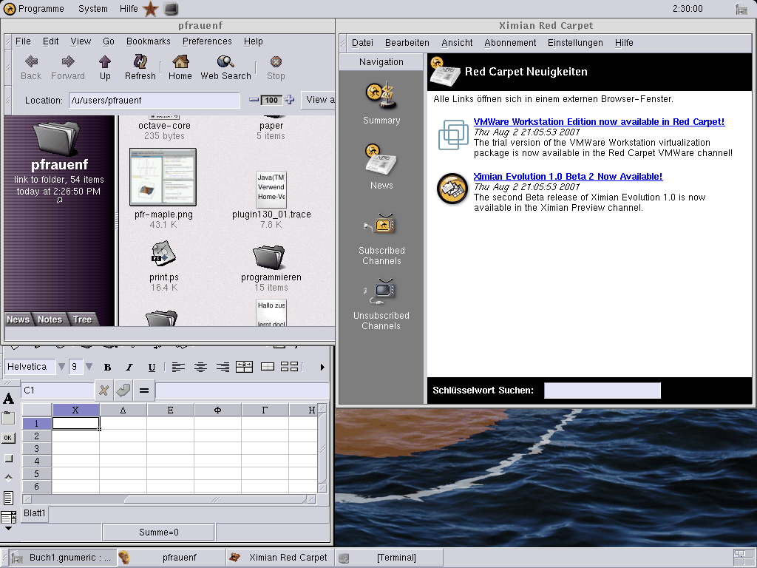
GNOME 1.2

Slide 3
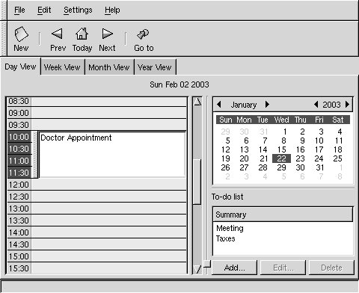
gnomecal

Slide 4
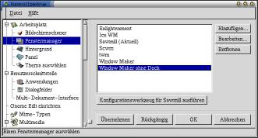
gnome-control-center

Slide 5
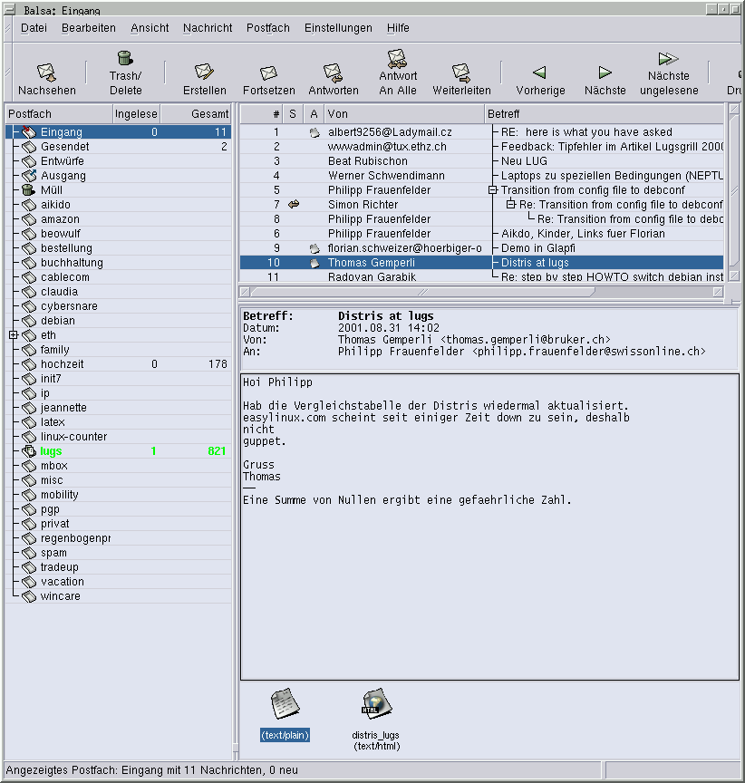
Balsa (email)

Slide 6
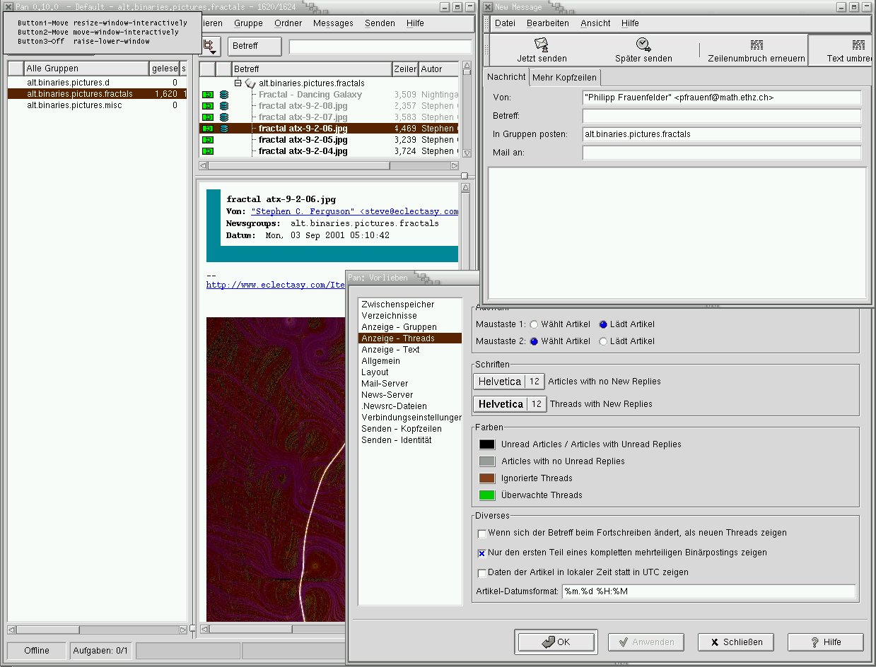
PAN (Usenet)

Slide 7
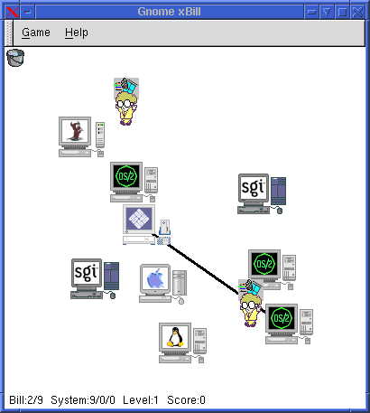
gnome-xbill

