Slide 1

History of GNOME
Jonathan Blandford
David Mason
Federico Mena-Quintero

Slide 2
In the beginning...
“We want to develop a free and complete set of user friendly applications and desktop tools, similar to CDE and KDE but based entirely on free software.”
- Miguel de Icaza
August 15 1997 - comp.os.linux.announce

Slide 3
Why not KDE?

Slide 4
Federico & GIMP

Slide 5
Red Hat Advanced Development Labs
(aka RHAD Labs)

Slide 6
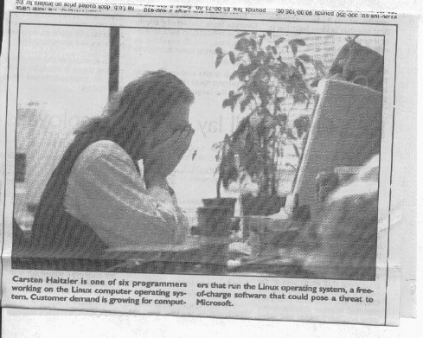

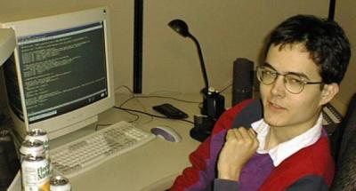
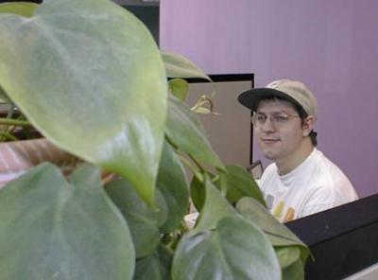
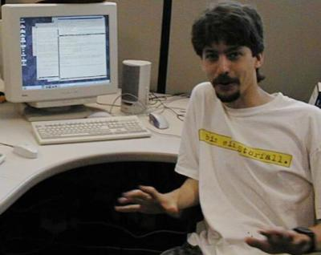
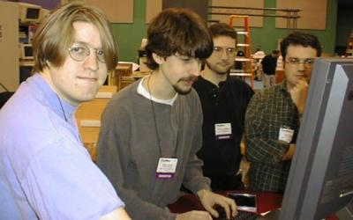

Slide 7
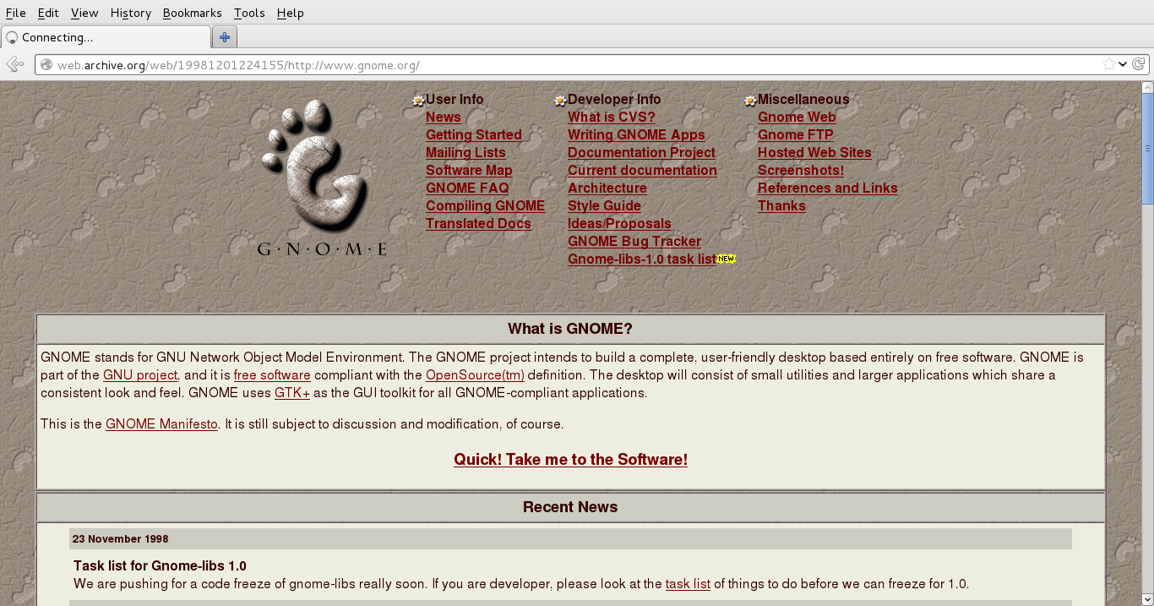

Slide 8
GNOME 1.0
Released March 1999
Press Conference at Linux World Expo
Good coverage in the press

Slide 9
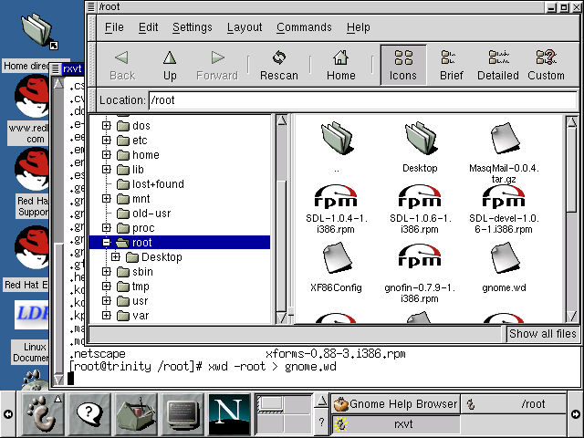

Slide 10
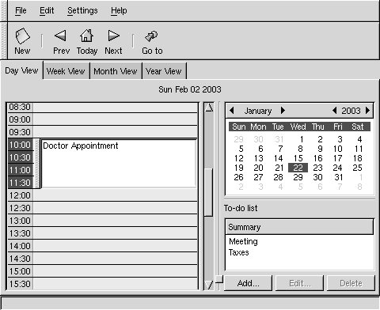
gnomecal

Slide 11
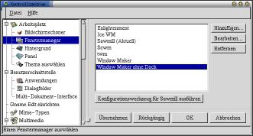
gnome-control-center

Slide 12
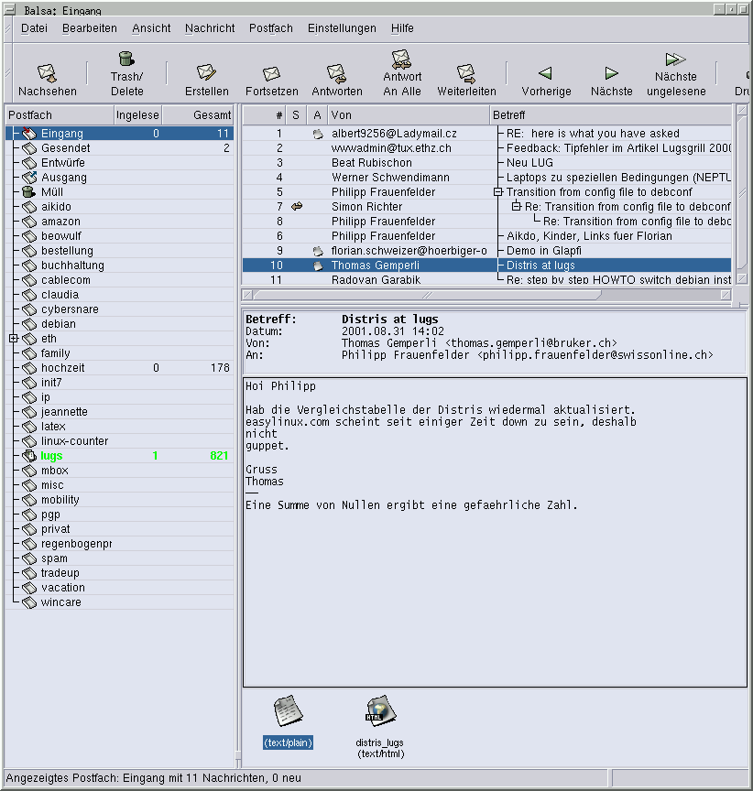
Balsa email!

Slide 13
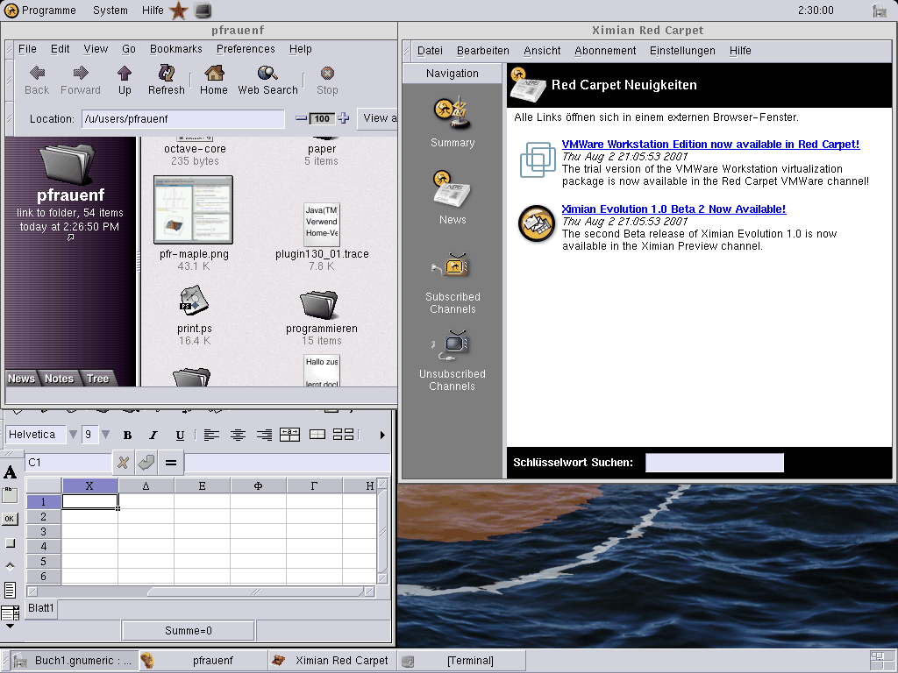

Slide 14
GNOME Companies Appear

Slide 15
GNOME Foundation
Announced 2000 at Linux World Expo
Support from IBM, Sun, Compaq, Red Hat, Helix Code, Eazel, and Collab.net
Sun had just released “Star Office” and announced GNOME would be default desktop on Solaris

Slide 16
"The announcements to be made on Tuesday underscore both the progress that Linux has made toward becoming a viable alternative to Windows and the challenges that remain in persuading business and consumer computer users to adopt the free operating system."
- New York Times

Slide 17

A Tribute to three great Gnomies

Slide 18

Ettore Perazzoli
Evolution Lead
F-spot
GNOME Libraries

Slide 19

Chema Celorio
GNOME Print
Gnome-vfs2
Control-center

Slide 20
MArk Finlay
GNOME Users Support Forum
Rhythmbox

Slide 21
GUADEC
Initial GUADEC March 2000 in Paris
Started to increase European Contributions
Matthieu Lacage organized it

Slide 22
It was a success
2000 Paris
2001 Copenhagen
2002 Seville
2003 Dublin
2004 Kristiansand
2005 Stuttgart
2006 Vilanova i la Geltrú

Slide 23
2007 Birmingham
2008 Istanbul
2009 Gran Canaria
2010 The Hague
2011 Berlin
2012 A Coruña!

Slide 24
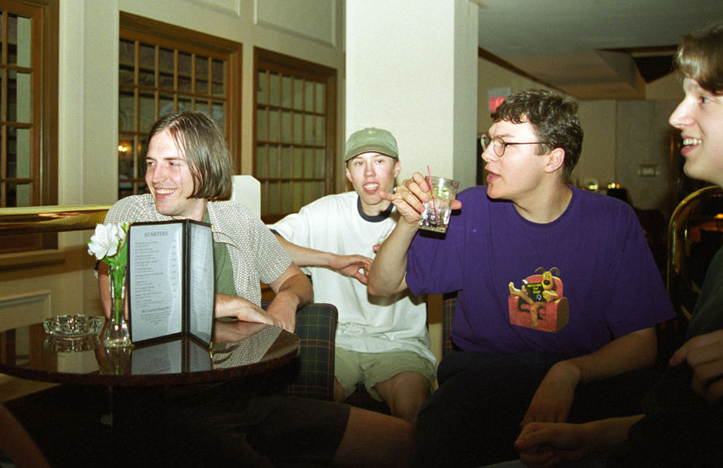
Linux Expo, Raleigh, 1998
Photo by Jamie Zawinski

Slide 25
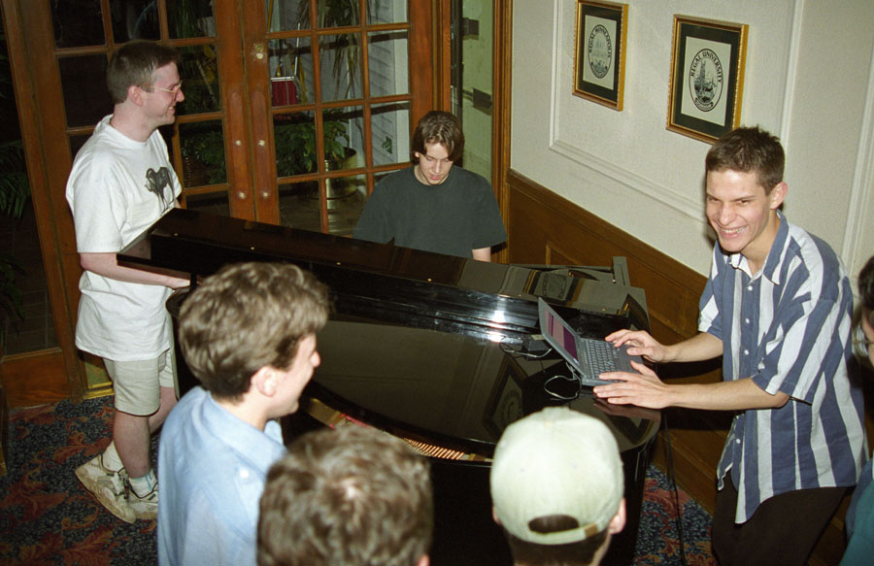
Linux Expo, Raleigh, 1998
Photo by Jamie Zawinski

Slide 26
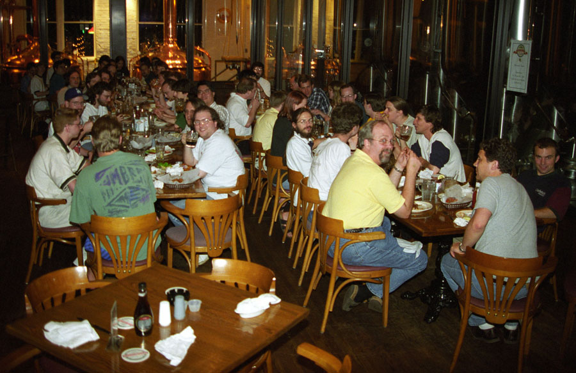
Linux Expo, Raleigh, 1998
Photo by Jamie Zawinski

Slide 27
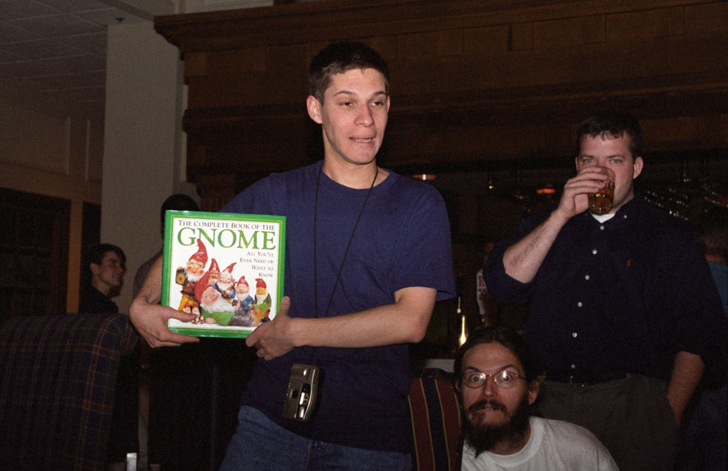
Linux Expo, Raleigh, 1998
Photo by Jamie Zawinski

Slide 28
GEGL
Genetically Engineered Goat, Large

