Slide 1
LBG-split for CD-quality audio signals
Multimedia Coding - 2020/2021
Michelotto Federico 1218322
September 17, 2021

Slide 2
Outline
Goal of the project
Vector Quantization
LBG-split method
Initialization by ‘’splitting’’
The empty cell problem
Results

Slide 3
What is this project about?

Slide 4
The goal of this project is to implement a vector quantization technique called LBG-split and apply it to CD-quality audio signals.
LBG stands for Linde, Buzo, Gray, the three scientists that devised this procedure.
Split stands for ‘’splitting’’, a technique used for the initialization of this method.

Slide 5
Vector Quantization

Slide 6
Vector Quantization (VQ)
Extension of the scalar quantization.
Instead of quantize individual samples, quantize blocks of samples (vectors).
The idea is to exploit the correlation of the source samples in order to increase the efficiency of the coding system.

Slide 7
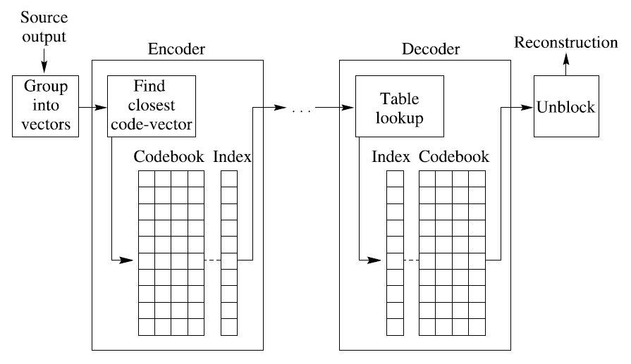
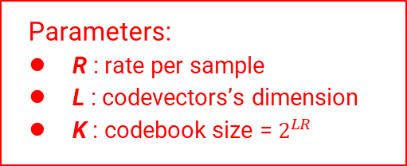
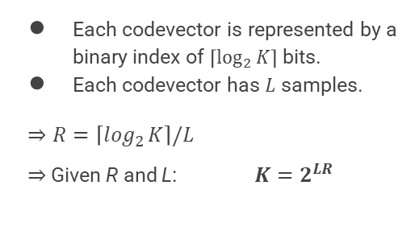
Design of a VQ scheme
Parameters:
R : rate per sample
L : codevectors’s dimension
K : codebook size = $2^{LR}$
Each codevector is represented by a binary index of $\left\lceil \log_{2}{K}\right\rceil$ bits.
Each codevector has $L$ samples.
$$⇒R=\left\lceil \log_{2}{K}\right\rceil /L$$
$⇒$Given R and L: $K=2^{LR}$

Slide 8
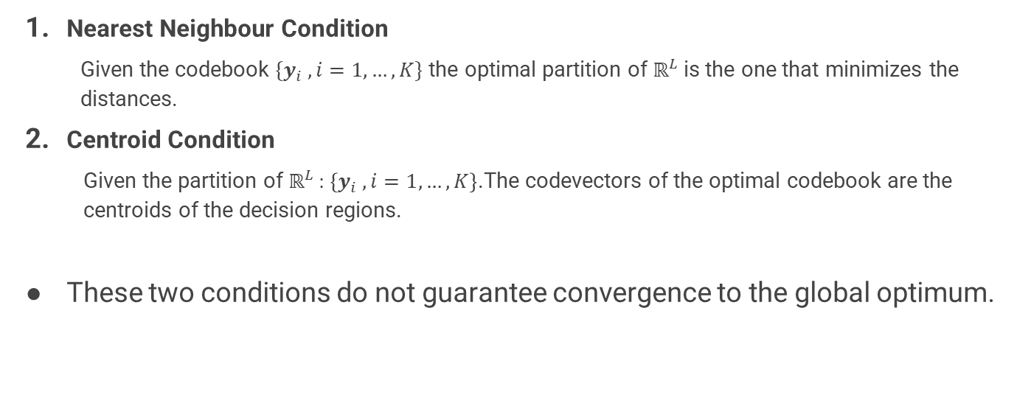
Necessary conditions for optimality (not sufficient)
Nearest Neighbour Condition
Given the codebook $\{y_{i} , i=1,…,K\}$ the optimal partition of $ℝ^{L}$ is the one that minimizes the distances.
Centroid Condition
Given the partition of $ℝ^{L}$ : $\left\{y_{i} ,i=1,…,K\right\}$.The codevectors of the optimal codebook are the centroids of the decision regions.
These two conditions do not guarantee convergence to the global optimum.

Slide 9
LBG-split

Slide 10
LBG
Extension of the popular Lloyd-Max algorithm used for scalar quantization.
Iterative algorithm that aims at minimizing the MSE (Mean Squared Error) exploiting the necessary conditions for optimality.
Two formulations:
Based on the knwoledge of probability density function of the source.
Based on a training set.
In practice (and in this project) the second option is used.

Slide 11
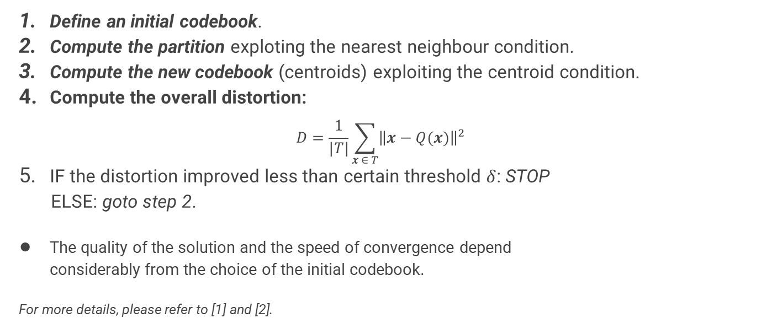
LBG algorithm
Define an initial codebook.
Compute the partition exploting the nearest neighbour condition.
Compute the new codebook (centroids) exploiting the centroid condition.
Compute the overall distortion:
$$D=\frac{1}{|T|}\sum_{x ∈ T}{{\left\|x−Q(x)\right\|}^{2}}$$
IF the distortion improved less than certain threshold $δ$: STOP
ELSE: goto step 2.
The quality of the solution and the speed of convergence depend considerably from the choice of the initial codebook.
For more details, please refer to [1] and [2].

Slide 12
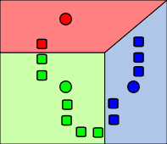
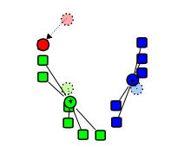
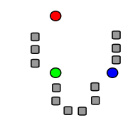
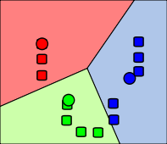
Example
Partitioning
Centroids computation
Iteration 1
Initial centers
…
Iteration 2

Slide 13
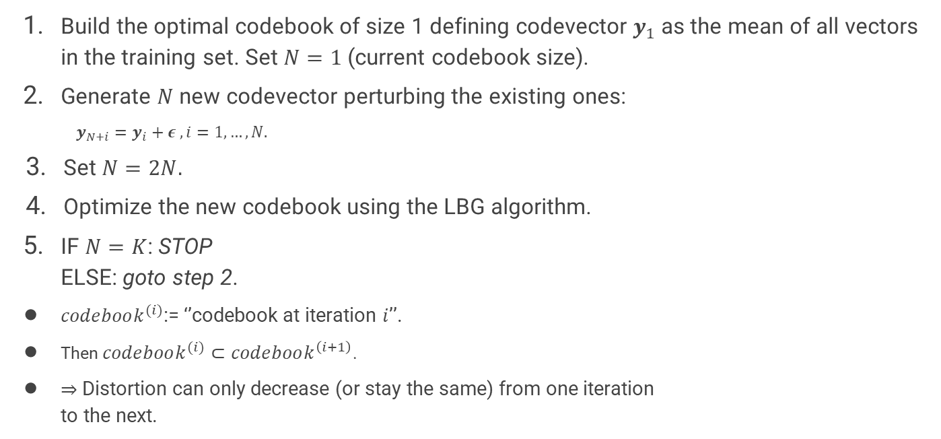
Initialization by ‘’splitting’’
Build the optimal codebook of size 1 defining codevector $y_{1}$as the mean of all vectors in the training set. Set $N=1$ (current codebook size).
Generate $N$ new codevector perturbing the existing ones:
$$y_{N+i}=y_{i}+ε ,i=1,…,N.$$
Set $N=2N.$
Optimize the new codebook using the LBG algorithm.
IF $N=K$: STOP
ELSE: goto step 2.
$codebook^{(i)}$:= ‘’codebook at iteration $i$’’.
Then $codebook^{(i)}⊂codebook^{\left(i+1\right)}$.
$⇒$Distortion can only decrease (or stay the same) from one iteration to the next.

Slide 14
The empty cell problem
During the LBG procedure, a codevector could have no samples associated to it.
There are two viable options:
Substitute the ‘’empty’’ codevector with a sample of the training set using some policy.
Do not update the codevector (in successive iterations it could be the nearest codevector to some samples).

Slide 15
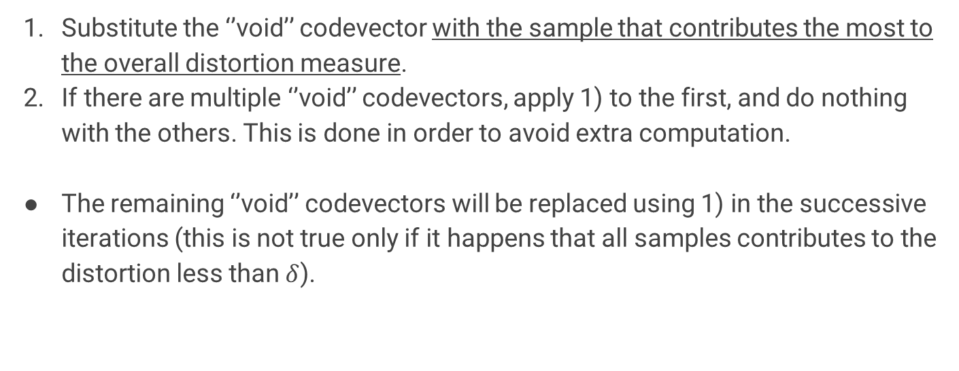
Strategy for the empty cell problem
Substitute the ‘’void’’ codevector with the sample that contributes the most to the overall distortion measure.
If there are multiple ‘’void’’ codevectors, apply 1) to the first, and do nothing with the others. This is done in order to avoid extra computation.
The remaining ‘’void’’ codevectors will be replaced using 1) in the successive iterations (this is not true only if it happens that all samples contributes to the distortion less than $δ$).

Slide 16
Dataset
‘’49mono.wav’’: 23 seconds of a woman speaking in english.
‘’54mono.wav’’: 21 seconds of a man speaking in german.
‘’58mono.wav’’: 16 seconds of “Zapataedo, Op. 23 No. 2, Larry Coryell”.
‘’64mono.wav’’: 31 seconds of “Carmina Burana: O Fortuna (1997-Remaster), Philharmonia Chorus & Philharmonia Orchestra & Riccardo Muti”.
‘’70mono.wav’’: 21 seconds of “Early in the mornin’, Eddie Rabbit”.
Since the sound signals were provided without any description, I used the popular mobile app Shazam to retrieve the name of the songs.

Slide 17
Results

Slide 18
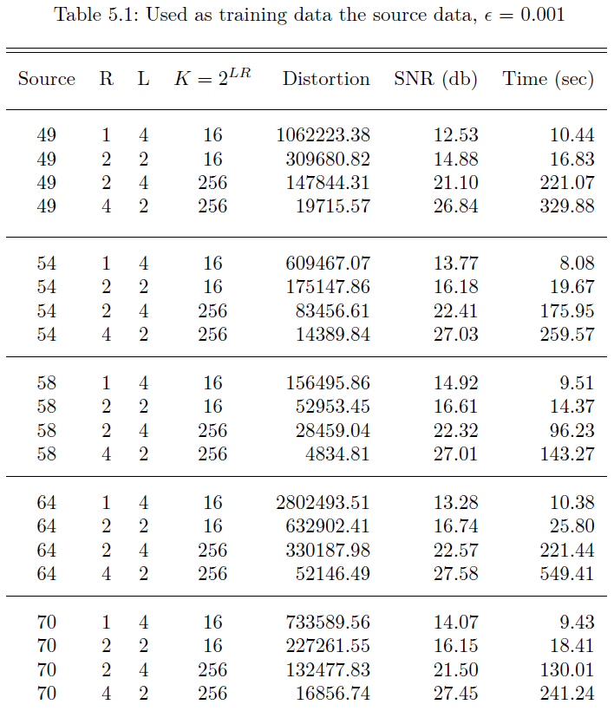
Results - 1

Slide 19
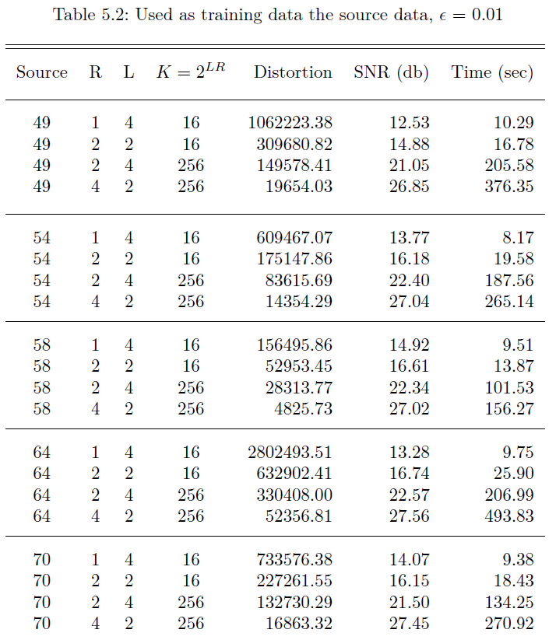
Results - 2

Slide 20
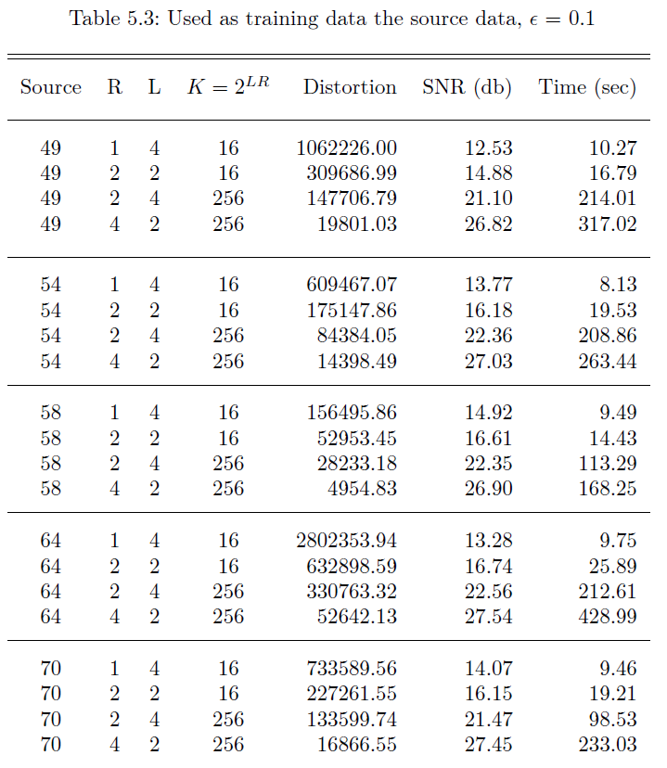
Results - 3

Slide 21
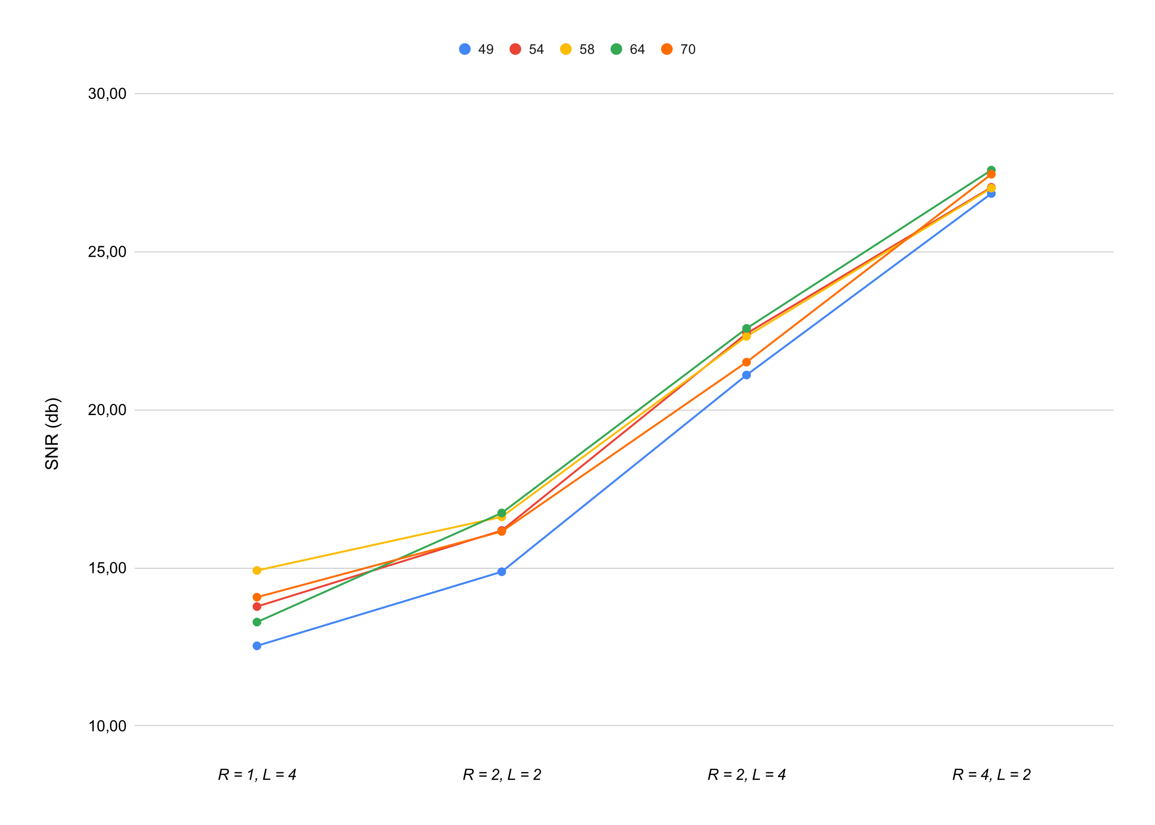
Results - comparisons ($ε=0.001$)

Slide 22
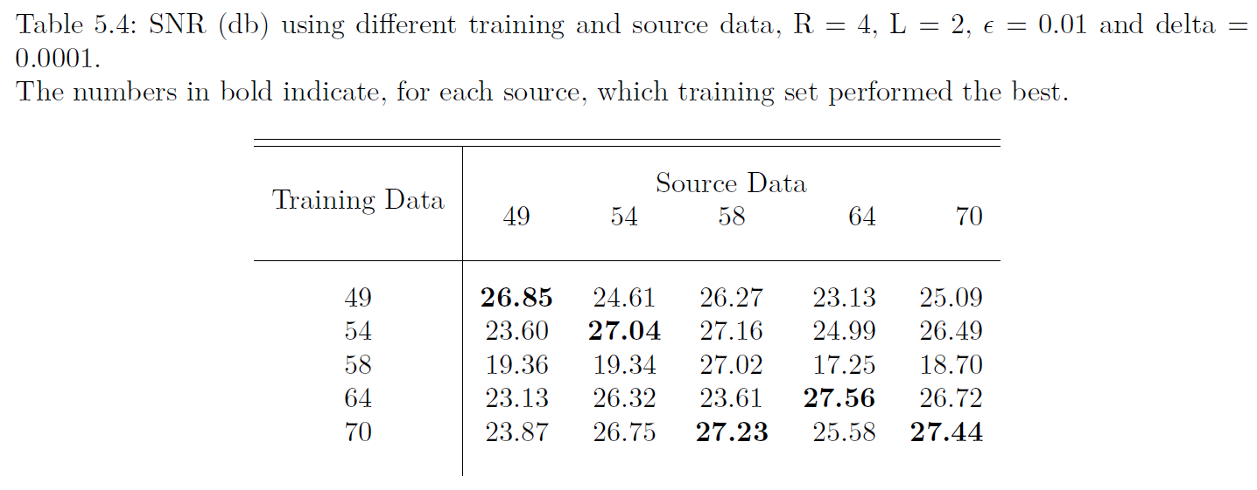
Results: different training and source data
Note that the audio signal “58mono.wav” is the one with the shortest duration.

Slide 23
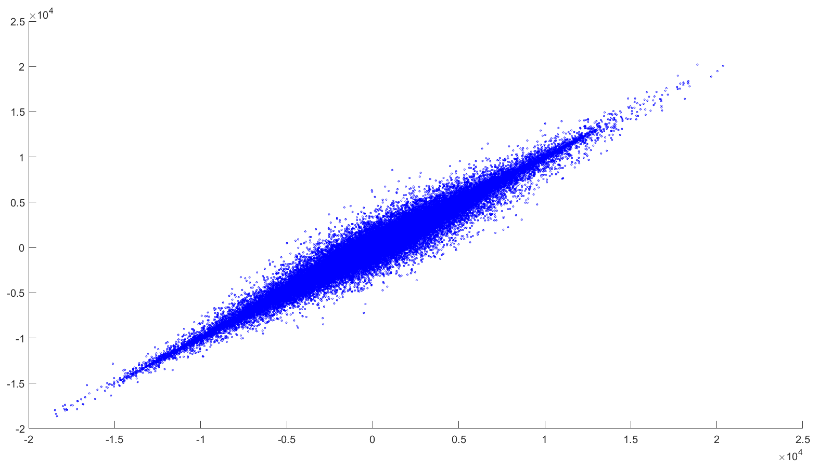
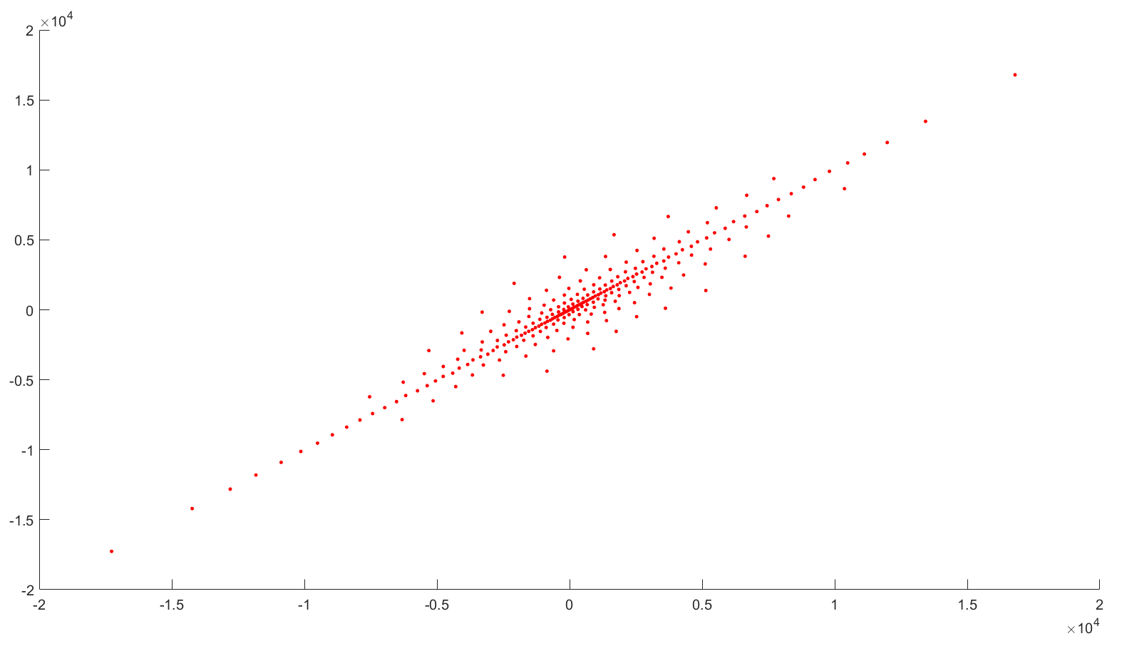
Visual result of the LBG-split technique
Training set “70mono.wav” (L=2)
Final codebook

Slide 24
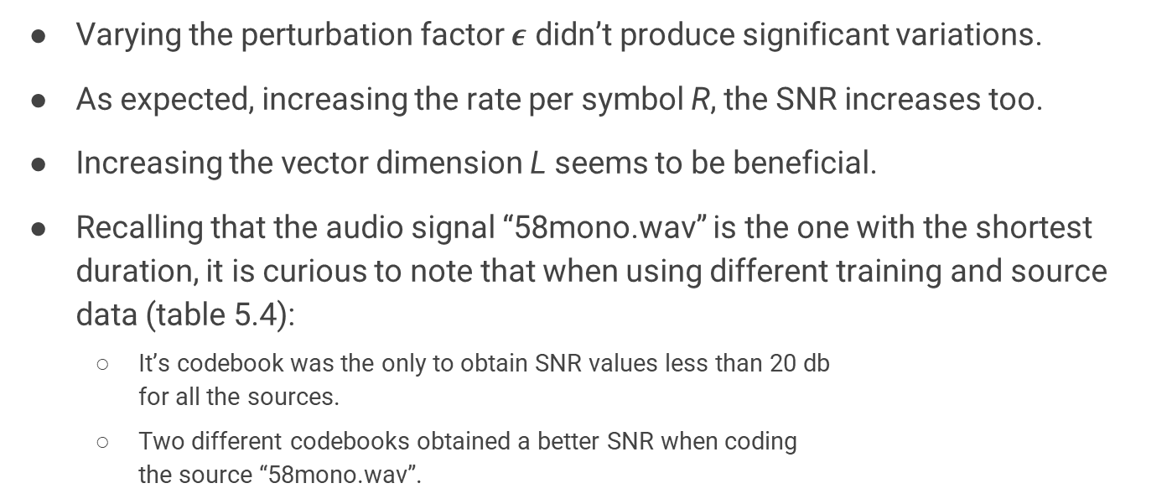
Conclusions
Varying the perturbation factor $ε$ didn’t produce significant variations.
As expected, increasing the rate per symbol R, the SNR increases too.
Increasing the vector dimension L seems to be beneficial.
Recalling that the audio signal “58mono.wav” is the one with the shortest duration, it is curious to note that when using different training and source data (table 5.4):
It’s codebook was the only to obtain SNR values less than 20 db for all the sources.
Two different codebooks obtained a better SNR when coding the source “58mono.wav”.

Slide 25
Bibliography
Y. Linde, A. Buzo, and R. Gray. “An Algorithm for Vector Quantizer Design”. In: IEEE Transactions on Communications 28.1 (1980), pp. 84–95.
K. Sayood. Introduction to Data Compression. The Morgan Kaufmann Series in Multimedia Information and Systems. Elsevier Science, 2017. ISBN: 9780128097052.

Slide 26
Thank you for the attention!

