Slide 1



MCMC Sampling:
Creating a Generic Sampler &
Comparison of MCMC Algorithms
Earl Duncan
Bayesian Research and Applications Group (BRAG)
7 Nov 2019

Slide 2
Introduction Part 1: Generic Sampler Part 2: Comparing Samplers Results
Introduction:
The main task of statistical modelling is estimating the unknown parameters.
In Bayesian methodology, Markov chain Monte Carlo (MCMC) methods are one of the most popular classes of estimation methods.
Make use of the full conditional distributions, or simply full conditionals (FCs).
The techniques available depend on the properties of the FCs.
Most of the time, we use software to do the heavy lifting for us:
Automatically deriving the FCs from the (marginal) priors and likelihood;
Determining which MCMC methods are appropriate/optimal for a given FC;
Actually implementing the MCMC methods;
Automatically tuning MCMC sampler specific tuning parameters; and
Possibly more (guessing an appropriate burn-in, initial values, etc.)
Common software includes WinBUGS/OpenBUGS, JAGS, stan, CARBayes (R package)
Software in development: greta (Nick Golding, BotB 2017)
Earl Duncan BRAG 7 Nov 2019 1

Slide 3
Introduction Part 1: Generic Sampler Part 2: Comparing Samplers Results
Motivation:
Sometimes the available software may be too restrictive for your use case. E.g.
Does not allow certain distributions or link functions (if not ‘built-in’, often there are hacks to introduce custom-defined distributions and link functions).
Does not allow certain models (e.g. JAGS prohibits cyclic graphs, so no CAR models).
Does not operate in certain environment (e.g. supercomputer nodes).
Does not handle high dimensions.
Is not efficient.
In these cases, you may need to implement the models and estimation yourself. This is no easy feat!
All that heavy-lifting done by software (see slide 1) now needs to be done by you.
Deriving the FCs generally isn’t too difficult (see my BRAG talk from 18 Aug 2016 for a guide).
In this presentation, I focus on the task of choosing and implementing MCMC sampler(s)
Earl Duncan BRAG 7 Nov 2019 2

Slide 4
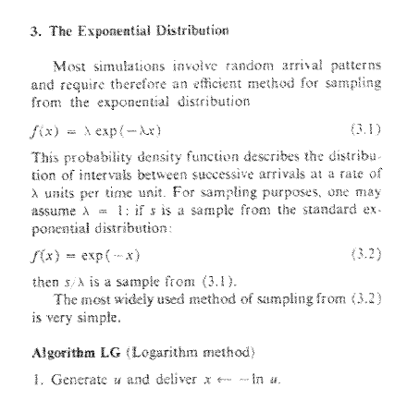


Introduction Part 1: Generic Sampler Part 2: Comparing Samplers Results
Monte Carlo to MCMC:
Consider the FC for some parameter $η$
$$p\left(η | y,α, β\right)∝Gamma\left(η;α+\sum_{i=1}{y_{i},β+N}\right)$$
where $y=(y_{1},…,y_{N})$ is observed data.
For fixed values of $α$ and $β$, we can use Monte Carlo methods to repeatedly sample from this distribution (or a transformation of it) to obtain an i.i.d. sample for $η$.
In R, we can generate such random variates for most well-known distributions using rgamma, rnorm, rpois, rexp, etc.
Use Monte Carlo sampling
Have a look at the help files to see what technique. E.g. ?rexp
Earl Duncan BRAG 7 Nov 2019 3

Slide 5
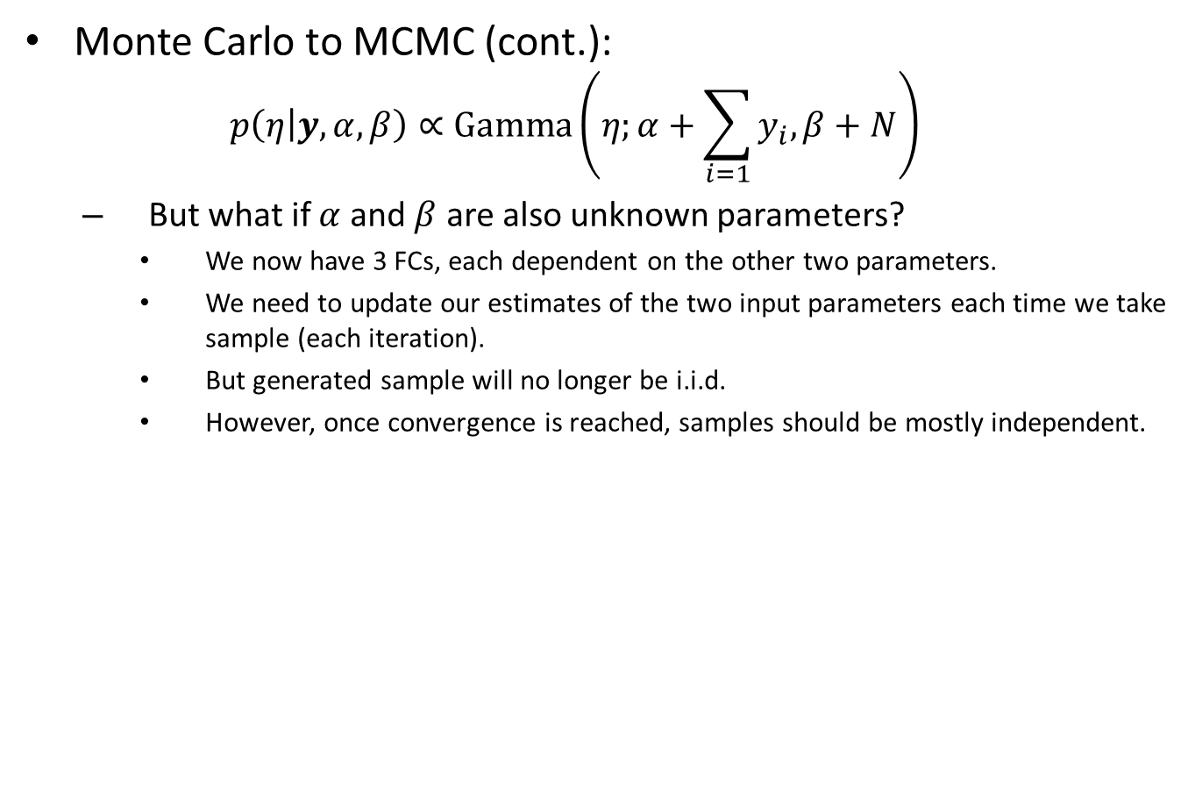
Introduction Part 1: Generic Sampler Part 2: Comparing Samplers Results
Monte Carlo to MCMC (cont.):
$$p\left(η | y,α, β\right)∝Gamma\left(η;α+\sum_{i=1}{y_{i},β+N}\right)$$
But what if $α$ and $β$ are also unknown parameters?
We now have 3 FCs, each dependent on the other two parameters.
We need to update our estimates of the two input parameters each time we take sample (each iteration).
But generated sample will no longer be i.i.d.
However, once convergence is reached, samples should be mostly independent.
Earl Duncan BRAG 7 Nov 2019 4

Slide 6
Introduction Part 1: Generic Sampler Part 2: Comparing Samplers Results
Historic overview of MCMC Samplers:
1953
Metropolis
Extensions:
1970
Metropolis-Hastings (MH)
1984
Gibbs
1990
(Improved efficiency?)
1987
Hamiltonian Monte Carlo (HMC)
2014
No U-turn sampler (NUTS) extension
1992
Adaptive rejection sampling (ARS)*
1995
ARMS
2010
CCARS
1997
Slice sampling (SS)
2003
Multivariate SS
& many extensions…
* Original version used derivatives. A derivative-free version was published later that same year. WinBUGS uses the derivative-free version. My results are based on the gradient-based version.
Earl Duncan BRAG 7 Nov 2019 5

Slide 7
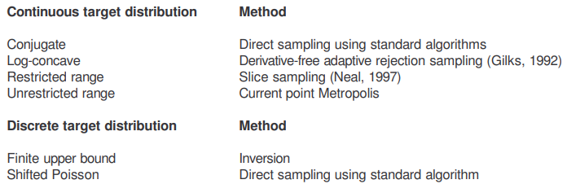
Introduction Part 1: Generic Sampler Part 2: Comparing Samplers Results
Note on WinBUGS:
Software may implement a single sampler, or choose from a set of samplers.
E.g. WinBUGS chooses a sampler as by a process of elimination:
Source: the WinBUGS manual
Earl Duncan BRAG 7 Nov 2019 6

Slide 8
Introduction Part 1: Generic Sampler Part 2: Comparing Samplers Results
Part 1: Creating a Generic Sampler
(using potentially different MCMC algorithms for each FC)
Earl Duncan BRAG 7 Nov 2019 7

Slide 9
Introduction Part 1: Generic Sampler Part 2: Comparing Samplers Results
Goal:
Develop a framework (R package) for implementing any arbitrary model which gives the user complete flexibility over what sampler is used for any set of FCs.
User must first determine each FC (or joint distribution) and decide which sampler to use.
The FC and MCMC sampler specific functions (see slide 11) are passed to a specialised sampling function which calls the necessary subroutines.
A posterior sample is obtained by looping over iterations.
Earl Duncan BRAG 7 Nov 2019 8

Slide 10
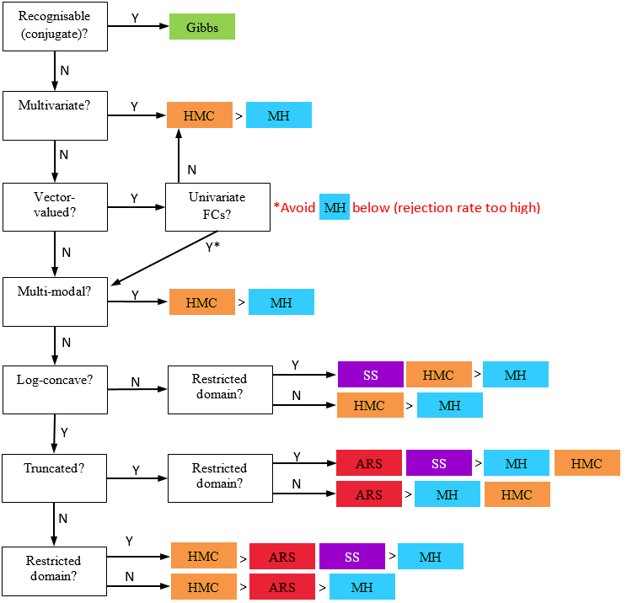
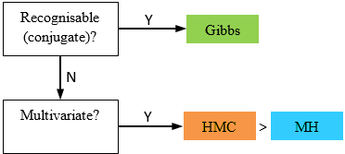
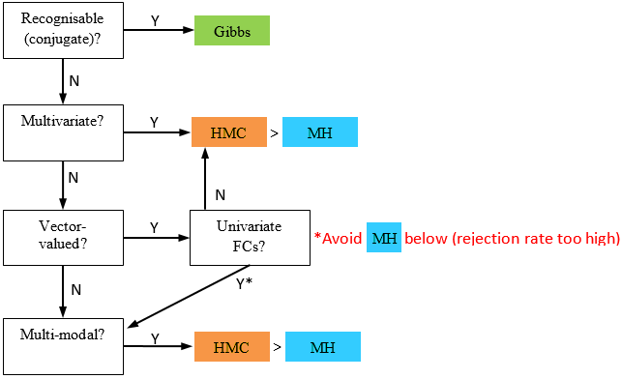
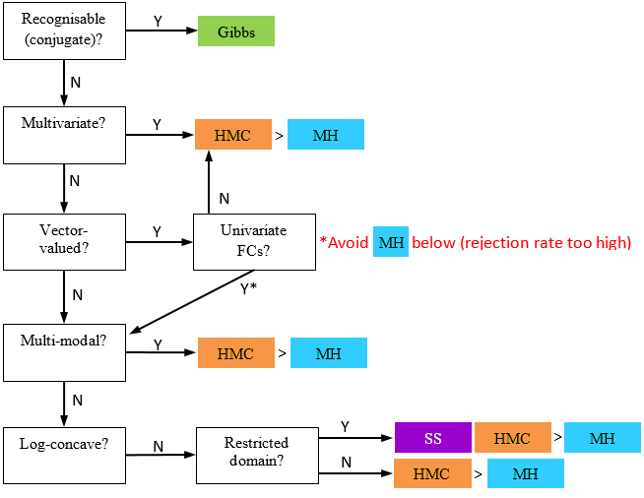
Introduction Part 1: Generic Sampler Part 2: Comparing Samplers Results
Work flow:
Define the model (likelihood and prior specification)
(Currently working with single kernel densities – see slide 16)
Derive the FCs
Decide which sampler to use for each FC. As a rough guide:
Global requirements:
MH algorithm requires a suitable proposal density.
Gradient-based ARS algorithm requires the target density be log-concave.
HMC will work for discrete distributions if pmf can be evaluated on a continuous domain e.g. by using gamma function instead of factorial (see next slide)
Earl Duncan BRAG 7 Nov 2019 9

Slide 11
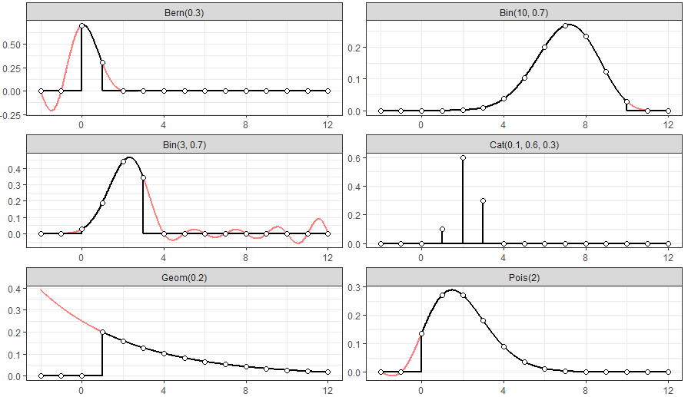
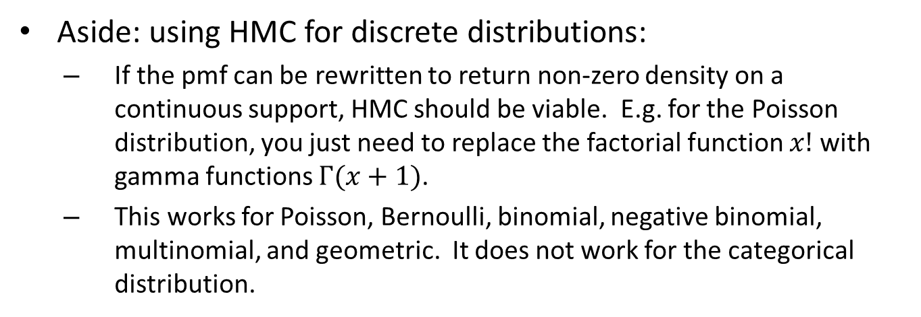
Introduction Part 1: Generic Sampler Part 2: Comparing Samplers Results
Aside: using HMC for discrete distributions:
If the pmf can be rewritten to return non-zero density on a continuous support, HMC should be viable. E.g. for the Poisson distribution, you just need to replace the factorial function $x!$ with gamma functions $Γ(x+1)$.
This works for Poisson, Bernoulli, binomial, negative binomial, multinomial, and geometric. It does not work for the categorical distribution.
Earl Duncan BRAG 7 Nov 2019 10

Slide 12
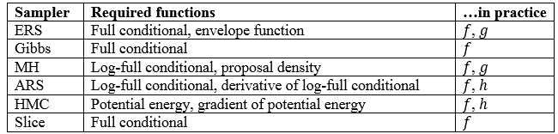
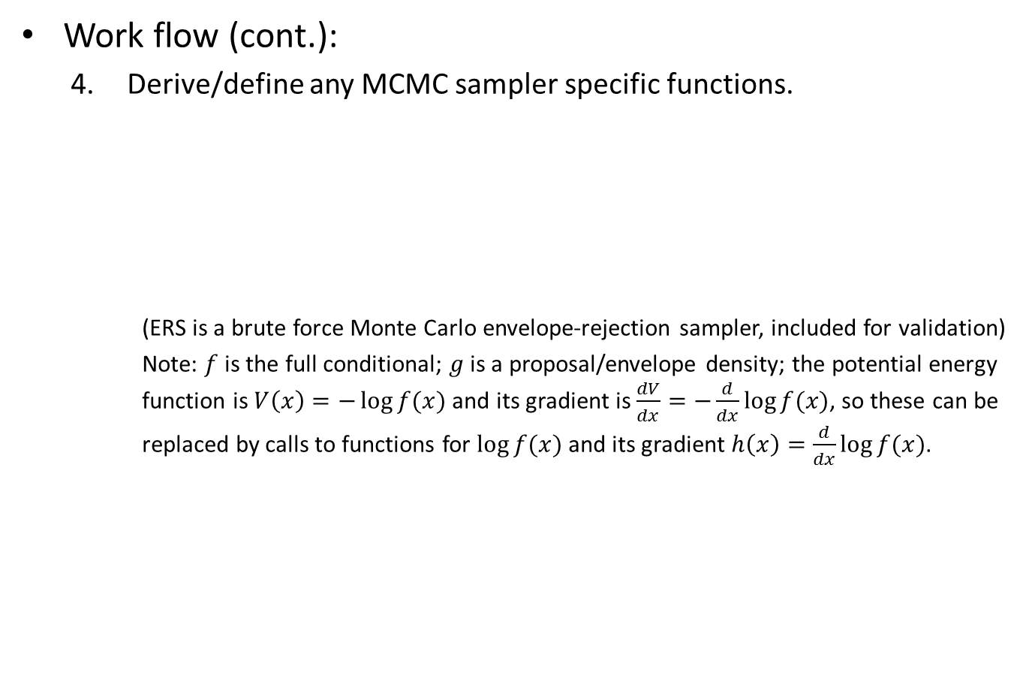
Introduction Part 1: Generic Sampler Part 2: Comparing Samplers Results
Work flow (cont.):
Derive/define any MCMC sampler specific functions.
(ERS is a brute force Monte Carlo envelope-rejection sampler, included for validation)
Note: $f$ is the full conditional; $g$ is a proposal/envelope density; the potential energy function is $V\left(x\right)=−\log{f(x)}$ and its gradient is $\frac{dV}{dx}=−\frac{d}{dx}log⁡f(x)$, so these can be replaced by calls to functions for $\log{f(x)}$ and its gradient $h\left(x\right)=\frac{d}{dx}log⁡f(x)$.
Earl Duncan BRAG 7 Nov 2019 11

Slide 13
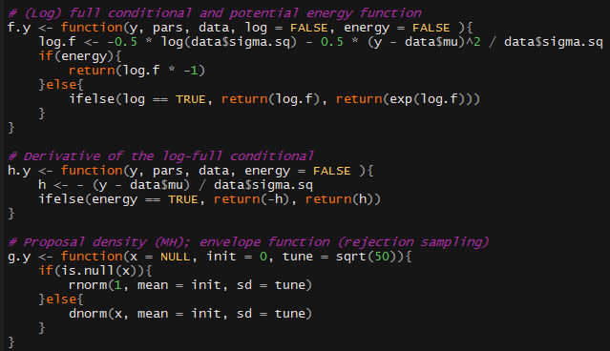

Introduction Part 1: Generic Sampler Part 2: Comparing Samplers Results
Work flow (cont.):
Convert to R code functions.
E.g. for parameter $y∼ 𝒩\left(y;μ, σ^{2}\right)$
Earl Duncan BRAG 7 Nov 2019 12

Slide 14
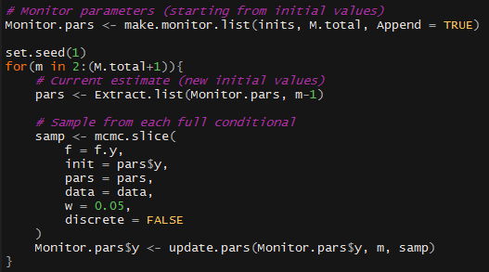
Introduction Part 1: Generic Sampler Part 2: Comparing Samplers Results
Work flow (cont.):
Pass these functions to the respective sampler function and loop to obtain a sample.
E.g. for a sample using SS:
SS sampler function
(log) full conditional from previous slide
Earl Duncan BRAG 7 Nov 2019 13

Slide 15
Introduction Part 1: Generic Sampler Part 2: Comparing Samplers Results
Part 2: Comparison of MCMC Algorithms
Earl Duncan BRAG 7 Nov 2019 14

Slide 16
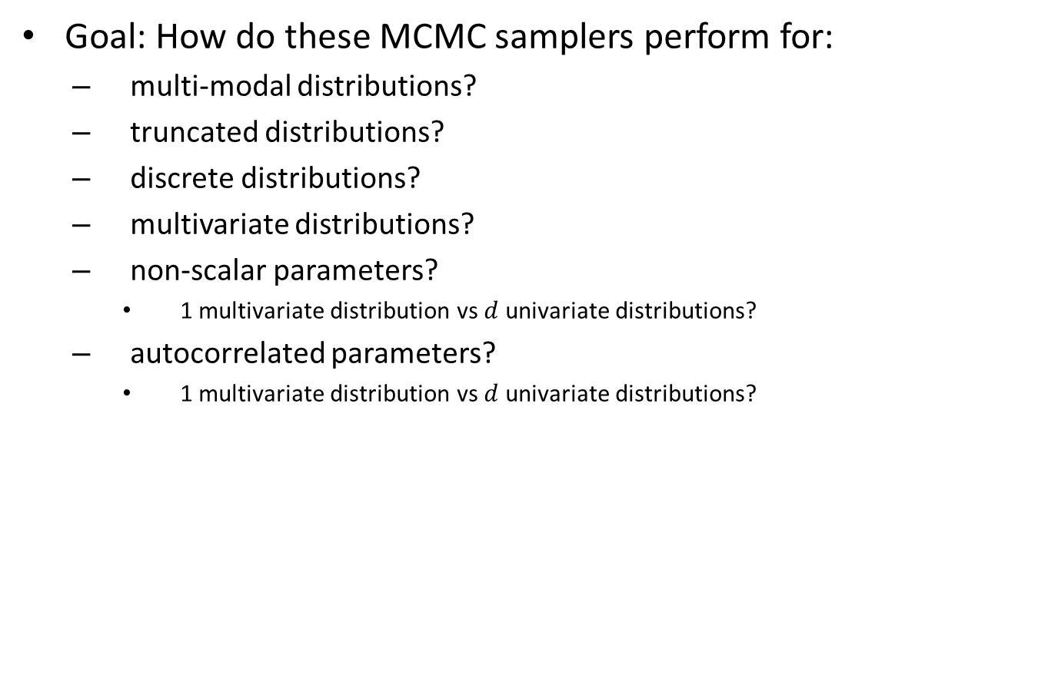
Introduction Part 1: Generic Sampler Part 2: Comparing Samplers Results
Goal: How do these MCMC samplers perform for:
multi-modal distributions?
truncated distributions?
discrete distributions?
multivariate distributions?
non-scalar parameters?
1 multivariate distribution vs $d$ univariate distributions?
autocorrelated parameters?
1 multivariate distribution vs $d$ univariate distributions?
(WIP – no results yet)
Earl Duncan BRAG 7 Nov 2019 15

Slide 17
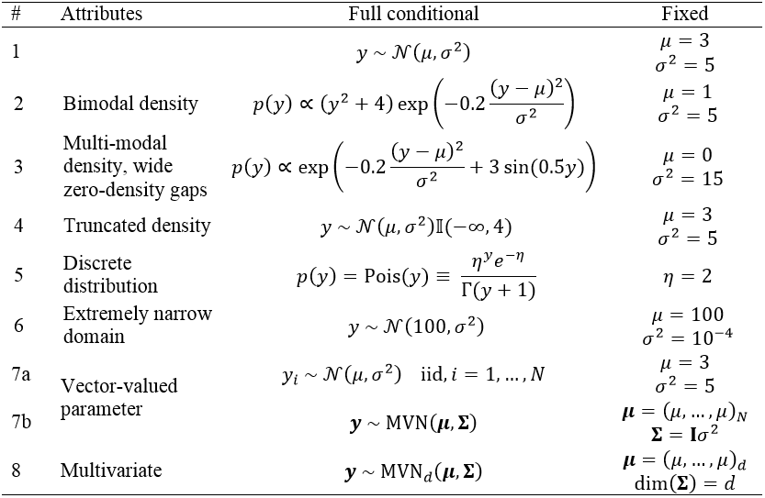
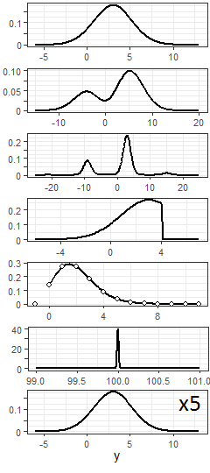

Introduction Part 1: Generic Sampler Part 2: Comparing Samplers Results
Test samplers across different models:
Very simple models!
No priors (1 FC; 1 (possibly non-scalar) unknown parameter)
No observed data (but all input parameters assumed known)
No autocorrelation
$$N=5, d=5$$
Earl Duncan BRAG 7 Nov 2019 16

Slide 18
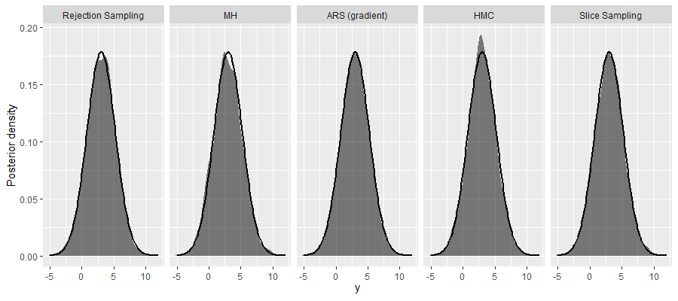
Introduction Part 1: Generic Sampler Part 2: Comparing Samplers Results
Results:
Model 1: Gaussian density
Earl Duncan BRAG 7 Nov 2019 17

Slide 19
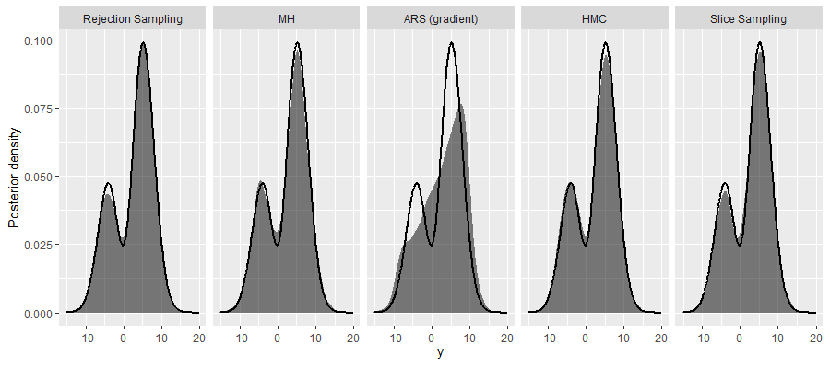
Introduction Part 1: Generic Sampler Part 2: Comparing Samplers Results
Results:
Model 2: bimodal density
Note: Generally ARS does not work for models like this which are not log-concave. However, with a bit of luck, the code may execute without run-time errors, but the results are likely to be very poor around convex portions of the distribution. Derivative-free versions of ARS or other extensions are required for good results.
Earl Duncan BRAG 7 Nov 2019 18

Slide 20
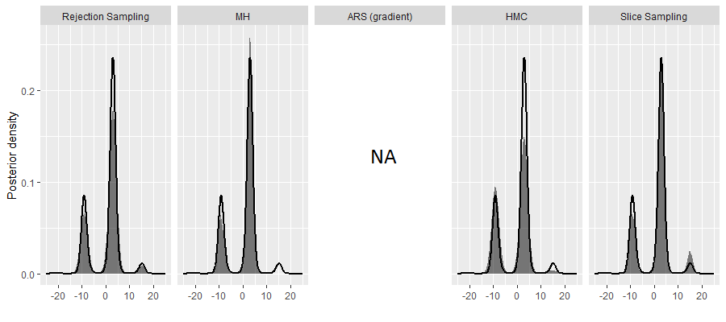
Introduction Part 1: Generic Sampler Part 2: Comparing Samplers Results
Results:
Model 3: multi-modal density
Looks like each algorithm struggles with this one, either over- or under-sampling different regions of high density (or missing modes completely).
Earl Duncan BRAG 7 Nov 2019 19

Slide 21
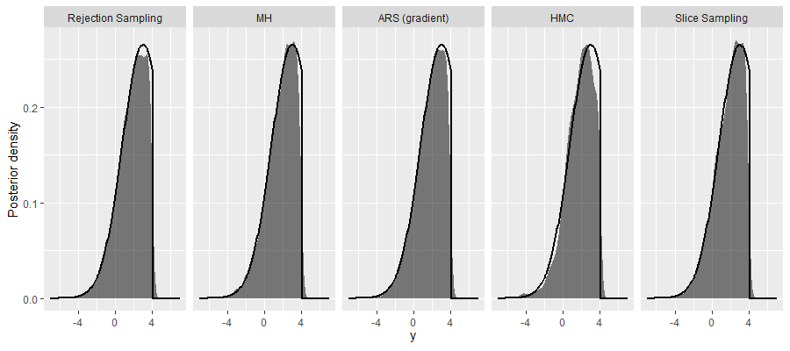
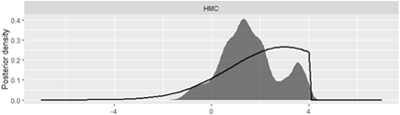
Introduction Part 1: Generic Sampler Part 2: Comparing Samplers Results
Results:
Model 4: truncated density
Note: increasing the mass and decreasing the step size tuning parameters (HMC) can help for truncated distributions (step size should be auto-tuned during burn-in).
Otherwise…
Earl Duncan BRAG 7 Nov 2019 20

Slide 22
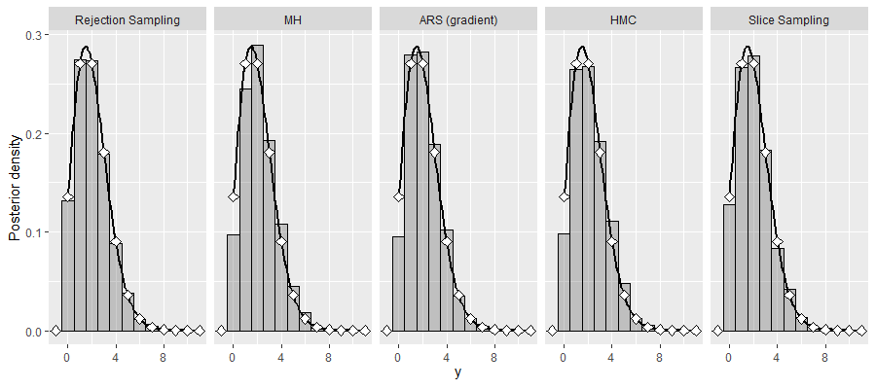
Introduction Part 1: Generic Sampler Part 2: Comparing Samplers Results
Results:
Model 5: discrete distribution
Recall HMC can be used for discrete distributions provided they can be evaluated on a continuous domain (see slide 10 for details).
Earl Duncan BRAG 7 Nov 2019 21

Slide 23
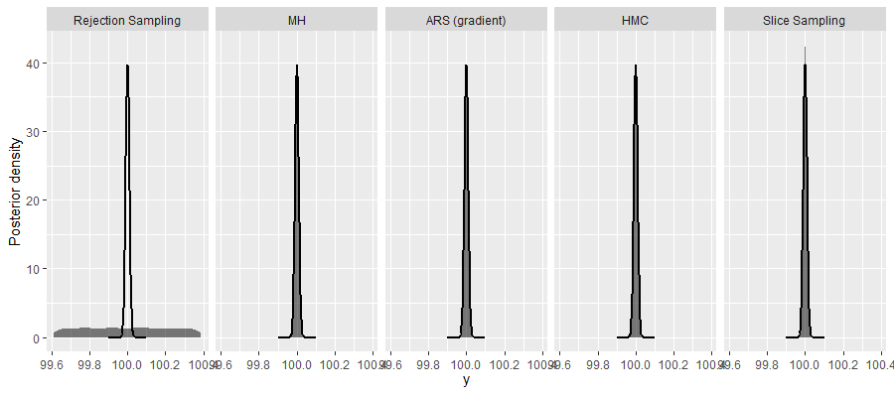
Introduction Part 1: Generic Sampler Part 2: Comparing Samplers Results
Results:
Model 6: density with a very narrow domain
ERS struggles unless the envelope (proposal) distribution is very close to the true posterior.
Earl Duncan BRAG 7 Nov 2019 22

Slide 24
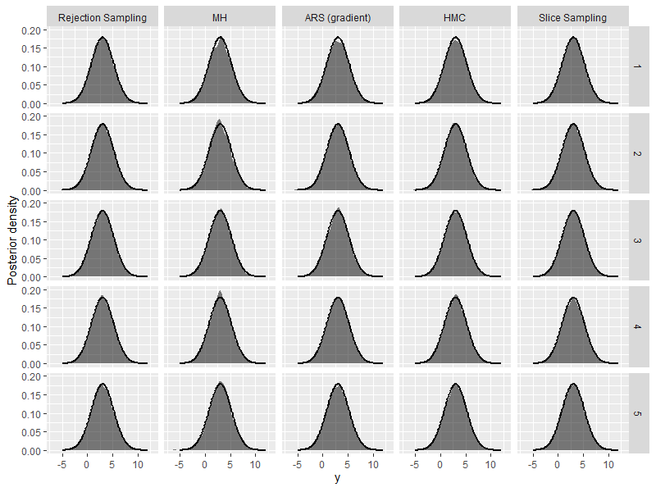
Introduction Part 1: Generic Sampler Part 2: Comparing Samplers Results
Results:
Model 7a: vector-valued parameter (univariate FCs)
Earl Duncan BRAG 7 Nov 2019 23

Slide 25
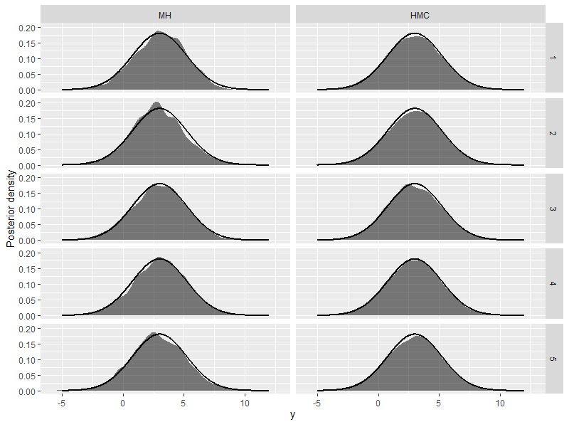
Introduction Part 1: Generic Sampler Part 2: Comparing Samplers Results
Results:
Model 7b: vector-valued parameter (1 multivariate FC, but marginal posteriors plotted)
Only MH and HMC attempted for multivariate FC distributions (see slide 9).
Earl Duncan BRAG 7 Nov 2019 24

Slide 26
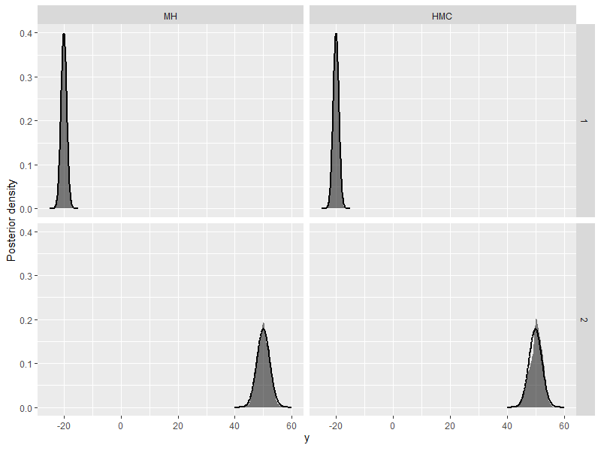
Introduction Part 1: Generic Sampler Part 2: Comparing Samplers Results
Results:
Model 8: multivariate FC
Only MH and HMC attempted for multivariate FC distributions (see slide 9).
Earl Duncan BRAG 7 Nov 2019 25

Slide 27
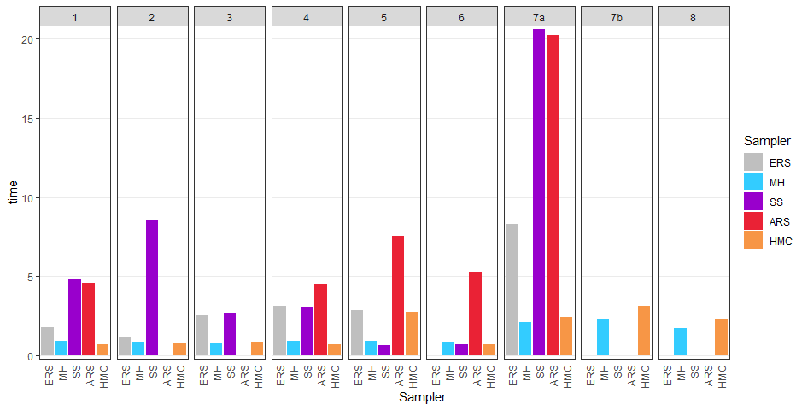
Introduction Part 1: Generic Sampler Part 2: Comparing Samplers Results
Computation time:
All models
Model 7 (vector-valued parameter) may be faster to treat parameter as multivariate (7b) rather than iid univariate (7a). But SS and ARS really only work well when univariate. For larger dimensions, it is probably more efficient to do multivariate (see slide 28).
Earl Duncan BRAG 7 Nov 2019 26

Slide 28
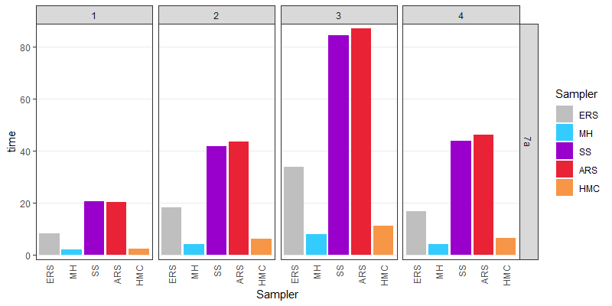
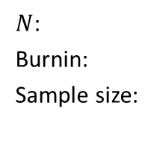
Introduction Part 1: Generic Sampler Part 2: Comparing Samplers Results
Computation time:
Model 7a variants
$N$:
Burnin:
Sample size:
5
2000
5000
10
2000
5000
20
2000
5000
5
4000
10000
Earl Duncan BRAG 7 Nov 2019 27

Slide 29
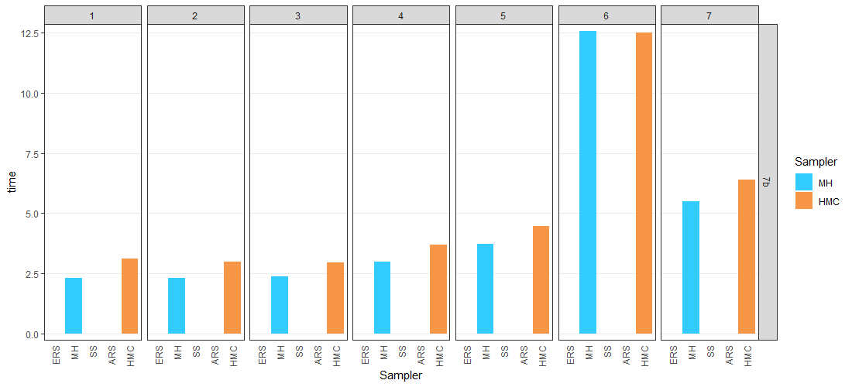
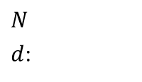
Introduction Part 1: Generic Sampler Part 2: Comparing Samplers Results
Computation time:
Model 7b variants
$N$
$d$:
5
5
5
10
5
50
10
5
15
5
20
5
25
5
Multivariate version scales well with data sample size, $N$, as expected.
Earl Duncan BRAG 7 Nov 2019 28

Slide 30
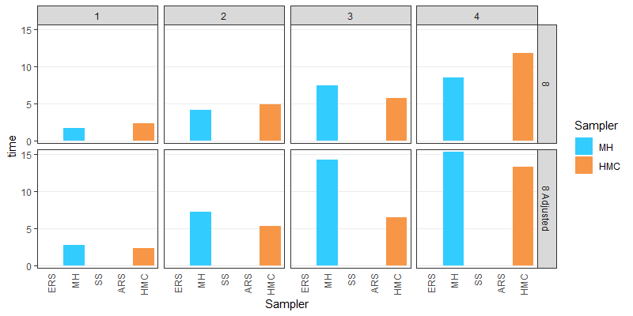

Introduction Part 1: Generic Sampler Part 2: Comparing Samplers Results
Computation time:
Model 8 variants
$d$:
2
10
20
30
Computation time in adjusted model has been inflated for rejection rate.
Earl Duncan BRAG 7 Nov 2019 29

Slide 31
Key references:
1987
Duane, S., A.D. Kennedy, B. J. Pendleton, and D. Roweth. 1987. Hybrid Monte Carlo. Physics Letters B 195 (2): 216-222. DOI: 10.1016/0370-2693(87)91197-x.
Gilks, W. R. and P. Wild. 1992. Adaptive rejection sampling for Gibbs sampling. Applied Statistics 41 (2): 337-348. DOI: 10.2307/2347565.
Gilks, W. R. 1992 “Derivative-free adaptive rejection sampling for Gibbs sampling”. In Bayesian Statistics 4, edited by J. Bernardo, J. Berger, A. P. Dawid, and A. F. M. Smith. Oxford University Press.
Hastings, W. K. 1970. Monte Carlo sampling methods using Markov chains and their applications. Biometrika 57 (1): 97-109. DOI: 10.2307/2334940.
Neal, R. M. 1997. Markov chain Monte Carlo methods based on ‘slicing’ the density function. Technical report no. 9722, Department of Statistics, University of Toronto. Available at www.cs.toronto.edu/~ radford/slice.abstract.html.
1992
1970
1997
Contact:
earl.duncan@qut.edu.au
https://bragqut.wordpress.com/people/earl-duncan/
Earl Duncan BRAG 7 Nov 2019 30

