Slide 1


Reversing Label Switching:
An Interactive Talk
Earl Duncan
20 July 2017

Slide 2
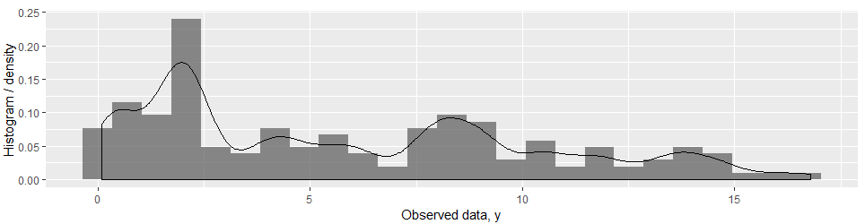
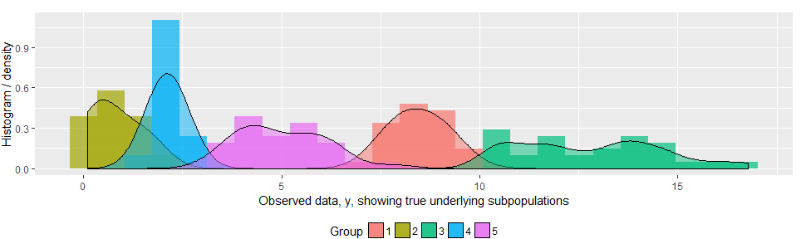
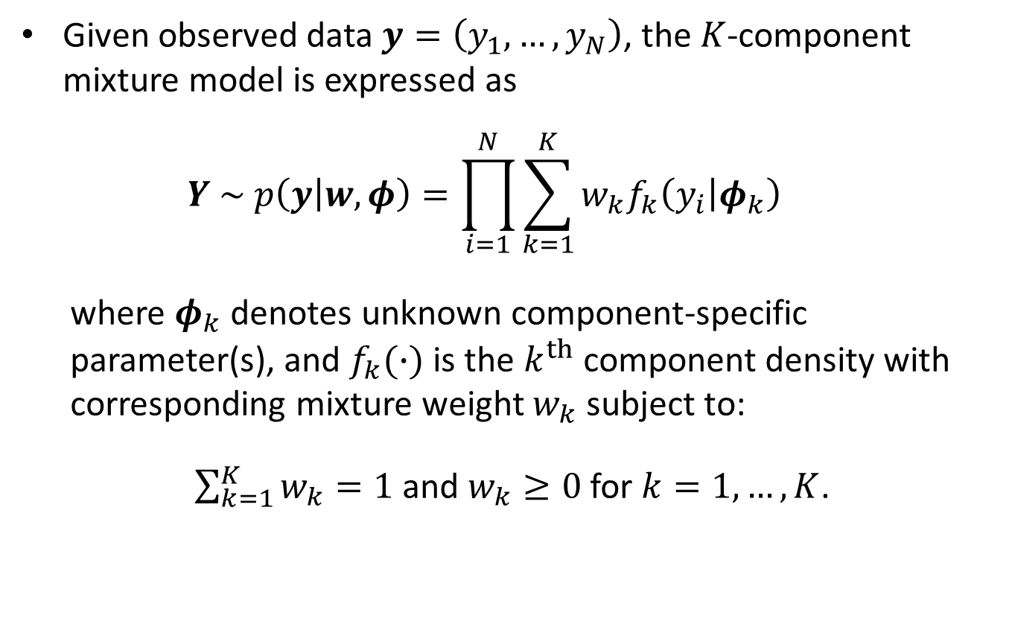
Introduction
Given observed data $y=\left(y_{1},…,y_{N}\right)$, the $K$-component mixture model is expressed as
$$Y \sim p\left(y | w,φ\right)=\prod_{i=1}^{N}{\sum_{k=1}^{K}{w_{k}f_{k}\left(y_{i} | φ_{k}\right)}}$$
where $φ_{k}$ denotes unknown component-specific parameter(s), and $f_{k}(∙)$ is the $k^{th}$ component density with corresponding mixture weight $w_{k}$ subject to:
$\sum_{k=1}^{K}{w_{k}}=1$ and $w_{k}≥0$ for $k=1,…,K$.
Marin, J-M., K. Mengersen, and C. P. Robert. 2005. “Bayesian modelling and inference on mixtures of distributions” In Handbook of Statistics edited C. Rao and D. Dey. New York: Springer-Verlag.
Earl Duncan BRAG 20 July 2017: Reversing Label Switching 1/12

Slide 3
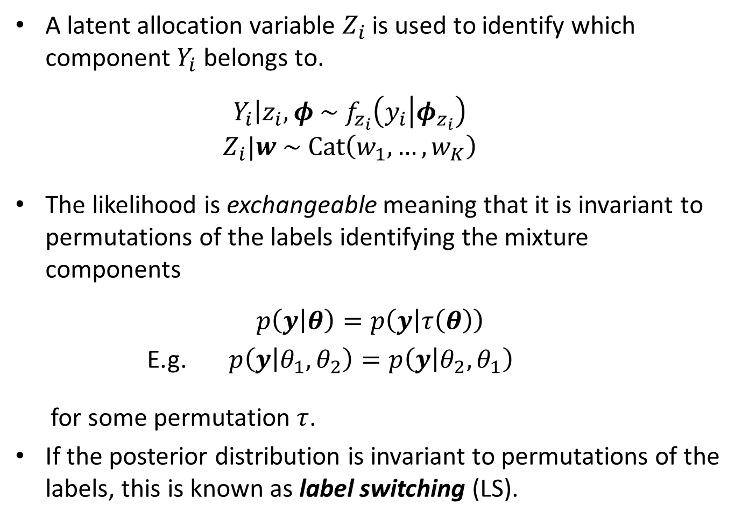
Introduction
A latent allocation variable $Z_{i}$ is used to identify which component $Y_{i}$ belongs to.
$$\left.Y_{i}\right|z_{i},φ \sim f_{z_{i}}\left(y_{i} | φ_{z_{i}}\right)$$
$$Z_{i}|w \sim Cat\left(w_{1}, …, w_{K}\right)$$
The likelihood is exchangeable meaning that it is invariant to permutations of the labels identifying the mixture components
$$p\left(y | θ\right)=p\left(y | τ\left(θ\right)\right)$$
E.g. $p\left(y | θ_{1},θ_{2}\right)=p\left(y | θ_{2},θ_{1}\right)$ .
for some permutation $τ$.
If the posterior distribution is invariant to permutations of the labels, this is known as label switching (LS).
Earl Duncan BRAG 20 July 2017: Reversing Label Switching 2/12

Slide 4
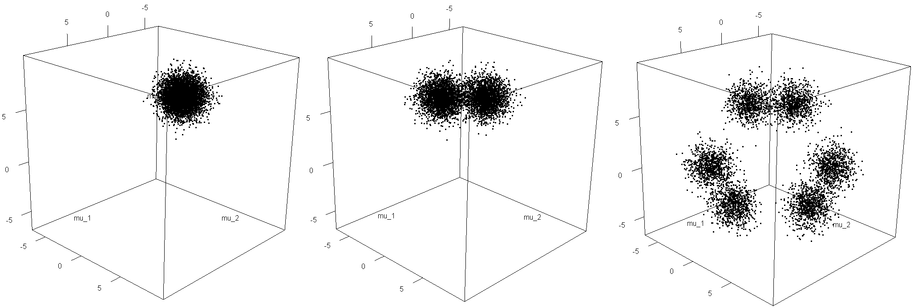
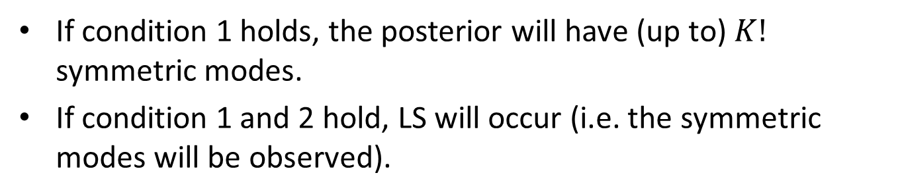
Introduction
Consider the conditions:
the prior is (at least partly) exchangeable
the sampler is efficient at exploring the posterior hypersurface
If condition 1 holds, the posterior will have (up to) $K!$ symmetric modes.
If condition 1 and 2 hold, LS will occur (i.e. the symmetric modes will be observed).
No label switching
LS between groups 1 and 2
LS between all 3 groups
Earl Duncan BRAG 20 July 2017: Reversing Label Switching 3/12

Slide 5
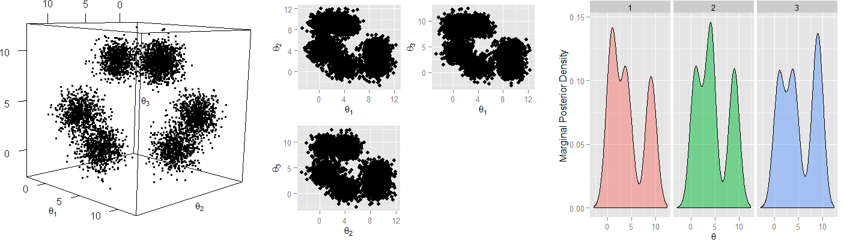
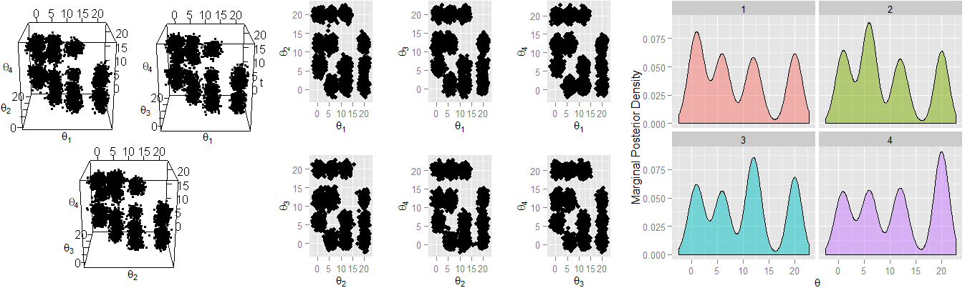
Introduction
If label switching occurs, the marginal posterior distributions are identical for each component. Therefore, it is impossible to make inferences!
K = 3
K = 4
Earl Duncan BRAG 20 July 2017: Reversing Label Switching 4/12

Slide 6
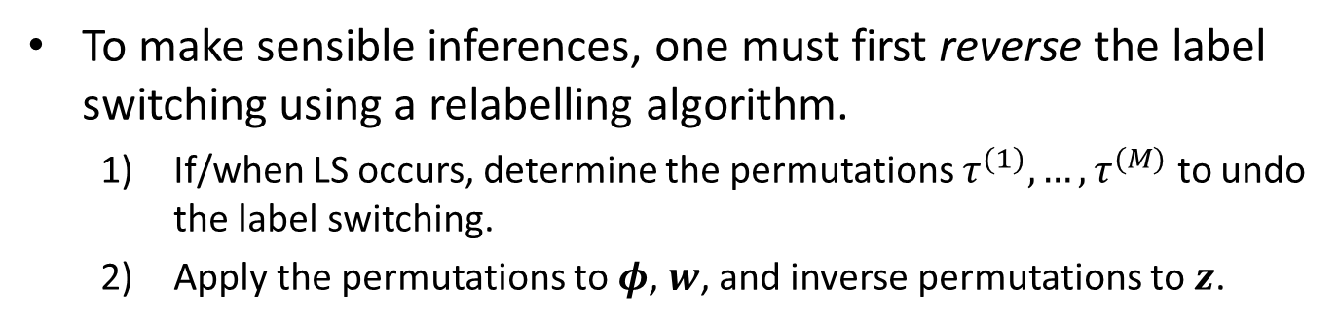

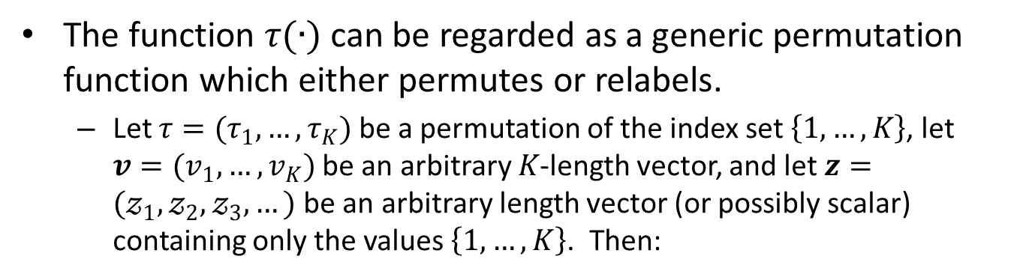
Introduction
To make sensible inferences, one must first reverse the label switching using a relabelling algorithm.
If/when LS occurs, determine the permutations $τ^{(1)},…,τ^{(M)}$ to undo the label switching.
Apply the permutations to $φ$, $w$, and inverse permutations to $z$.
The function $τ(∙)$ can be regarded as a generic permutation function which either permutes or relabels.
Let $τ=(τ_{1}, …, τ_{K})$ be a permutation of the index set $\left\{1,…,K\right\}$, let $v=(v_{1},…,v_{K})$ be an arbitrary $K$-length vector, and let $z=(𝓏_{1},𝓏_{2},𝓏_{3},…)$ be an arbitrary length vector (or possibly scalar) containing only the values $\left\{1,…,K\right\}$. Then:
Permute: $τ\left(v_{1},…,v_{K}\right)=\left(v_{τ_{1}},…,v_{τ_{K}}\right)$
Relabel: $τ\left(𝓏_{1},𝓏_{2},𝓏_{3},…\right)=\left(τ_{𝓏_{1}},τ_{𝓏_{2}},τ_{𝓏_{3}},…\right)$
Earl Duncan BRAG 20 July 2017: Reversing Label Switching 5/12

Slide 7
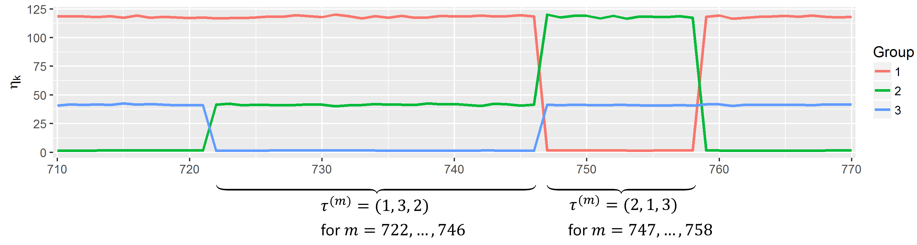
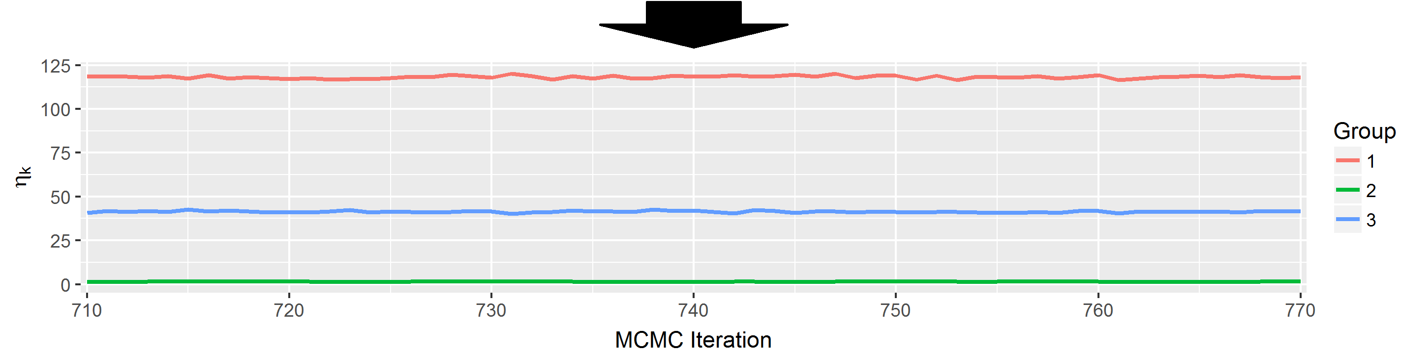
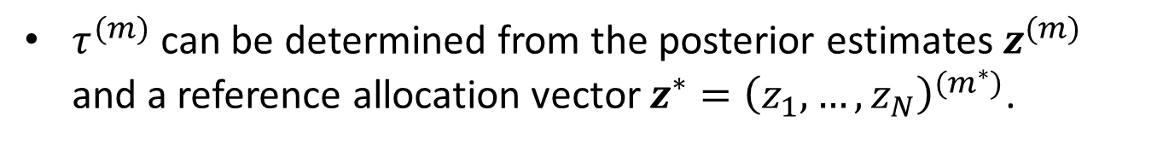
Example
Example: determining $τ$
$τ^{(m)}$ can be determined from the posterior estimates $z^{(m)}$ and a reference allocation vector $z^{∗}={\left(z_{1},…,z_{N}\right)}^{(m^{∗})}$.
Earl Duncan BRAG 20 July 2017: Reversing Label Switching 6/12

Slide 8
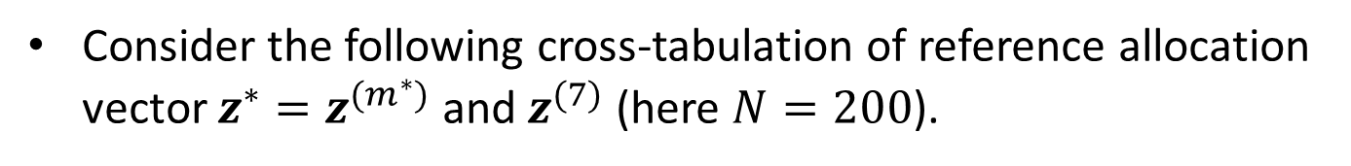



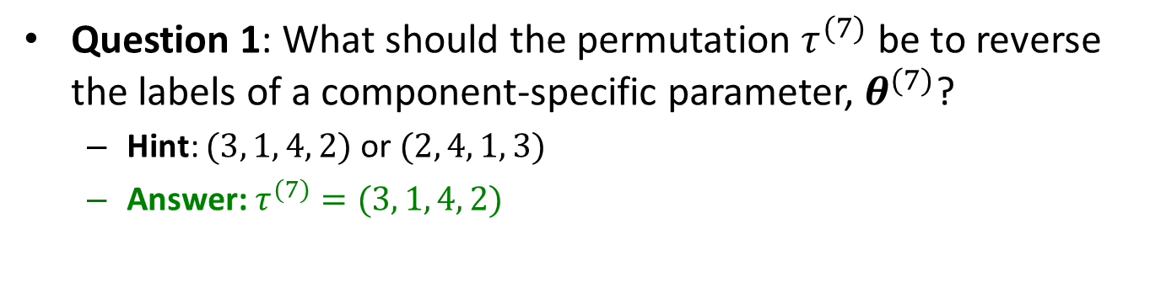
Exercises
Consider the following cross-tabulation of reference allocation vector $z^{∗}=z^{(m^{∗})}$ and $z^{(7)}$ (here $N=200$).
$$z^{∗}$$
$$\begin{matrix}\begin{matrix} \\ \begin{matrix}1 \\ 2 \\ 3 \\ 4\end{matrix}\end{matrix} & \begin{matrix}\begin{matrix} 1 & 2 & 3 & 4 \end{matrix} \\ \left[\begin{matrix}0 & 90 & 0 & 0 \\ 0 & 0 & 2 & 14 \\ 52 & 0 & 1 & 3 \\ 0 & 2 & 35 & 1\end{matrix}\right]\end{matrix}\end{matrix}$$
$$z^{(7)}$$
Question 1: What should the permutation $τ^{(7)}$ be to reverse the labels of a component-specific parameter, $θ^{(7)}$?
Hint: $(3, 1, 4, 2)$ or $(2, 4, 1, 3)$
Answer: $τ^{(7)}=(3, 1, 4, 2)$
Earl Duncan BRAG 20 July 2017: Reversing Label Switching 7/12

Slide 9
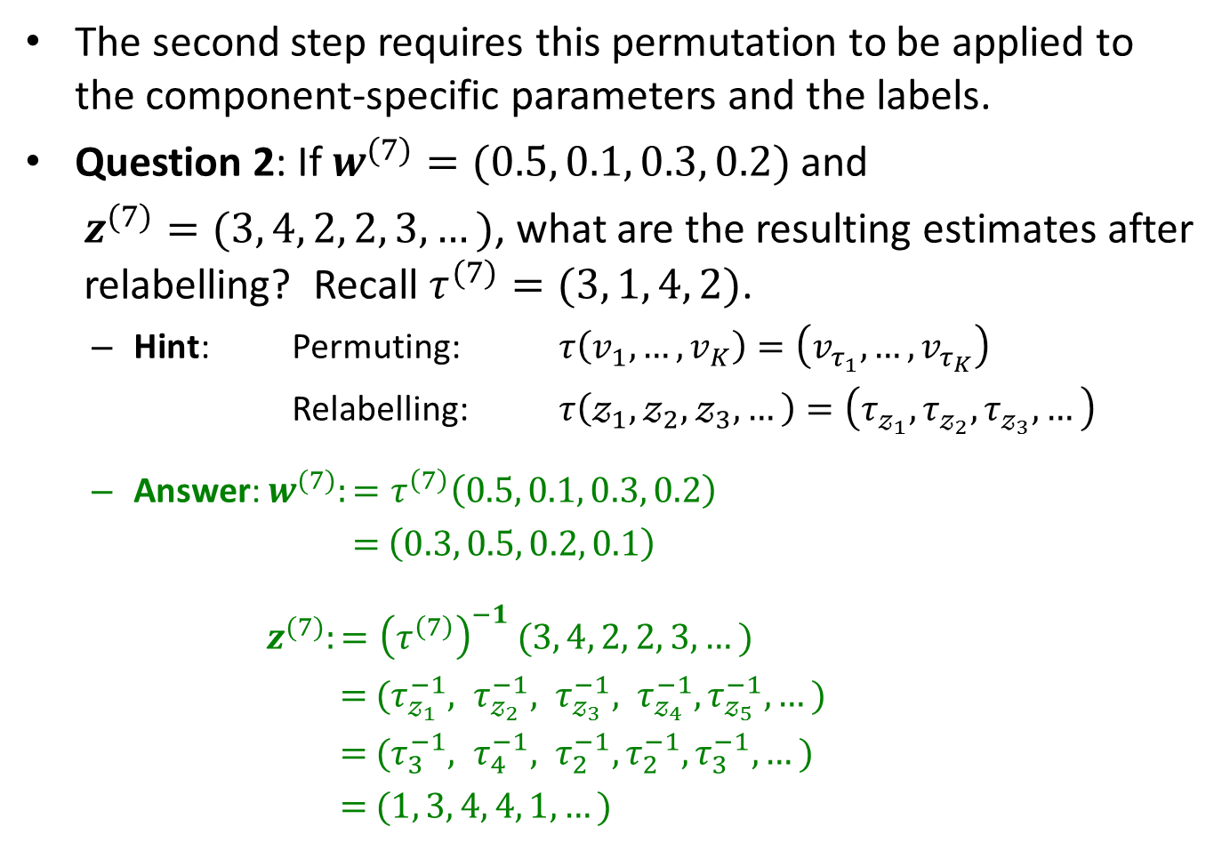
Exercises
The second step requires this permutation to be applied to the component-specific parameters and the labels.
Question 2: If $w^{(7)}=(0.5, 0.1, 0.3, 0.2)$ and
$z^{(7)}=(3, 4, 2, 2, 3, …)$, what are the resulting estimates after relabelling? Recall $τ^{(7)}=(3, 1, 4, 2)$.
Hint: Permuting: $τ\left(v_{1},…,v_{K}\right)=\left(v_{τ_{1}},…,v_{τ_{K}}\right)$
Relabelling: $τ\left(𝓏_{1},𝓏_{2},𝓏_{3},…\right)=\left(τ_{𝓏_{1}},τ_{𝓏_{2}},τ_{𝓏_{3}},…\right)$
Answer: $w^{(7)}:=τ^{\left(7\right)}\left(0.5, 0.1, 0.3, 0.2\right)$
$=$ $\left(0.3, 0.5, 0.2, 0.1\right)$
$z^{(7)}:={\left(τ^{\left(7\right)}\right)}^{−1} (3, 4, 2, 2, 3, …)$
$=$ $(τ_{𝓏_{1}}^{−1}, τ_{𝓏_{2}}^{−1}, τ_{𝓏_{3}}^{−1}, τ_{𝓏_{4}}^{−1},τ_{𝓏_{5}}^{−1},…)$
$=$ $(τ_{3}^{−1}, τ_{4}^{−1}, τ_{2}^{−1}, τ_{2}^{−1}, τ_{3}^{−1},…)$
$=$ $(1, 3, 4, 4, 1,…)$
Earl Duncan BRAG 20 July 2017: Reversing Label Switching 8/12

Slide 10
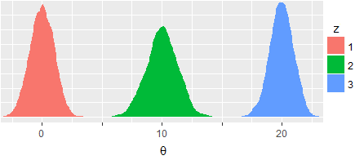
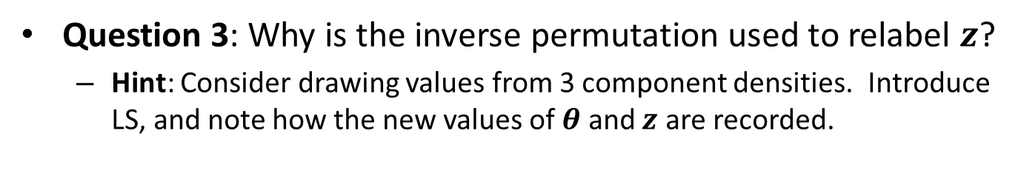

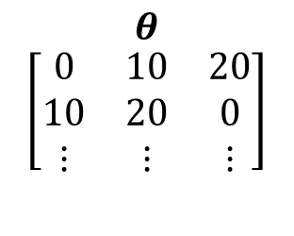
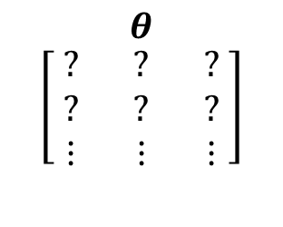
Exercises
Question 3: Why is the inverse permutation used to relabel $z$?
Hint: Consider drawing values from 3 component densities. Introduce LS, and note how the new values of $θ$ and $z$ are recorded.
$$\begin{matrix}θ \\ \left[\begin{matrix} ? & ? & ? \\ ? & ? & ? \\ ⋮ & ⋮ & ⋮\end{matrix}\right]\end{matrix}$$
w/o LS
w/ LS
Answer:
Draw values without LS, then with LS:
$$\begin{matrix}θ \\ \left[\begin{matrix}0 & 10 & 20 \\ 10 & 20 & 0 \\ ⋮ & ⋮ & ⋮\end{matrix}\right]\end{matrix}$$
$⇒τ_{LS}=(2, 3, 1)$ $⇒τ=τ_{LS}^{−1}=(3, 1, 2)$
But how are the values of $z$ recorded?
Earl Duncan BRAG 20 July 2017: Reversing Label Switching 9/12

Slide 11


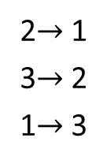

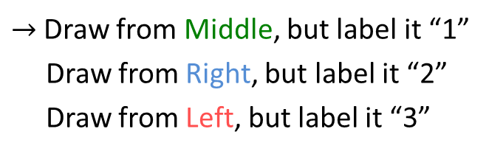
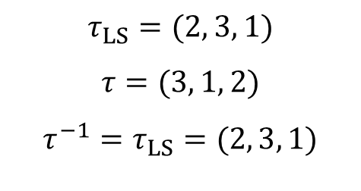
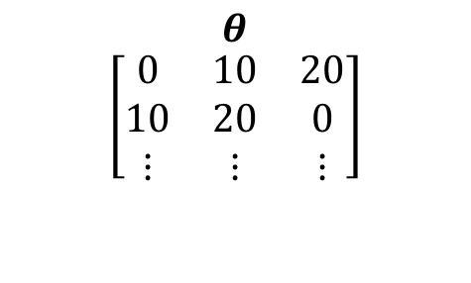
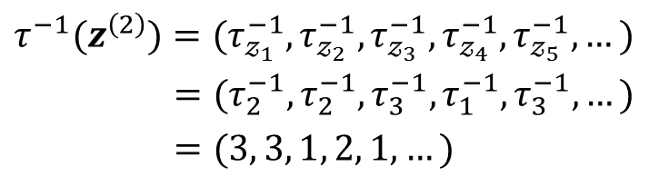

Exercises
Answer continued:
$$τ_{LS}=(2, 3, 1)$$
$$τ=(3, 1, 2)$$
$$τ^{−1}=τ_{LS}=(2, 3, 1)$$
$$\begin{matrix}θ \\ \left[\begin{matrix}0 & 10 & 20 \\ 10 & 20 & 0 \\ ⋮ & ⋮ & ⋮\end{matrix}\right]\end{matrix}$$
$→$ Draw from Middle, but label it “1”
Draw from Right, but label it “2”
Draw from Left, but label it “3”
2$→$ 1
3$→$ 2
1$→$ 3
$$⇓$$
$$\begin{matrix}z \\ \left[\begin{matrix}3 & 3 & 1 & 2 & 1 & ⋯ \\ ? & ? & ? & ? & ? & ⋯ \\ ⋮ & ⋮ & ⋮ & ⋮ & ⋮ & ⋱\end{matrix}\right]\end{matrix}$$
$$τ^{−1}(z^{\left(2\right)})=(τ_{𝓏_{1}}^{−1},τ_{𝓏_{2}}^{−1},τ_{𝓏_{3}}^{−1},τ_{𝓏_{4}}^{−1},τ_{𝓏_{5}}^{−1},…)$$
$=(τ_{2}^{−1},τ_{2}^{−1},τ_{3}^{−1},τ_{1}^{−1},τ_{3}^{−1},…)$
$=(3, 3, 1, 2, 1,…)$
$$\begin{matrix}z \\ \left[\begin{matrix}3 & 3 & 1 & 2 & 1 & ⋯ \\ 2 & 2 & 3 & 1 & 3 & ⋯ \\ ⋮ & ⋮ & ⋮ & ⋮ & ⋮ & ⋱\end{matrix}\right]\end{matrix}$$
$$⇔$$
Earl Duncan BRAG 20 July 2017: Reversing Label Switching 10/12

Slide 12
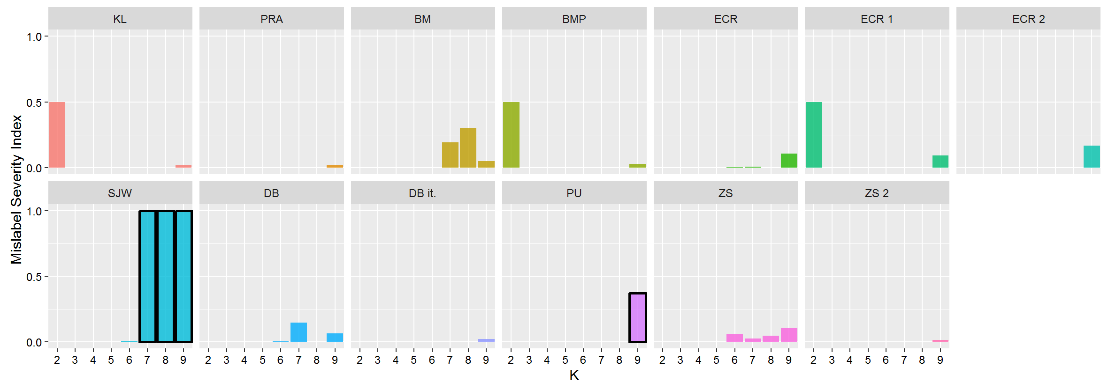
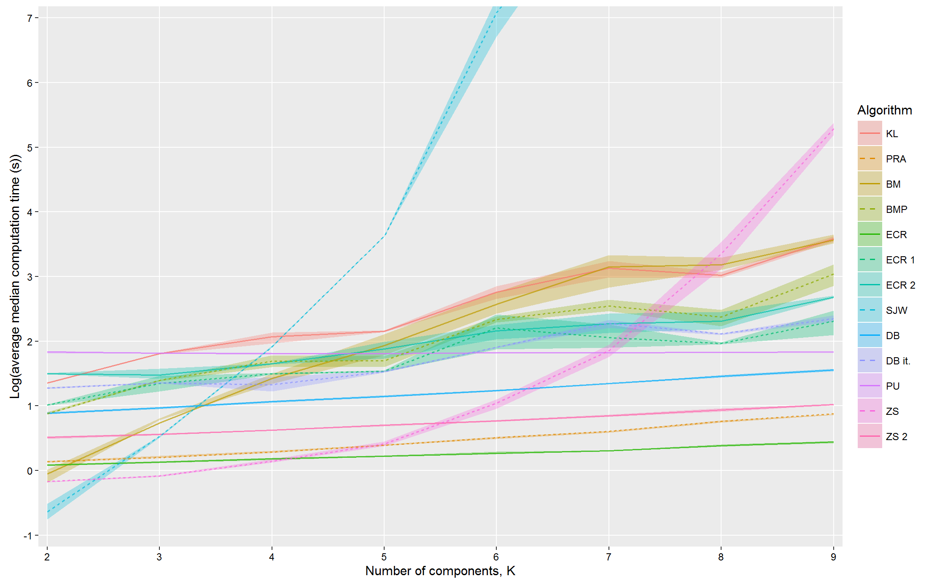
Comparison of Relabelling Algorithms
Earl Duncan BRAG 20 July 2017: Reversing Label Switching 11/12

Slide 13
Questions?
Any questions?
Earl Duncan BRAG 20 July 2017: Reversing Label Switching 12/12

