Slide 1

HOW DOES THE SCHOOL SYSTEM AFFECTS STUDENTS’ WELL-BEING?
Analysis on the PISA dataset

Slide 2
AIM OF OUR PROJECT
How does the school system and in particular its relationships with technology affect students’ well-being?
SCHOOL
TECHNOLOGY
Use of technology
Interest technology
Comptence in technology
Teacher support
FAMILY
Family support
Economic status
Study time
Techonology availability

Slide 3
TARGET OF OUR ANALYSIS
WELL BEING
Attitude towards learning activities
Competitiveness
Fear of failure
Bullying

Slide 4
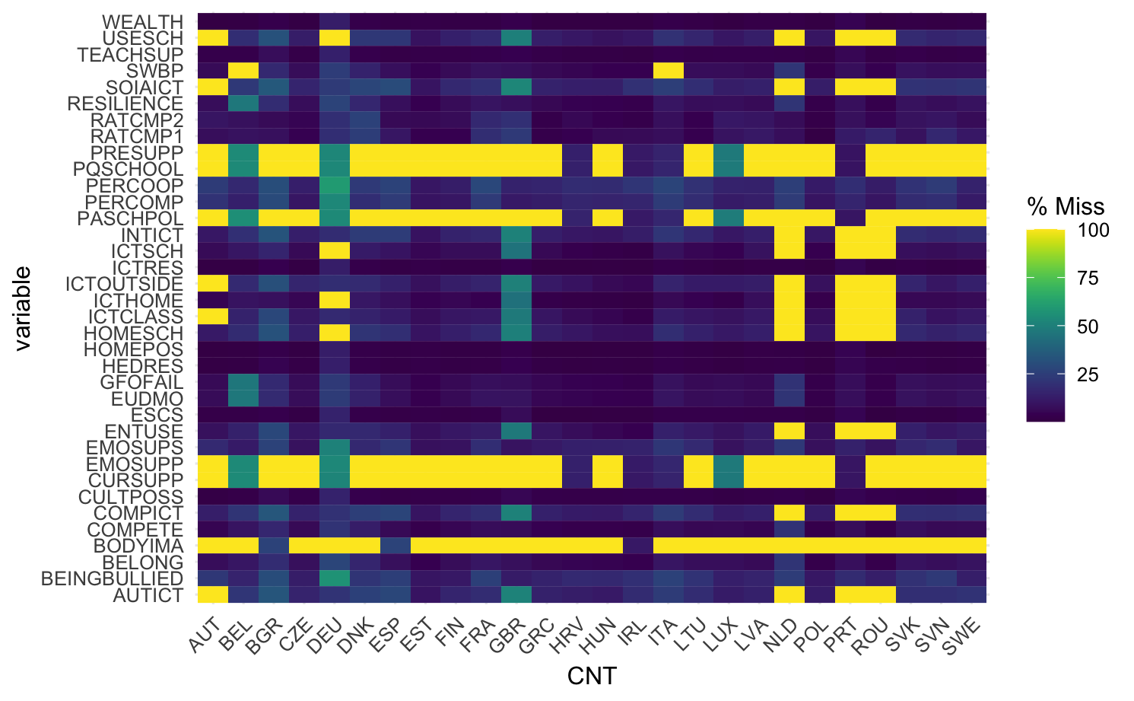
SELECTED COUNTRIES

Slide 5
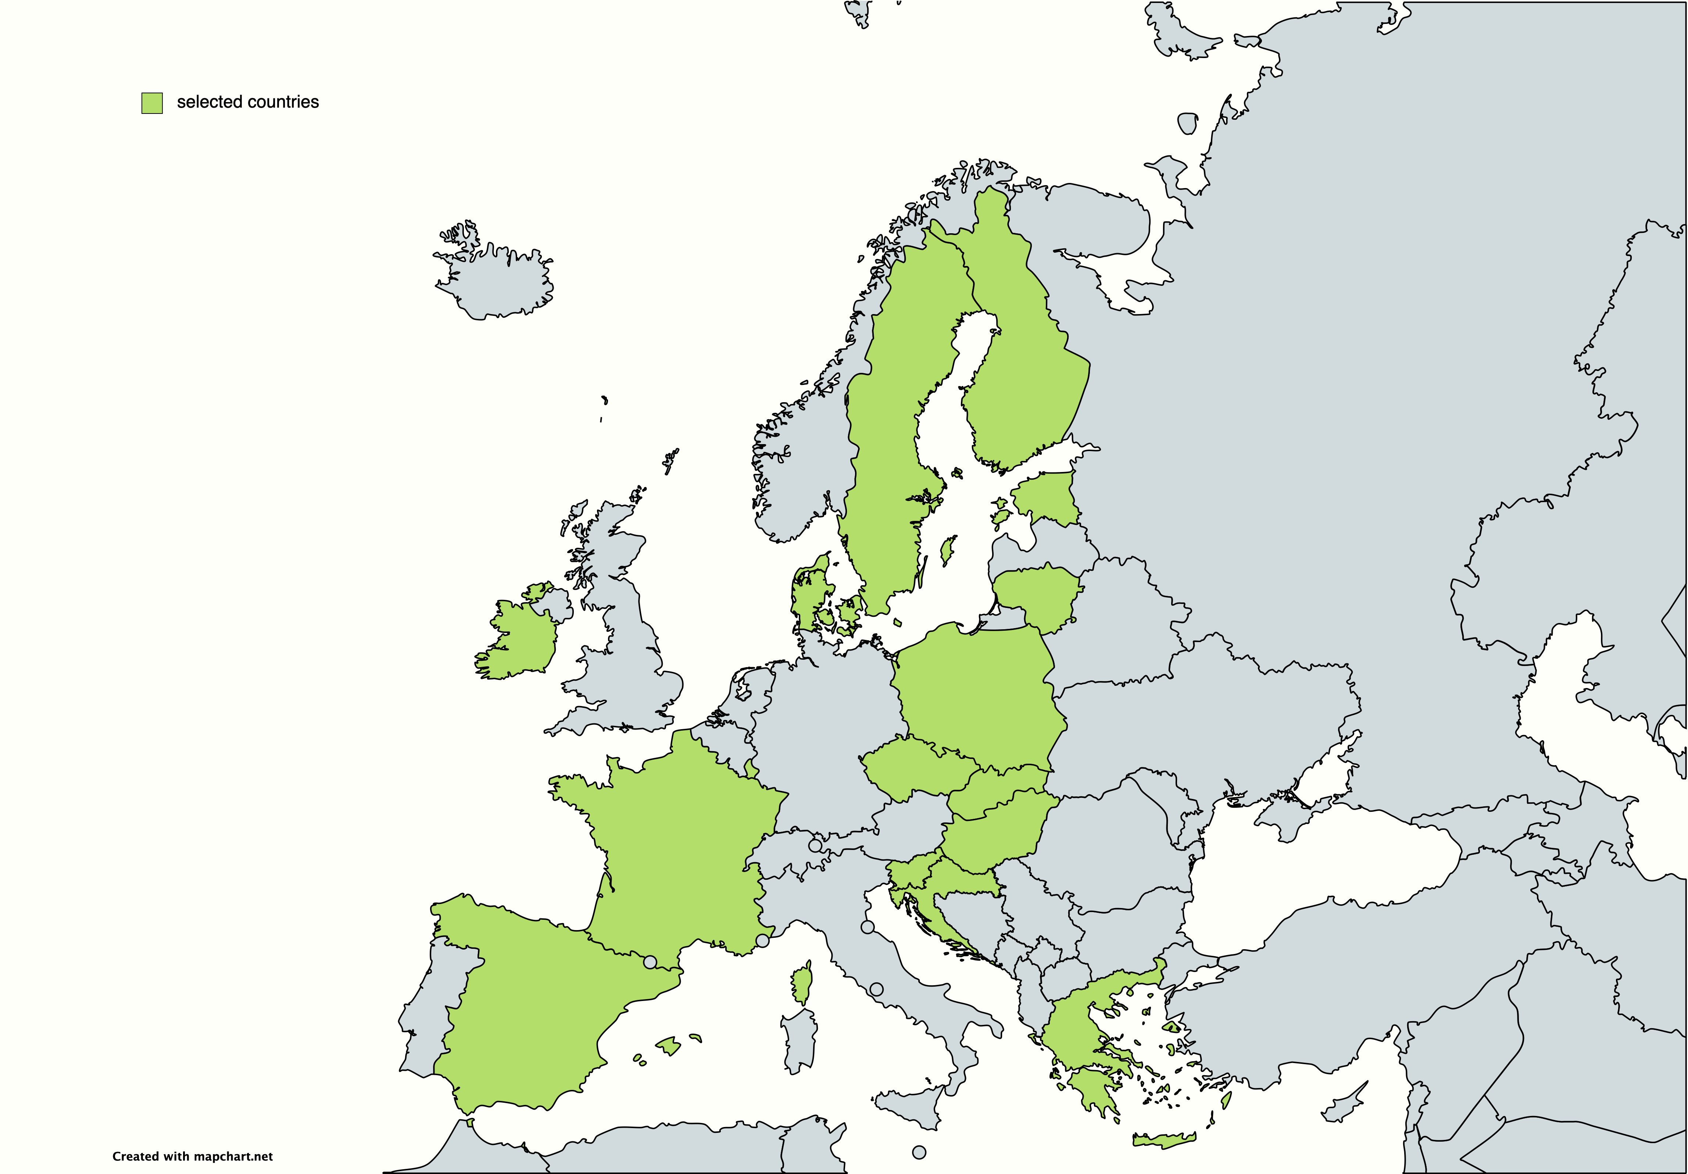
SELECTED COUNTRIES

Slide 6
DEVELOPMENTS
NA treatment
Exploratory analysis
Regression
Mixed effect model

Slide 7
OPEN QUESTIONS
Working with a smaller dataset
Grouping observation by schools
No gaussianity
Reducing dimensionality with factor analysis

Slide 8
THANK YOU FOR YOUR ATTENTION!

Slide 9
MANOVA

