Slide 1

HOW DOES THE SCHOOL SYSTEM AFFECTS STUDENTS’ WELL-BEING?
Analysis on the PISA dataset

Slide 2
AIM OF OUR PROJECT
We want to study students’ well-being according to different aspects of their life, considering the final indices instead of the specific questions addressed to the students
SCHOOL
TECHNOLOGY
Use of technology
Interest in technology
Competence in technology
Teacher support
FAMILY
Family support
Economic status
Study time
Technology availability

Slide 3
TARGET OF OUR ANALYSIS
WELL BEING
Attitude towards learning activities
Competitiveness
Fear of failure
Bullying

Slide 4
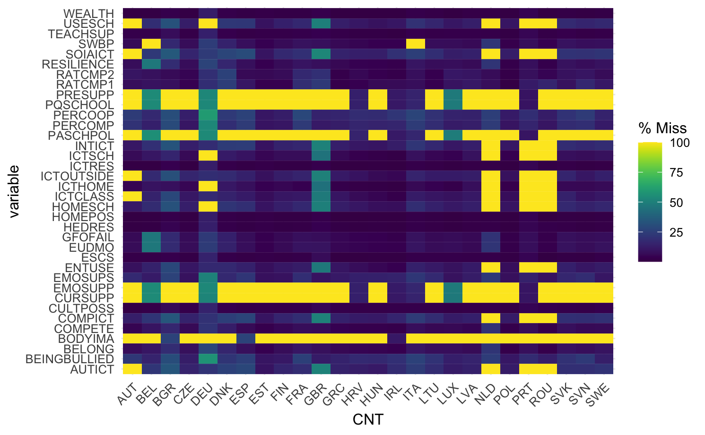
SELECTED COUNTRIES

Slide 5
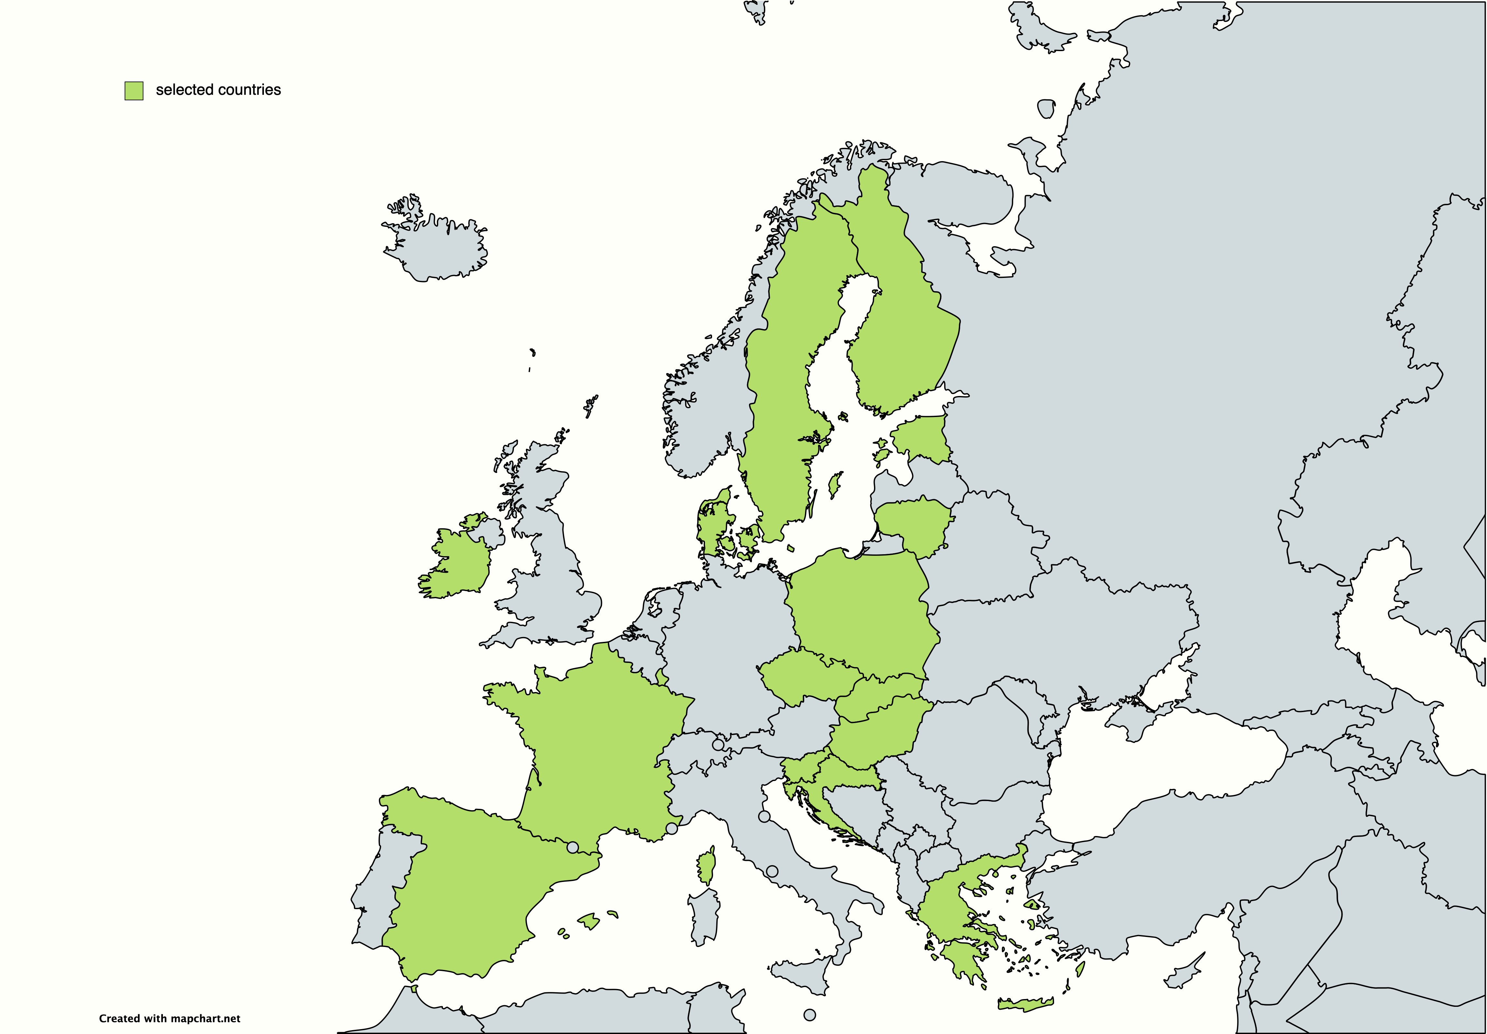

SELECTED COUNTRIES

Slide 6
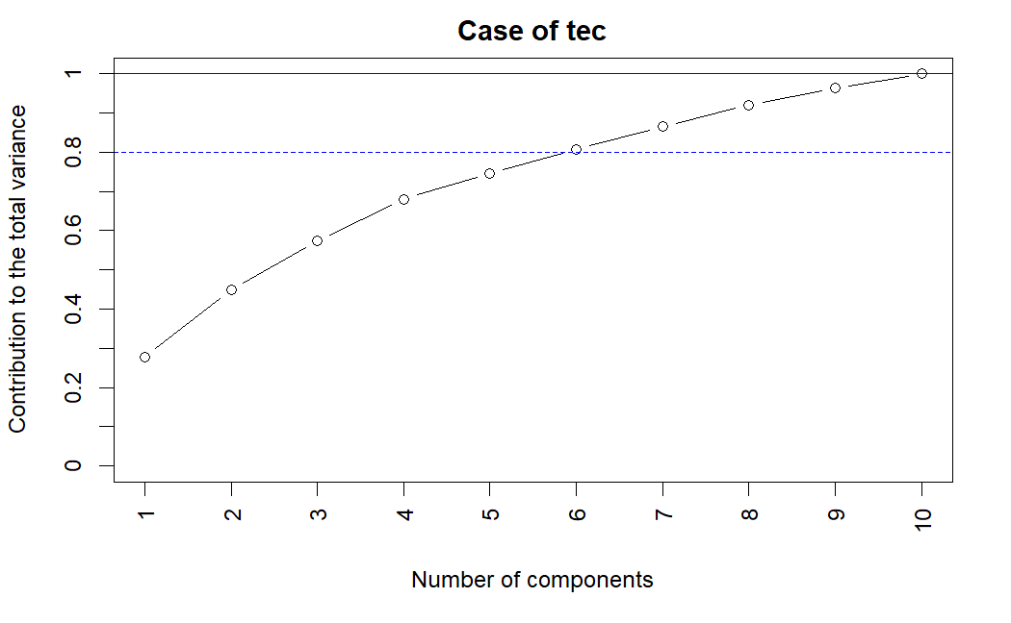
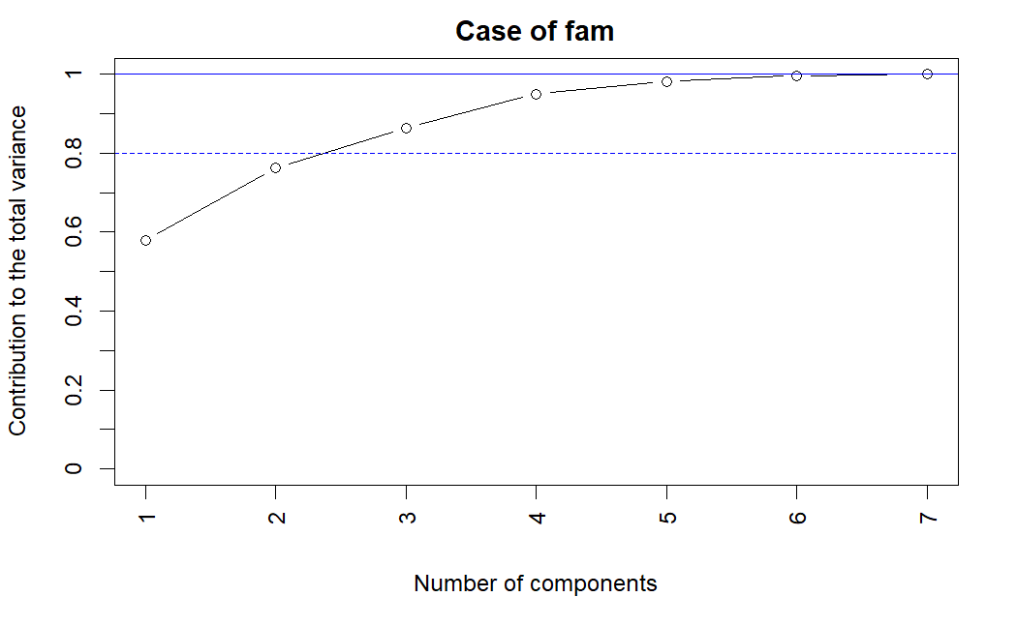
DIMENSIONALITY REDUCTION WITH PCA

Slide 7
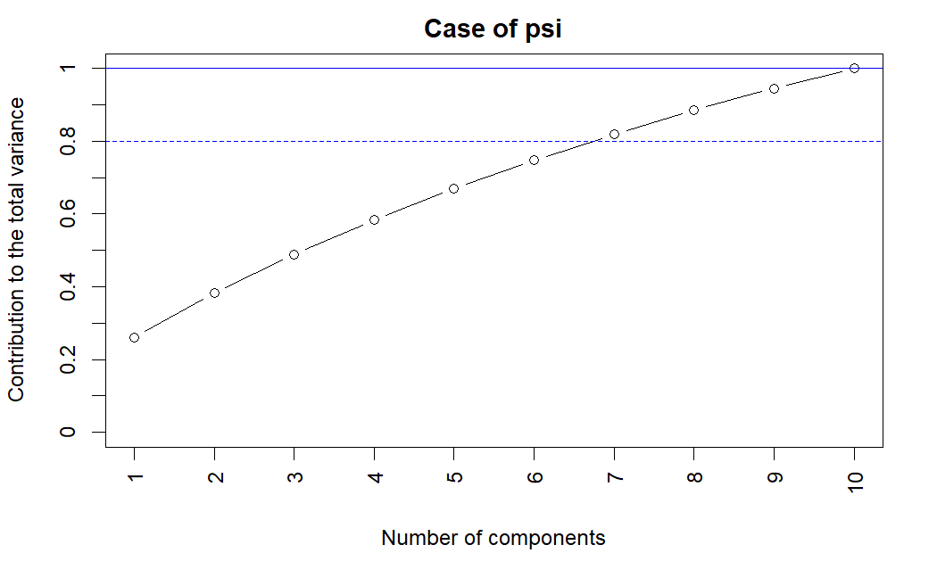
DIMENSIONALITY REDUCTION WITH PCA

Slide 8
DEVELOPMENTS
NA treatment
Exploratory analysis
Regression
Mixed effect model

Slide 9
OPEN QUESTIONS
Working with a smaller dataset
Grouping observations by school
No gaussianity assumption
Compute a score to synthesize the well being of the students

Slide 10
THANK YOU FOR YOUR ATTENTION!

