Slide 1
Recommendation
for Magist
realised by:
Project Team 2
Alisa
Federico
Benedikt
Kalpana
Mohammed
Cyrus

Slide 2
Table of content:
Eniac’s Scope and Strategy
Factors considered for Business analysis:
In relation to the products
In relation to the delivery time
In relation to the sellers
Conclusion

Slide 3
Eniac’s Scope and Strategy:
Eniac wants to enter the brazilian market and looks for a platform to sell from.
We are analysing the Magist business data to give a founded recommendation if Eniac should work with magist.

Slide 4
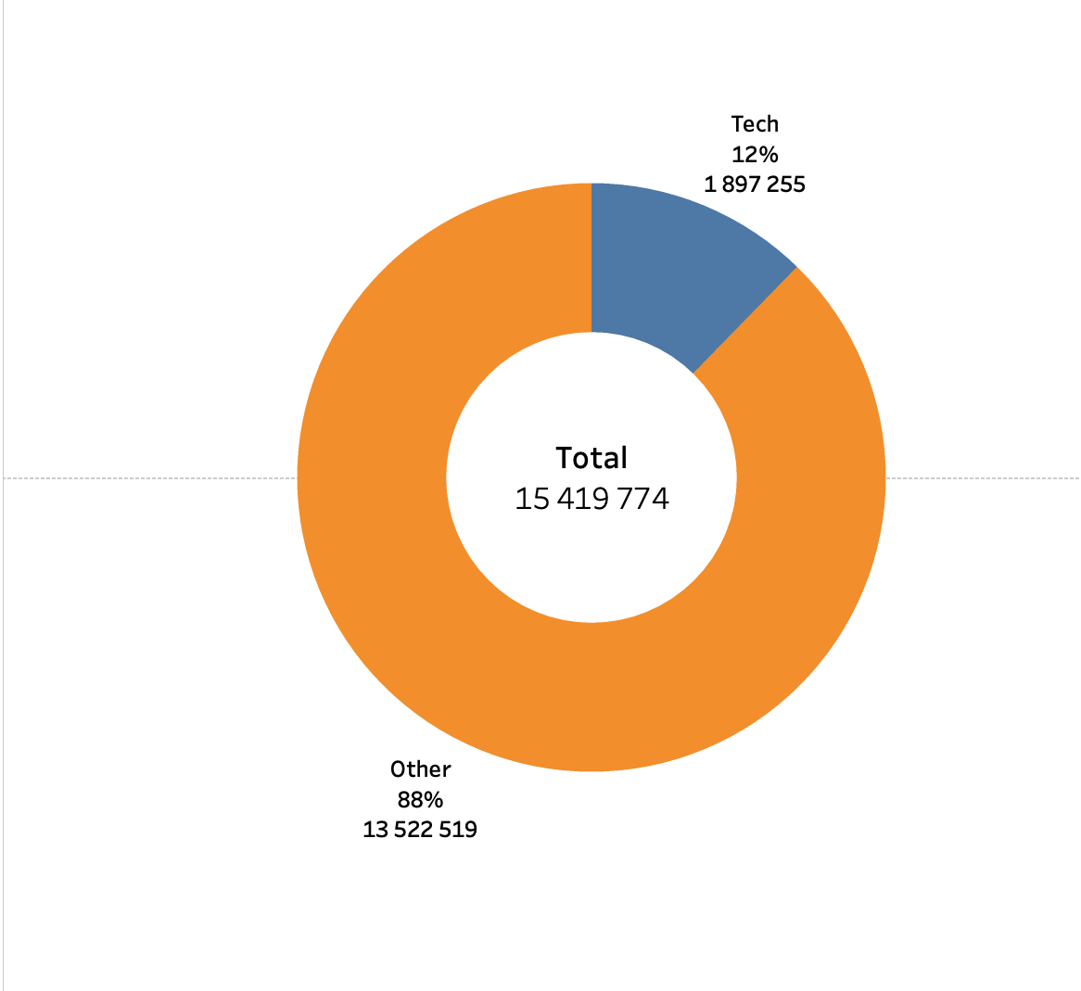
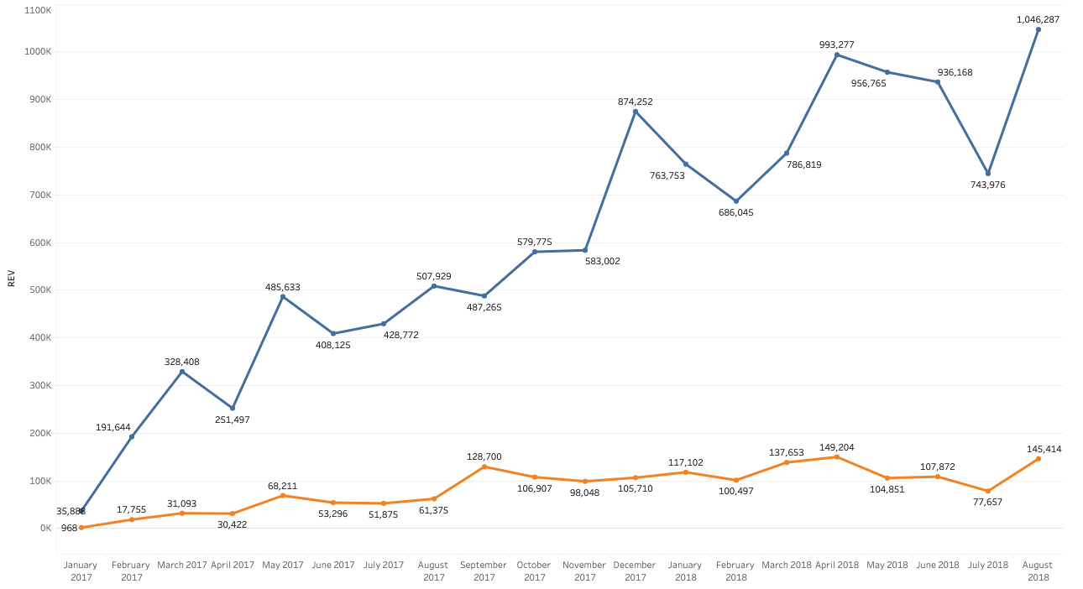
Products under Tech Category:
Magist is not really a Apple tech platform.
only 12% of sales being tech products.
that is backed up by the number of products and sellers in the tech categories, which both are a minority.

Slide 5
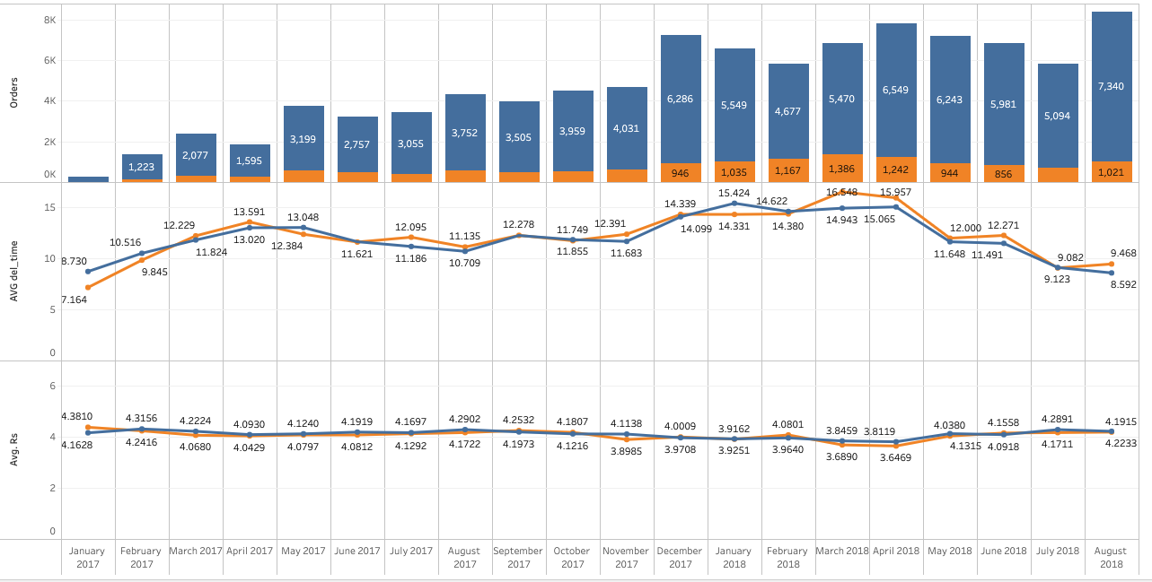
Average Delivery Time & Review Score:
Shipping times and quality of service keep an acceptable performance in stress periods
Review scores are constantly above 4 of 5

Slide 6
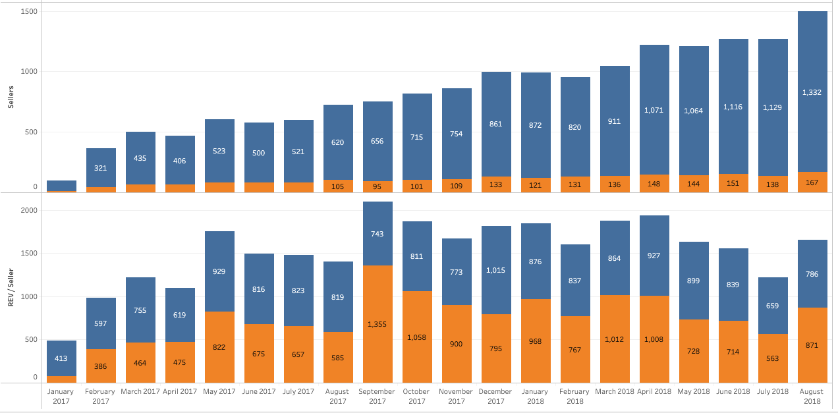
Sellers, Sales and Revenue:
Sellers are gradually increasing, tech sellers remain marginal
Revenue for sellers is in a downtrend since Q3 of 2017

Slide 7
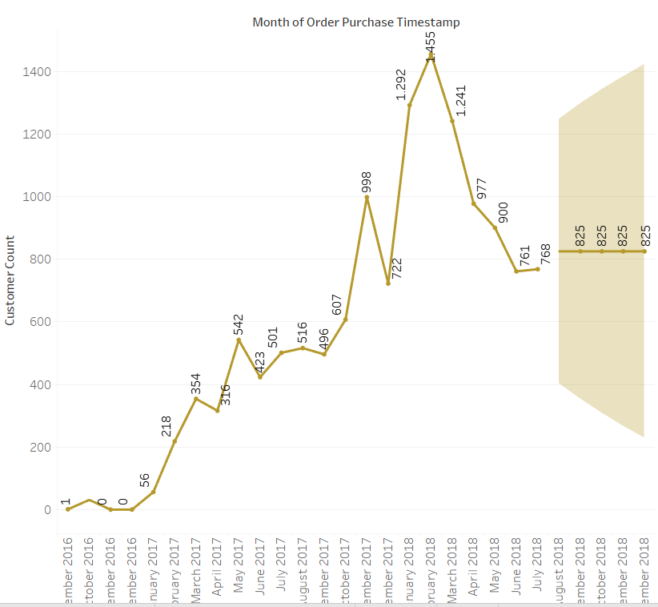
Our recommendation:
Dont go for Magist.
Reasons for rejection:
Decrease / stagnation in purchases, customer count & sellers not promising.
Tech Category products are marginal in Magist portfolio and perspective doesn’t look different.
Average tech-product-price is also less than average product price of ENIAC 540€.
We miss critical data like products specs, exact categories, as well as income.
Data Snapshot it to small for a final conclusion

Slide 8


