Slide 1
Face2Face: an innovative way to face recognition
DL-IC 2018 Project
Edoardo D’Amico - Giovanni Gabbolini - Federico Parroni

Slide 2
Introduction
What is Face2Face?
Authentication is a crucial part in most of the current digital systems:
Banks
Personal devices
…..
Face2Face allows to implement a biometric authentication based on face recognition, using a different approach from the current state of the art.
Pros | Cons
Cost/performance tradeoff Real time usage Integrability | Non deterministic matching Environmental conditions

Slide 3
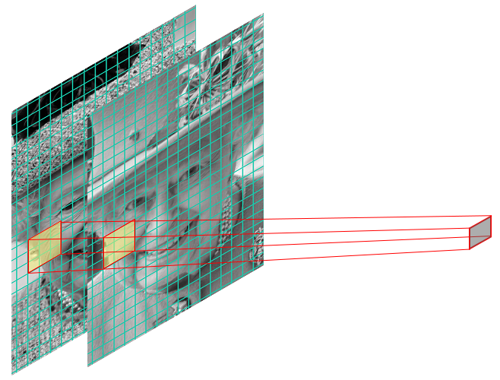
How does it work?
Face2face compares images using a deep CNN. (nothing new?)
Main Idea: use convolutional layers directly to extract similarity between faces depicted in two images.
Two gray scale images are stacked one on top of the other.
2-dimensional convolutional layers filter those images extracting an embedding of the initial input.
A fully-connected neural network outputs a “face-matching” probability of the given embedding.
Notes:
would naturally tell the relation between the two images in terms of similarity among identities of people appearing in
those.

Slide 4
Model selection
The model space is huge:
High number of hyperparameters
Number of models grows exponentially with those
No chance to evaluate them all
Candidates restricted to a small portion:
Selected a subset of models (following Bengio[1])
Performed a standard validation procedure

Slide 5
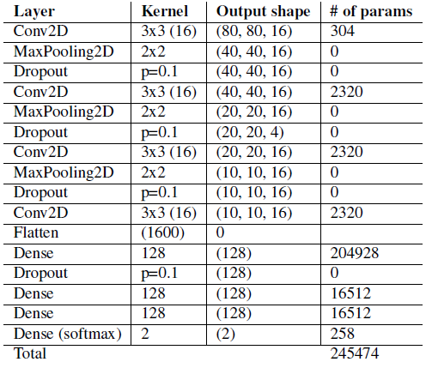
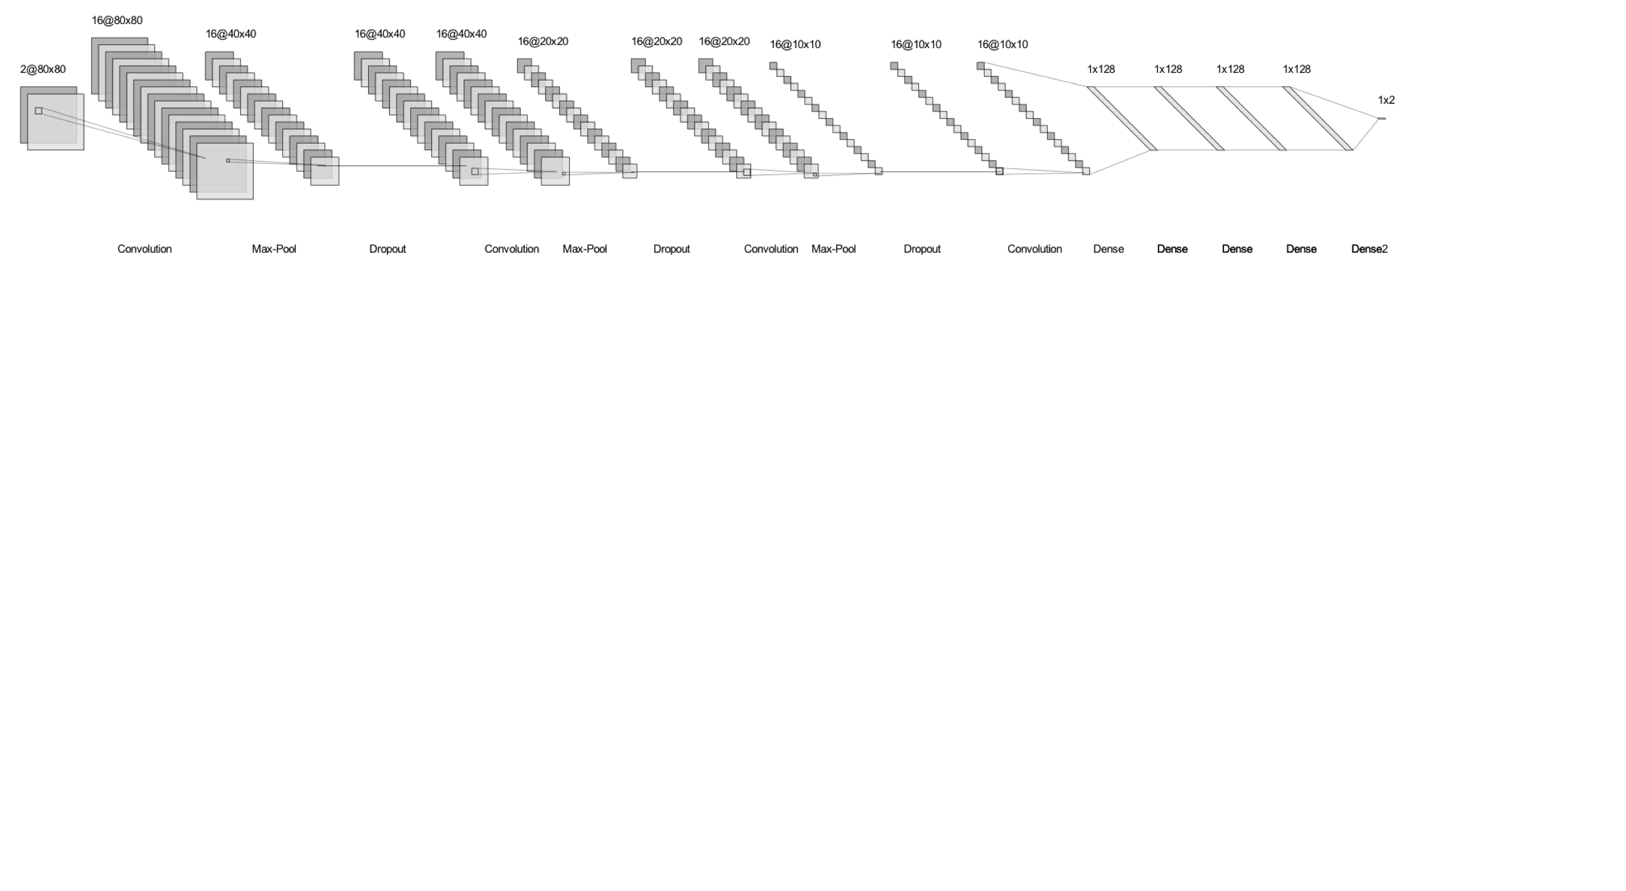
Architecture
The convolutional neural network is made up of 2 main parts:
Convolutional layers: 3 convolution + pool + dropout layers
Fully-connected layers: 3 dense layers

Slide 6
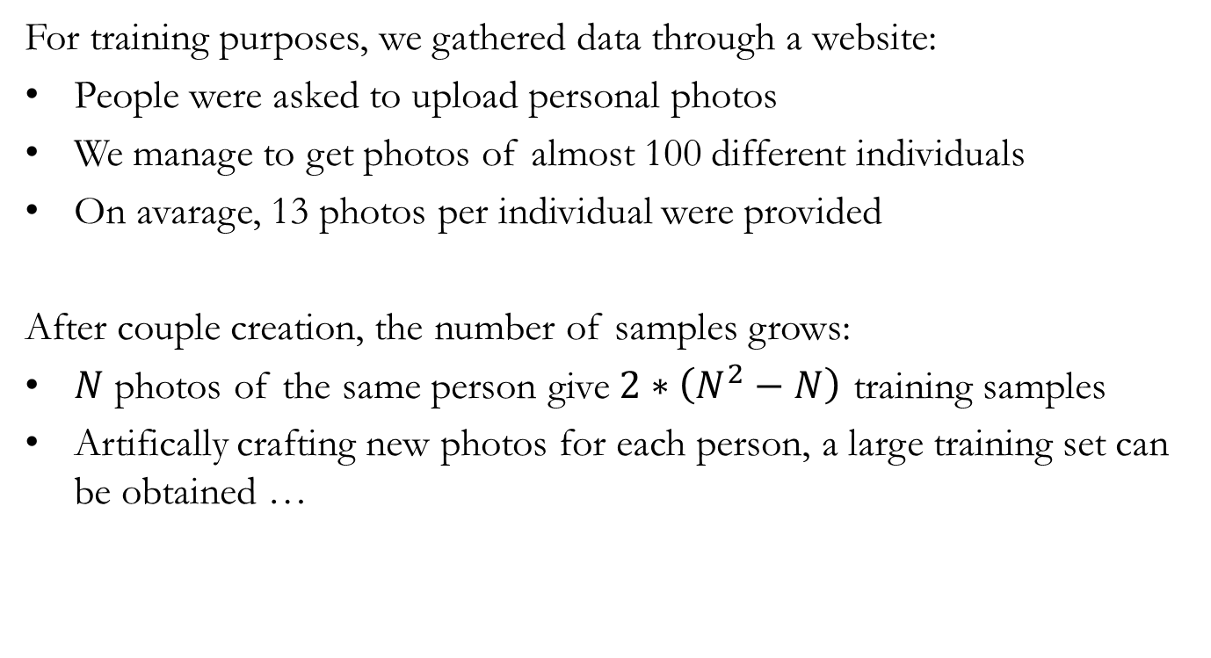
Data
Harvesting
For training purposes, we gathered data through a website:
People were asked to upload personal photos
We manage to get photos of almost 100 different individuals
On avarage, 13 photos per individual were provided
After couple creation, the number of samples grows:
$N$ photos of the same person give $2∗\left(N^{2}−N\right)$ training samples
Artifically crafting new photos for each person, a large training set can be obtained …

Slide 7
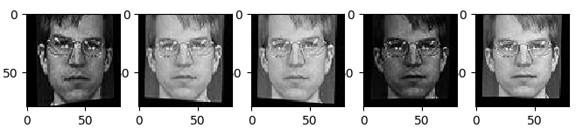
Data
Augmentation
Using Augmentor [2], we managed to craft 5 new images for each of the photo we had.
Transformation | Probability
Flip left-right | 0.5
Skew left-right (magnitudes vary) | 1
Increase brightness | 0.5
Decrease brightness | 0.5
Adaptive equalization | 0.5
Notes:
Gain more advantage from the augmentation

Slide 8
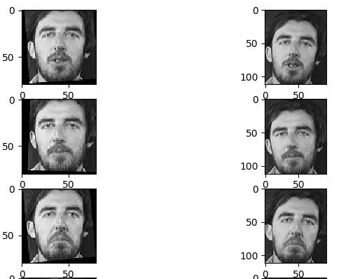
Data
Normalization
To achieve higher accuracies, we have transformed the images in a standardized way, following this procedure:
Find a face in an image
and crop it ([3])
Resize to a standard size
Bring the eyes in a
fixed position ([4])

Slide 9
Training procedure
Dynamic couples creation:
Select a subset of people from the training set.
For every person create all the possible couples from his photos
Creation of a number of positive samples
Join every photo of a person on the set with photos of other random person
Creation of the same number of negative samples

Slide 10
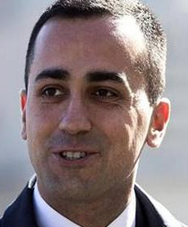
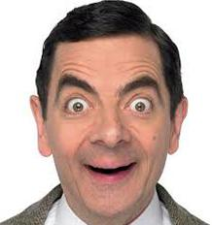
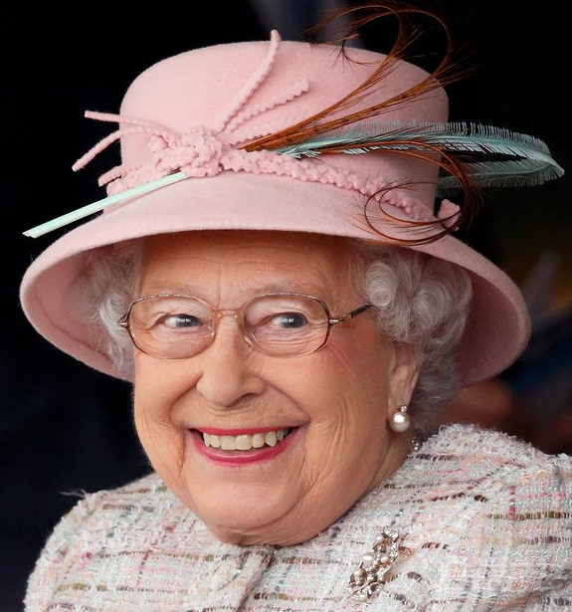


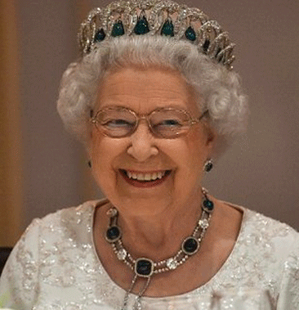
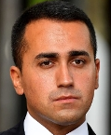

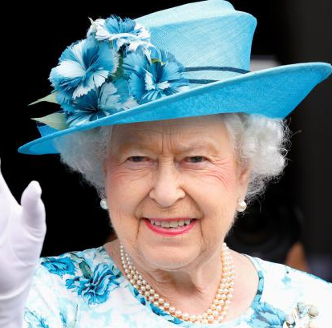
Data
Positive couples creation
Rowan Atkinson
Queen Elizabeth
Luigi Di Maio

Slide 11
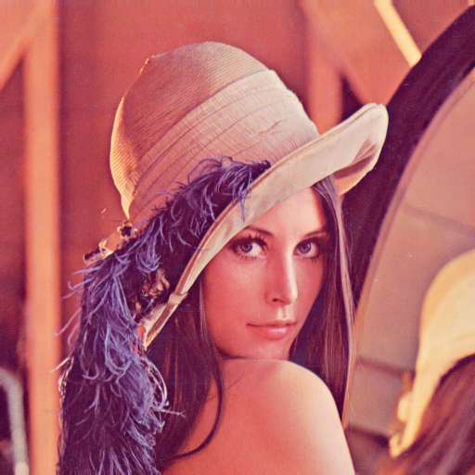
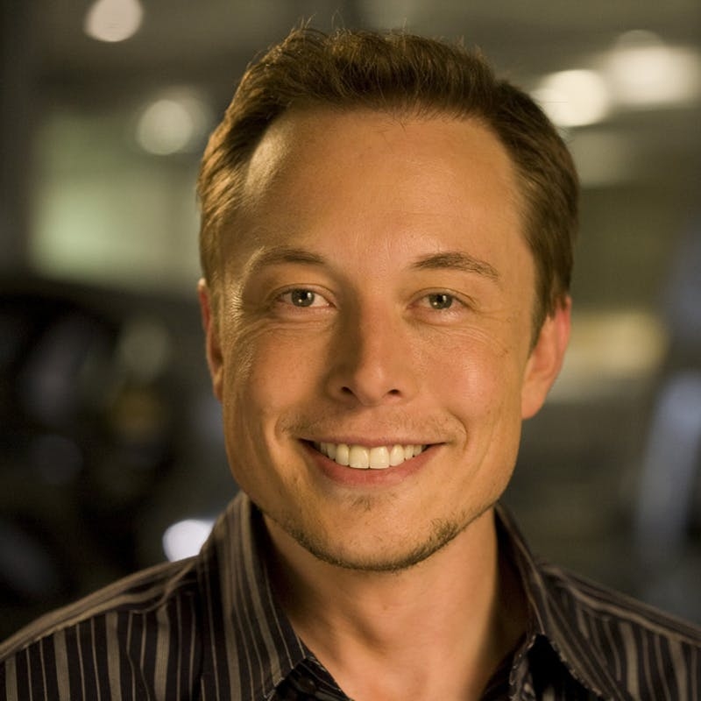
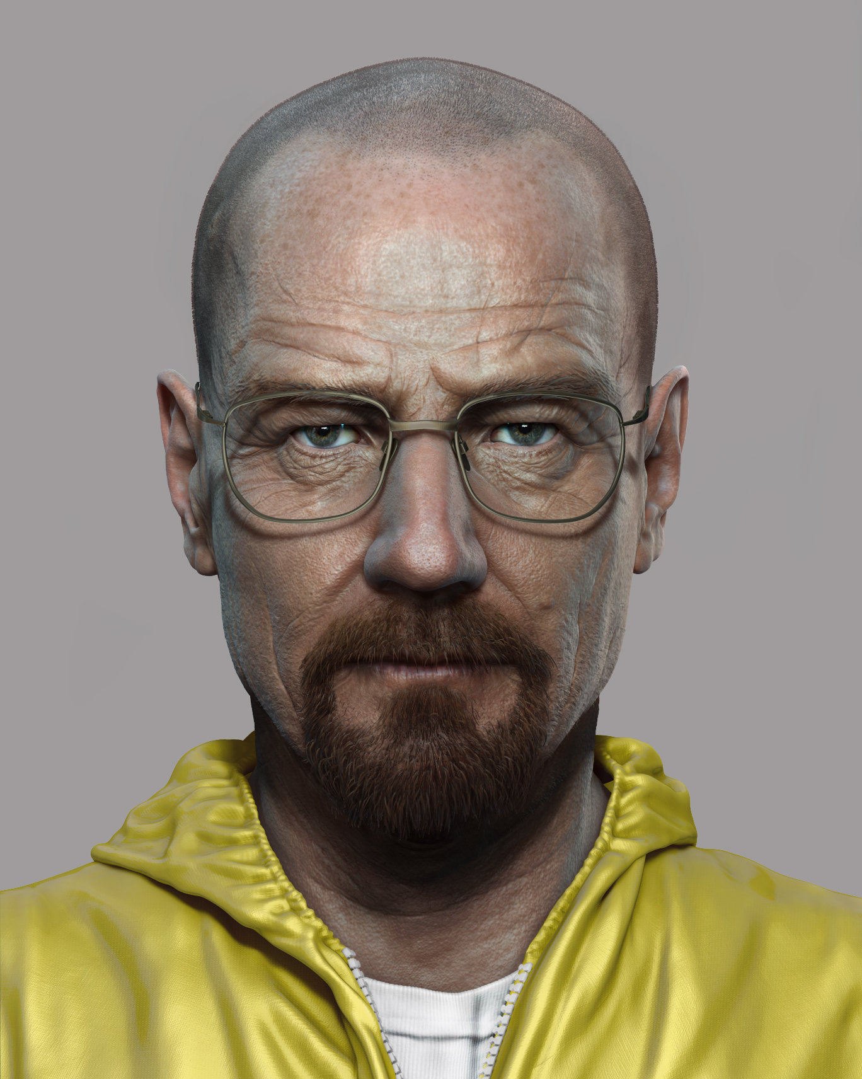
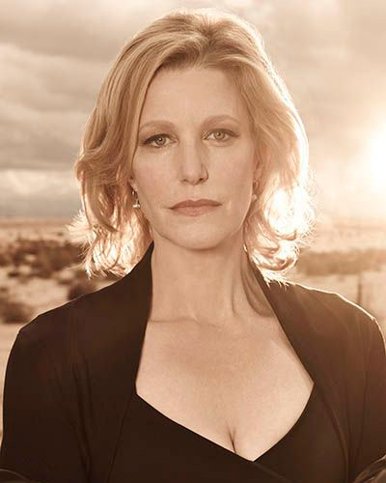


Data
Negative couples creation
Rowan Atkinson
Queen Elizabeth
Luigi Di Maio

Slide 12
Training procedure
Couples creation:
Select a subset of people from the dataset.
For every person create all the possible couples from his photos
Creation of a number of positive samples
Join every photo of a person on the set with photos of other random person
Creation of the same number of negative samples
Training starts:
Train on the couples until overfitting
When overfitting starts, go to 1 (Change data).

Slide 13
Evaluation
The evaluation has been done on couples generated from different test set:
Test set taken from the initial data set (20%)
Test set called « Labelled Faces in the Wild ( LFW ) »
The evaluation has been done on the « face-matching » task using as prediction the output of the net.
Beyond the usually figures of merith as the accuracy and precision, to further evaluate the performance also the ROC curve and the AUC parameter has been analyzed.
Notes:
Remember a sample is not an image but a couple of images stacked on upon the other as mentioned before.
Receiver operating characteristic

Slide 14
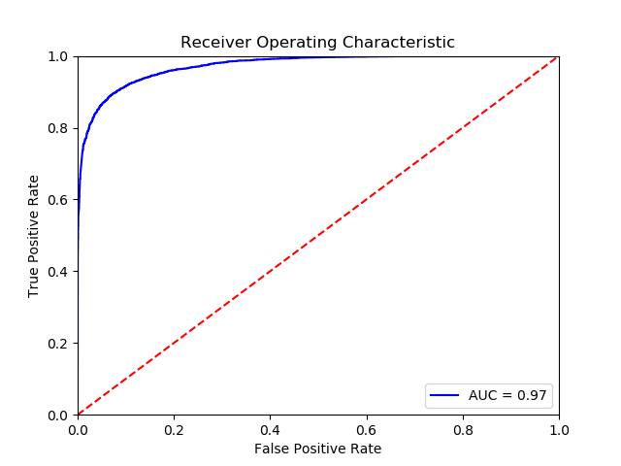
Own test set
On the test set created from our initial dataset we have reached:
AUC = 0.97
The Accuracy and Precision
have been evaluated using two
different tresholds, one of which
has been chosen thanks to the ROC
curve.
Treshold | Accuracy | Precision
0.5 | 0.915 | 0.9278
0.975 | 0.845 | 0.9985

Slide 15
LFW dataset
On the LFW dataset the Accuracy and Precision have been evaluated using the same two tresholds used for the evaluation on the initial test set.
Must be remembered that the faces in this dataset are not gathered up to be used as training data for authentication purpose, in fact most of the images are depicting a face in an inappropriate pose for our task.
Treshold | Accuracy | Precision
0.5 | 0.745 | 0.7474
0.975 | 0.775 | 0.9824

Slide 16
Conclusion
We provide a model useful to guarantee authentication in
general purpose applications in a real time scenario.
Accuracy is not very high (current state of the art is 99.63 in LFW), but precision is what matters since in 1 second about 8 prediction are done.
A further improvement can be done by using parallel comparisons of different photos and acting in a majority voting way.

Slide 17
Thanks for your attention

Slide 18
Bibliography
[1]: Yoshua Bengio Practical Recommendations for Gradient-Based Training of Deep Architectures
[2]: https://github.com/mdbloice/Augmentor
[3]: https://www.learnopencv.com/histogram-of-orientedgradients/
[4]: https://www.pyimagesearch.com/2017/05/22/facealignment-with-opencv-and-python/

