Slide 1

Data Mining Project 2019!
10454243 - Di Pietro Gianpaolo
10638513 - Patuelli Simone
10638331 - Damico Edoardo
10636497 - Parroni Federico
10588939 - Gabbolini Giovanni

Slide 2
Project Pipeline
In a preliminary exploration of the data we tried to figure out the problem
and identify some useful patterns.
Data Exploration
Cleaned row data.
Created a structure that makes easy merging different datasets.
Preprocessing
Imputed some missing values.
Created many useful features.
Data Enrichment
Model Implementation
We focused on models based on gradient boosted trees.
Every result was analyzed and studied in order to improve the model.
Result analisys
Notes:
Aggiungere qualcosa a destra

Slide 3
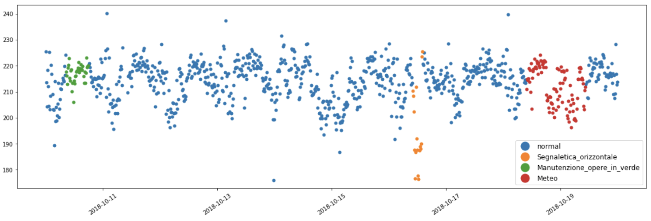
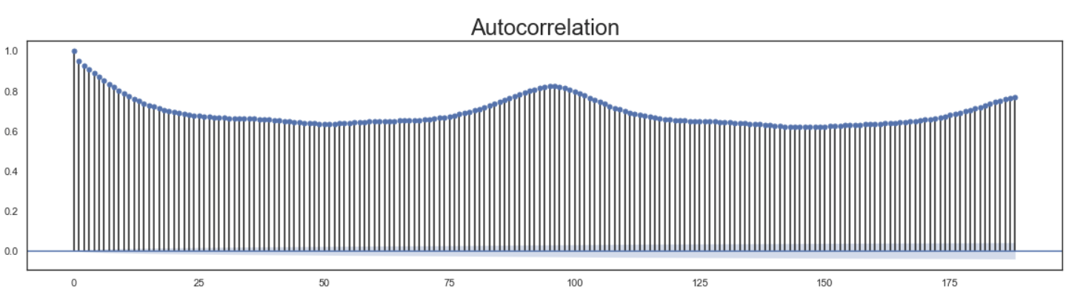
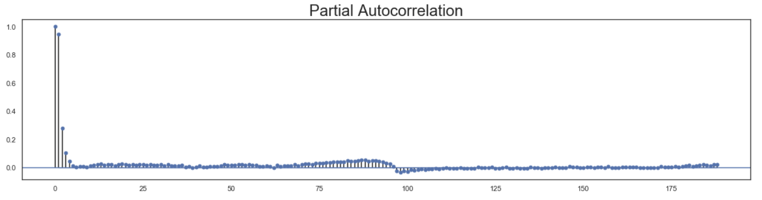
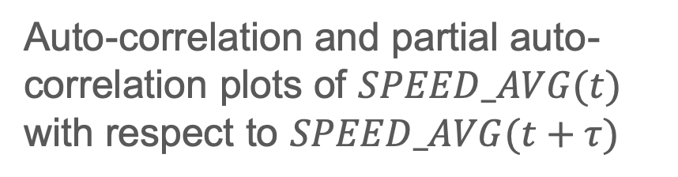
Data Exploration
Each event affect data in different way
Auto-correlation and partial auto-correlation plots of $SPEED_AVG(t)$ with respect to $SPEED_AVG(t+τ)$

Slide 4
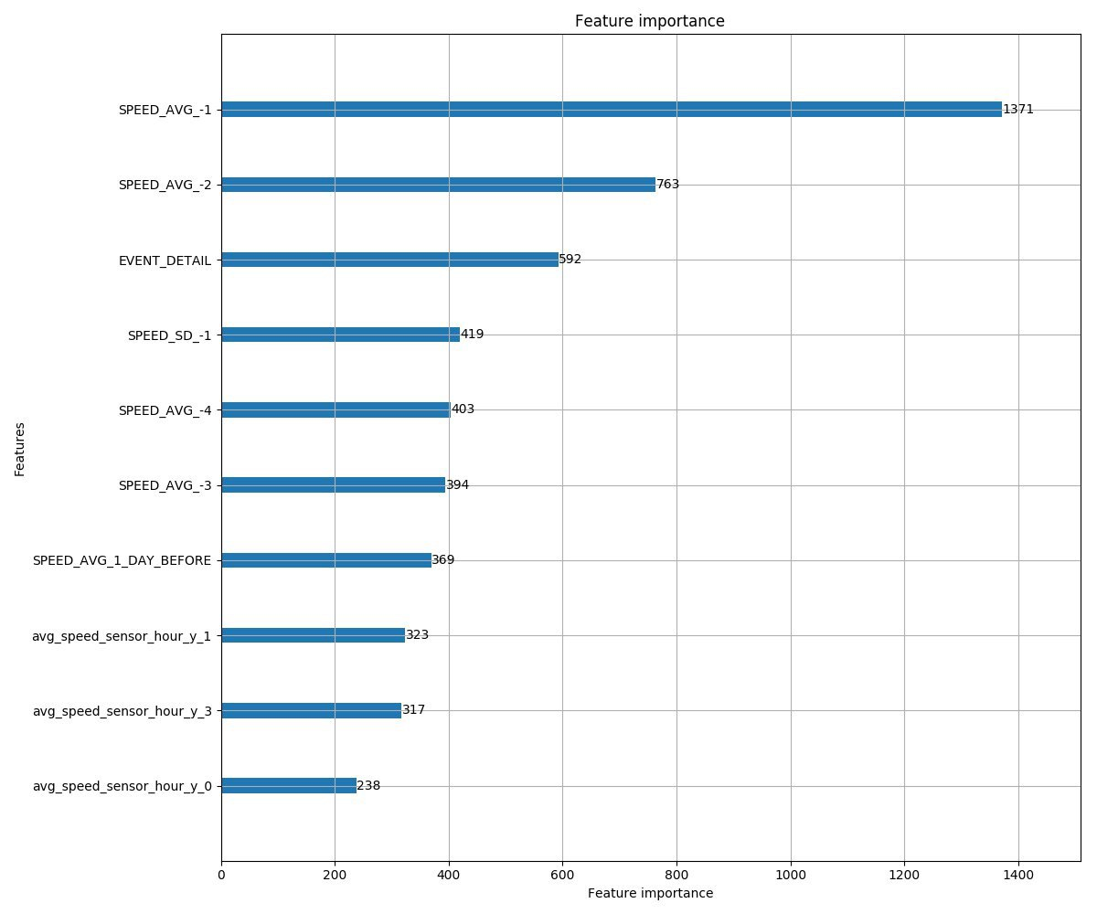
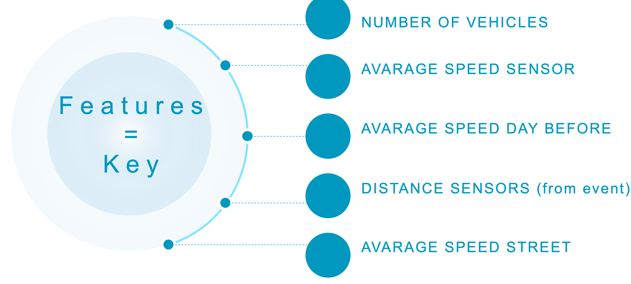
Data Enrichment

Slide 5
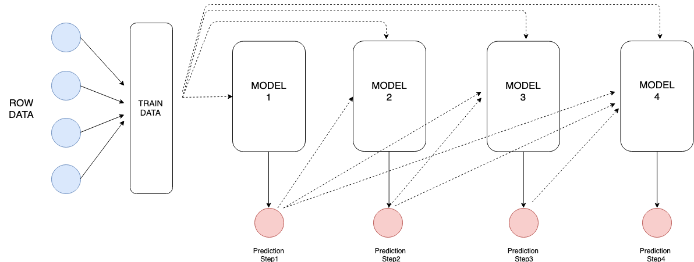
Model and Results
We use an hibrid model composed of two regressor chains, one with catBoost and one with lightGBM
OUR MODEL
FINAL RESULT
BASELINE
MAE= 9.38
MAE= 8.67

