Slide 1
Performance Evaluation Fair Cellular Network
Leonardo Bernardi
Gioele Carignani
Federico Rossi

Slide 2
Introduction
This study concerns the analysis of the behaviour of packets delivered by an antenna to mobile nodes connected to it . The antenna follows a very simplified approach of the one used in LTE.
For our needs we made some assumptions:
Maximum packet size fixed to 75 bytes
Only 3 different RNGs
Ideal communication channel

Slide 3
Scenarios
Base scenario:
10 users
120 seconds simulation
30 seconds warm-up
10 reps for warm-up evaluation
100 reps for data gathering
Uniform distributed CQIs:
CQIs are extracted from an uniform distribution U(1,15).
Stability condition holds for all the users in the same way
Binomial distributed CQIs:
Each user has its own success probability used to extract number of successes in 14 repeated trials (then +1 to generate the CQI).
For more meaningful results users are splitted into two classes, one with low success probability (e.g. 0.2) and one with high (e.g. 0.8)
Stability condition has to be shaped upon the users with low success probability (thus strictier w.r.t. first scenario).

Slide 4
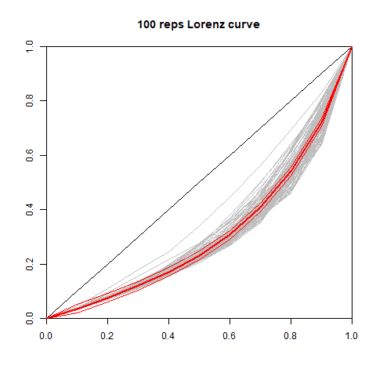
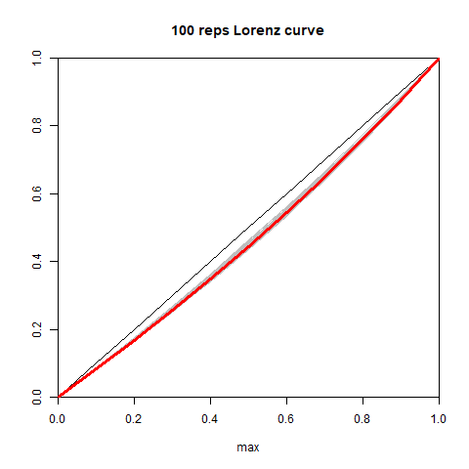
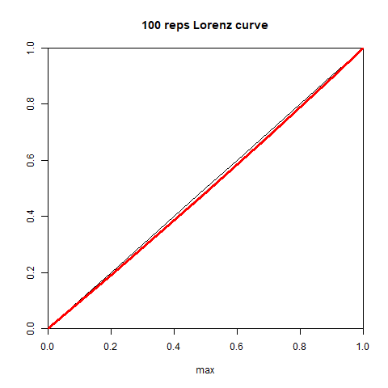
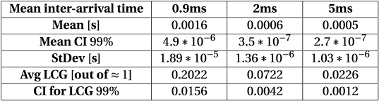
Uniform CQIs scenario (Response time)
0.9ms
2ms
5ms

Slide 5
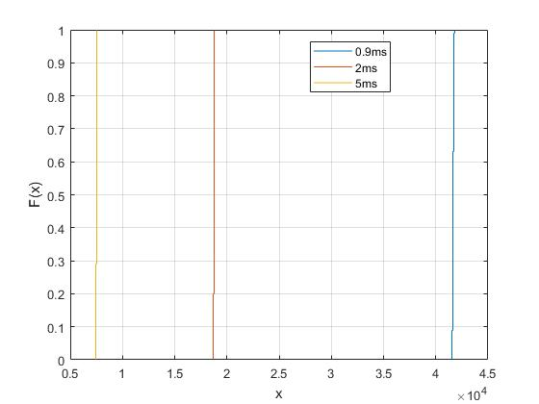
Uniform CQIs scenario (Throughput)
ECDF at a given workload is more or less a delta around x=λ*E[packetSize]
Lorenz curves are not useful, due to the very low variability of the throughput between users (i.e. quite perfect fairness)
This also holds for binomial CQIs, with slightly different values.

Slide 6
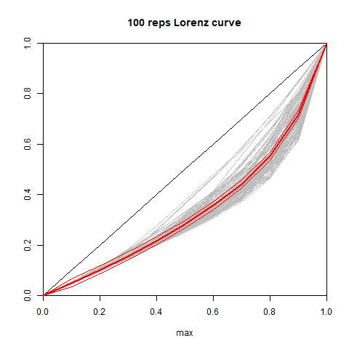
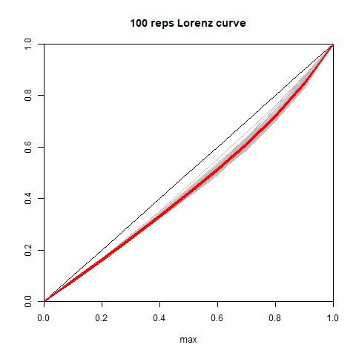
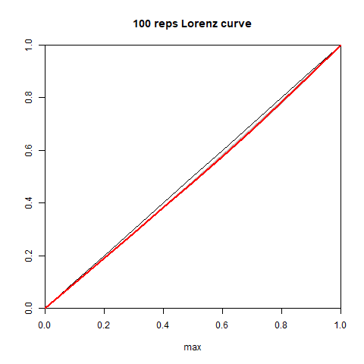
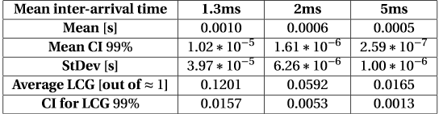
Binomial CQIs scenario (Response time)
1.3ms
2ms
5ms

Slide 7
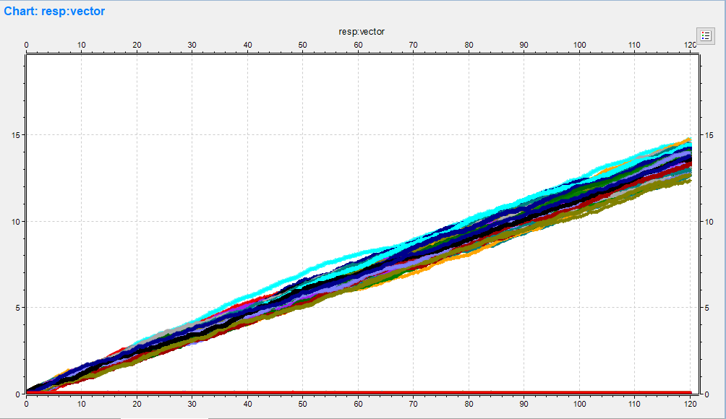
Binomial CQIs scenario (Response time cont.)
We tested the system with low p at 0.05 and high p at 0.95 (inter-arrival time 2ms)
This resulted in some users reaching stability for response time, while having others diverging.

Slide 8
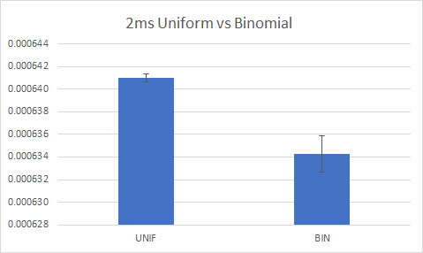
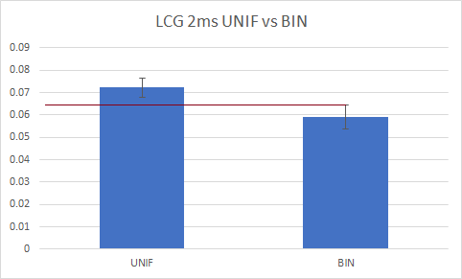
Comparison – (Response time & LCG)
The mean response as the LCG time is pretty the same.
At 2ms binomial has a wider CI → closer to stability limit than uniform.
At 5ms they’re both quite distant from limit, so we have pretty the same behaviour.

Slide 9
Comparison – (Throughput)
Same workload → same throughput
Uniform can undergo heavier workloads, so it has higher maximum throughput
Fairness in terms of throughput is very near to the perfect line of maximum fairness.

Slide 10

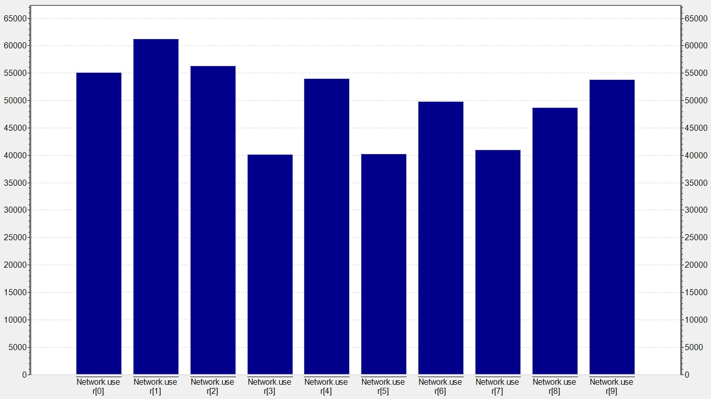
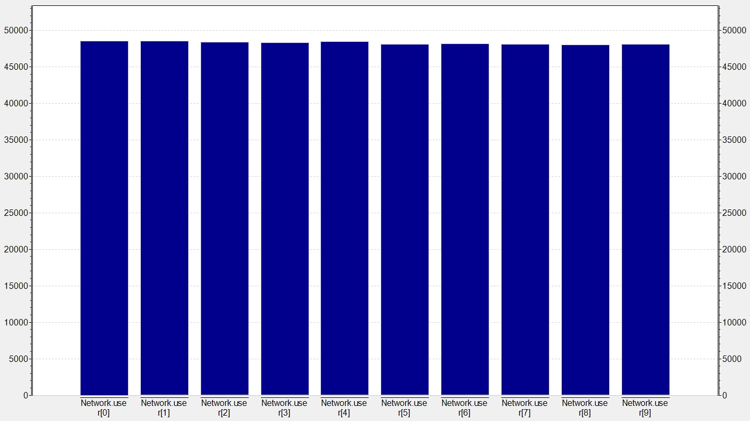
Optimised algorithm
We modified our scheduling algorithm by using an historical average (α=0.4), the older version had two problems:
Overflow with high counting numbers (>2^32)
Some users could incur in a situation of starvation

Slide 11
Conclusions
Stability for the Uniform Scenario depends only on the aggregate mean arrival rate, instead in the Binomial Scenario it also depends on the lowest success probability.
In the Uniform scenario our network supports a heavier workload w.r.t. Binomial, but in the same conditions with Binomial CQIs there is in average a better user experience (very similar though).
The optimisation brought really good improvements, in fact the already pretty good fairness improved in both cases (in the binomial case between users of the same class), and also a lower response time.

