Slide 1

School of Engineering
Department of Information Engineering
MSc Degree Course in Robotic and Automation Engineering
Analysis, design and implementation of AI/ML-based techniques for automatic video surveillance and control systems in smart cities
Professor:
Sergio Saponara
Tutor:
Federico Rossi
Student:
Giacomo Mugnaini

Slide 2



Introduction
In the EUPilot context, an AI-based video processing system represents one of the main use case to test the accelerators developed in the project.
For the purpose of creating an innovative and effective solution that improves current security systems, Leonardo developed an AI-based video surveillance system called Ganimede.
2

Slide 3


Introduction
AI-based video surveillance systems:
Analyze large volumes of data extrapolating intelligent informations
Increase security sending real-time warnings about unwanted or dangerous situations in different scenarios such as smart cities, airports, harbors or critical infrastructures.
Support the activity of control room operators ensuring a more efficient use of resources.
3

Slide 4
System Architecture
Basically, Ganimede is composed by a set of surveillance cameras (mounted on drones or placed in strategic points) that send over 10000 video streams to edge computing resources (such as GPU NVIDIA Tesla T4 or GPU NVIDIA A100).
At the edge level, data are processed and, if necessary, sent to the control room.
Post-process feedback
Edge Resources
Control Room
Video Streams
Terminal Video Alarms (if necessary)
4

Slide 5
The application: Man Down
Among all the tasks that can be performed on Ganimede platform, one of interest is the man down task.
It consists of identifying, tracking and counting people lying on the ground.
The algorithm is made of three main components:
Object Detector: detects objects of interest in the scene
Man Down Classifier: performs a filtering and classifies the remaining objects as man down
Tracking Algorithm: tracks and counts all the man down objects
5

Slide 6
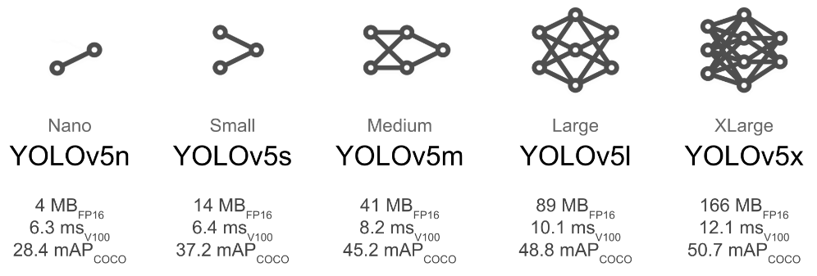
Object Detector
YOLOv5 [1]
YOLOv5 (You Only Look Once) is a single-stage object detector developed by Ultralytics and completely implemented using the PyTorch framework.
Models are trained on Microsoft COCO (Common Objects in Context) dataset which includes 80 classes such as person, bicycle, car, airplane, dog etc…
Models accuracy is evaluated on COCO validation set using the mean average precision (mAP) metric
Models speed is evaluated using a GPU NVIDIA Tesla V100
[1] https://github.com/ultralytics/yolov5
6

Slide 7
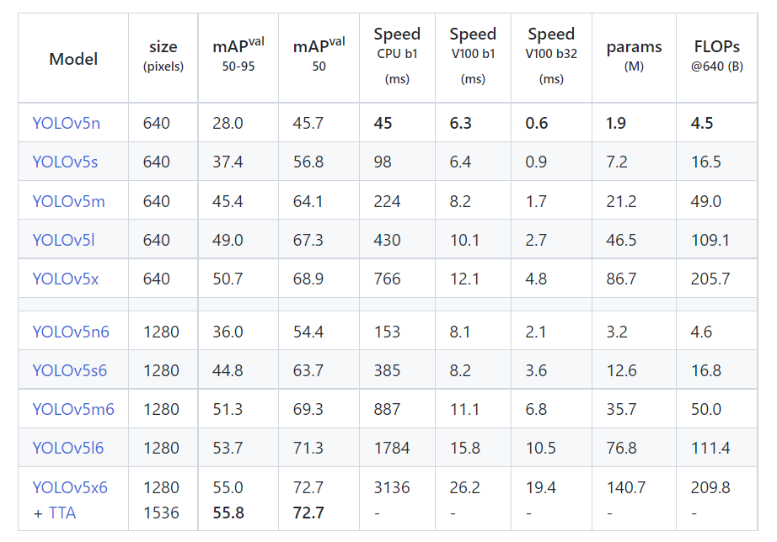
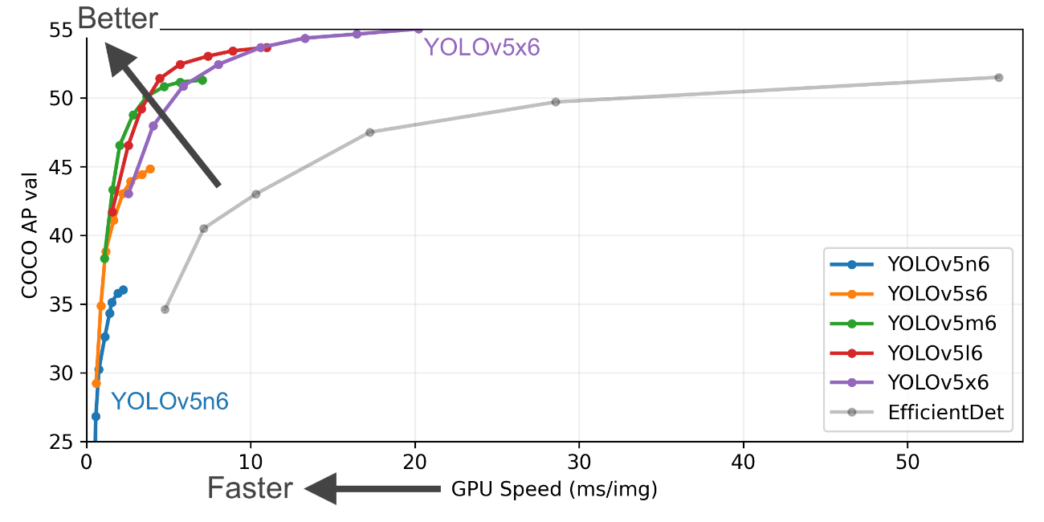
Object Detector
YOLOv5
Differences between YOLOv5 models in terms of accuracy and speed.
7

Slide 8

Object Detector
YOLOv5 detection: pre-processing
Pre-processing is performed on CPU
[0.027, … , 0.003]
Input image in HWC format and BGR colors
Image converted in CHW format and RGB colors and resized to 640x640
Image normalized (from 0 – 255 to 0 – 1)
Image flattened
(1D array of 1228800 elements)
8

Slide 9

Object Detector
YOLOv5 detection: inference
YOLO inference is performed on GPU
[0.447, … , 0.573]
[6.52e+00, ... , 8.88e-03]
Image flattened
(1D tensor of 1228800 elements)
Model output
(1D output array of 2142000 elements)
YOLOv5 model forward pass
9

Slide 10
Object Detector
YOLOv5 detection: post-processing
Post-processing is performed on CPU
Reshape
Non-Maximum Suppression
[6.52e+00, ... , 8.88e-03]
Model output
(1D output tensor of 2142000 elements)
Detections
(N array of 6 components)
Each array is composed by:
Bounding box in xyxy form (4 elements)
Probability score (1 element)
Class ID (1 element)
10

Slide 11
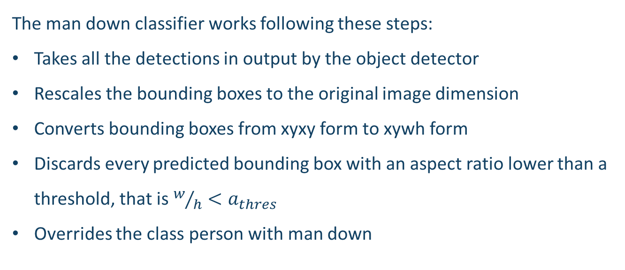
Man Down Classifier
Man Down classifier is performed on CPU
The man down classifier works following these steps:
Takes all the detections in output by the object detector
Rescales the bounding boxes to the original image dimension
Converts bounding boxes from xyxy form to xywh form
Discards every predicted bounding box with an aspect ratio lower than a threshold, that is $w/h<a_{thres}$
Overrides the class person with man down
11

Slide 12
Tracking Algorithm
DeepSORT [2]
DeepSORT is a computer vision algorithm capable of tracking objects while assigning an ID to each of them.
It is considered as an extension of the SORT (Simple Online and Realtime Tracking) algorithm.
It enhances tracking by introducing a Convolutional Neural Network for re-identifying objects across frames.
[2]
N. Wojke, A. Bewley e D. Paulus, «Simple Online and Realtime Tracking with a Deep Association Metric» in 2017 IEEE International Conference on Image Processing (ICIP), Beijing, China, 2017.
12

Slide 13
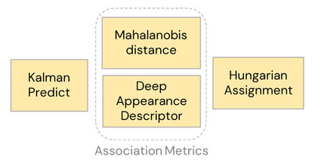
Tracking Algorithm
DeepSORT
Algorithm main parts:
Estimation
Feature Extraction
Data Association
Tracks Handling
13

Slide 14
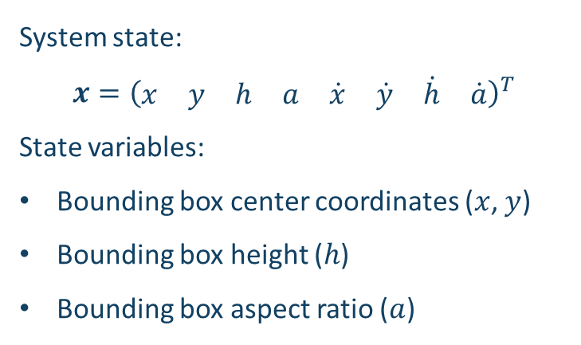
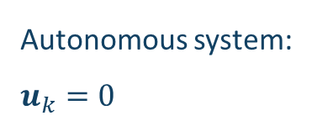
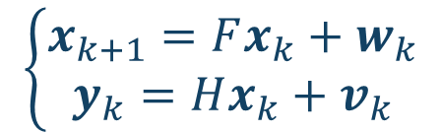
Tracking Algorithm
DeepSORT Estimation: Kalman Filter
The estimation part is performed by a Kalman Filter.
For the detections, a linear constant velocity model is considered.
$$\left\{\begin{matrix}x_{k+1}=Fx_{k}+w_{k} \\ y_{k}=Hx_{k}+v_{k}\end{matrix}\right.$$
Autonomous system: $u_{k}=0$
System state:
$$x={\left(\begin{matrix}x & y & h & a & \dot{x} & \dot{y} & \dot{h} & \dot{a}\end{matrix}\right)}^{T}$$
State variables:
Bounding box center coordinates ($x$, $y$)
Bounding box height ($h$)
Bounding box aspect ratio ($a$)
14

Slide 15
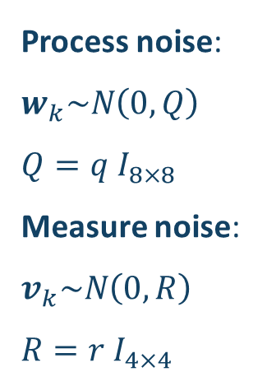
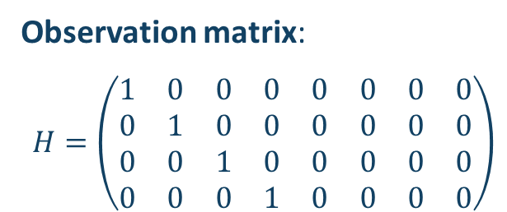
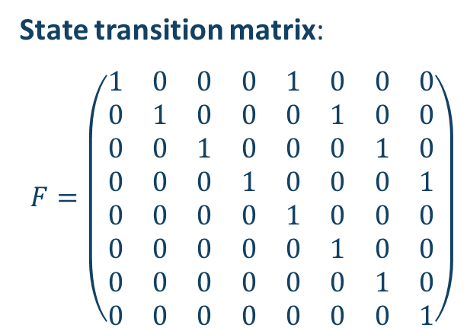
Tracking Algorithm
DeepSORT Estimation: Kalman Filter
Process noise:
$w_{k}\sim N\left(0,Q\right)$
$$Q=q{ I}_{8×8}$$
Measure noise:
$v_{k}\sim N\left(0,R\right)$
$$R={r I}_{4×4}$$
State transition matrix:
$$F=\left(\begin{matrix}1 & 0 & 0 & 0 & 1 & 0 & 0 & 0 \\ 0 & 1 & 0 & 0 & 0 & 1 & 0 & 0 \\ 0 & 0 & 1 & 0 & 0 & 0 & 1 & 0 \\ 0 & 0 & 0 & 1 & 0 & 0 & 0 & 1 \\ 0 & 0 & 0 & 0 & 1 & 0 & 0 & 0 \\ 0 & 0 & 0 & 0 & 0 & 1 & 0 & 0 \\ 0 & 0 & 0 & 0 & 0 & 0 & 1 & 0 \\ 0 & 0 & 0 & 0 & 0 & 0 & 0 & 1\end{matrix}\right)$$
Observation matrix:
$$H=\left(\begin{matrix}1 & 0 & 0 & 0 & 0 & 0 & 0 & 0 \\ 0 & 1 & 0 & 0 & 0 & 0 & 0 & 0 \\ 0 & 0 & 1 & 0 & 0 & 0 & 0 & 0 \\ 0 & 0 & 0 & 1 & 0 & 0 & 0 & 0\end{matrix}\right)$$
15

Slide 16
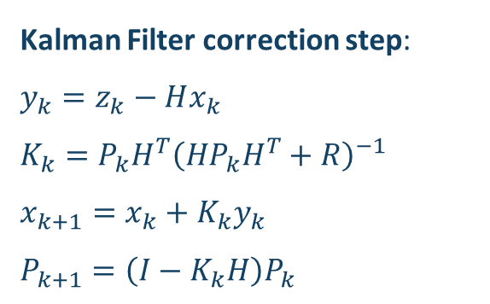
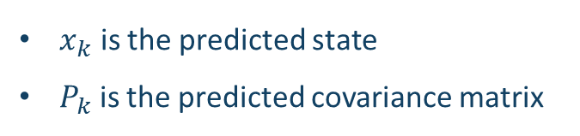
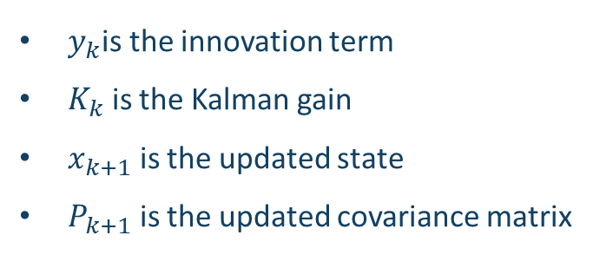
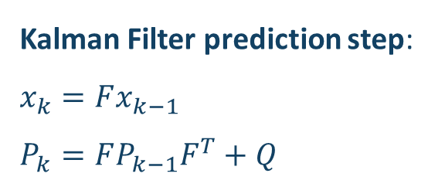
Tracking Algorithm
DeepSORT Estimation: Kalman Filter
Kalman Filter prediction step:
$$x_{k}=Fx_{k−1}$$
$$P_{k}=FP_{k−1}F^{T}+Q$$
$x_{k}$ is the predicted state
$P_{k}$ is the predicted covariance matrix
___________________________________________________________________________
Kalman Filter correction step:
$$y_{k}=z_{k}−Hx_{k}$$
$$K_{k}=P_{k}H^{T}{\left(HP_{k}H^{T}+R\right)}^{−1}$$
$$x_{k+1}=x_{k}+K_{k}y_{k}$$
$$P_{k+1}=\left(I−K_{k}H\right)P_{k}$$
$y_{k}$is the innovation term
$K_{k}$ is the Kalman gain
$x_{k+1}$ is the updated state
$P_{k+1}$ is the updated covariance matrix
16

Slide 17
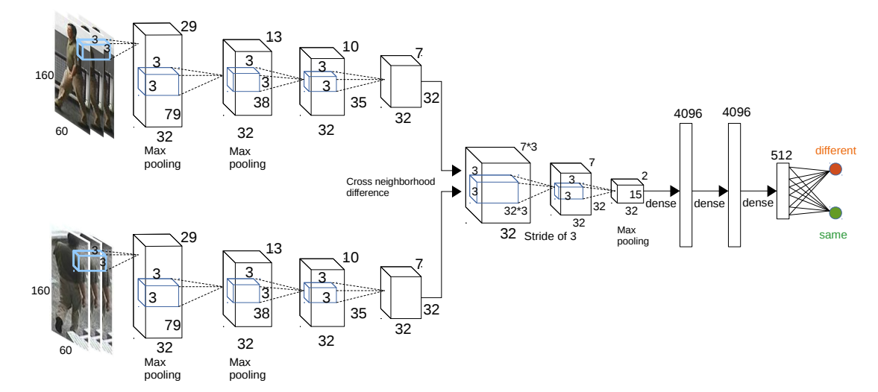
Tracking Algorithm
DeepSORT Feature Extraction
Feature extraction is performed by a CNN trained on a large re-identification dataset (such as Market-1501, MSMT17, MARS or DukeMTMC-reID).
The feature extractor computes particular vectors called appearance descriptors.
17

Slide 18
Tracking Algorithm
DeepSORT Data Association
Data association represents the core of the DeepSORT algorithm.
The goal of data association phase is to correctly associate detections to pre-existing tracks.
This is done following two steps:
Applying the Matching Cascade algorithm on the set of tracks and detections.
Applying an Intersection over Union (IoU) matching on the remaining unmatched detections and unmatched tracks.
Both the matching problems are solved using the Hungarian algorithm [3].
[3]
H. W. Kuhn, «The Hungarian Method for the Assignment Problem,» Naval Research Logistic Quarterly, vol. 2, n. 1-2, pp. 83-97, 1955.
18

Slide 19
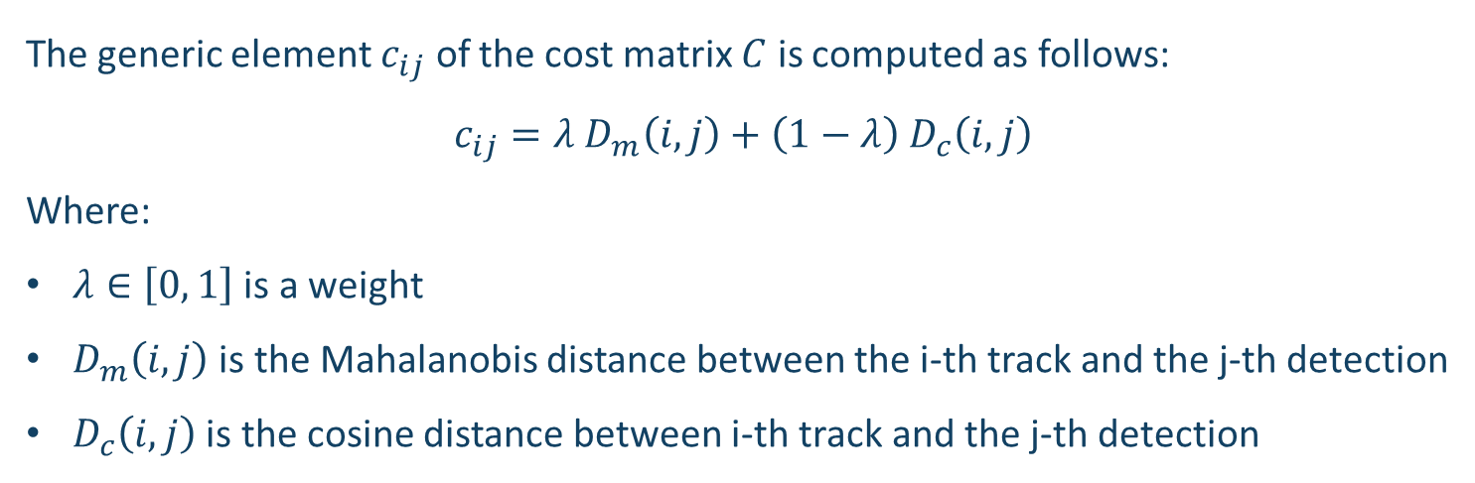
Tracking Algorithm
DeepSORT Data Association: Matching Cascade
The generic element $c_{ij}$ of the cost matrix $C$ is computed as follows:
$$c_{ij}=λ D_{m}\left(ⅈ,j\right)+\left(1−λ\right) D_{c}\left(ⅈ,j\right)$$
Where:
$λ∈\left[0, 1\right]$ is a weight
$D_{m}\left(ⅈ,j\right)$ is the Mahalanobis distance between the i-th track and the j-th detection
$D_{c}\left(ⅈ,j\right)$ is the cosine distance between i-th track and the j-th detection
19

Slide 20
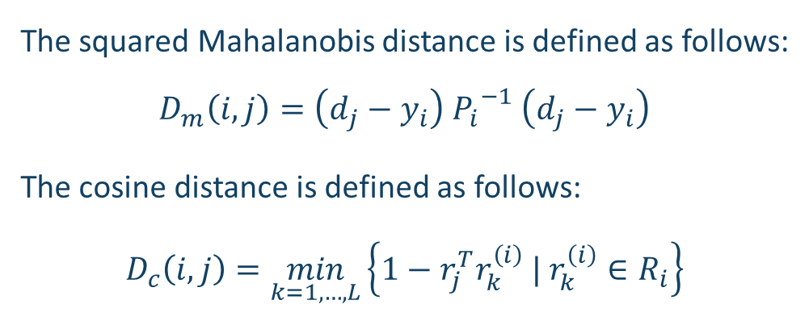
Tracking Algorithm
DeepSORT Data Association: Matching Cascade
The squared Mahalanobis distance is defined as follows:
$$D_{m}\left(ⅈ,j\right)=\left(ⅆ_{j}−y_{i}\right) {P_{i}}^{−1} \left(ⅆ_{j}−y_{i}\right)$$
The cosine distance is defined as follows:
$$D_{c}\left(ⅈ,j\right)=\min_{k=1,…,L}\left\{1−r_{j}^{T}r_{k}^{\left(i\right)} | r_{k}^{\left(i\right)}∈R_{i}\right\}$$
Metric that exploits Kalman Filter estimation
Appearance descriptors set
(the dimension of the set is a parameter of the algorithm)
20

Slide 21
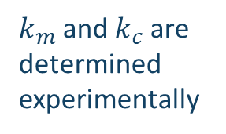
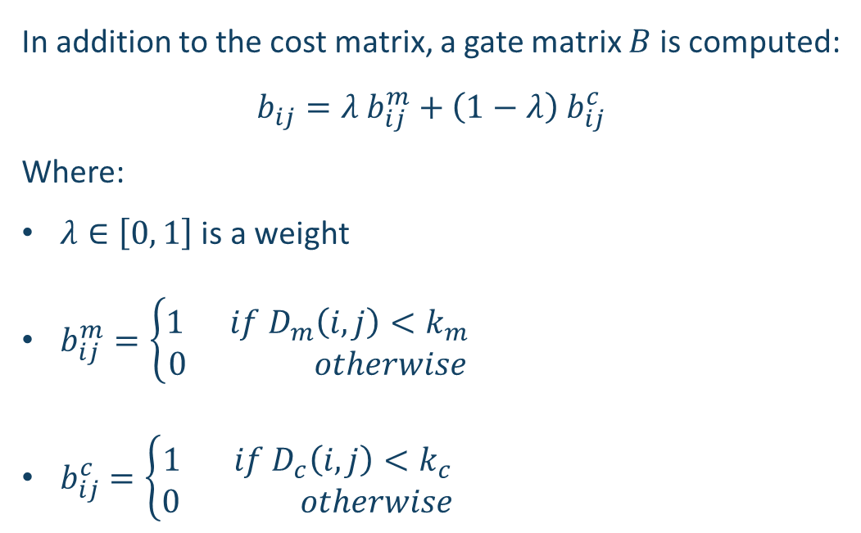
Tracking Algorithm
DeepSORT Data Association: Matching Cascade
In addition to the cost matrix, a gate matrix $B$ is computed:
$$b_{ij}=λ b_{ij}^{m}+\left(1−λ\right){ b}_{ij}^{c}$$
Where:
$λ∈\left[0, 1\right]$ is a weight
$b_{ij}^{m}=\left\{\begin{aligned}1 if D_{m}\left(ⅈ,j\right)<k_{m} \\ 0 otherwise\end{aligned}\right.$
$b_{ij}^{c}=\left\{\begin{aligned}1 if D_{c}\left(ⅈ,j\right)<k_{c} \\ 0 otherwise\end{aligned}\right.$
$k_{m}$and $k_{c}$are determined experimentally
21

Slide 22
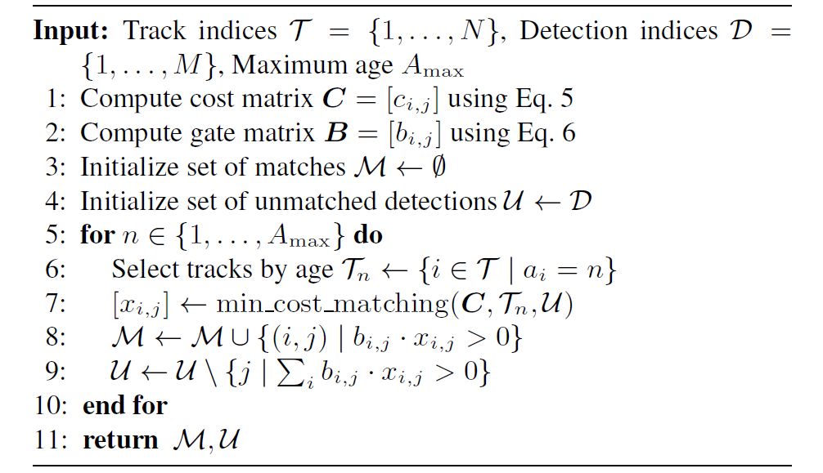
Tracking Algorithm
DeepSORT Data Association: Matching Cascade
22

Slide 23
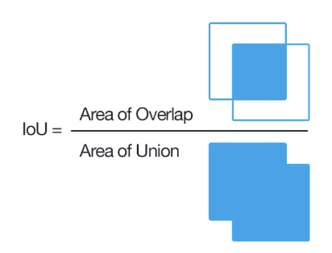
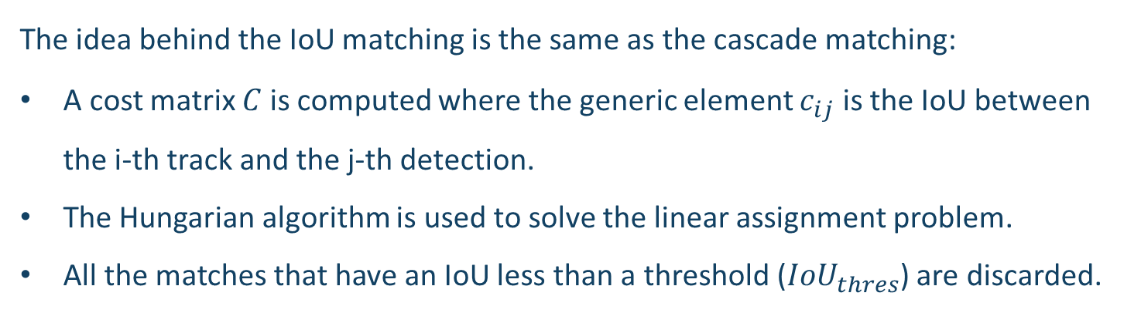
Tracking Algorithm
DeepSORT Data Association: IoU Matching
Given two bounding boxes, Intersection over Union (IoU) is defined as the ratio between the intersection area and the union area of the two bounding boxes.
The idea behind the IoU matching is the same as the cascade matching:
A cost matrix $C$is computed where the generic element $c_{ij}$ is the IoU between the i-th track and the j-th detection.
The Hungarian algorithm is used to solve the linear assignment problem.
All the matches that have an IoU less than a threshold (${IoU}_{thres}$) are discarded.
23

Slide 24
Tracking Algorithm
DeepSORT Track Handling
After the data association part of the algorithm, three cases can occur:
First Case: A track and a detection have been matched
Second Case: A track is unmatched
Third Case: A detection is unmatched
24

Slide 25
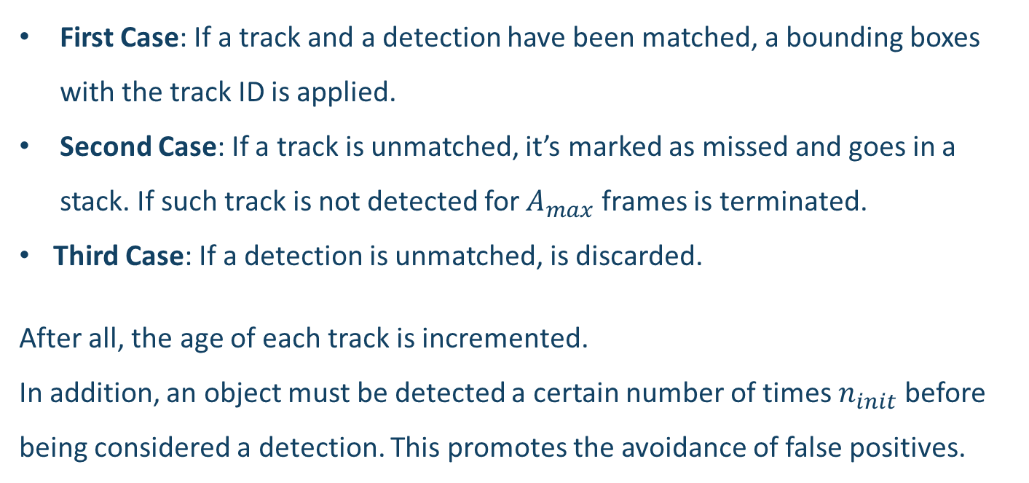
Tracking Algorithm
DeepSORT Track Handling
First Case: If a track and a detection have been matched, a bounding boxes with the track ID is applied.
Second Case: If a track is unmatched, it’s marked as missed and goes in a stack. If such track is not detected for $A_{max}$ frames is terminated.
Third Case: If a detection is unmatched, is discarded.
After all, the age of each track is incremented.
In addition, an object must be detected a certain number of times $n_{init}$ before being considered a detection. This promotes the avoidance of false positives.
25

Slide 26
Experimental Tests
Platforms
Tests has been conducted on several different platforms:
ARM Cortex-A72
ARM Neoverse N1
Fujitsu A64FX (ARMv8-A based)
Intel i7-10750H
Intel Xeon
Intel i7-10750H + NVIDIA GeForce GTX 1650 Ti (with TensorRT optimization)
Intel Xeon + NVIDIA Tesla T4 (with TensorRT optimization)
Intel Xeon + NVIDIA A100 (with TensorRT optimization)
26

Slide 27
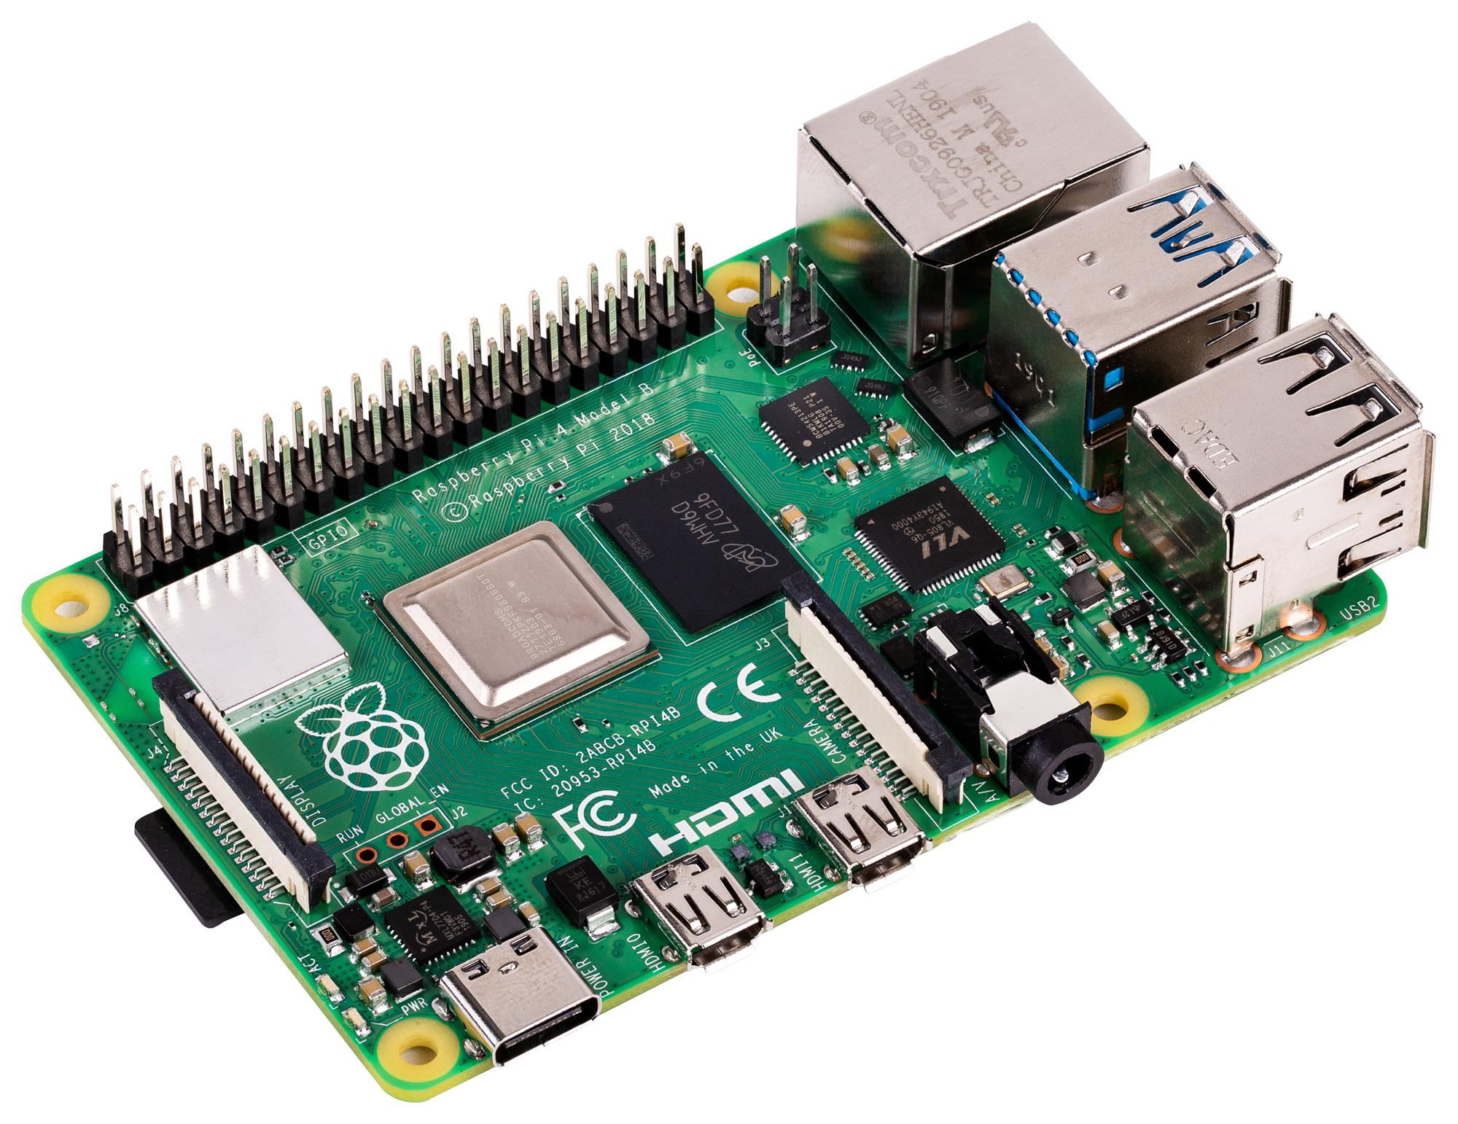
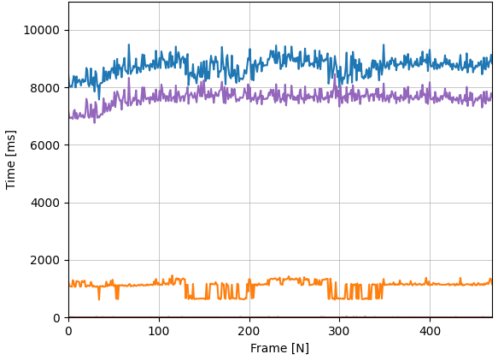
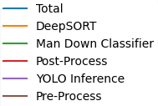
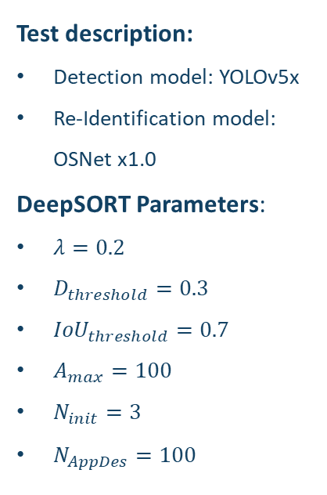
Experimental Tests
Results with ARM Cortex-A72
Speed
Test description:
Detection model: YOLOv5x
Re-Identification model: OSNet x1.0
DeepSORT Parameters:
$λ=0.2$
$D_{threshold}=0.3$
${IoU}_{threshold}=0.7$
$A_{max}=100$
$N_{init}=3$
$N_{AppDes}=100$
27

Slide 28
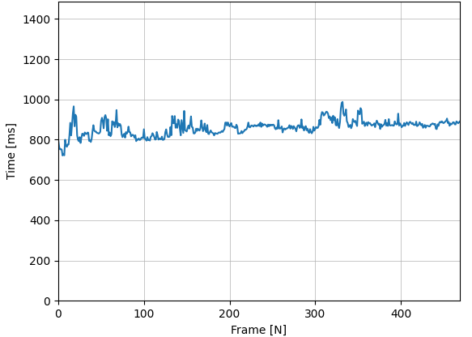
Experimental Tests
Results with ARM Neoverse N1
Inference Speed
Test description:
Detection model: YOLOv5x
Re-Identification model: OSNet x1.0
DeepSORT Parameters:
$λ=0.2$
$D_{threshold}=0.3$
${IoU}_{threshold}=0.7$
$A_{max}=100$
$N_{init}=3$
$N_{AppDes}=100$
28

Slide 29
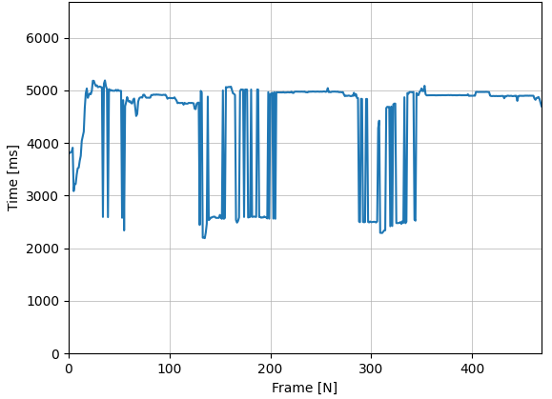
Experimental Tests
Results with ARM Neoverse N1
DeepSORT Speed
Test description:
Detection model: YOLOv5x
Re-Identification model: OSNet x1.0
DeepSORT Parameters:
$λ=0.2$
$D_{threshold}=0.3$
${IoU}_{threshold}=0.7$
$A_{max}=100$
$N_{init}=3$
$N_{AppDes}=100$
29

Slide 30
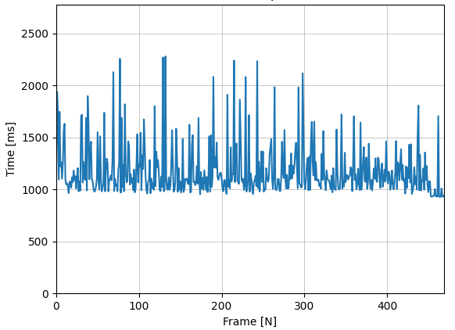
Experimental Tests
Results with Fujitsu A64FX
Inference Speed
Test description:
Detection model: YOLOv5x
Re-Identification model: OSNet x1.0
DeepSORT Parameters:
$λ=0.2$
$D_{threshold}=0.3$
${IoU}_{threshold}=0.7$
$A_{max}=100$
$N_{init}=3$
$N_{AppDes}=100$
30

Slide 31
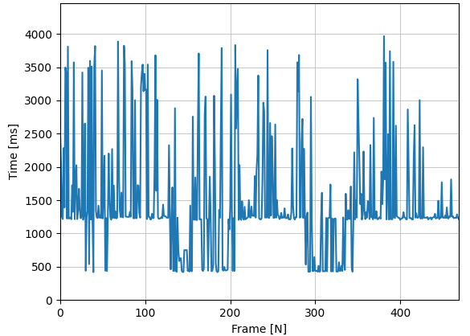
Experimental Tests
Results with Fujitsu A64FX
DeepSORT Speed
Test description:
Detection model: YOLOv5x
Re-Identification model: OSNet x1.0
DeepSORT Parameters:
$λ=0.2$
$D_{threshold}=0.3$
${IoU}_{threshold}=0.7$
$A_{max}=100$
$N_{init}=3$
$N_{AppDes}=100$
31

Slide 32
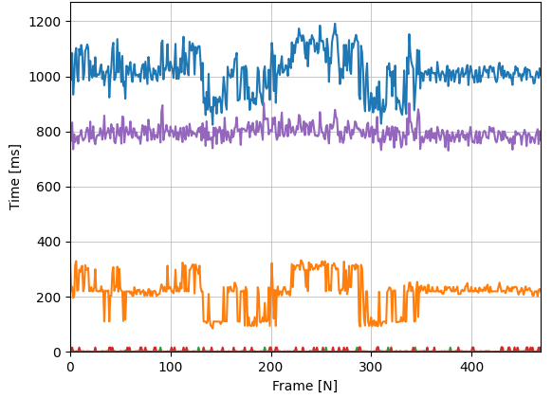
Experimental Tests
Results with Intel i7-10750H
Speed
Test description:
Detection model: YOLOv5x
Re-Identification model: OSNet x1.0
DeepSORT Parameters:
$λ=0.2$
$D_{threshold}=0.3$
${IoU}_{threshold}=0.7$
$A_{max}=100$
$N_{init}=3$
$N_{AppDes}=100$
32

Slide 33
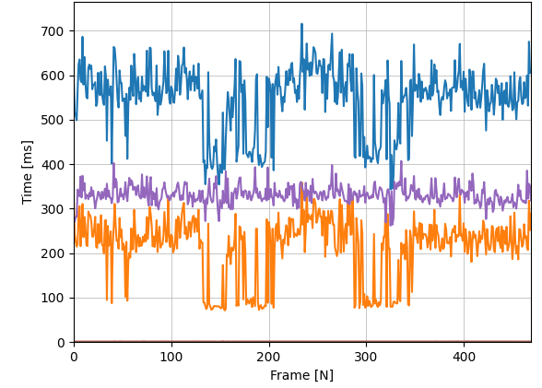
Experimental Tests
Results with Intel Xeon
Speed
Test description:
Detection model: YOLOv5x
Re-Identification model: OSNet x1.0
DeepSORT Parameters:
$λ=0.2$
$D_{threshold}=0.3$
${IoU}_{threshold}=0.7$
$A_{max}=100$
$N_{init}=3$
$N_{AppDes}=100$
33

Slide 34
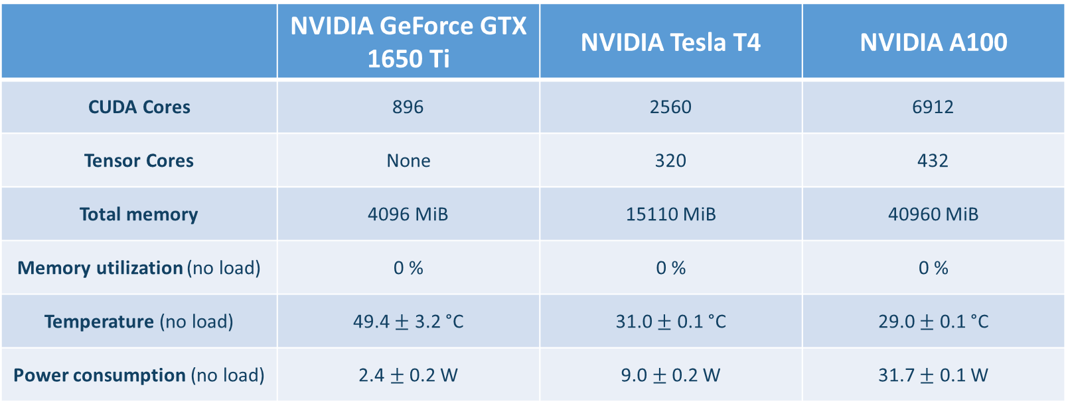
Experimental Tests
NVIDIA GPUs informations
Library used to get GPU stats: NVIDIA Management Library (NVML)
 | NVIDIA GeForce GTX 1650 Ti | NVIDIA Tesla T4 | NVIDIA A100
CUDA Cores | 896 | 2560 | 6912
Tensor Cores | None | 320 | 432
Total memory | 4096 MiB | 15110 MiB | 40960 MiB
Memory utilization (no load) | 0 % | 0 % | 0 %
Temperature (no load) | 49.4 $±$ 3.2 °C | 31.0 $±$ 0.1 °C | 29.0 $±$ 0.1 °C
Power consumption (no load) | 2.4 $±$ 0.2 W | 9.0 $±$ 0.2 W | 31.7 $±$ 0.1 W
34

Slide 35
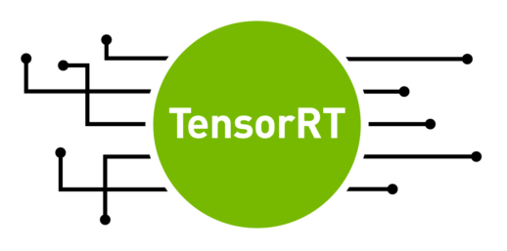
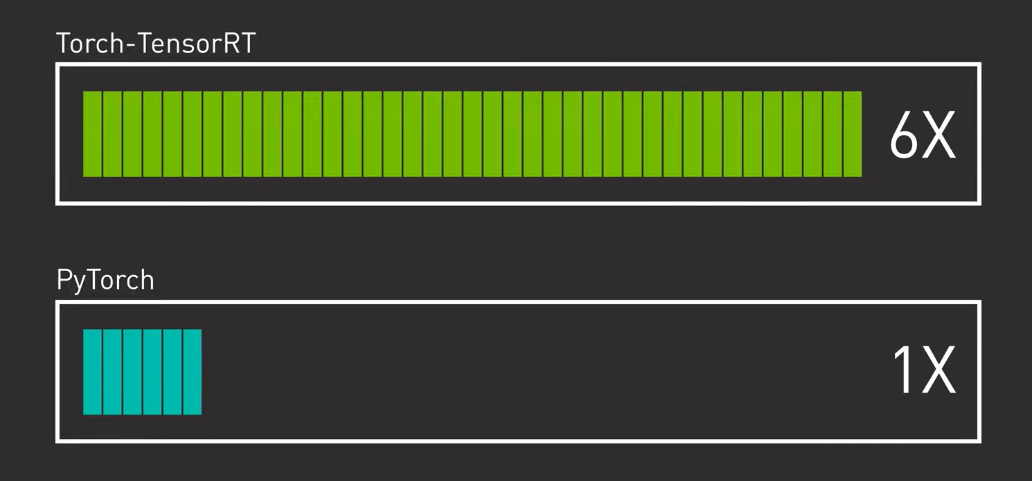
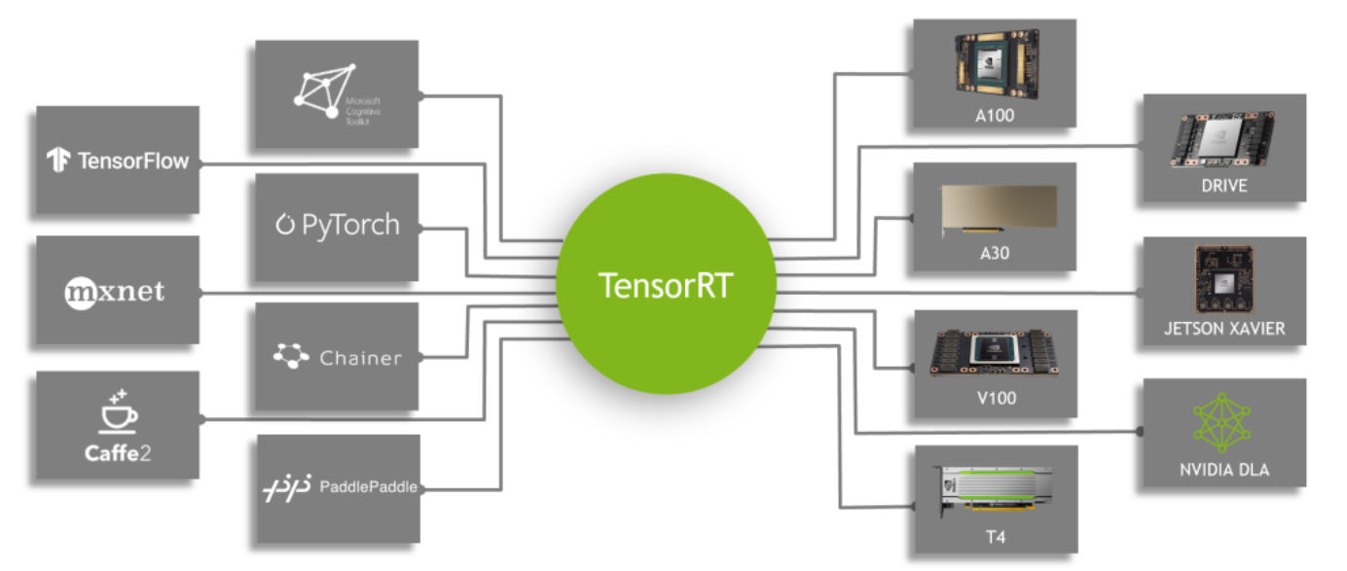
Experimental Tests
Optimization Tools: NVIDIA TensorRT
Tests has been executed using NVIDIA TensorRT, a software library for high performance deep learning inference on NVIDIA GPUs.
It accelerates inference in several different ways:
Reducing model precision preserving accuracy
Fusing layers and tensors
Selecting best data layers and algorithms for the target GPU platform
Reusing memory for tensors efficiently
Executing multiple input streams in parallel
35

Slide 36
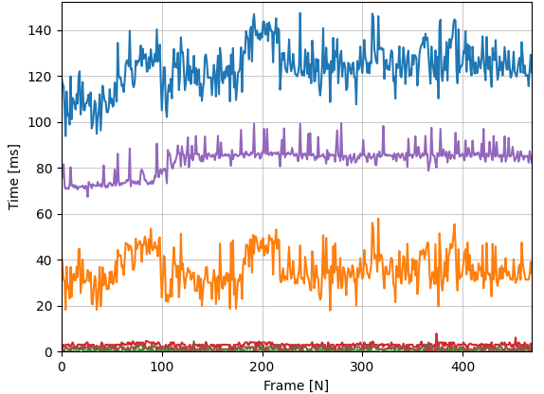
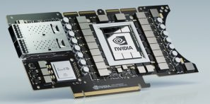
Experimental Tests
Results with Intel i7-10750H and NVIDIA GeForce GTX 1650 Ti
Speed
Test description:
Detection model: YOLOv5x
Re-Identification model: OSNet x1.0
DeepSORT Parameters:
$λ=0.2$
$D_{threshold}=0.3$
${IoU}_{threshold}=0.7$
$A_{max}=100$
$N_{init}=3$
$N_{AppDes}=100$
36

Slide 37
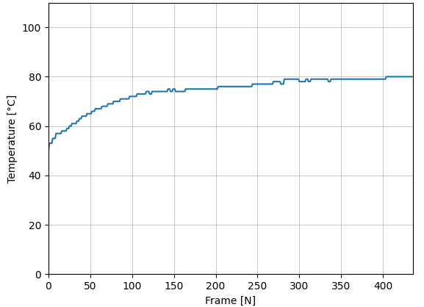
Experimental Tests
Results with Intel i7-10750H and NVIDIA GeForce GTX 1650 Ti
GPU Temperature
Test description:
Detection model: YOLOv5x
Re-Identification model: OSNet x1.0
DeepSORT Parameters:
$λ=0.2$
$D_{threshold}=0.3$
${IoU}_{threshold}=0.7$
$A_{max}=100$
$N_{init}=3$
$N_{AppDes}=100$
37

Slide 38
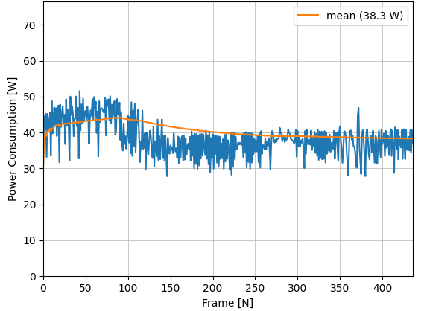
Experimental Tests
Results with Intel i7-10750H and NVIDIA GeForce GTX 1650 Ti
GPU Power Consumption
Test description:
Detection model: YOLOv5x
Re-Identification model: OSNet x1.0
DeepSORT Parameters:
$λ=0.2$
$D_{threshold}=0.3$
${IoU}_{threshold}=0.7$
$A_{max}=100$
$N_{init}=3$
$N_{AppDes}=100$
38

Slide 39
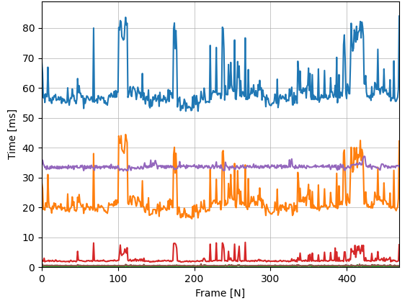
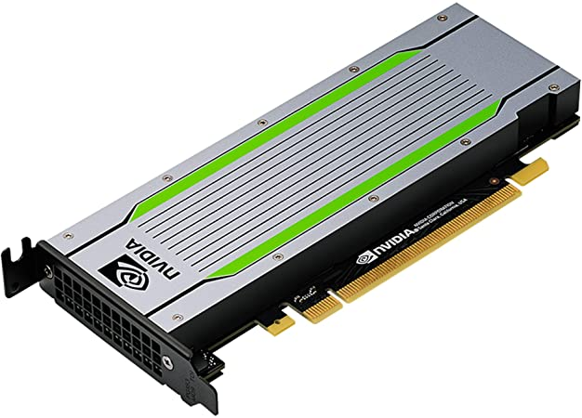
Experimental Tests
Results with Intel Xeon and NVIDIA Tesla T4
Speed
Test description:
Detection model: YOLOv5x
Re-Identification model: OSNet x1.0
DeepSORT Parameters:
$λ=0.2$
$D_{threshold}=0.3$
${IoU}_{threshold}=0.7$
$A_{max}=100$
$N_{init}=3$
$N_{AppDes}=100$
39

Slide 40
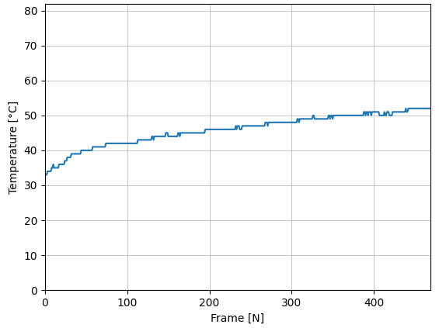
Experimental Tests
Results with Intel Xeon and NVIDIA Tesla T4
GPU Temperature
Test description:
Detection model: YOLOv5x
Re-Identification model: OSNet x1.0
DeepSORT Parameters:
$λ=0.2$
$D_{threshold}=0.3$
${IoU}_{threshold}=0.7$
$A_{max}=100$
$N_{init}=3$
$N_{AppDes}=100$
40

Slide 41
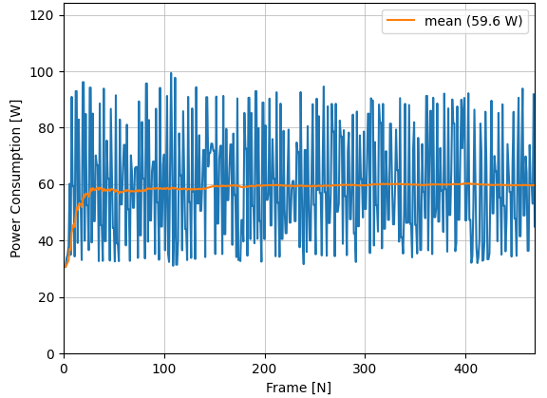
Experimental Tests
Results with Intel Xeon and NVIDIA Tesla T4
GPU Power Consumption
Test description:
Detection model: YOLOv5x
Re-Identification model: OSNet x1.0
DeepSORT Parameters:
$λ=0.2$
$D_{threshold}=0.3$
${IoU}_{threshold}=0.7$
$A_{max}=100$
$N_{init}=3$
$N_{AppDes}=100$
41

Slide 42
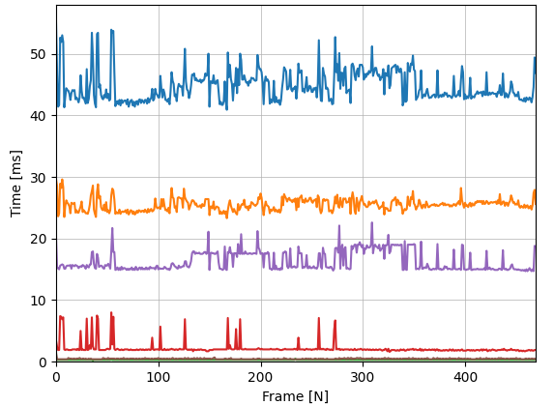
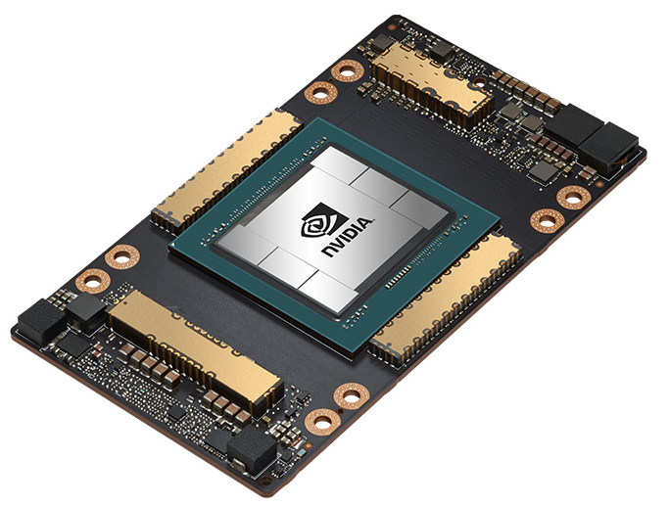
Experimental Tests
Results with Intel Xeon and NVIDIA A100
Speed
Test description:
Detection model: YOLOv5x
Re-Identification model: OSNet x1.0
DeepSORT Parameters:
$λ=0.2$
$D_{threshold}=0.3$
${IoU}_{threshold}=0.7$
$A_{max}=100$
$N_{init}=3$
$N_{AppDes}=100$
42

Slide 43
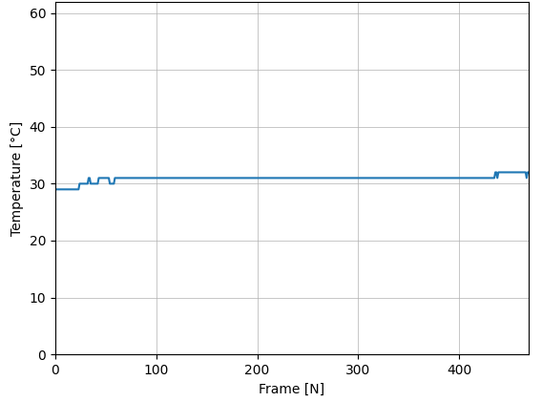
Experimental Tests
Results with Intel Xeon and NVIDIA A100
GPU Temperature
Test description:
Detection model: YOLOv5x
Re-Identification model: OSNet x1.0
DeepSORT Parameters:
$λ=0.2$
$D_{threshold}=0.3$
${IoU}_{threshold}=0.7$
$A_{max}=100$
$N_{init}=3$
$N_{AppDes}=100$
43

Slide 44
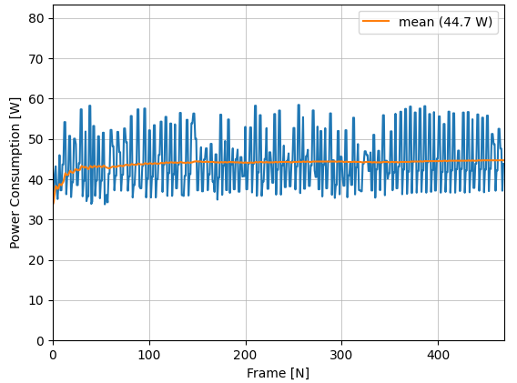
Experimental Tests
Results with Intel Xeon and NVIDIA A100
GPU Power Consumption
Test description:
Detection model: YOLOv5x
Re-Identification model: OSNet x1.0
DeepSORT Parameters:
$λ=0.2$
$D_{threshold}=0.3$
${IoU}_{threshold}=0.7$
$A_{max}=100$
$N_{init}=3$
$N_{AppDes}=100$
44

Slide 45
Conclusion
Platform | FPS | YOLO Inference Speed (ms) | Man Down Classifier (ms) | DeepSORT Speed (ms)
ARM Cortex-A72 | 0.1 | 7632 | 1.2 | 1032
ARM Neoverse N1 | 0.2 | 878 | 0.5 | 3794
Fujitsu A64FX | 0.4 | 1221 | 1.1 | 1233
Intel i7-10750H | 1.0 | 794 | 0.3 | 200
Intel Xeon | 1.8 | 335 | 0.3 | 197
Intel i7-10750H + NVIDIA GeForce GTX 1650 Ti | 6.5 | 82.9 | 0.3 | 37.9
Intel Xeon + NVIDIA Tesla T4 | 11.6 | 33.9 | 0.3 | 28.3
Intel Xeon + NVIDIA A100 | 16.3 | 16.2 | 0.3 | 25.3
45

Slide 46

Conclusion
FPS
Platforms:
ARM Cortex-A72
ARM Neoverse N1
Fujitsu A64FX
Intel i7-10750H
Intel Xeon
Intel i7-10750H + GPU NVIDIA GeForce GTX 1650 Ti
Intel Xeon + NVIDIA Tesla T4
Intel Xeon + NVIDIA A100
46

Slide 47

Conclusion
YOLO (average) inference speed
Platforms:
ARM Cortex-A72
ARM Neoverse N1
Fujitsu A64FX
Intel i7-10750H
Intel Xeon
Intel i7-10750H + GPU NVIDIA GeForce GTX 1650 Ti
Intel Xeon + NVIDIA Tesla T4
Intel Xeon + NVIDIA A100
47

Slide 48

Conclusion
DeepSORT (average) speed
Platforms:
ARM Cortex-A72
ARM Neoverse N1
Fujitsu A64FX
Intel i7-10750H
Intel Xeon
Intel i7-10750H + GPU NVIDIA GeForce GTX 1650 Ti
Intel Xeon + NVIDIA Tesla T4
Intel Xeon + NVIDIA A100
48

