Slide 1
THE SHAPE OF A STIMULUS
Trajectory Geometry of Mouse Neuron Population Activity
30563 MATHEMATICAL MODELLING FOR NEUROSCIENCE
Francesca Casillo, Alessandro Lombardi, Edoardo Panella, Federico Scaffidi Muta
Notes:
Good morning, I am Francesca and this is our project. The Shape of a Stimulus.

Slide 2
A mouse watches three videos.
Do its neurons code them as three distinguishable population states?
Notes:
A mouse watches three very different videos, and we are watching its brain.
[pause]
Eight thousand neurons firing at once. Recorded one by one, simultaneously, while it watches. And we asked one question.
Can we see, in those neuronal patterns, what the mouse is seeing?
To put it in other words: IF I handed you a snapshot of cortical activity, just a vector of numbers encoding the eight thousand neurons firing, could you tell me which video the mouse was watching at JUST by looking at the geometry of this space?
That was our research question. Everything that follows is our attempt to answer it.

Slide 3
Why this slice of MICrONS for this research question?
CLIP
MONET2
TRIPPY
Natural movie footage
Grey-scale textured noise
Synthetic wave patterns
FUNCTIONAL DATA · ~8,000 NEURONS RECORDED SIMULTANEOUSLY
4 CORTICAL AREAS · V1 · LM · RL · AL
Notes:
Three videos.
→ Gesture left.
CLIP is real-world movie footage.
→ Gesture center.
MONET2 is grey-scale textured noise. Designed to have controlled statistics, but visually — nothing.
→ Gesture right.
TRIPPY is synthetic wave patterns. Patterns that don't exist anywhere in nature.
[pause]
One natural stimulus. Two synthetic ones.
→ Slow down for the next line. This is a planted seed.
This is a KEY information that will LATER matter
[pause]
The data is from MICrONS — about eight thousand neurons recorded simultaneously across four cortical areas. V1, the primary visual cortex. Plus three higher areas — LM (Lateromedial area), RL(Rostrolateral area), and AL(Anterolateral area).
We can ask each of them the same question, and see if they disagree.

Slide 4
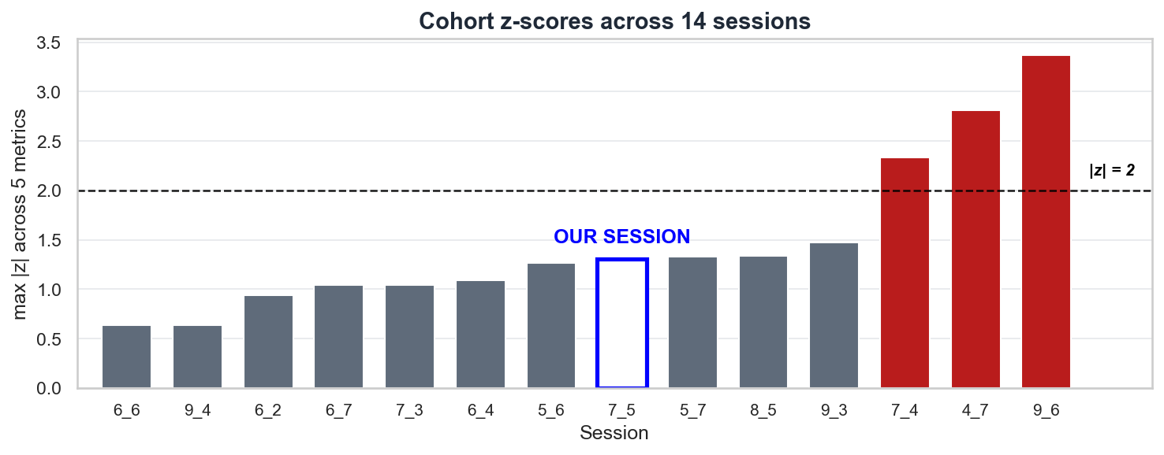
Session choice and trial structure
SESSION 7_5 · |z| ≤ 1.31 ACROSS ALL METRICS · 8,194 NEURONS (COHORT MEDIAN: 8,176)
453 TRIALS · 377 CLIP · 38 MONET2 · 38 TRIPPY · INTERLEAVED
Notes:
Before any analysis, we picked only one session. One out of fourteen.
The red bars on the right — those are sessions we threw out. They are outliers with a z-score greater than 2. In particular:
7_4 had too many neurons compared to the others
4_7 had response magnitudes were anomalously high
9_6 the mouse was running far more than the others
We picked Session 7_5. It sits at the median on every quality metric we measured. It recorded about eight thousand neurons across 453 trials. The three movies are interleaved.
------------------------------------------------------
NOTE: z score is how many standard deviations a value sits from the cohort average.
The metrics we used were:
Neuron count — how many neurons were recorded in that session.
Area composition — how those neurons were distributed across the four cortical areas (V1, LM, RL, AL).
Mean activity — the average firing-rate magnitude across neurons.
Mean pupil diameter — proxy for the mouse's arousal level.
Mean treadmill speed — how much the mouse was running.

Slide 5
Preprocessing techniques
Running influences V1 — 11 outlier trials removed (2.4%)
Photobleaching — linear detrend per trial
PIPELINE: OUTLIER FILTER → LINEAR DETREND → PER-NEURON Z-SCORE
Notes:
Three preprocessing steps.
One — we filtered out trials where the mouse was running too hard, because running modulates V1.
Two — we linear-detrended each trial, because the calcium signal photobleaches.
Three — we z-scored each neuron, so the loudest neurons don't dominate the geometry.
Standard pipeline. Now the interesting part.
LINEAR DETRENDING: means fitting a straight line to the slow decline and subtracting it, leaving only the variation around the line, which is the actual signal.

Slide 6
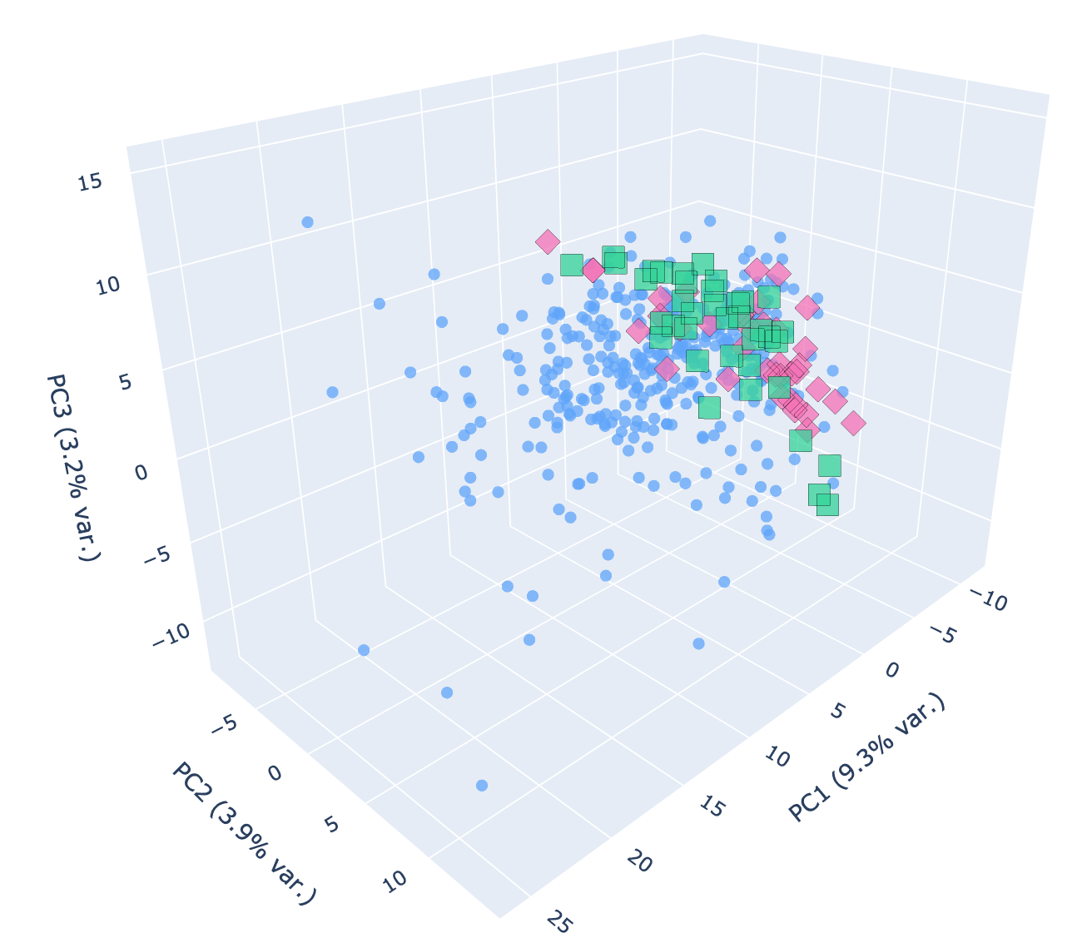
Experiment 1: trial-mean PCA
n = 453 trials · 5,485 neurons · top 3 PCs
PCA does not encode any signal
BUT
98.9%
classifier accuracy on the same trial-mean vectors
majority baseline: 83.2%
LM 98.0% · RL 97.8% · AL 94.7%
THE SIGNAL IS THERE. PCA ISN'T ALIGNED WITH IT.
Notes:
Experiment one.
For each of the 453 trials, we collapsed time. One trial represents one mean activity vector. Then applied PCA. Here we observe the 3 principal components graph.
→ Gesture at the scatter plot. Then turn back to the audience.
What do you see?
[pause]
Nothing. Three classes piled on top of each other. PCA tells us — there's no signal here.
[pause]
We didn't believe it.
So we took those same vectors. And trained a linear classifier on them.
→ Slow down. This is the first reversal. Land it.
[pause]
Ninety-eight point nine percent.
Majority baseline is 83 percent. So this isn't trivial. The classifier is finding something real. And it works in every cortical area we tested.
[pause]
So what's going on? The signal is there. PCA just isn't pointed at it.
What we learned through this experiment is that variance is not signal.

Slide 7
Experiment 2:
Trial-averaged trajectories - projected into PC space
Three separated clusters in every area
BUT IS THE SEPARATION REAL?
Notes:
Experiment two builds on that observation. This time we retain the time axis.
For each cortical area and each stimulus class, we averaged trials frame by frame — obtaining a trial-averaged trajectory through neural state space — and we apply PCA to these trajectories
The result is on screen.
→ Pause and let them look at the four panels.
[pause]
In every area, the three conditions form three visibly distinct, non-overlapping regions in PC1–PC2 space. On its face, this is exactly the result we were looking for.
[pause]
→ Drop your voice slightly here. This is the methodological caveat.
There is, however, a concern. The principal components were fit on trial averages that already carry the class labels — the same labels we are now trying to recover. The directions of maximum variance are therefore not independent of those labels; they are partially aligned with them by construction. Before treating this apparent separation as evidence, we have to rule out that bias.

Slide 8
Biased Test: PCA fit on real-label trial averages, then shuffled data projected
through the same PCs
Honest Test: full feature space with no projection on all neurons
Monet2 ⇔ Trippy never reliably separates in any area
THE COLLAPSE PERSISTS
Notes:
Here's the test. We want to know if those distances are real or just noise. So we shuffle. We mix the trial labels and recompute the distance on the nonsense data. A hundred times. That gives us a distribution of what happens by chance. If our real distance is bigger than basically all of them, it's signal. If it isn't — it's noise.
The p-value is just the fraction of those random shuffles that beat the real one. So p = 0.02 means only 2% of the random mix produced a distance this big. The smaller, the better. Below 0.05 — we call it real.
Now — two versions of the test.
The biased version — fit PCA on real labels, then project shuffled-label data through those same axes. It says everything separates, even random labels, because the axes themselves already know the answer.
The honest version is different. No projection. Full feature space. All eight thousand neurons. Compute distances directly. Compare against the shuffle null.
That's what's on the screen. P-values. Per pairwise contrast. Per area.
→ Gesture at the three groups of bars, left to right.
As we can see there is nothing significat except the distane between clip and trippy in Rostroateral area.
HOWEVER WHAT STRIKES TO OUR EYES IS
Monet2 versus Trippy — the two synthetic conditions.
[pause]
Never separates. Anywhere.
[long pause]
So those beautiful clusters from the previous slide? Partly a projection artifact. Two stimuli that look completely different to us — to the brain, in linear terms — they're the same thing.

Slide 9
Two controls - both pass
TRIAL-COUNT CONTROL
NEURON-COUNT CONTROL
THE ISSUE
Clip has 377 trials —
Monet2 and Trippy only 38
THE ISSUE
V1 has 5,485 neurons —
AL only 414.
WHAT WE DID
Subsampled Clip down to 38 trials.
WHAT WE DID
Matched all areas to 414 neurons.
RESULTS
Distances unchanged
Trial-count is not the explanation.
.
RESULTS
V1's lead vanishes.
All areas sit at the same level.
LINEAR METHODS HIT A CEILING
Notes:
Two controls before we change direction. Both pass.
Trial-count. Clip has 377 trials, the other two have 38. Maybe Clip looks separate just because we have more data. So we subsampled Clip down to 38. Distances unchanged.
Neuron-count. V1 had a few more neurons than the higher areas, and at face value V1 looked like the best decoder. We matched neuron counts — V1's lead disappeared. Everyone sits at the same level.
We're not crazy. V1 isn't special. And linear methods are at their ceiling. Adding more neurons doesn't help.

Slide 10

Experiment 3: same method—zoomed inside Clip
Cinematic
sport1m
Three sub-categories separate in every area with p ≤ 0.02
BUT IS ONE AREA SPECIAL?
Rendered
Notes:
So we changed the question.
Linear methods can't decode synthetic-versus-synthetic signal. What if, instead of comparing across the three videos, we zoomed inside one?
Clip has natural sub-categories. Cinematic — Hollywood films. Sport1m — YouTube sports footage. Rendered — CGI. Synthetic, but trying to look real.
So now we have three categories on a more interesting gradient. From clearly natural — to clearly artificial.
Same method. Same honest test.
[pause]
This time it works. Three sub-categories separate in every area. P less than 0.02 across the board.
Which means we can finally ask the interesting question. Is one area better at this than the others?

Slide 11
After population matching – per-neuron signal
AL is a naturalness detector, the same axis Experiment 2 found.
AL DETECTS ARTIFICIALITY, NOT THE CATEGORY.
The same boundary, again.
Notes:
To answer that, we computed the maximum Euclidean distance between trial-averaged trajectories for each pairwise contrast — the same metric as Experiment 2, but with neuron counts equalized across the four areas. Because the previous slide showed that raw distance scales with population size, this matching is what makes the cross-area comparison meaningful: any difference between areas now reflects coding, not count.
Three pairwise contrasts. Four areas each. The bars on screen.
→ Gesture at left bars. (Anterolateral area)
Cinematic versus sport1m — both naturalistic categories. All four areas perform roughly equivalently. AL is unremarkable.
→ Gesture at middle bars.
Cinematic versus Rendered — naturalistic against CGI. AL stands out.
→ Gesture at right bars.
Sport1m versus Rendered — also naturalistic against CGI. AL stands out again.
[long pause]
The pattern is unambiguous. AL is elevated only when Rendered — the synthetic, computer-generated category — is part of the contrast. When both categories are naturalistic, the four areas are indistinguishable.
The interpretation follows directly. AL is not encoding category membership per se. AL is selectively responsive to whether the input is natural or artificial.
[pause]
AL is a naturalness detector.
[pause]
→ And here's the callback. Land it slowly.
And here is what makes this result robust.
The same axis emerged in Experiment 2. There, the only contrast that survived the honest test was naturalistic versus synthetic — Clip distinguishable from the two synthetic stimuli, but Monet2 and Trippy indistinguishable from each other. We are now in a different regime entirely: within-class rather than across-class, finer-grained, with matched populations. And the same boundary emerges.
Two independent analyses. The same axis. Natural versus synthetic.
That is not noise. That is a finding.

Slide 12
LIMITATIONS | WHAT’S NEXT
Linear methods may miss non-linear structure | CEBRA or manifold embeddings designed for exactly this regime
Single session (7_5) — cohort generalization untested | Cross-session replication
Connectomics unused — structural link untested | Functional ⇔ structural link use the connectome to test whether functional clusters reflect wiring
Linear methods sense the naturalness boundary
but hit a ceiling for synthetic vs. synthetic
Notes:
So what's the takeaway.
Linear methods cleanly sense one boundary in mouse visual cortex — natural versus synthetic. And they hit a wall on synthetic-versus-synthetic. Monet2 and Trippy look nothing alike to us — but in linear neural space, they collapse together.
Three things would push this further.
One — everything we did is linear, and a lot of cortex isn't. CEBRA, or other manifold-based embeddings, are designed exactly for this regime.
Two — we ran on a single session. Cross-session replication is the obvious next step.
And three — the one we wish we'd had time for. MICrONS isn't just functional data. It has the connectome for these neurons. The wiring. Sitting there. Unused.
The natural follow-up is to ask why AL detects naturalness. And maybe — the answer is in the circuit.
That's where this analysis stops and the next one begins — thank you, and I'd welcome your questions.

Slide 13
Any questions?

Slide 14
THANK YOU!

