Slide 1


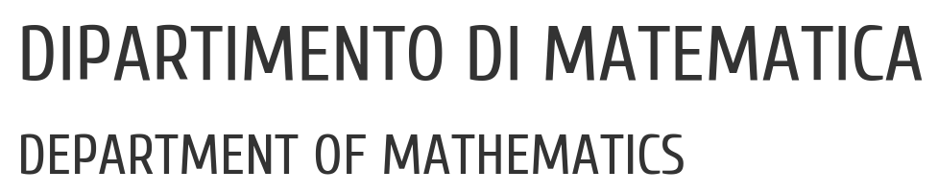

UNIVERSITY OF PADUA
Analysis of the implementation of the
Stipula legal calculus using
Distributed Ledger Technologies
Master’s degree thesis
Supervisor
Professor Silvia Crafa
Graduand
Federico Zanardo

Slide 2

Table of contents
Context
Aim of the thesis
Stipula
Analysis and design
Implementation
Considerations
Conclusions

Slide 3
Contents
What is a platform for running Stipula contracts?
Contents of the thesis
1. Architectural Analysis
Proposal of an distributed platform scalable from a server to a peer-to-peer network
Asset definition and UTXO model
2. Specific implementation
Compiler and Virtual Machine
Asset transfers
Obligations and event scheduling
Research question

Slide 4
Context
Context
Legal contracts
Principle of freedeom of form
Language easy for non-experts

Slide 5
Stipula
Basic ideas
Code-driven law
Intermediate Domain-Specific Language (IDSL)

Slide 6
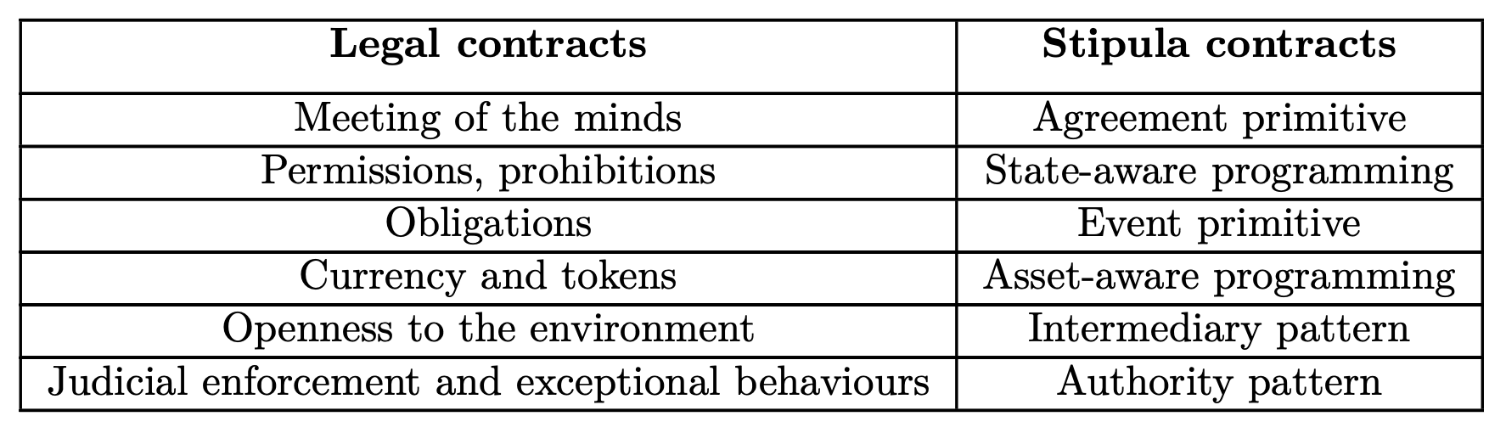
Stipula
Code-driven normativity

Slide 7
stipula BikeRental {
asset wallet:stipula_coin_asd345
field cost, rentingTime, use_code
agreement (Lender, Borrower)(cost, rentingTime){
Lender, Borrower: cost, rentingTime
} ==> @Inactive
@Inactive Lender : offer(z)[] {
z -> use_code
} ==> @Proposal
@Proposal Borrower : accept()[y]
(y == cost) {
y -o wallet;
now + rentingTime >>
@Using {
»End_reached» -> Borrower
wallet -o Lender
} ==> @End
} ==> @Using
@Using Borrower : end()[] {
wallet -o Lender
} ==> @End
}

Slide 8
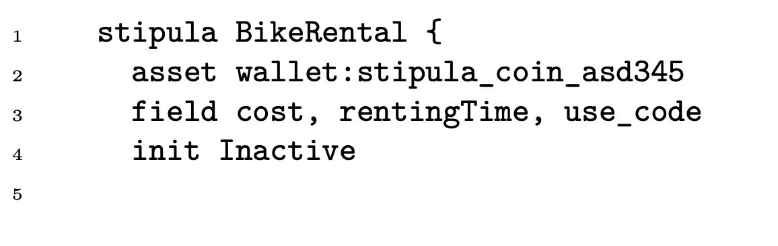
Stipula
Building blocks - Introduction
Stipula languale is untyped
Every contract begins with keyword stipula

Slide 9
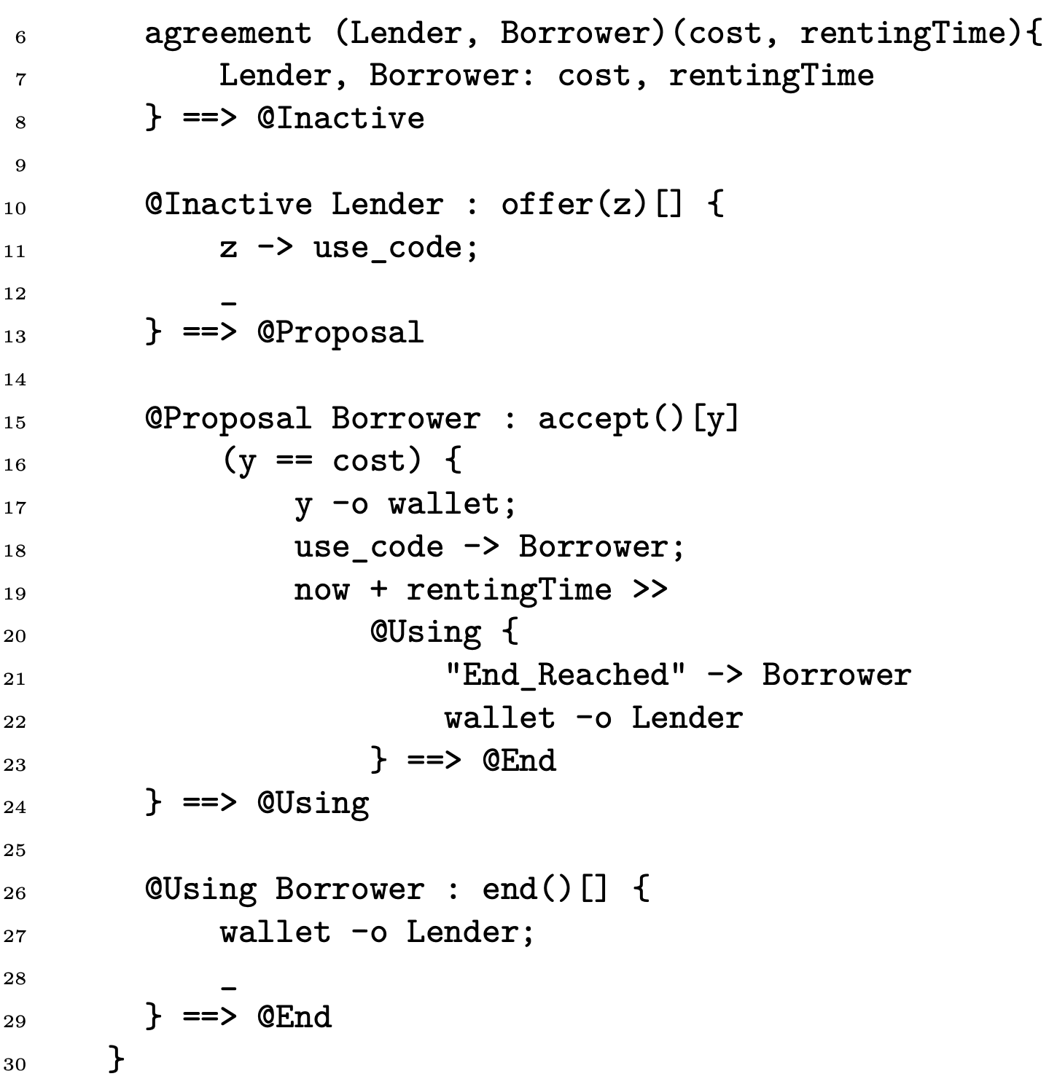
Stipula
Building blocks – Contract example
Bike rental

Slide 10
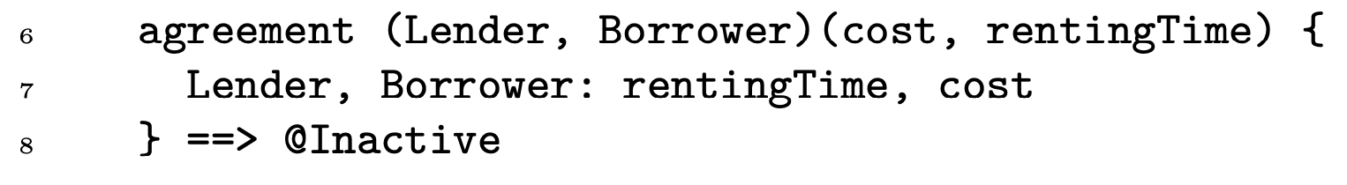
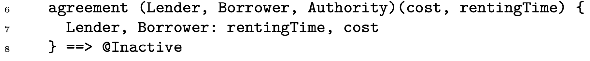
Stipula
Buildig blocks - Agreement
Meeting of minds
Add a supervisor

Slide 11
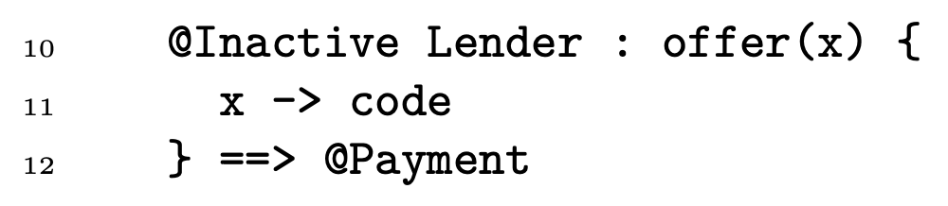
Stipula
Buildig blocks –
Permissions and prohibitions
State-machine programming approach

Slide 12
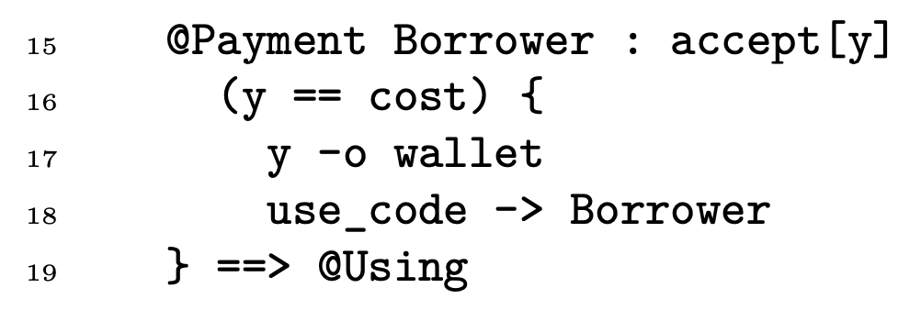
Stipula
Buildig blocks - Assets
Reduce the risk of double-spending, accidental loss, or locked-in assets

Slide 13
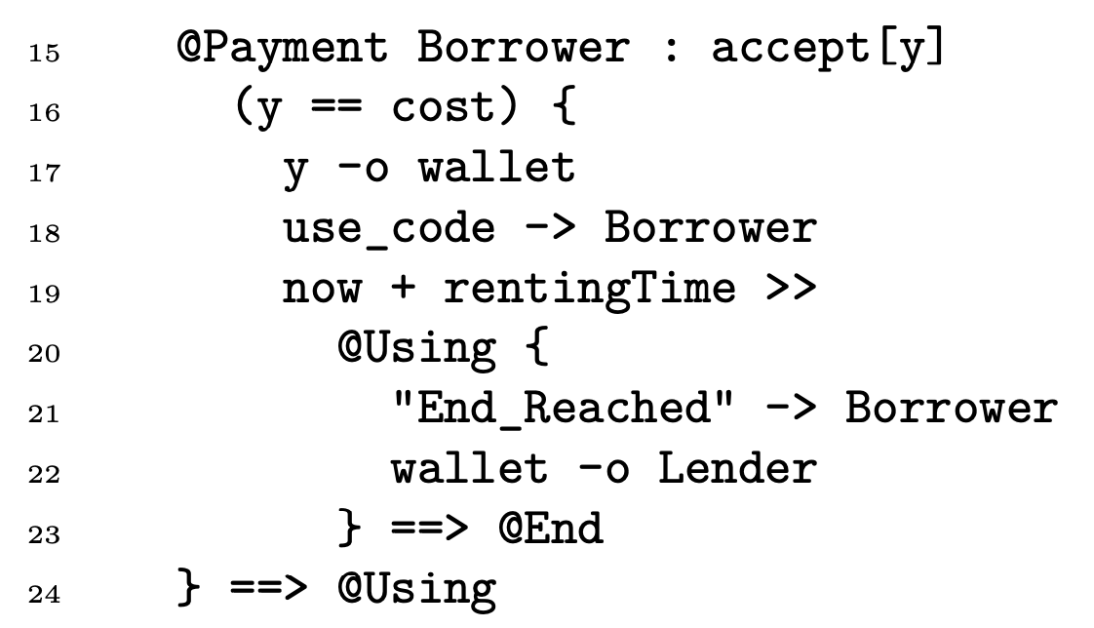
Stipula
Buildig blocks - Obligations
Prescribe certain actions to be performed within a specified timeframe
Event primitive

Slide 14
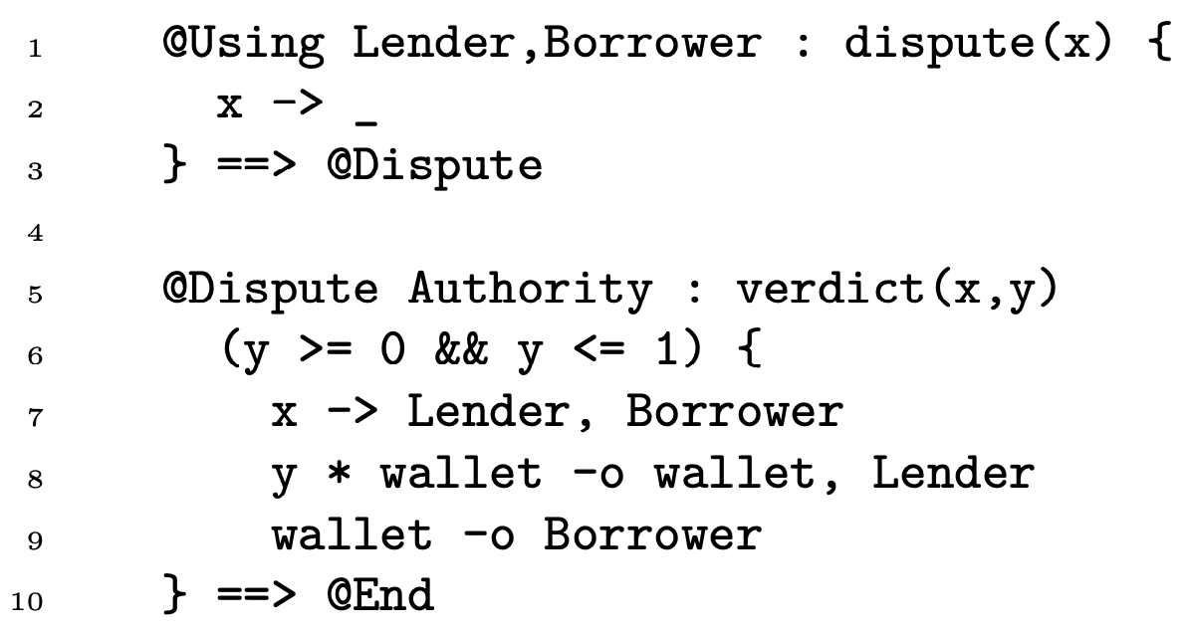
Stipula
Buildig blocks –
Third party enforcements
Approach for managing disputes without the need for additional features, which resembles the actions of a court.

Slide 15
Analysis and design
Basic ideas
Concept of time is not dependent on external factors (i.e., time required for the generation of a block)
Invoking events scheduled over time feature
Marked separation between the layer that deals with saving information in an immutable register and guaranteeing security, and the layer that deals with the execution of contracts

Slide 16
Analysis and design
Basic ideas – Layer separation
Marked separation between the layer that deals with saving information in an immutable register and guaranteeing security, and the layer that deals with the execution of contracts

Slide 17
Architectural analysis
Single instance on a server
Peer-to-peer network of nodes
Peer-to-peer network of nodes that rely on an underlying layer
Difference between Stipula server and Stipula node

Slide 18
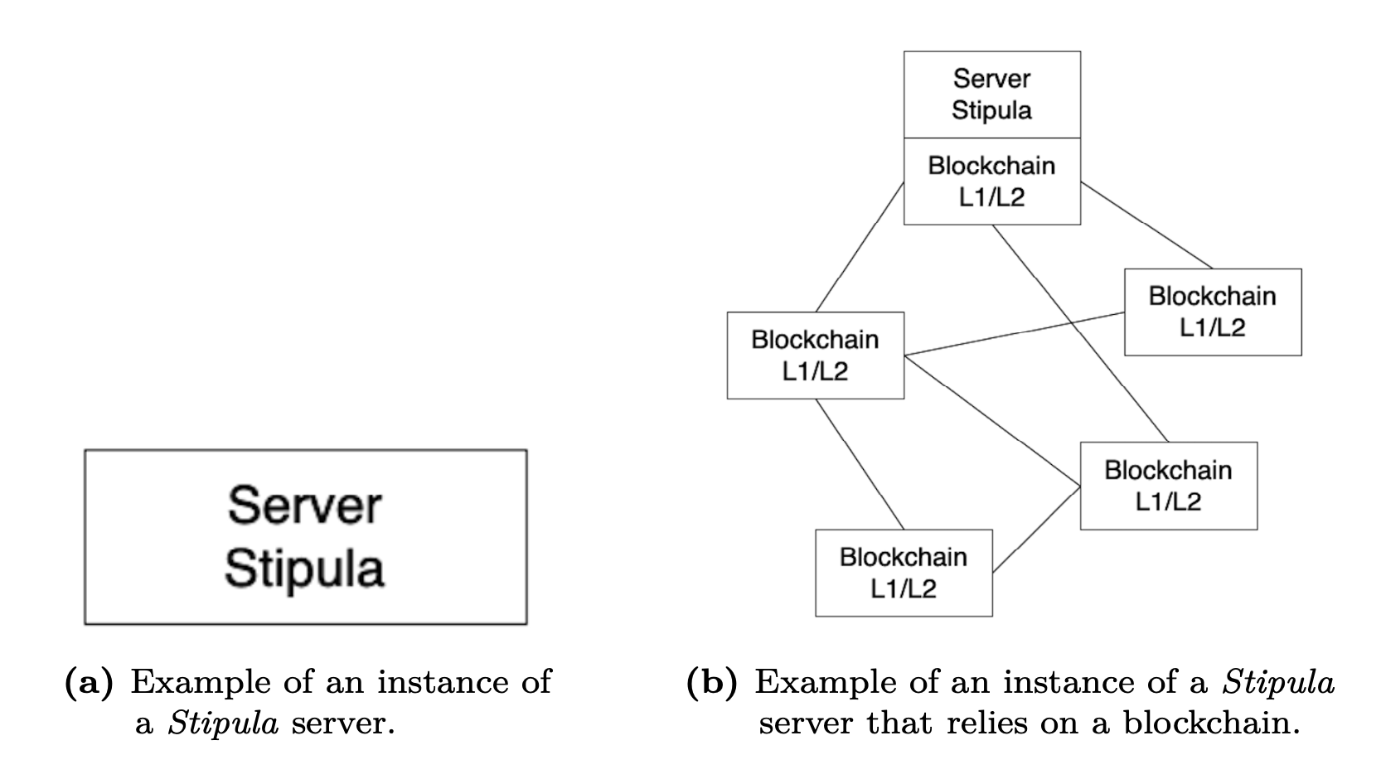
Analysis and design
Basic ideas –
Possible configurations

Slide 19
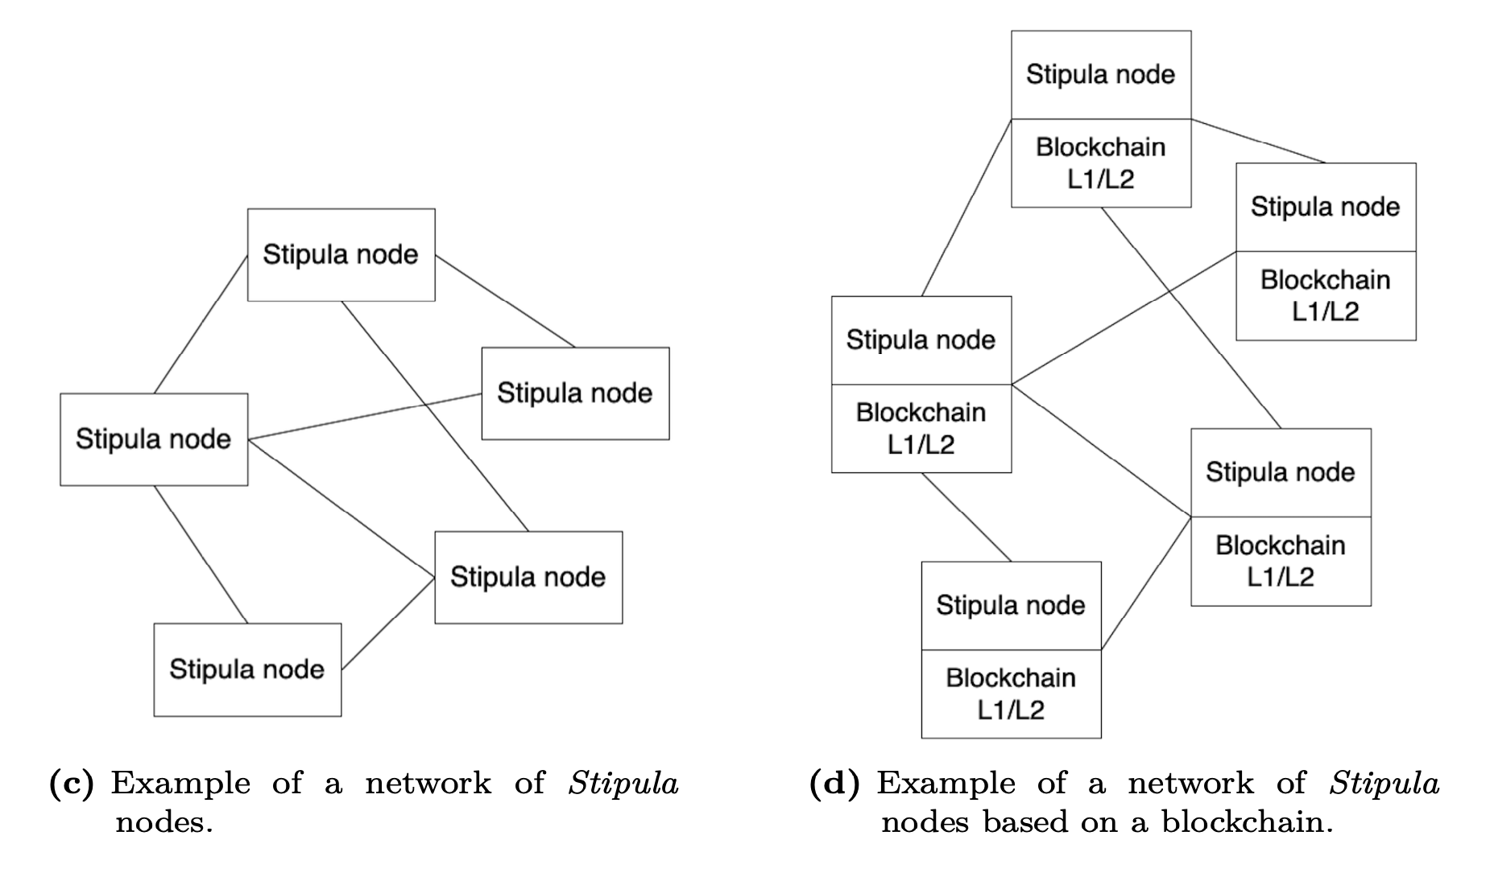
Analysis and design
Basic ideas –
Possible configurations

Slide 20
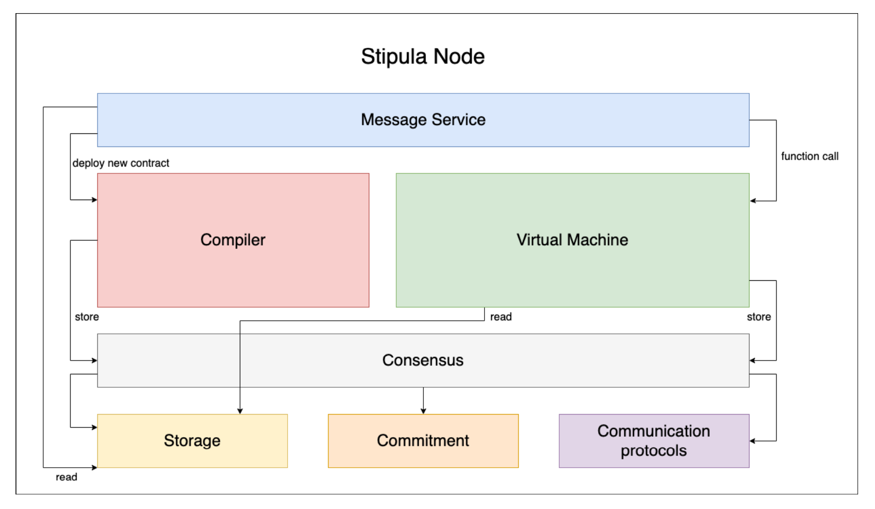
1. Architectural analysis
Proposed architecture

Slide 21
Analysis and design
Proposed architecture
Compiler
Efficiency
Correctness of contract
Interoperability
Virtual Machine
Contract execution
Event scheduling
Safety of asset transfers

Slide 22
Analysis and design
Proposed architecture
Storage vs commitment draws in diffrente configs

Slide 23
Analysis and design
Architecture – Message Service
TCP socket
Client send a payload in a specific format (SignedMessage)
Route the client request to other modules

Slide 24
Analysis and design
Architecture – Compiler
Why compilation over interpretation
Inference
Compilation approach allows interoperability with other languages

Slide 25
Analysis and design
Architecture – Virtual Machine
Platform independence and secure environment
Stack-based virtual machine
Management of various memory areas
Scheduling events management

Slide 26
Analysis and design
Architecture – Consensus
Allows multiple nodes to agree on a single result
Goals: data consistency, fault tolerance, conflict-free and security

Slide 27
Analysis and design
Architecture – Storage
Assets
Transfer of assets
Contracts
Contract instances

Slide 28
Analysis and design
Architecture – Commitment
Memorize a minimal set of key information allows reconstructing the evolution of the contract and of the asset transfers that have taken place over time
Proving the existence of a particular information
Offer a higher level of security

Slide 29
Analysis and design
Architecture –
Communication protocols
Allow communication between nodes
Exchange information to determine consent about the status of a contract
Exchange information to manage connections with other nodes

Slide 30
1. Architectural analysis
Definition of assets
Unique identifier: stipula_coin_asd345
Name of the asset: StipulaCoin
Unit name: STC
Decimals: 2
Maximum supply: 10000

Slide 31
Analysis and design
Asset management –
Definition of assets
Fungible assets and non-fungible assets
Unique identifier: stipula_coin_abc123
Name of the asset: StipulaNFT
Unit name: SNFT
Decimals: 0
Maximum supply: 1

Slide 32
Analysis and design
Asset management –
Transfer of assets
Consistency in the quantity transferred
Prevent assets from getting stuck in the contract
Proof of ownership
Avoid double-spending

Slide 33
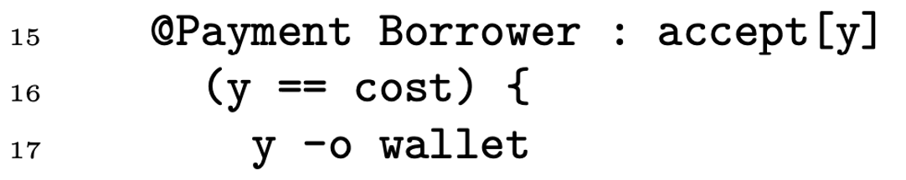
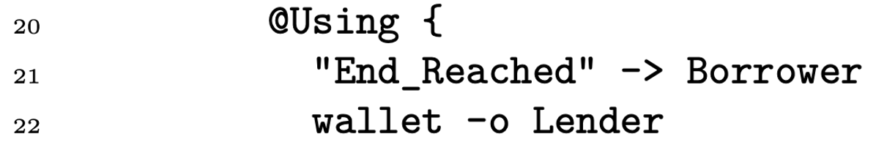
Analysis and design
Asset management –
Transfer of assets
Avoid party-to-party transfers
Pay-to-Contract
Pay-to-Party

Slide 34
1. Architectural analysis
Asset-balance models
How to manage the balances of various assets
Account-balance-based and UTXO (Unspent Transaction Output)
Dire perché ho scelto UTXO

Slide 35
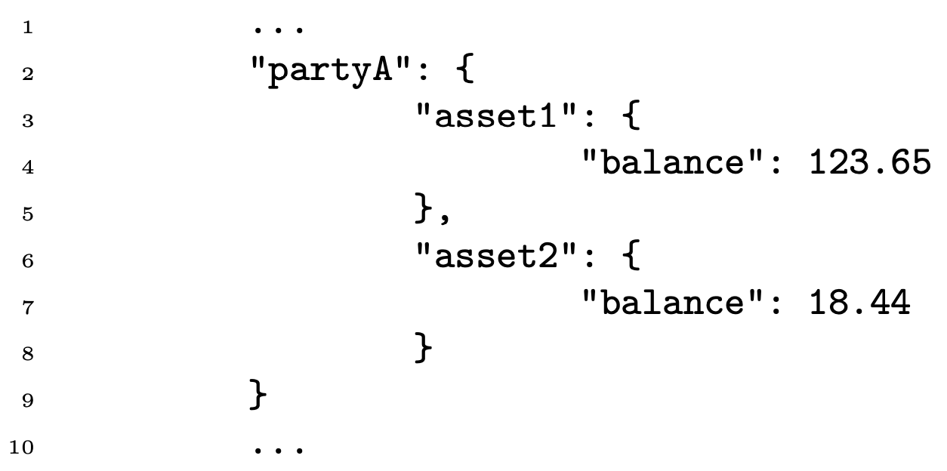
Analysis and design
Asset management –
Account-balance-based model
Problems in terms of scalability and security

Slide 36
Analysis and design
UTXO model
A UTXO as a box that contains a certain amount of an asset
This box is close by a single-use-seal which can only be broken by the owner of the quantity of assets in question
Advantages:
parallelization, partially solves the double-spending problem, security

Slide 37
Analysis and design
UTXO model
(More advanced transaction types, such as requiring more signatures or a certain amount of time before that the funds can be transferred)
multisig wallet
blocco temporale dei soldi

Slide 38
Analysis and design
Adopted solution
Definition of a Script language to specify the conditions under which a transaction can be spent in the network
Inspired from Bitcoin Script language
A program in Script language allows a party to provide a cryptographic proof of ownership of a UTXO

Slide 39
Analysis and design
Asset management –
UTXO model
Pay-to-Public-Key-Hash (P2PKH) in Bitcoin
lockScript: lock the funds
unlockScript: cryptographic proof provided by the owner of the funds
script = unlockScript + lockScript

Slide 40
Analysis and design
Script
PUSH str <signature> PUSH str <pub_key>
DUP SHA256 PUSH str <pub_key_hash> EQUAL CHECKSIG

Slide 41
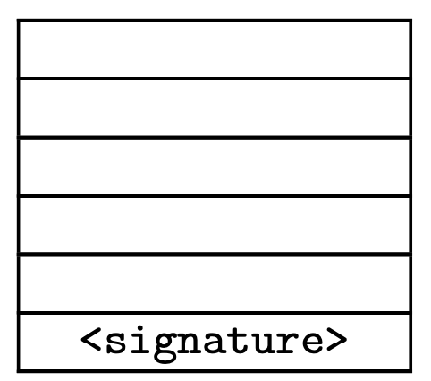
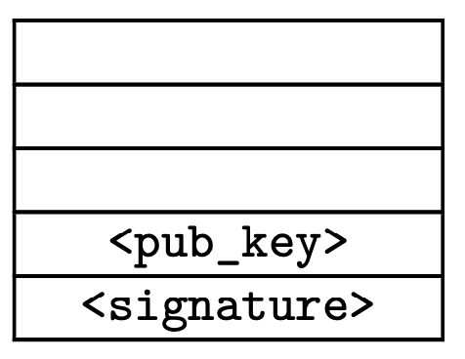
Analysis and design
Asset management –
UTXO/Single-use-seal model
PUSH str <signature>
PUSH str <pub_key>

Slide 42
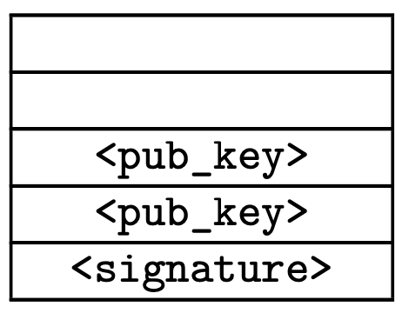
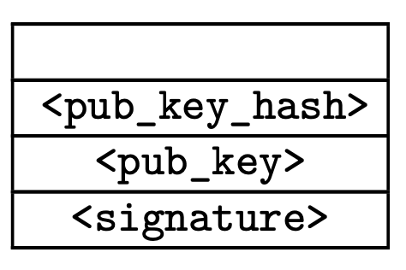
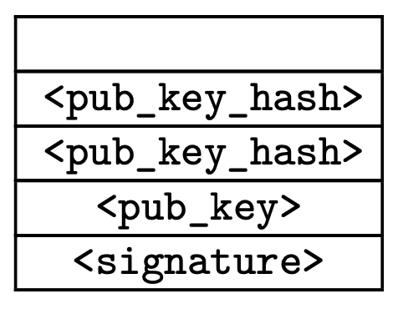
Analysis and design
Asset management –
UTXO/Single-use-seal model
DUP
SHA256
PUSH str <pub_key_hash>

Slide 43
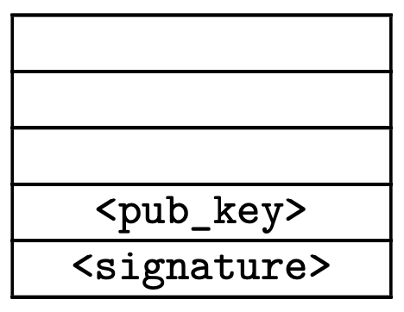
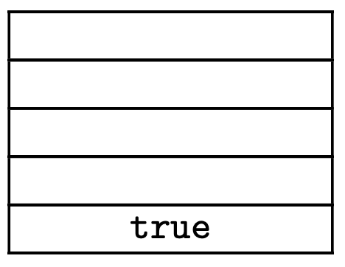
Analysis and design
Asset management –
UTXO/Single-use-seal model
EQUAL
CHECKSIG

Slide 44
Analysis and design
Asset management –
UTXO model
Script language enables more advanced transaction types, such as requiring more signatures or a certain amount of time before that the funds can be transferred

Slide 45
Analysis and design
Asset management –
UTXO model
Script language enables more advanced transaction types, such as requiring more signatures or a certain amount of time before that the funds can be transferred
Fungibility of assets and non-fungibility of UTXO/single-use-seals
Difference from Ethereum

Slide 46
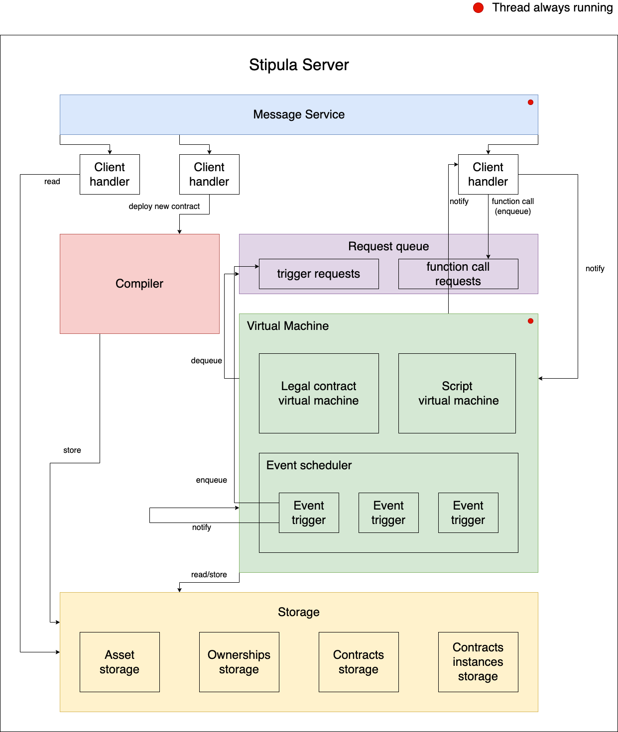
2. Specific implementation

Slide 47
Implementation
Contracts and contract instances
The difference is similar to class and object (or instance of a class) for object-oriented programming
The contract will be immutable, while a contract instance can change over time

Slide 48
Implementation
Message Service
MessageServer
Shared memory
ClientHandler
ClientConnection

Slide 49
Implementation
Message Service - Messages
Direct encoding of Java objects in JSON format
DeployContract
AgreementCall
FunctionCall
GetAssetById
GetOwnershipByAddress

Slide 50
Implementation
Message Service –
AgreementCall message
Identifier of the contract
Arguments of agreement function
Public keys of the parties that want to create a new instance of a contract
This message must be sent only one time to the Stipula server or Stipula node

Slide 51
Implementation
Message Service –
FunctionCall message
Identifier of contract instance
Function name to call
Arguments of the function

Slide 52
Implementation
Compiler
Lexer
Parser
Semantic analyzer
Code generator

Slide 53
Implementation
Stipula bytecode
Compiler (ANTLR tool): lexer, parser, semantic analyzer and code generator
This language was designed to mirror the features of the high-level language and to run on a stack-based virtual machine

Slide 54
Implementation
Stipula bytecode - Types
Integers: int <variable_name> 123
Strings: str <variable_name> abc
Booleans: bool <variable_name> true or bool <variable_name> false
Time (seconds): time <variable_name> 123

Slide 55
Implementation
Stipula bytecode - Types
Real numbers: real <variable_name> 123 1
Party: party <variable_name> ubL35Am7TimL5R4oMwm2OxgAYA3XT3BeeDE56oxqdLc=
Asset: asset <variable_name> 100 2 stipula_coin_asd345

Slide 56
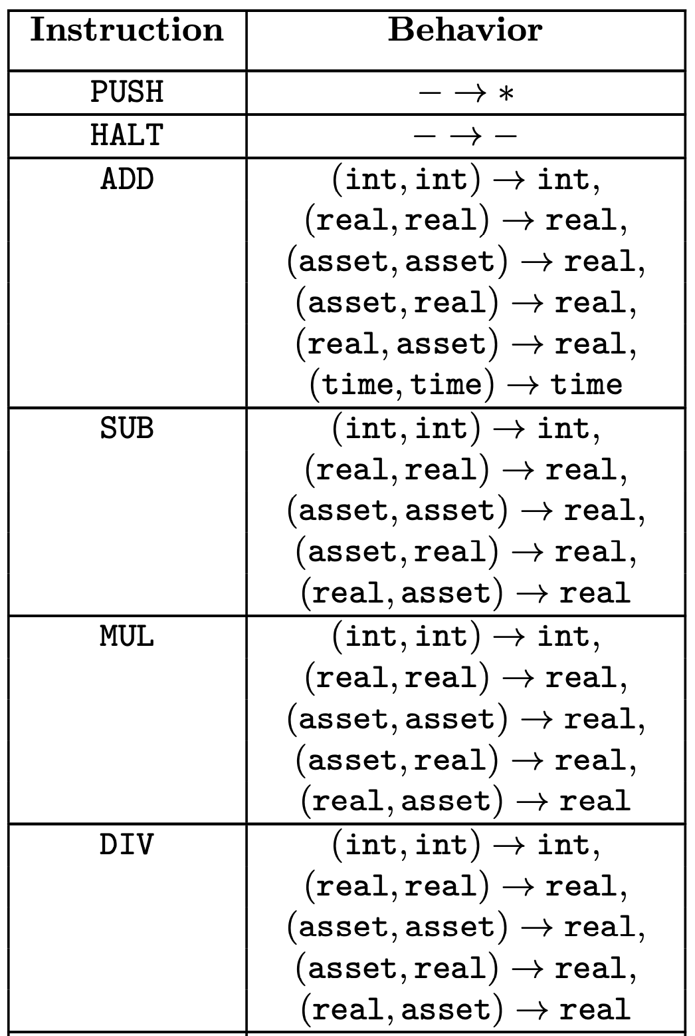
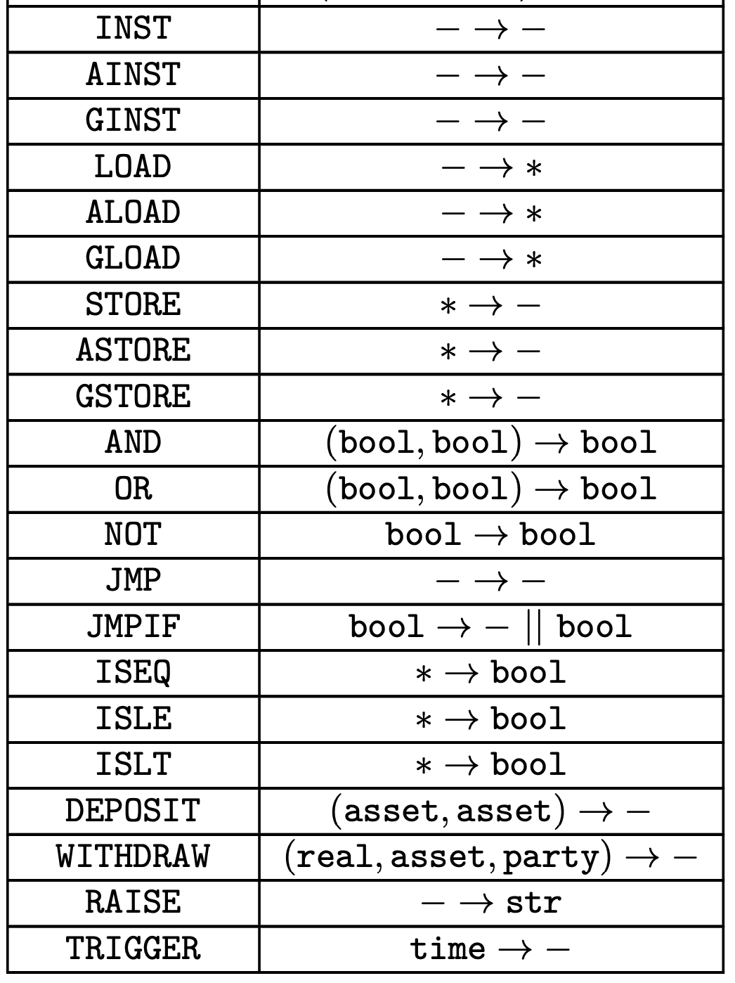
Implementation
Stipula bytecode – Instructions

Slide 57
Implementation
Stipula bytecode - Functions
Agreement: fn agreement Alice,Bob Inactive real,str
Obligation: obligation Swap obligation_1 End
Generic: fn Inactive Alice deposit Swap int,asset

Slide 58
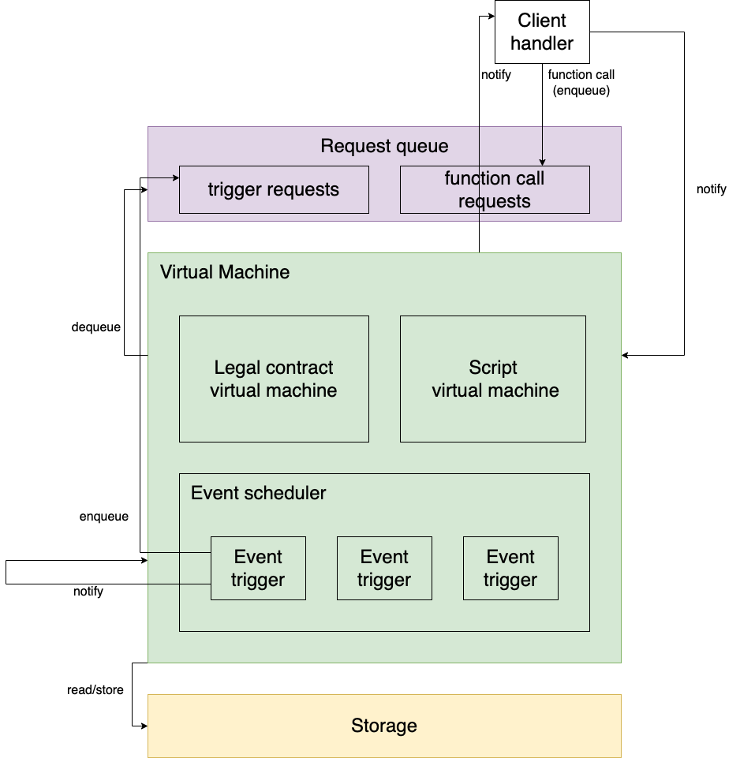
Implementation
Virtual Machine

Slide 59
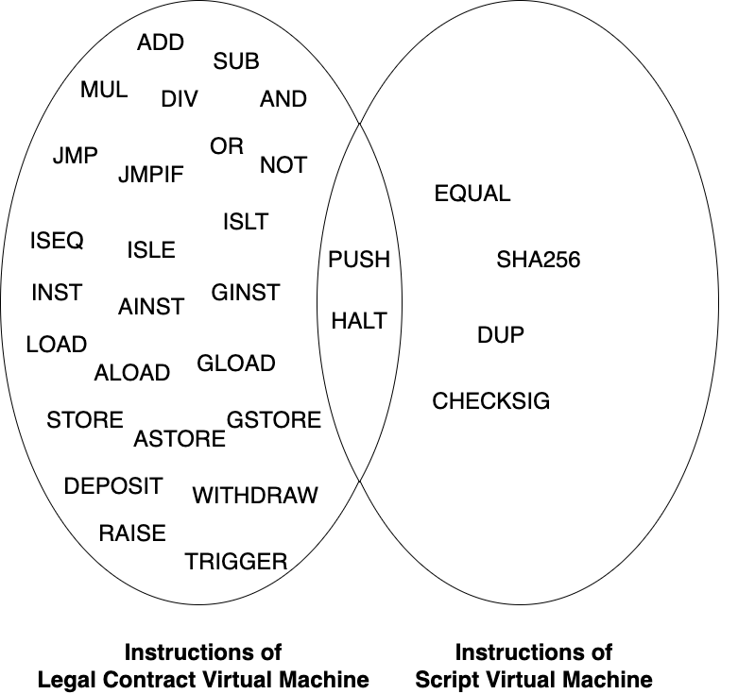
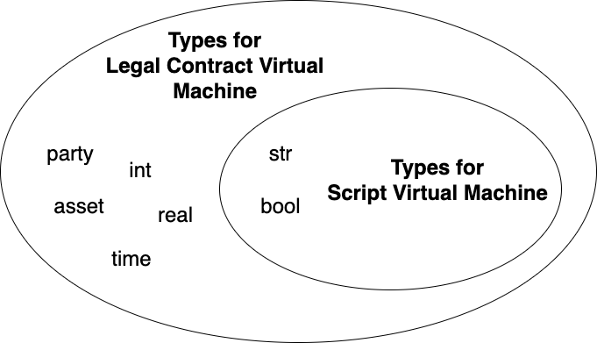
Implementation
Virtual Machine
Legal Contract Virtual Machine
Script Virtual Machine

Slide 60
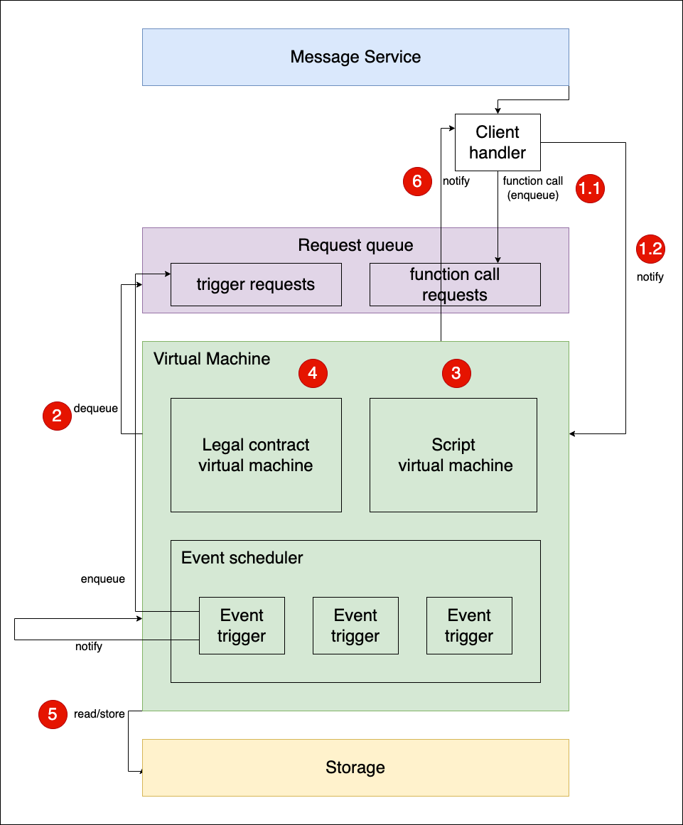
Implementation
Virtual Machine
Illustrate the execution flow of a generic contract that requires as input a value of type asset, and that therefore, the user has to make a payment

Slide 61
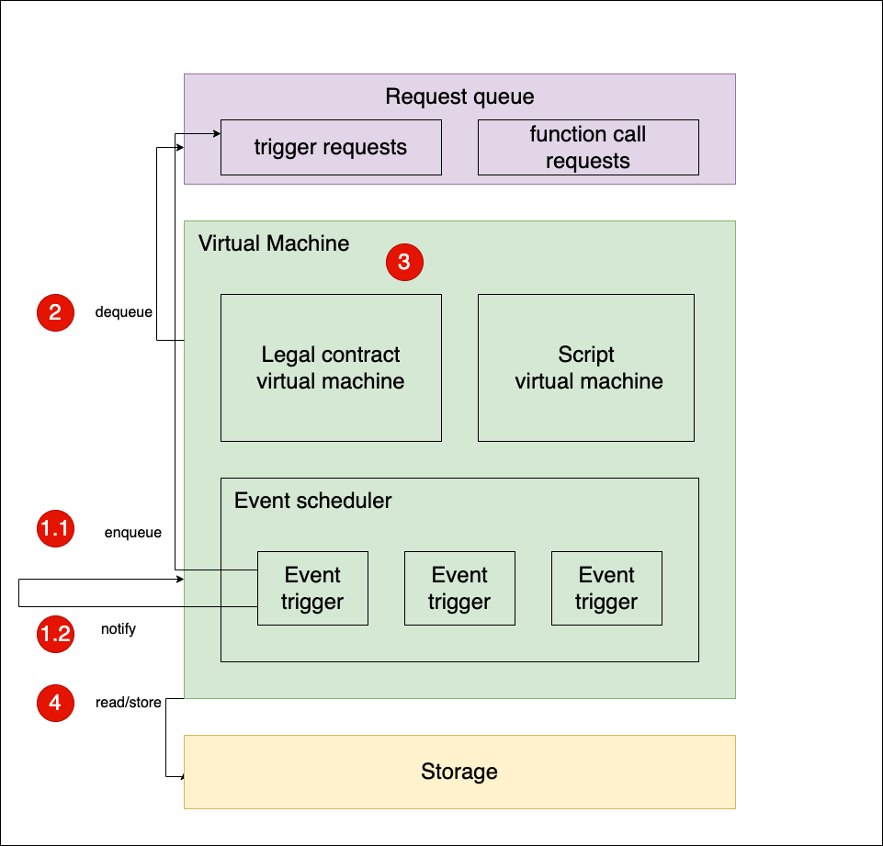
Implementation
Virtual Machine
Illustrate the execution flow of an obligation

Slide 62
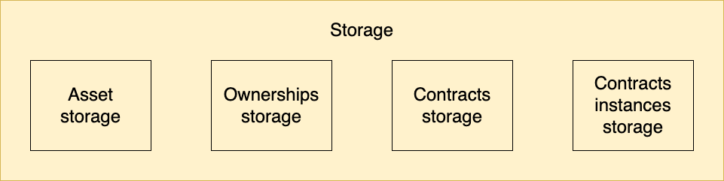
Implementation
Storage

Slide 63
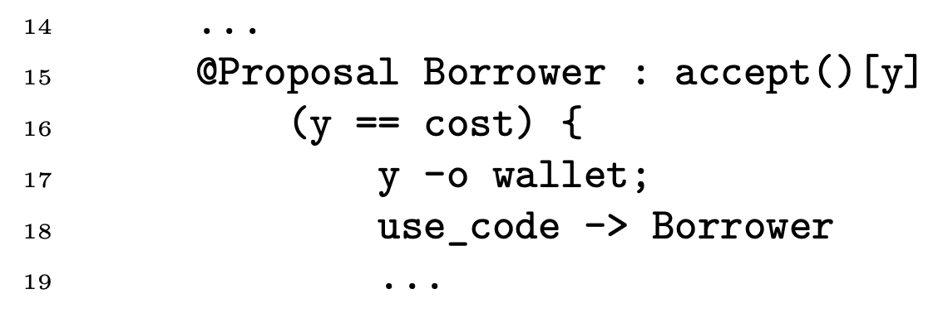
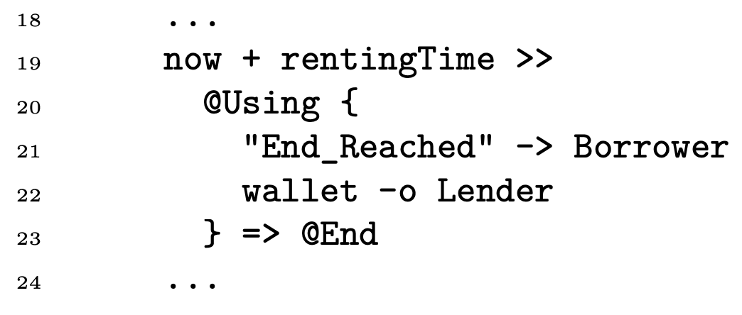
Considerations
Missing features –
Language features not implemented
Sending messages from the contract to a party

Slide 64
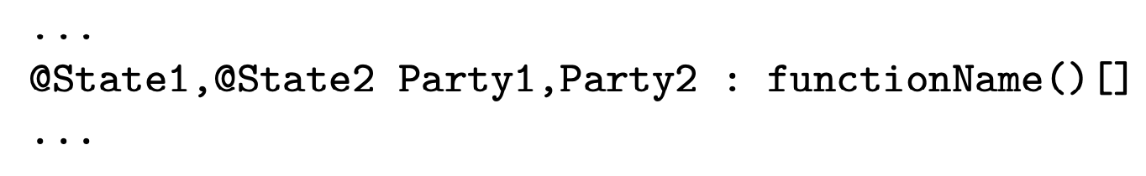
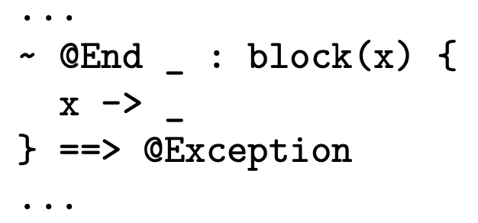
Considerations
Missing features –
Language features not implemented
Syntactic sugar

Slide 65
Considerations
Missing features –
Single-use-seal merge
In order to make a payment, the user must have available a single-use-seal of the exact quantity required by the contract
If the user does not have a single-use-seal of the requested quantity, the user cannot make the payment

Slide 66
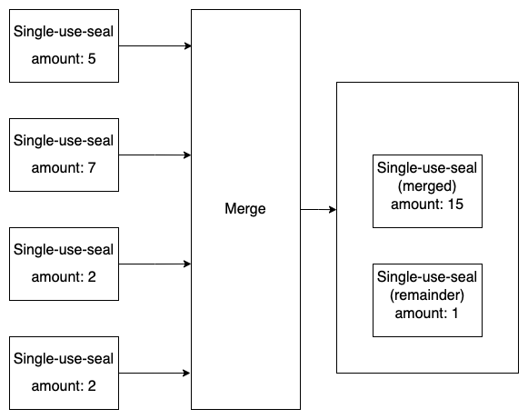
Considerations
Missing features –
Single-use-seal merge

Slide 67
Missing features
Creation of assets and their distribution
The functionality of scheduling the execution of certain piece of code over time could be leveraged to manage the creation, issuance and destruction of assets

Slide 68
Considerations
Optimizations – Virtual Machine
Parallelization of single-use-seals
Parallelization of function calls

Slide 69
Considerations
Optimizations – Storage
Parallelization of read requests
When a write request is received, it takes priority over read requests

Slide 70
Considerations
Limits of the architecture
Computational and memory resources required

Slide 71
Considerations
Future improvements
Implementation of the consensus module and communication protocols
Implementation of the commitment module
Script language extension
Creation of assets and their distribution
Implementation of additional software (i.e., SDK, wallet, …)

Slide 72
Conclusions
Challenges
Mapped out a project direction
Desgin an implementation-agnostic architecture

Slide 73
Conclusions
Challenges
Virtual Machine, compiler and Stipula bytecode (research, design and implementation)
Asset management and Script language (research, design and implementation)
Distributed context and consent (reasearch and first draft)

Slide 74
Conclusions
Organization
Research phase: from October to December 2022
Research, desgin and development phase: from December 2022 to April 2023

Slide 75
Conclusions
Design considerations
Virtual Machine, compiler and Stipula bytecode (research, design and implementation)
Asset management and Script language (research, design and implementation)
Distributed context and consent (reasearch and first draft)

Slide 76
Conclusions
Implementation considerations
~15,000 lines of code (4,500 generated by ANTLR tool)
107 classes
Most of the code is dedicated to the development of the Virtual Machine, the Stipula bytecode and the compiler

Slide 77
UNIVERSITY OF PADUA
Thank you for your attention!
Notes:
We have finished our presentation, thank you for your attention.

