Slide 1
Academy App Accessibility Standards

Slide 2
Business scenario
High expectations
  Large project: Multiple stakeholders/teams involved, high volume of users
  No exceptions: Only an accessible app would go live
Not an easy task
  We knew from the experience with the Legacy App that it wasn’t going to be easy
  Challenging accessibility standards to be met (next slide)
  Not everything would be met: Power Apps limitations
Short timeframe
  We started building definitions starting June
  Deadline for D+ grade: mid September
    No open ‘High’ severity bugs, which are not product dependent (PowerApps limitations)
    Needed to submit an exception request and get approval

Slide 3
High level Timeline
Bug fixing:
Internal alignment
Lots of research
Long, daily working sessions
5/23:
Project definitions started
6/1:
Initial design provided by design team
Initial conversations with accessibility team started
Front end dev started
7/15:
First submission of app to accessibility team
7/19:
Inclusive design consult PPT provided by Accessibility team
8/9:
Second submission of app to accessibility team
8/16:
Accessibility feedback completed: 45 bugs, 19 high severity
Evolved into:
83 Bugs logged in ADO, 34 high severity
9/14:
D+ exception request
9/21:
Accessibility D+ grade granted. Good to launch
9/26: App launch

Slide 4
Accessibility Challenges
Accessibility standards can be summarized in 4 categories (from low to high difficulty):
  Color Contrast
    Color contrast ratio between text and fill should be higher than 3:1, and between borders and backgrounds 4:1.
  Keyboard navigation
    The entire app should be navigable using keyboard, following a logical TAB order
  Screen reader
    NVDA screen reader should read in a logical order, announce live regions and roles of the different controls
  Responsiveness
    Controls need to accommodate to fit the screen regardless of the zoom level

Slide 5
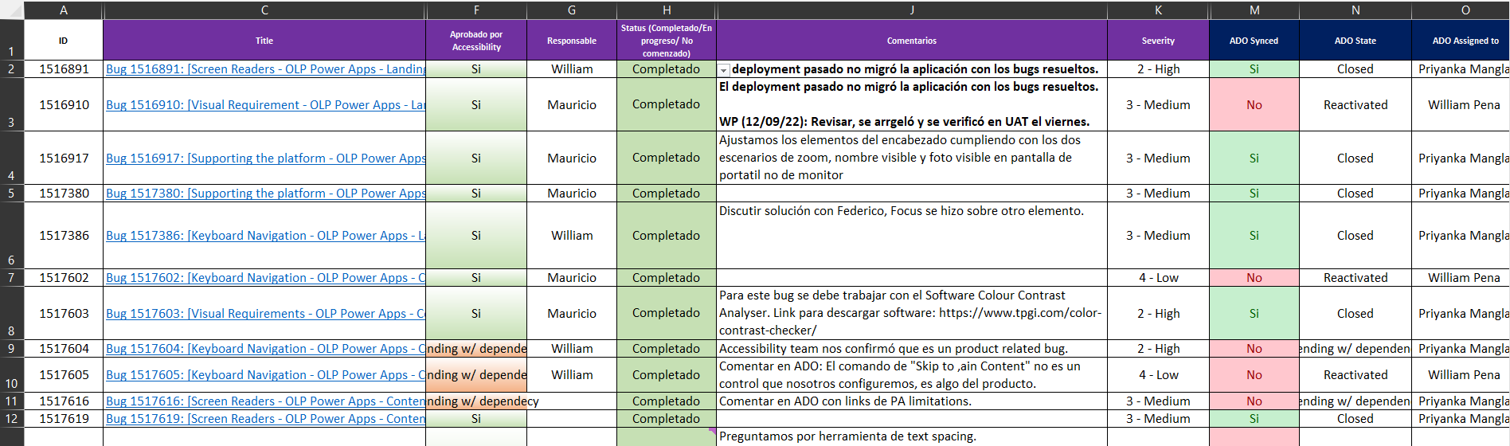
Team alignment/Methodology
Excel file for internal team:
  Daily tracking
  Kept updated with status in ADO
    Any Work items to be discussed during accessibility meetings (Tuesdays) were flagged
    Weekly deployment to UAT for accessibility revision and feedback (Fridays)
  In Spanish for team alignment including Mauricio

Slide 6
App Demo

Slide 7
Accessibility Challenges: Color Contrast
Main Requirements
  Luminosity contrast ratios should comply with specific standards depending on colors. This applies for:
    Text.
    Buttons.
    Focus borders.
    Element borders.
    Images.
    Icons / Shapes.
    Dropdowns / Search boxes.
    HTMLs.
  When adjusting the app for high contrast modes, ensure luminosity contrast ratio based on standards.
  The required luminosity contrast ratio is usually provided by accessibility team, but it can be found in: Understanding Success Criterion 1.4.3: Contrast (Minimum) (w3.org)
Bug examples:
  Bug 1531353 (Link broken on purpose for privacy reasons))
    Luminosity ratio of high contrast theme related dropdown controls with focus indicator fails to meet minimum required ratio.
  Bug 1517603 (Link broken on purpose for privacy reasons)
    Luminosity contrast ratio of focus indicator for 'apply' and 'clear all' buttons is 2.1:1 which is less than 3:1.
  Bug 1518059: (Link broken on purpose for privacy reasons)
    In High contrast Aquatic Desert modes, Differentiation for selected/unselected tile is not able to differentiate.ng the platform - OLP Power Apps - Content page]: In High contrast Aquatic Desert modes, Differentiation for selected/unselected tile is not able to differentiate

Slide 8
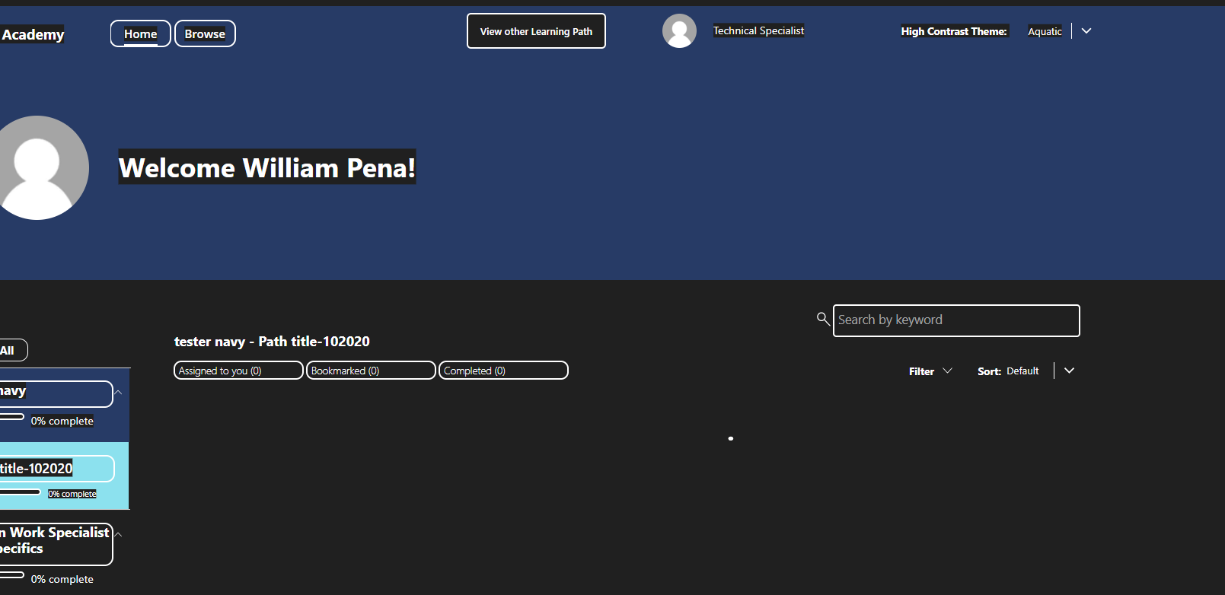
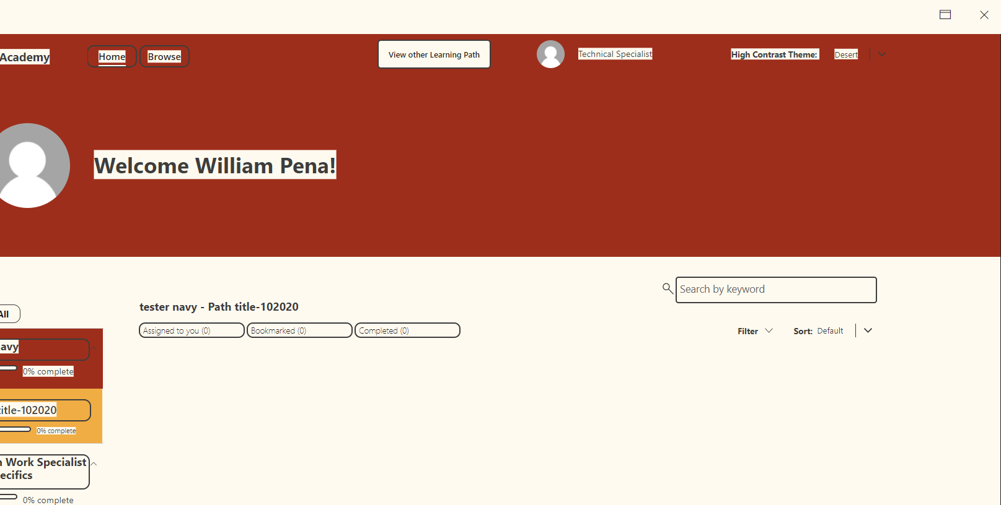
High Contrast Themes
Aquatic Theme
Desert Theme
To set up the app for the high contrast modes, have in mind that Power Apps does not has the ability to know specifically in which theme the Windows operating system is set. This means, one must create a theme inside the app to comply with luminosity contrast requirements.

Slide 9
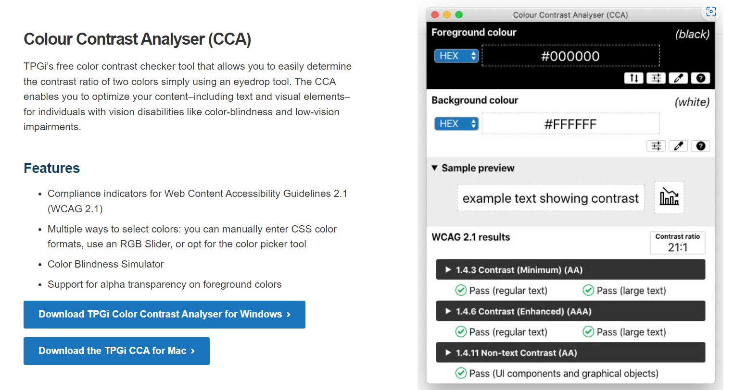
Accessibility Challenges: Color Contrast
Tools:
  Colour Contrast Analyzer (CCA)
The “CCA” is a relevant tool when talking accessibility.
This is the same tool accessibility team uses.
It is used to check contrast color throughout the app. It will be an essential tool as many colors one uses are not color-blind compatible or do not comply with accessibility requirements.
It is also extremely useful when setting up the app for high contrast themes.
The tool is available for Windows and iOS operating systems and can be downloaded here: Color Contrast Checker - TPGi
Image: https://www.tpgi.com/color-contrast-checker/

Slide 10
Accessibility Challenges: Keyboard navigation
Main Requirements
  Create focus borders around all the interactive elements for visual guidance.
    Ensure the focus border complies with luminosity ratios.
    Ensure the focus border does not get truncated or hidden when applying zoom or adjusting screen size.
    Ensure the focus border gives enough space for the text even when text spacing is applied.
  Build a logical and organized sequence of navigation for the interactive elements of the app.
  Make sure focus is not loss before navigating to the last interactive element.
Bug examples:
  Bug 1517727(Link broken on purpose for privacy reasons)
    Keyboard focus is unnecessarily moving to whole tile section upon activating 'Collapse All' or 'Expand All' control.
  Bug 1518011(Link broken on purpose for privacy reasons)
    Keyboard focus indicator is not visible on the entire page for tiles.
  Bug 1521879(Link broken on purpose for privacy reasons)
    Keyboard focus is not on sequential order in the page, while navigating using keyboard tab key.
  Bug 1522094(Link broken on purpose for privacy reasons)
    Keyboard focus indicator is not properly visible after invoking 'Go' button while navigating using tab key.

Slide 11
Accessibility Challenges: Screen reader
Main Requirements
  Screen reader should narrate the exact information of the element, no more than that.
  The sequence of reading must be logical according to accessibility requirements.
  Every focused element in the app while using keyboard navigation must have a logical and understandable name.
  There are shortcut keys for certain elements such as buttons or tables, make sure screen reader reacts when using these shortcut keys.
Bug examples:
  Bug 1517884
    Screen readers are not narrating state information for 'Home' control while navigating using shortcut key 'B'.
  Bug 1517959
    Screen readers focus is not in sequential order on the page while navigating using arrow keys in browse/VPC mode.
  Bug 1517996
    Screen reader does not announce any information after activating 'Bookmark', 'Mark as complete' or 'Rate content' controls.
  Bug 1517982
    Screen reader focus moving multiple times to buttons in the page while navigating using the down arrow key.

Slide 12

Accessibility Challenges: Screen reader
Tools:
  NVDA Screen Reader
The screen reader tool will come in handy when accessibility creates bugs about the reader not narrating the way it should.
This tool is the same the Accessibility Team uses, which is something one can leverage to fully correct all bugs found in the app.
The tool is available for only for Windows and can be downloaded through: NV Access | Download NVDA

Slide 13
Accessibility Challenges: Responsiveness
Main Requirements
    No elements should be hidden regardless of the screen size, up to 400% percent.
    No texts should become truncated, at any screen size
    Max 1 horizontal scroll bar per screen
    Max 1 vertical scrollbar per screen
Bug examples:
Bug 1521839
  At 400% Zoom mode, few content present in the page getting truncated.
Bug 1521798
  After resizing the page at 200% zoom, page content is not displaying properly.

Slide 14
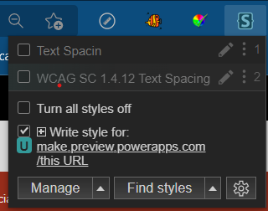
Accessibility Challenges: Responsiveness
Tools:
  Text Spacing Tool:
This tool was used to add space to the text in every element of the app to comply with accessibility standards.
The tool is called Stylus. It is available for Chrome and enabling Edge to install other browsers extensions it can be added and used in Edge as well. It can be found under the name “Stylus”.
This is the same tool Microsoft’s Accessibility Team used to check the app.

Slide 15
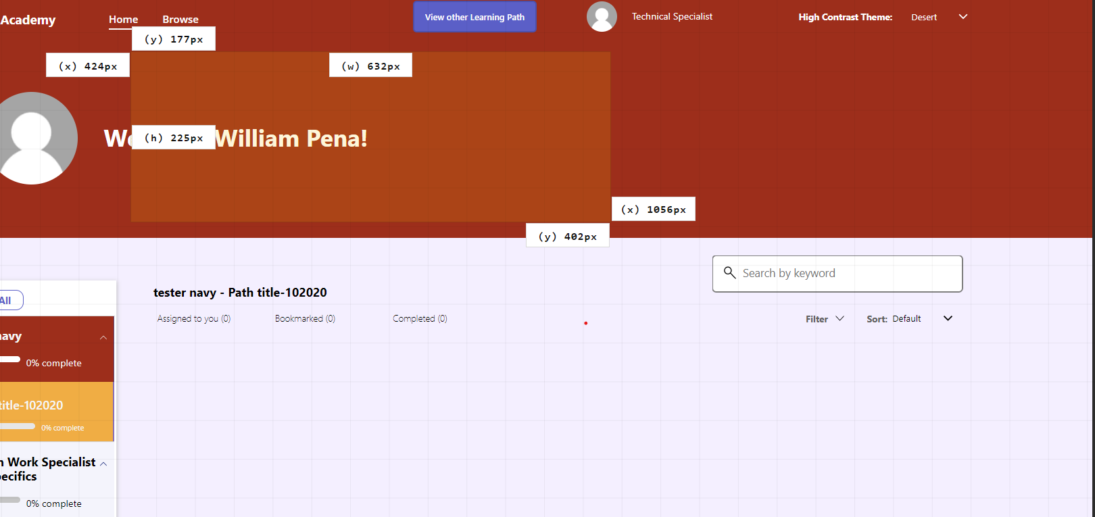
Accessibility Challenges: Responsiveness
Tools:
  Page Ruler
The page ruler tool is useful to measure certain distances between elements.
This is an extension of the browser and can be found under the name “Page Ruler”.
To measure accurately the app must be used with 100% mode inside the edit mode of Power Apps or 100% mode when played.
All measurements are displayed in px (pixels).

Slide 16
Recommendations regarding Standards & Best Practices:
Color contrast related accessibility requirements should be considered as standards for all projects
  Most users will have a UX if color contrast standards are met, along with existing Standards defined by the Solutions team
All other accessibility requirements should be considered as Standards for deliverables which require D+ grade accessibility fulfillment, and as Best practices for other deliverables, because:
  Fulfilling accessibility standards takes a lot of effort
  The Accessibility team will only support these projects where the requirement is defined
  Useful link for General Accessibility Guidelines:
  Accessibility “Official” Design Standards: Designing for Web Accessibility – Tips for Getting Started | Web Accessibility Initiative (WAI) | W3C

