Slide 1
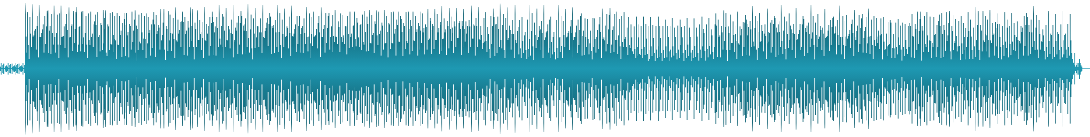
SoundScraping
Creating the world’s most comprehensive techno tracks database
github.com/fedesigns/soundscraping

Slide 2
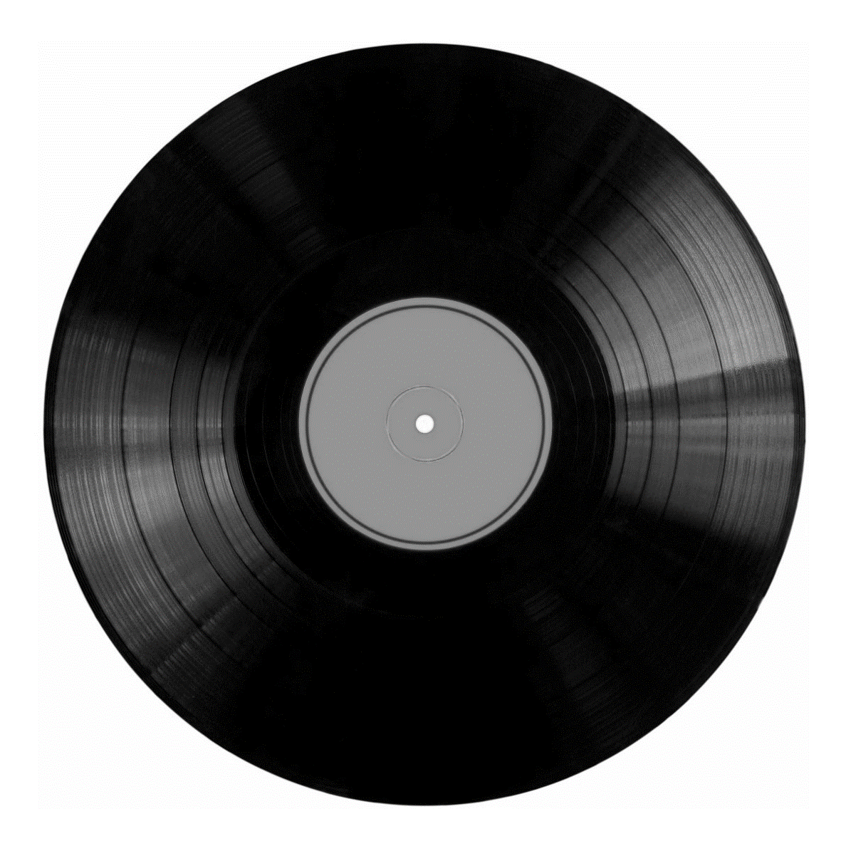
Why?
Emotion vs popularity
Multimodal evaluation
I miss raves

Slide 3
Beatport
Soundcloud
Reliable metadata
Comments, in context
Waveforms
Likes, reposts, plays
BPM, key, genre
Artist info, track covers

Slide 4
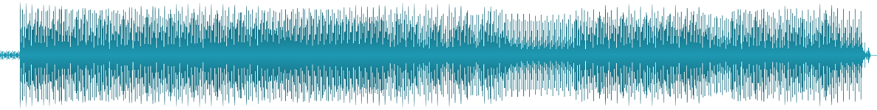
1. Choose artists
Picked from my playlist
Will add many more
Automating this?

Slide 5
2. Find SoundCloud Tracks
String manipulation x URL query
Error pages
Fake/old profiles

Slide 6
3. Get artist information
Followers
Bio, location
Images

Slide 7
4. Get track information
Accessing track page
Likes, reposts, plays
Comments

Slide 8
5. Get comments
Text
Time in track
Time in history

Slide 9
6. Find track on Beatport
Track or set?
Closing pop up
Checking match

Slide 10
7. Get features
BPM, key, genre
Reliable metadata
Waveform

Slide 11
8. Store data
3 x .csv files, exception handling
(Some) cleaning embedded in pipeline
Waveforms, images, audios accessible as URLs

Slide 12
Next
steps
Improve artist search pipeline
More time = more artists, tracks, comments
Transfer everything to cloud, SQL database
Sentiment & audio features analysis
Generating track images, sounds?
Notes:
Improve artist search – use search function, select first artist, pick first result instead of guessing URL string
Scrape more artists, more tracks, more comments, more beatport details with more time
Transfer/do the above in SQL database, running code and directly storing everything in the cloud
Download all images and store them in data lake before they change?
Soundcloud to mp3 to download audio for awesome feature extraction

Slide 13


