Slide 1
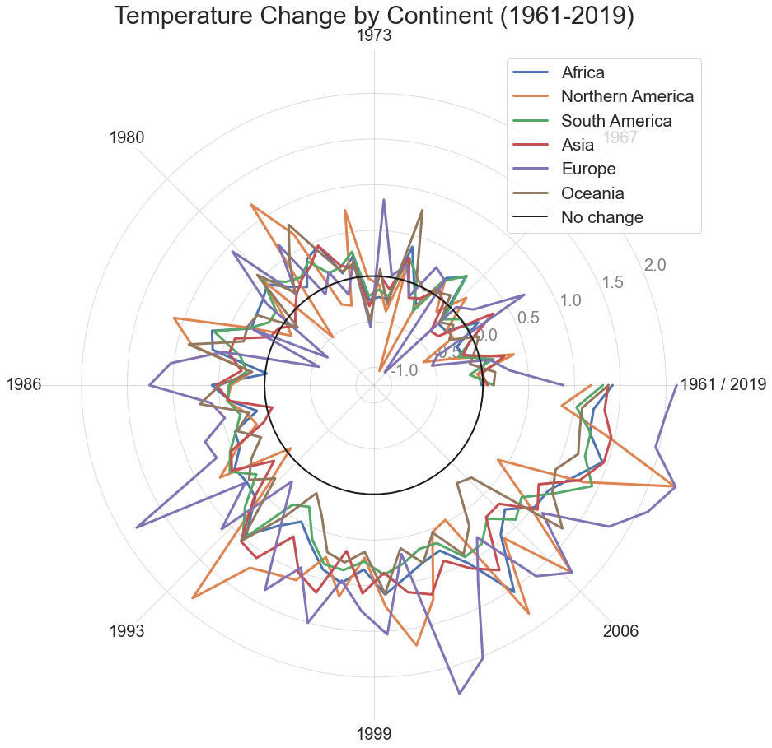
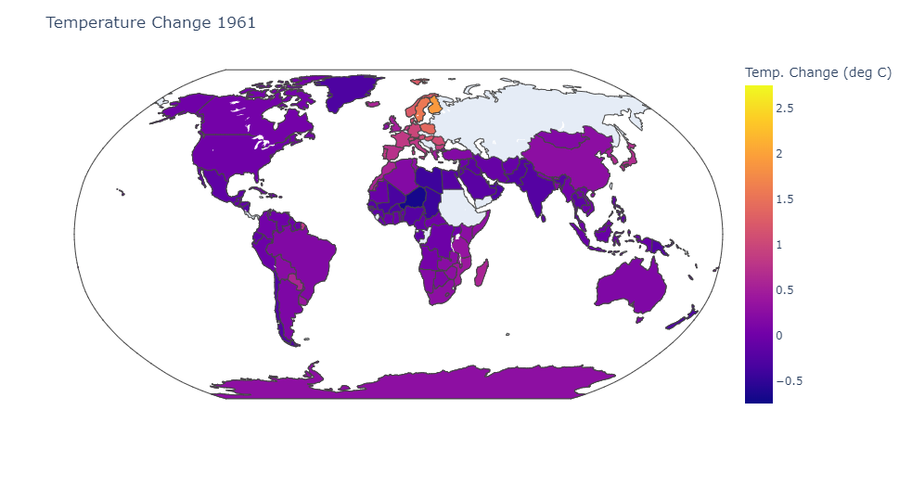
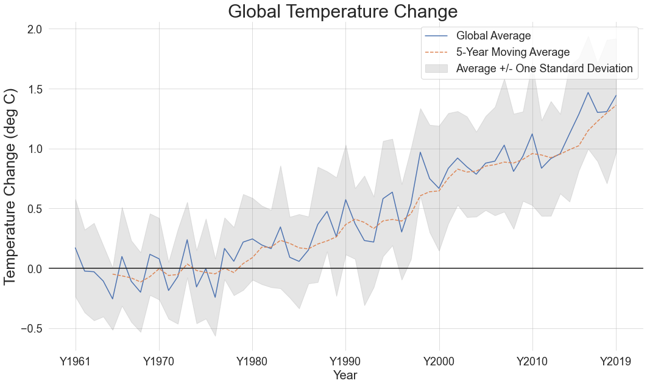
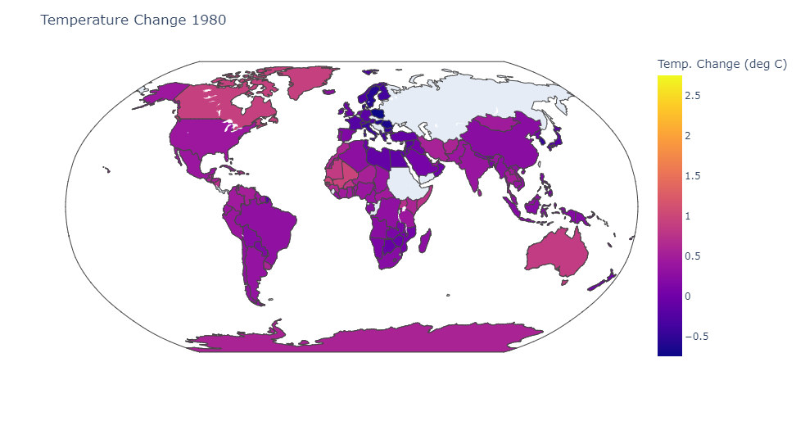
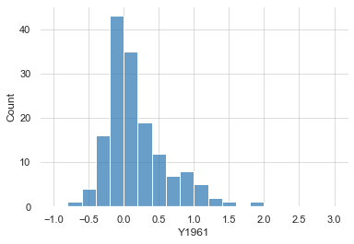
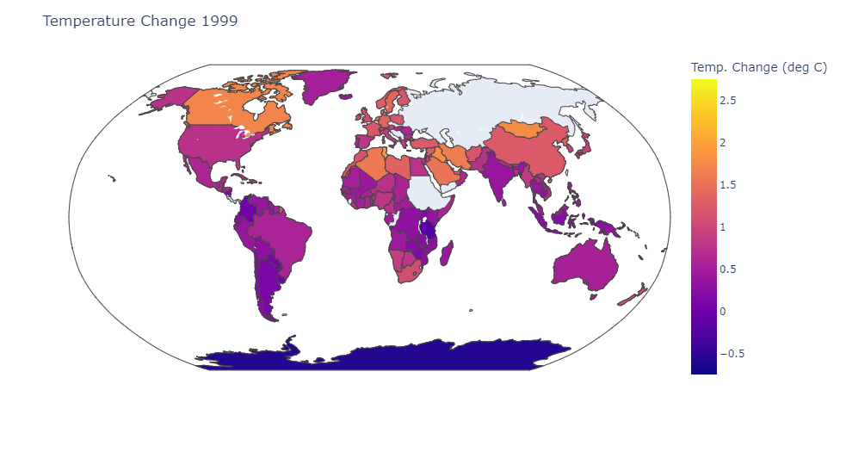
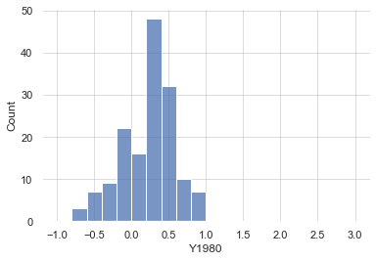
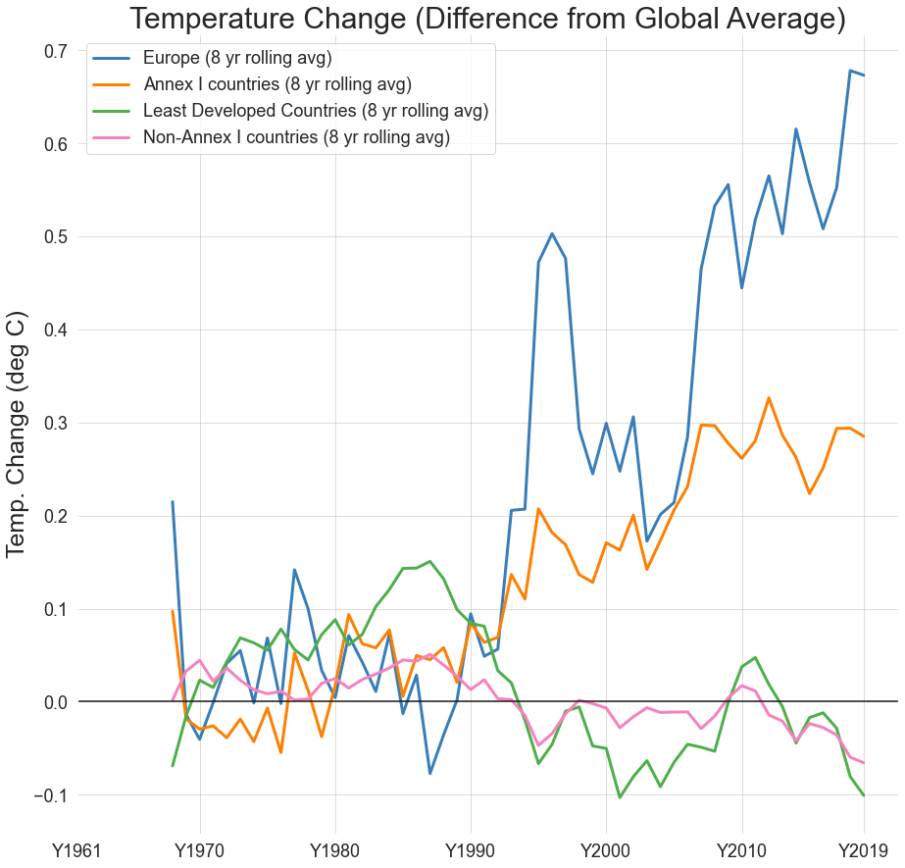
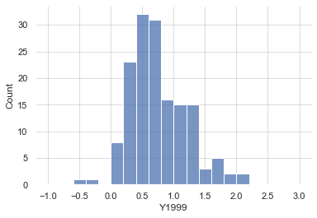
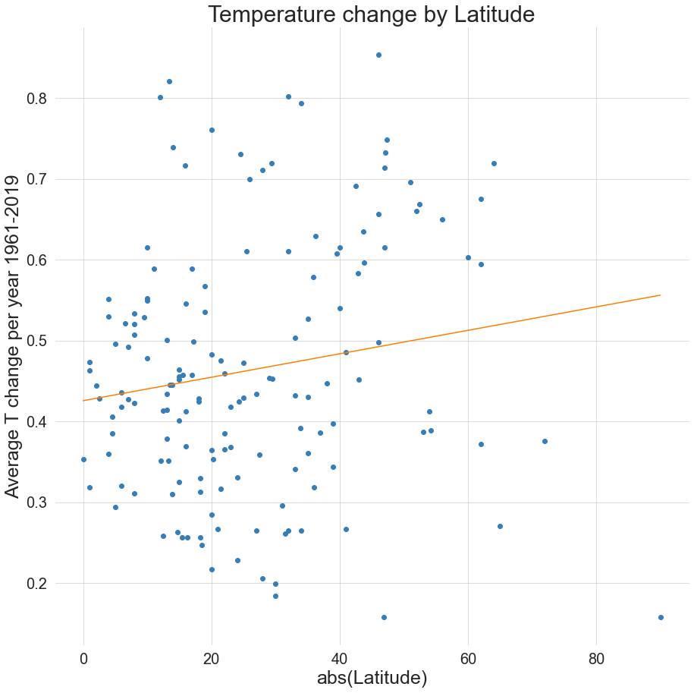
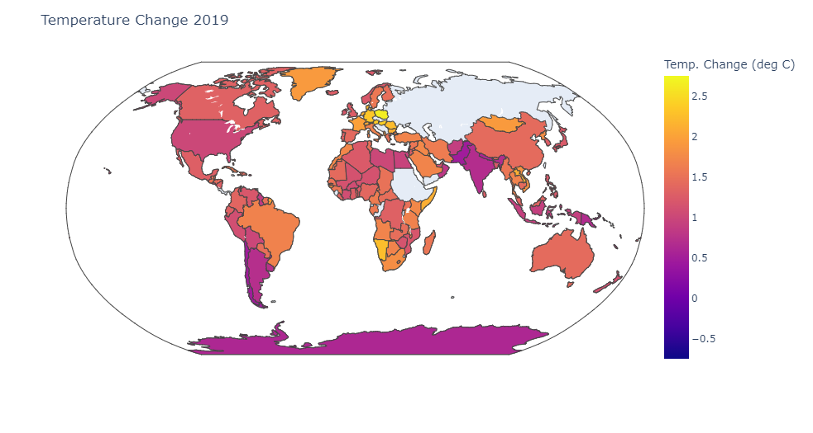
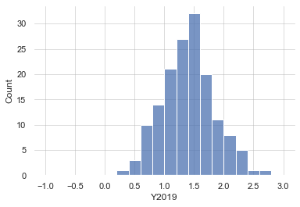
Trends in Global Temperature change
Jeremy Fedewa
CMSE 402 Semester Project
Introduction
Who Is Most Affected By Climate Change?
For this project, I wanted to get a better idea of the global trends in climate change and how they impact different people around the world.
These trends may be useful in informing both future action on climate change, as well as efforts to mitigate the negative outcomes of climate change
The 4-panel figure to the left shows global temperature change for the years 1961, 1980, 1999, and 2019.
A uniform color bar was used to highlight any trends in the data.
It’s clear from the maps to the left that – despite climate change being a global issue - not all parts of the world are equally affected by climate change.
To the left, temperature change for each continent (excluding antarctica) is shown on a radial plot. We can see that while temperatures in most continents have been rising steadily, Europe has had several large spikes, and tends to be higher than other continents.
Global Trends in Climate Change
Global Trends in Temperature Change
To the right, I plotted the 8-year rolling averages for Europe, Less developed countries, and both Annex-I and non-Annex-I countries
Annex-I countries are Industrialized countries which were OECD members in 1992.
This shows very clearly that more industrialized countries have tended to experience more temperature change.
The above figure shows the yearly temperature change compared to the average temperature form 1951-1980 along with a shaded region corresponding to a 1σ deviation from the mean
There is a clear upward trend globally, with the average global temperature anomaly for the year 2019 at nearly +1.5 degrees Celsius.
In the figure on the right, I’ve plotted average temperature anomaly vs absolute value of latitude, showing a slight positive correlation.
This indicates that counties further from the equator tend to experience more temperature change
Above, to the right of the maps is a series of four histograms, showing the distribution of temperature change for the years corresponding to the maps, showing the same upward trend in temperature.

