Slide 1
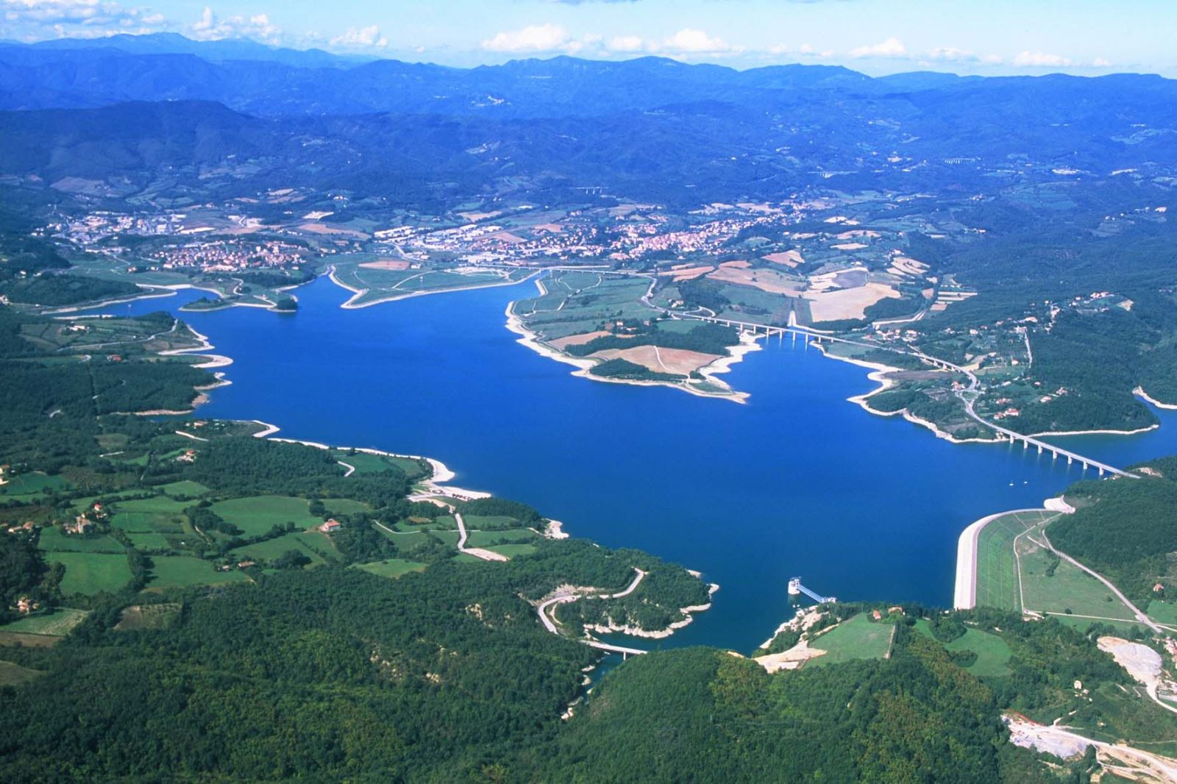
Predicting Water Levels at Lake Bilancino
Alex Federspiel

Slide 2
The Problem
The Acea Group is an Italian multiutility operator.
Difficulties include seasonal variation and predicting when rainfall will affect the lake.
They want to be able to efficiently supply water to their consumers.
Use rainfall from surrounding cities to predict water levels.
Water levels rise in the fall and winter and lower in spring and summer.
Rainfall seeps into the ground and becomes groundwater which moves slowly and can be lost along the way.

Slide 3
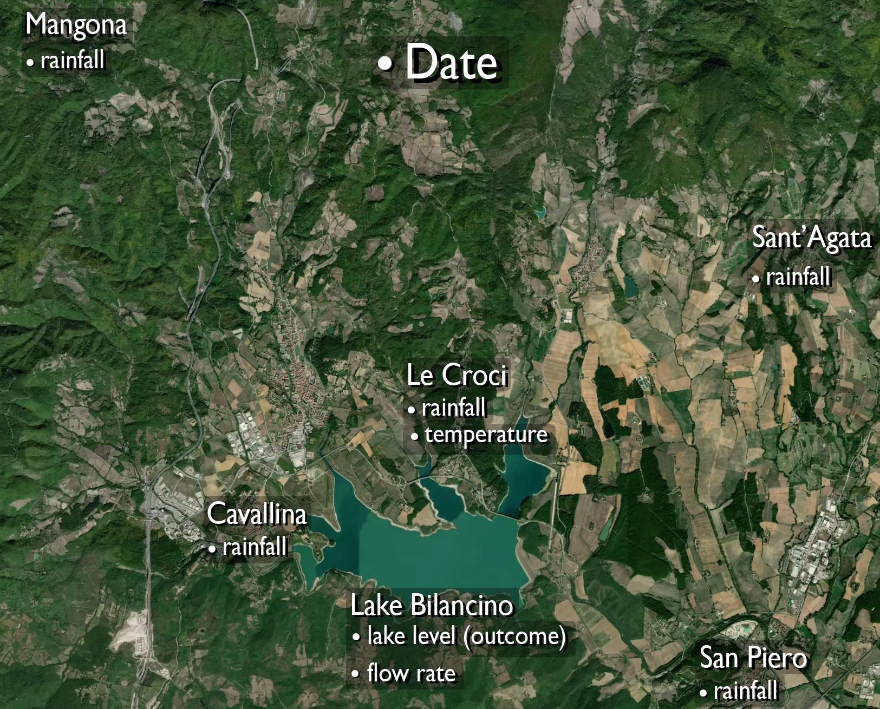
Variables
Data ranged from 2002 to 2020.
Some missing values.
Outcome variable
Lake level
Predictors
City rainfalls
Le Croci temperature
Lake flow rate

Slide 4
Preprocessing
Any rows containing NA values were removed.
Entire first 2 years of dataset.
Changed scope of variables.
Temperature → Average Temperature over 2 Weeks
Lake Level → Weekly Lake Change
Added in rainfall delay variables.
Up to 2 weeks back.
12 variables to 80

Slide 5
Variable Selection
LASSO was used to select variables.
80 → 41 variables
Thought about using LASSO for each city separately.
Ran data through 5 models: LASSO, Regression Tree, Random Forest, KNN, GBM
Looked at the top 20 most important variables for each model.
Even more variables could be removed from dataset: 41 → 24

Slide 6
RMSE of the Models
Model | 41 Variable Dataset | 24 Variable Dataset
LASSO | 0.30 | 0.31
Tree | 0.36 | 0.35
Random Forest | 0.26 | 0.26
KNN | 0.34 | 0.32
GBM | 0.23 | 0.25

Slide 7
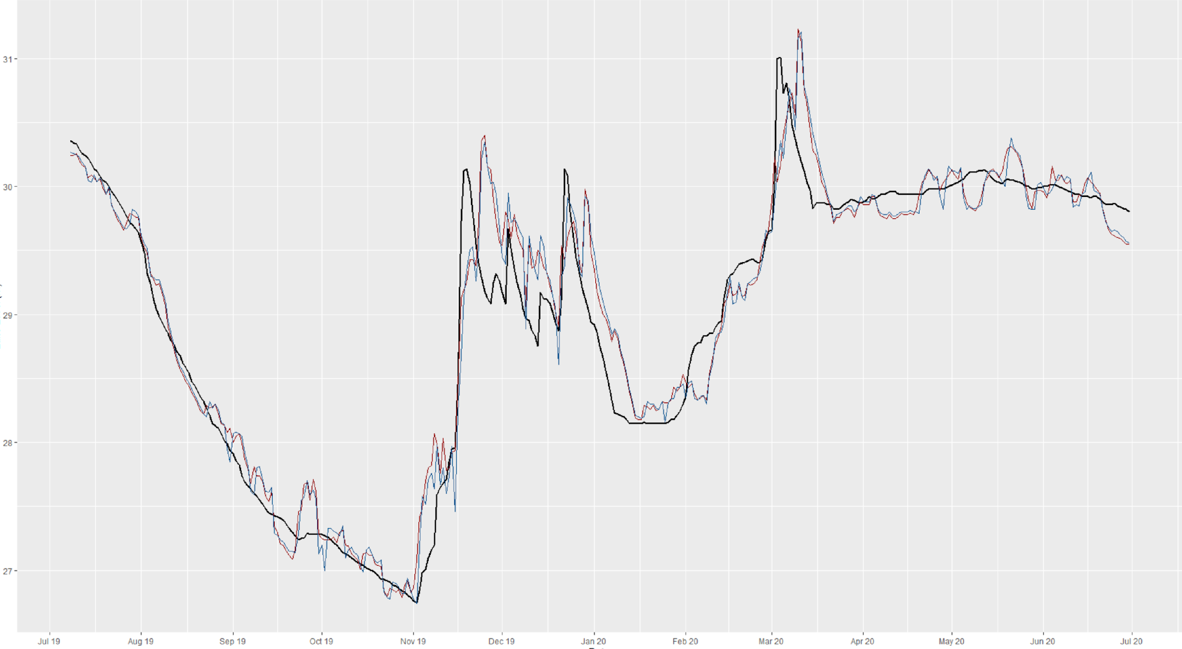
LASSO Model

Slide 8
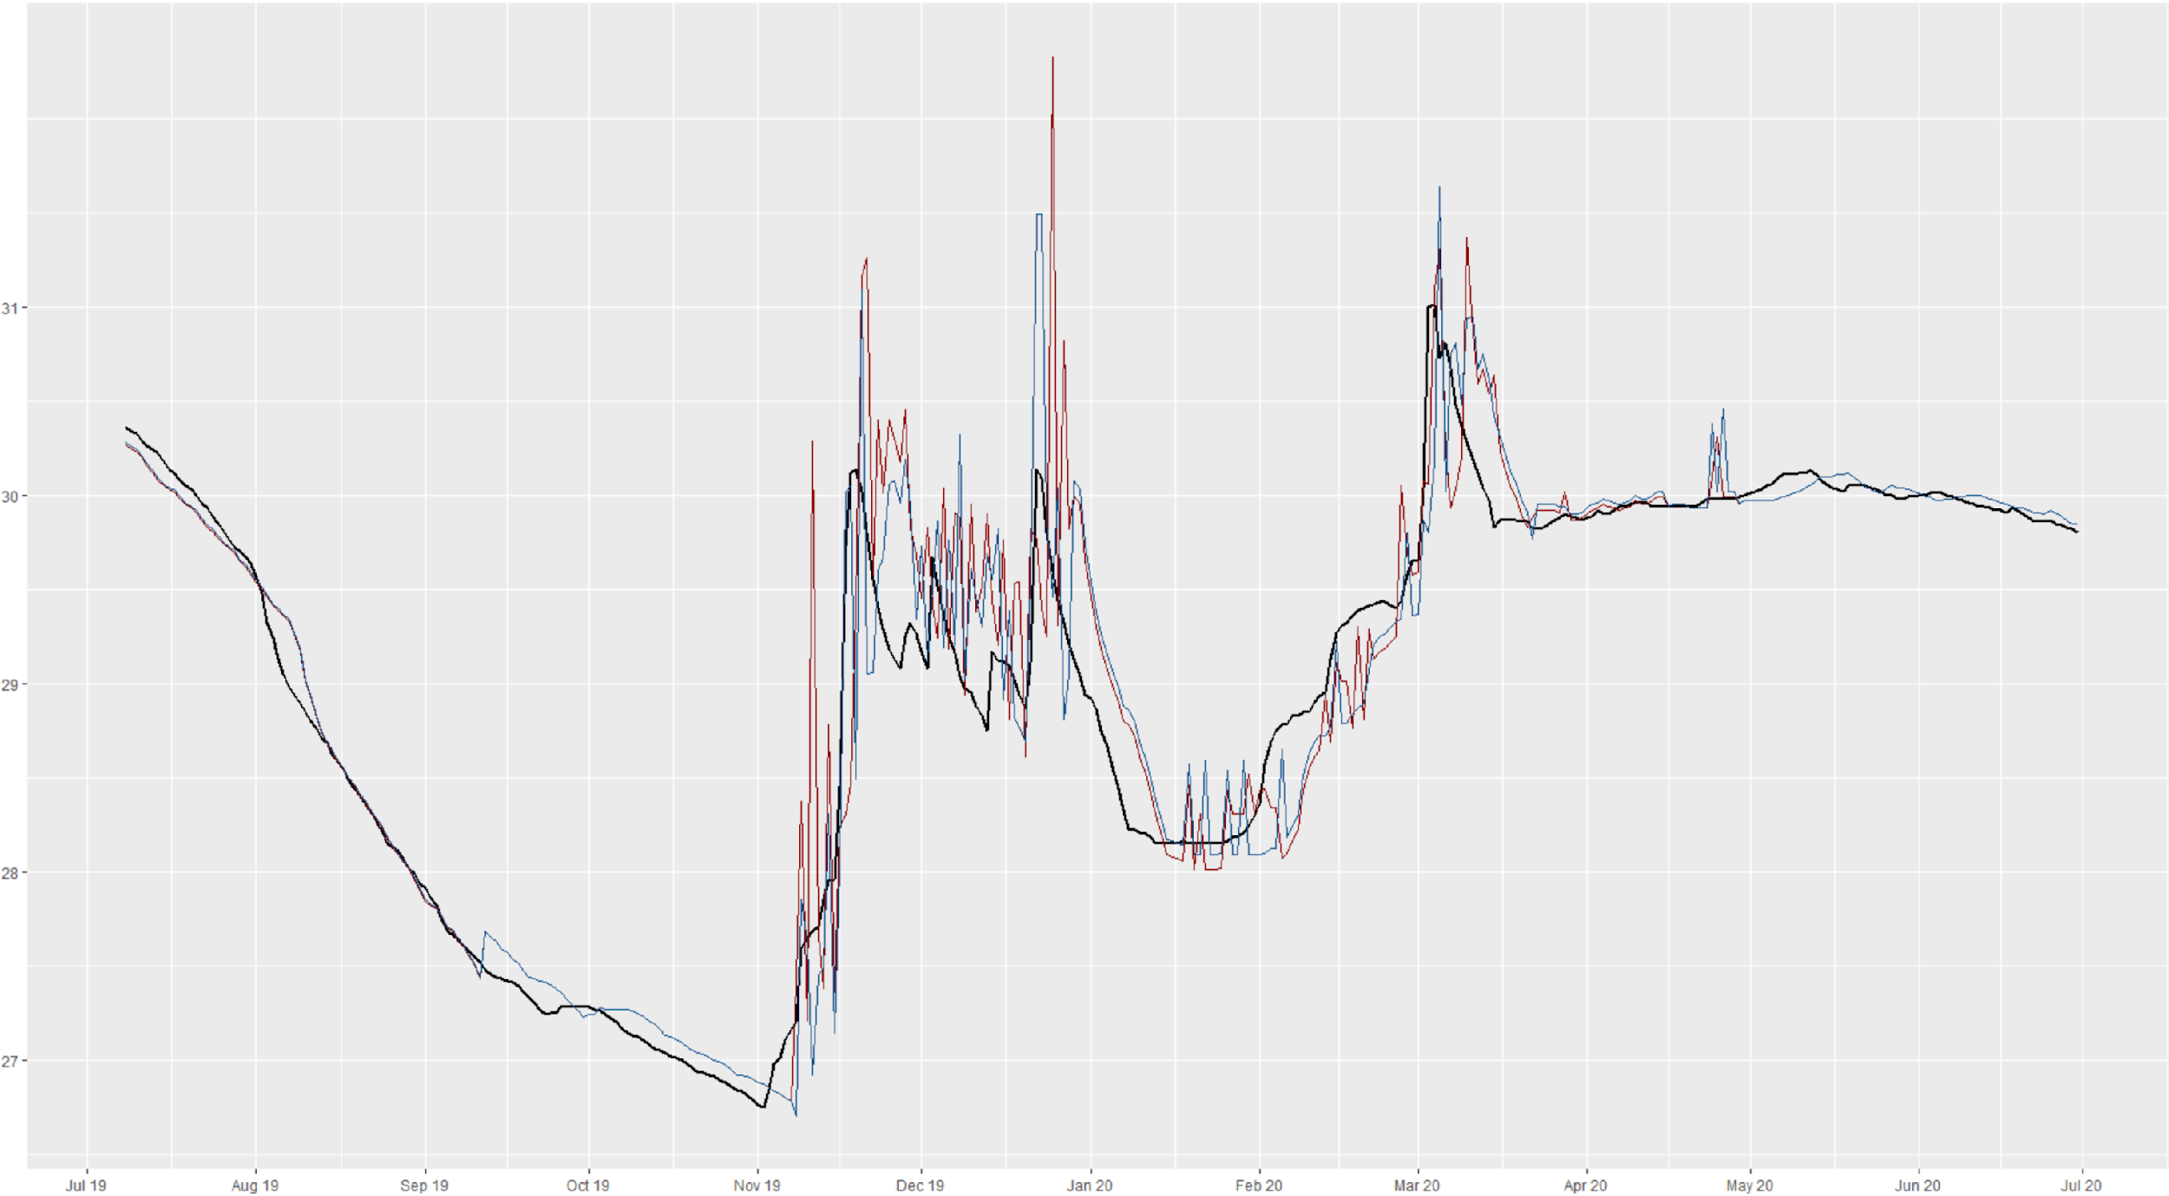
Regression Tree Model

Slide 9
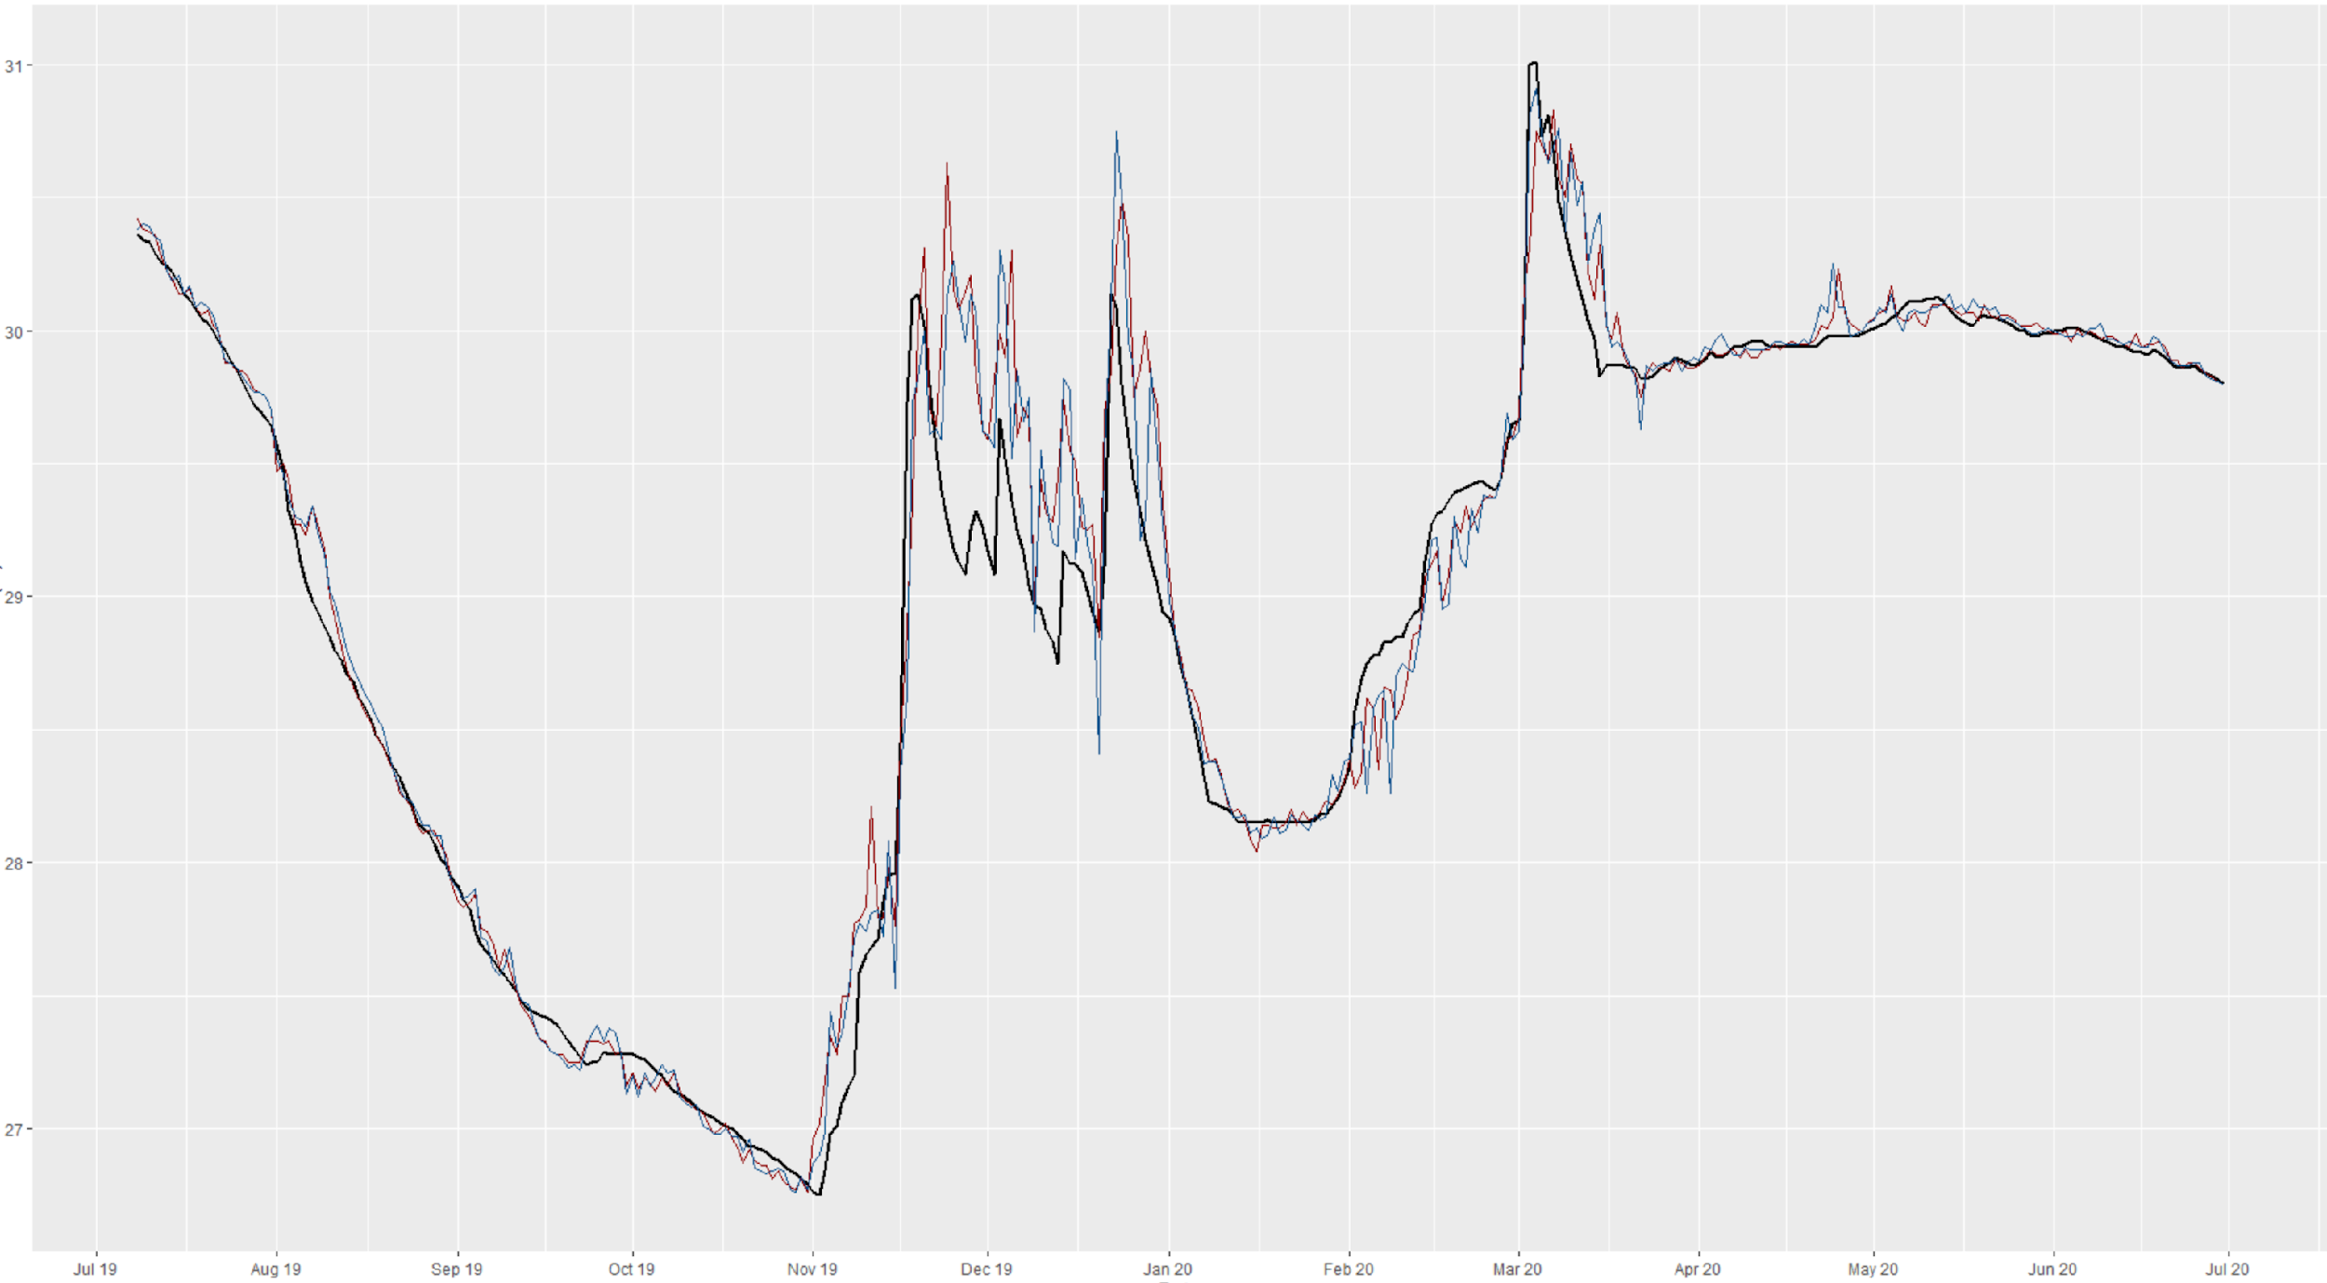
Random Forest Model

Slide 10
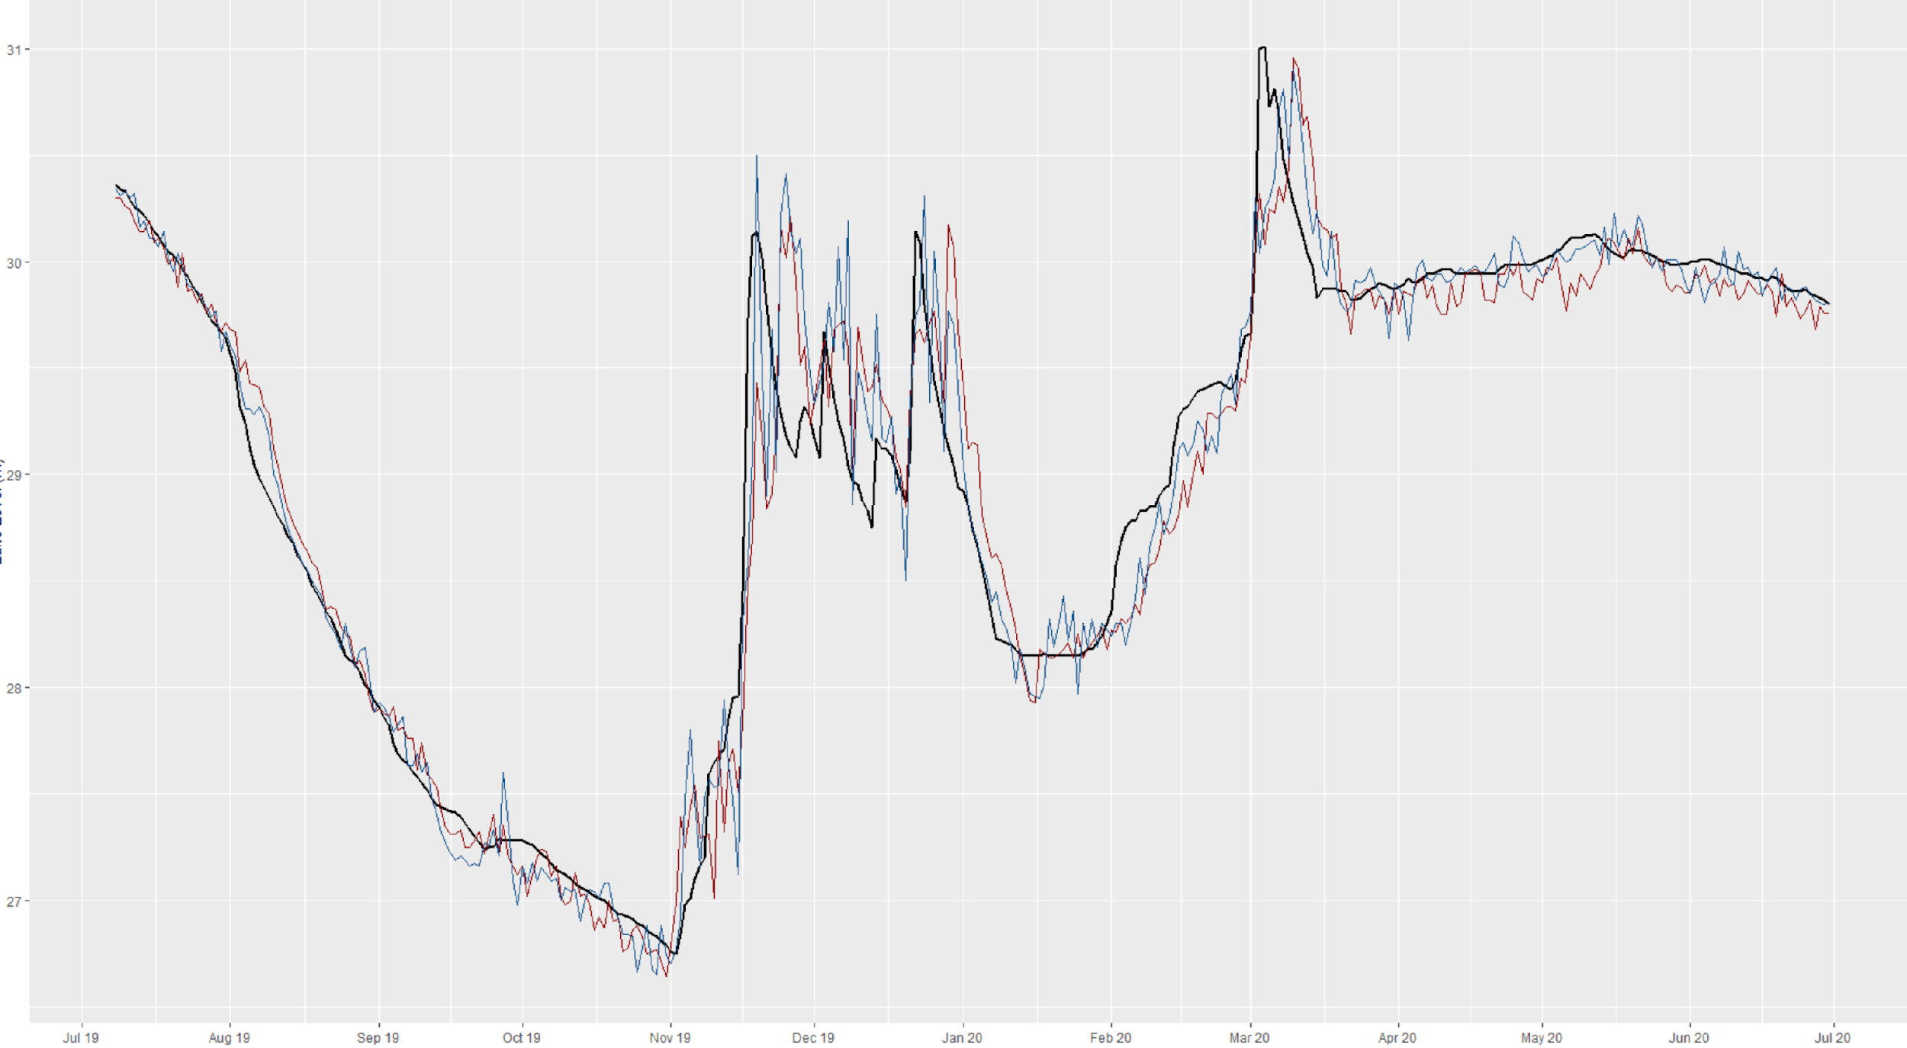
KNN Model

Slide 11
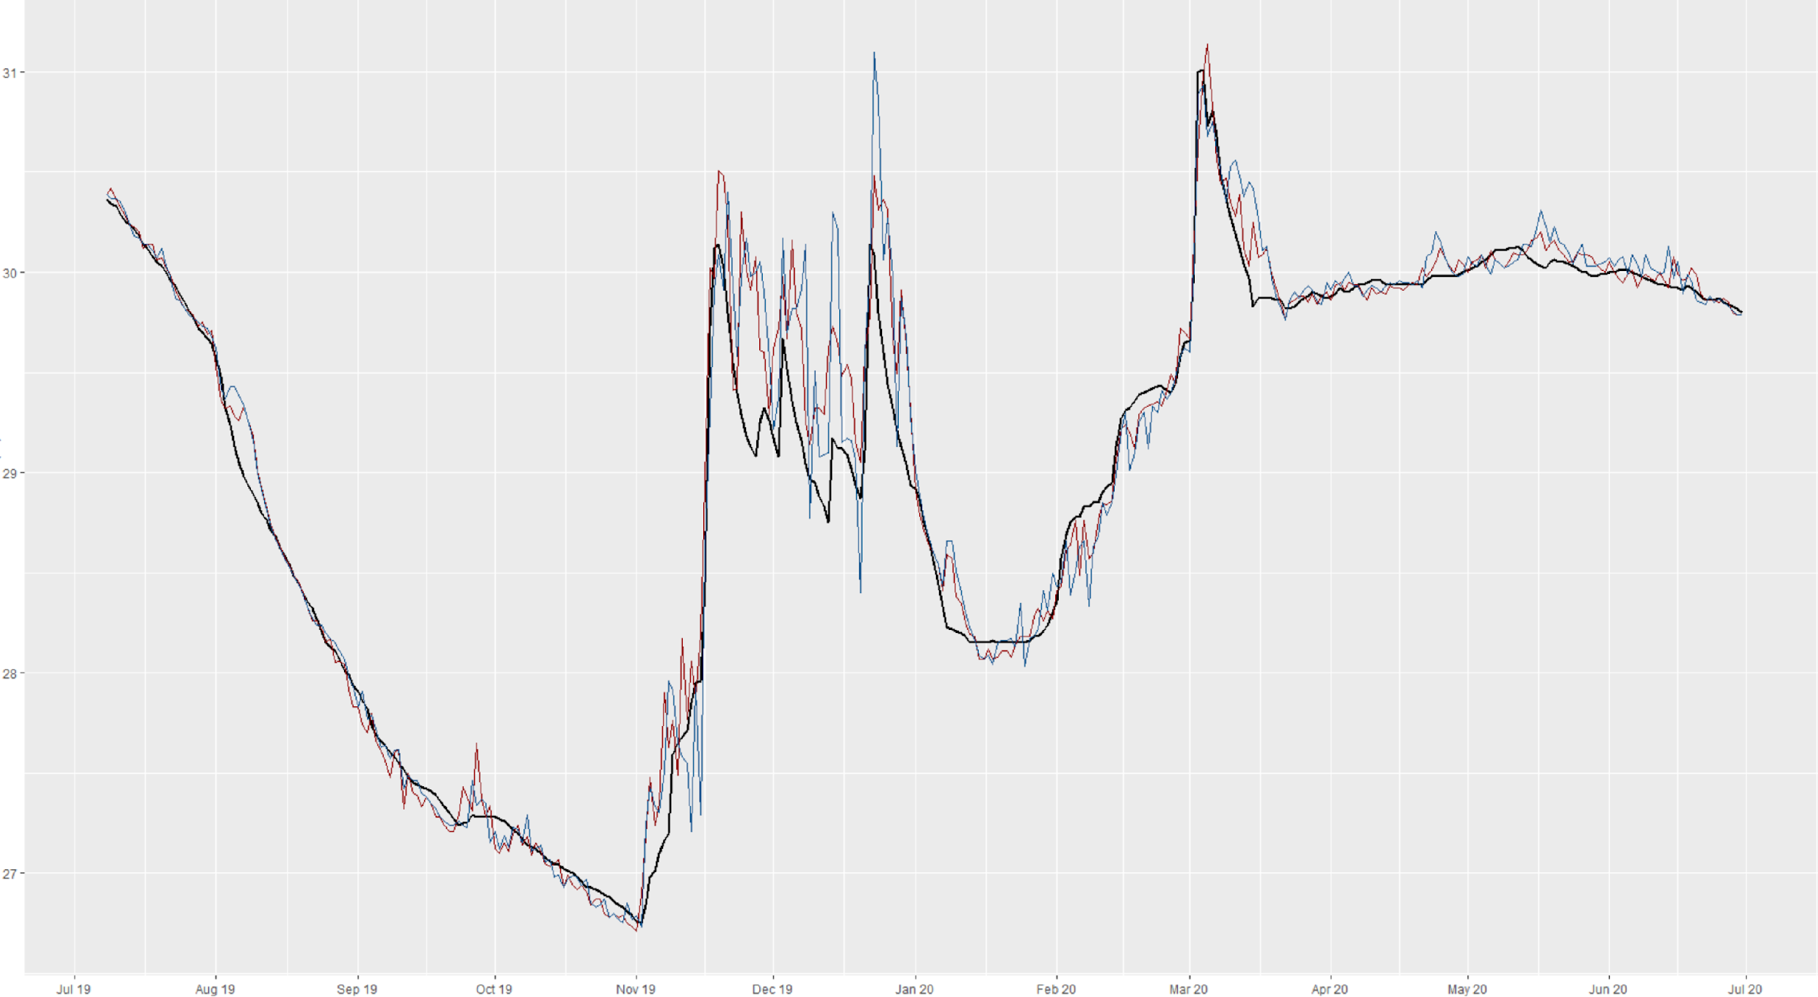
GBM Model

Slide 12

Questions
How well do the models predict for the scope of this problem?
What is the allowance of error?
Is it more beneficial to under predict?

Slide 13
Thank you!
Any questions?

