Slide 1
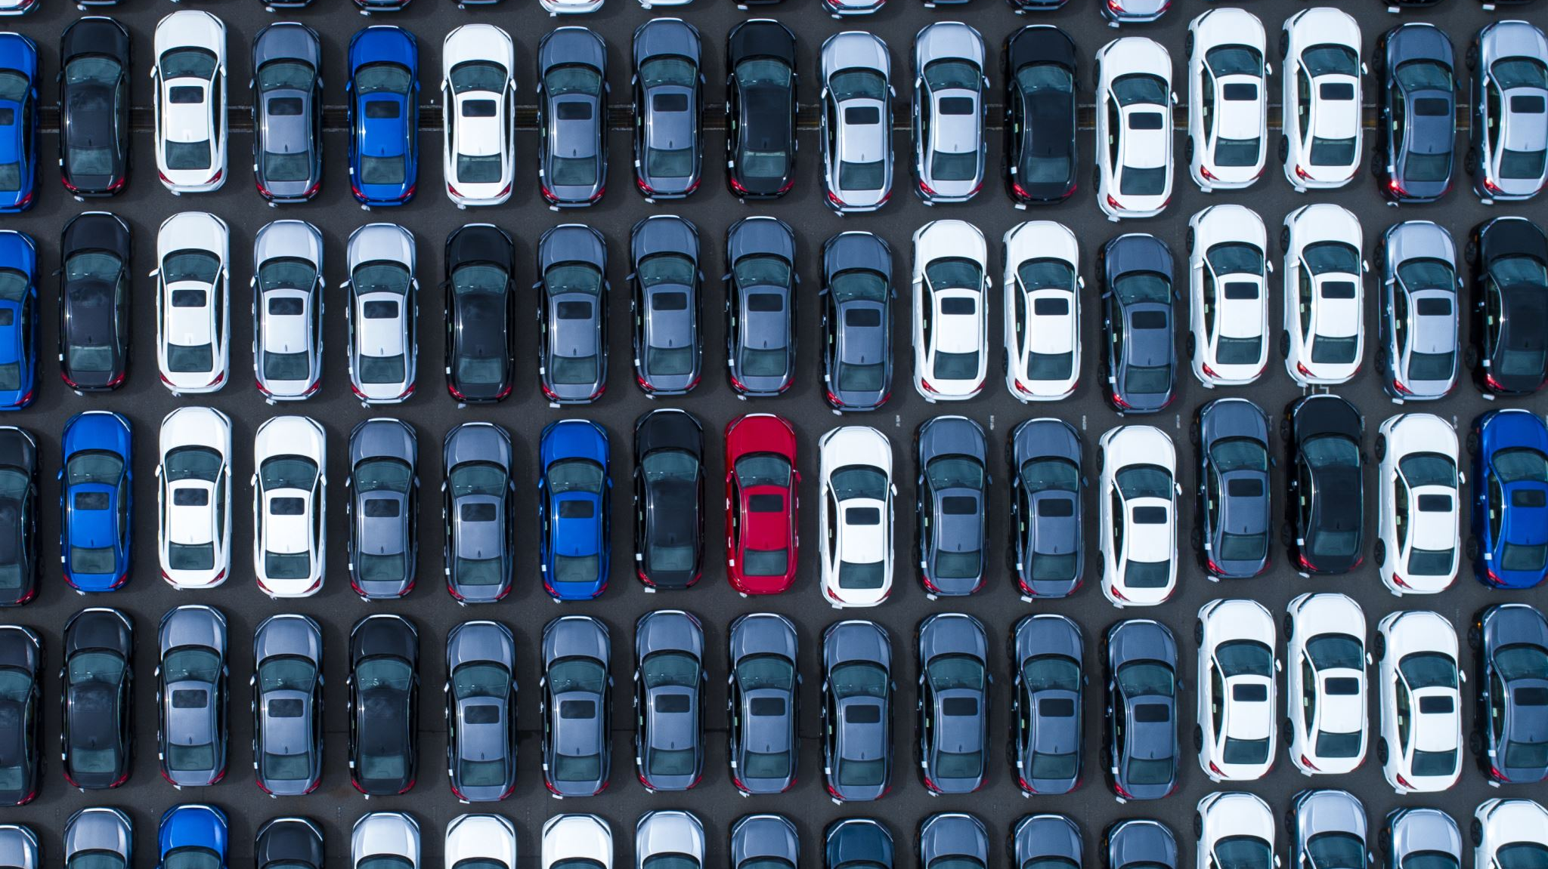
Car Rental Simulation
Alex Federspiel

Slide 2
The System
Customers park their car for a duration.
Renters rent one of the cars for a duration.
Shuttle system transports customers between car rental and airport.

Slide 3

Objectives
Figure out if the system is feasible.
Maximize profit
Parking lot size
Shuttle size
Shuttle amount
Clerk amount

Slide 4
Additional Assumptions
Customers can get to the airport in time for their flight.
There is no time to prep for vehicles when returned.

Slide 5
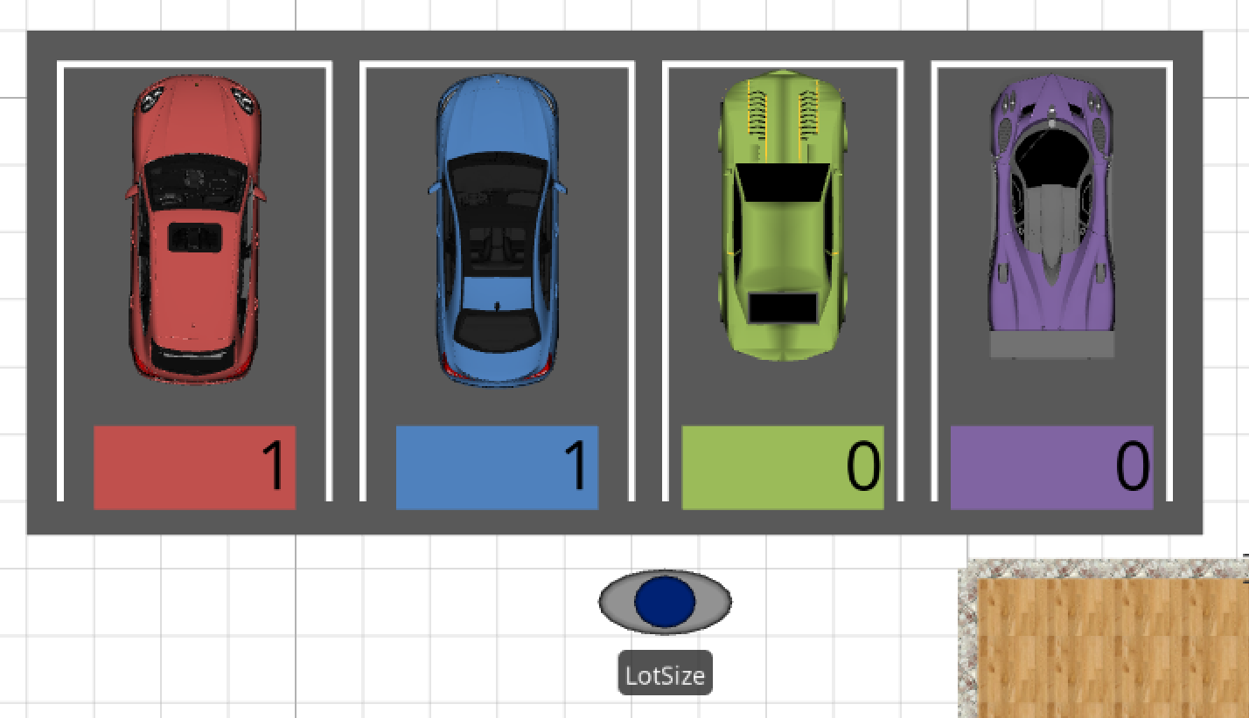
How Cars are Parked
On the surface a simple tally is used.
A resource with a capacity is referenced for the total lot size.

Slide 6
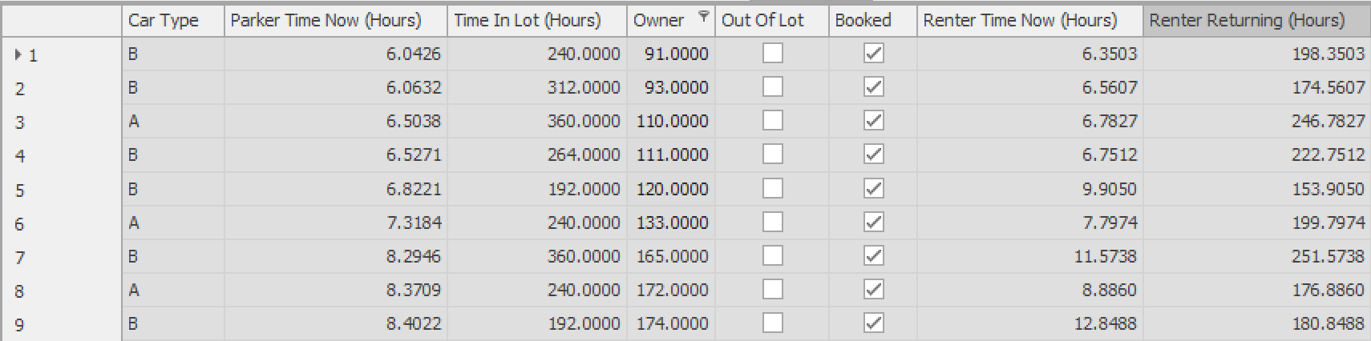
How Cars are Parked
Behind the scenes, processes are used to generate an output table.

Slide 7
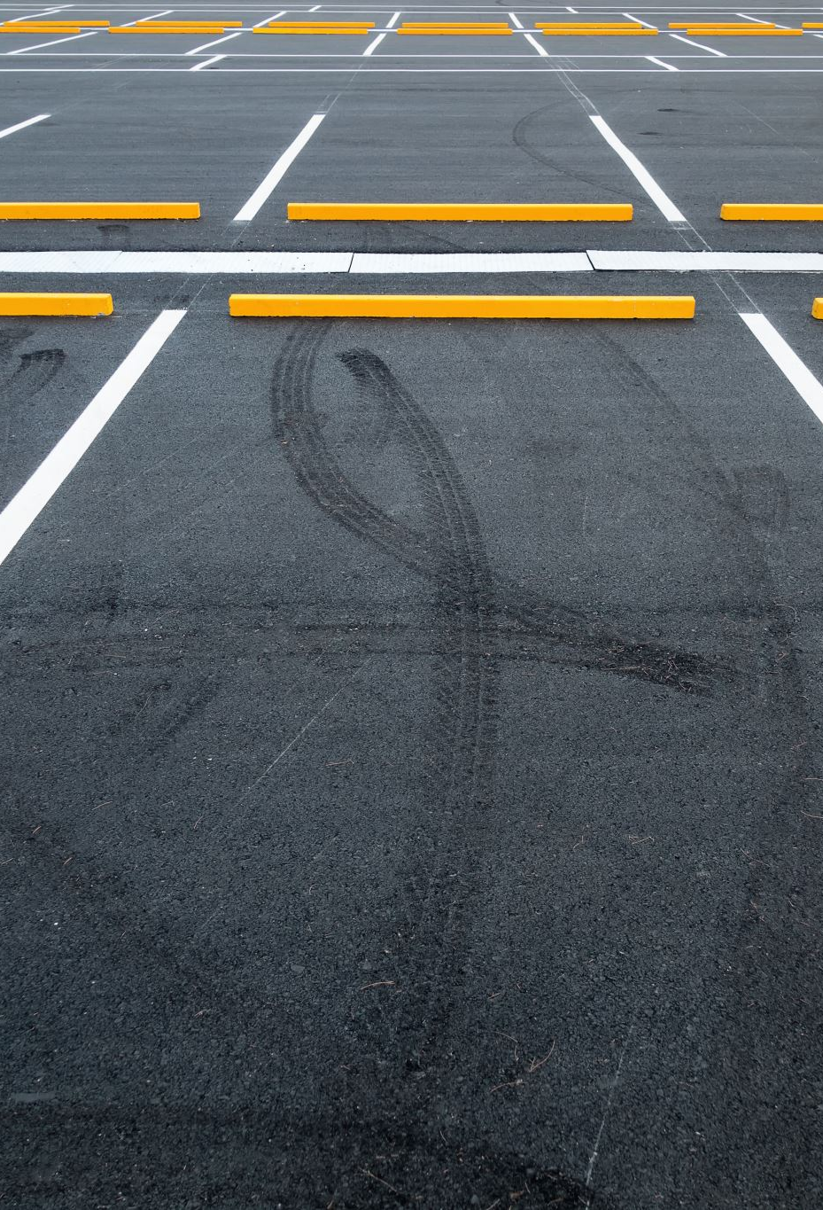
Parking Entities
Before they can park, a process runs to make sure the total cars in the lot isn’t greater than the parking lot size.
Then a process runs add to the table the car type, the time now, the owner ID, and the vacation time of the owner.

Slide 8
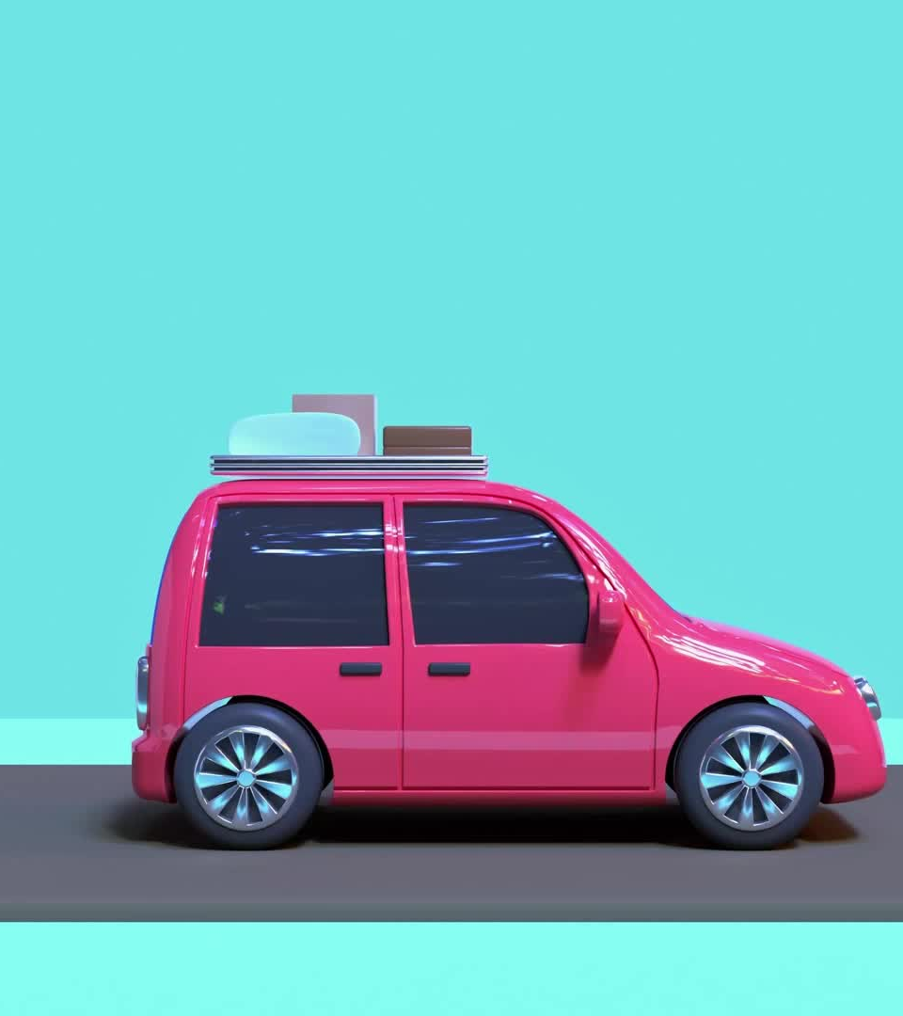
Renting Entities
Renting entities select their car from an app before they go to the rental station. This is a process that searches for such that they will be back before the owner. The process “books” the car.
When they get to the rental station, the car they booked is flagged as out of lot.

Slide 9
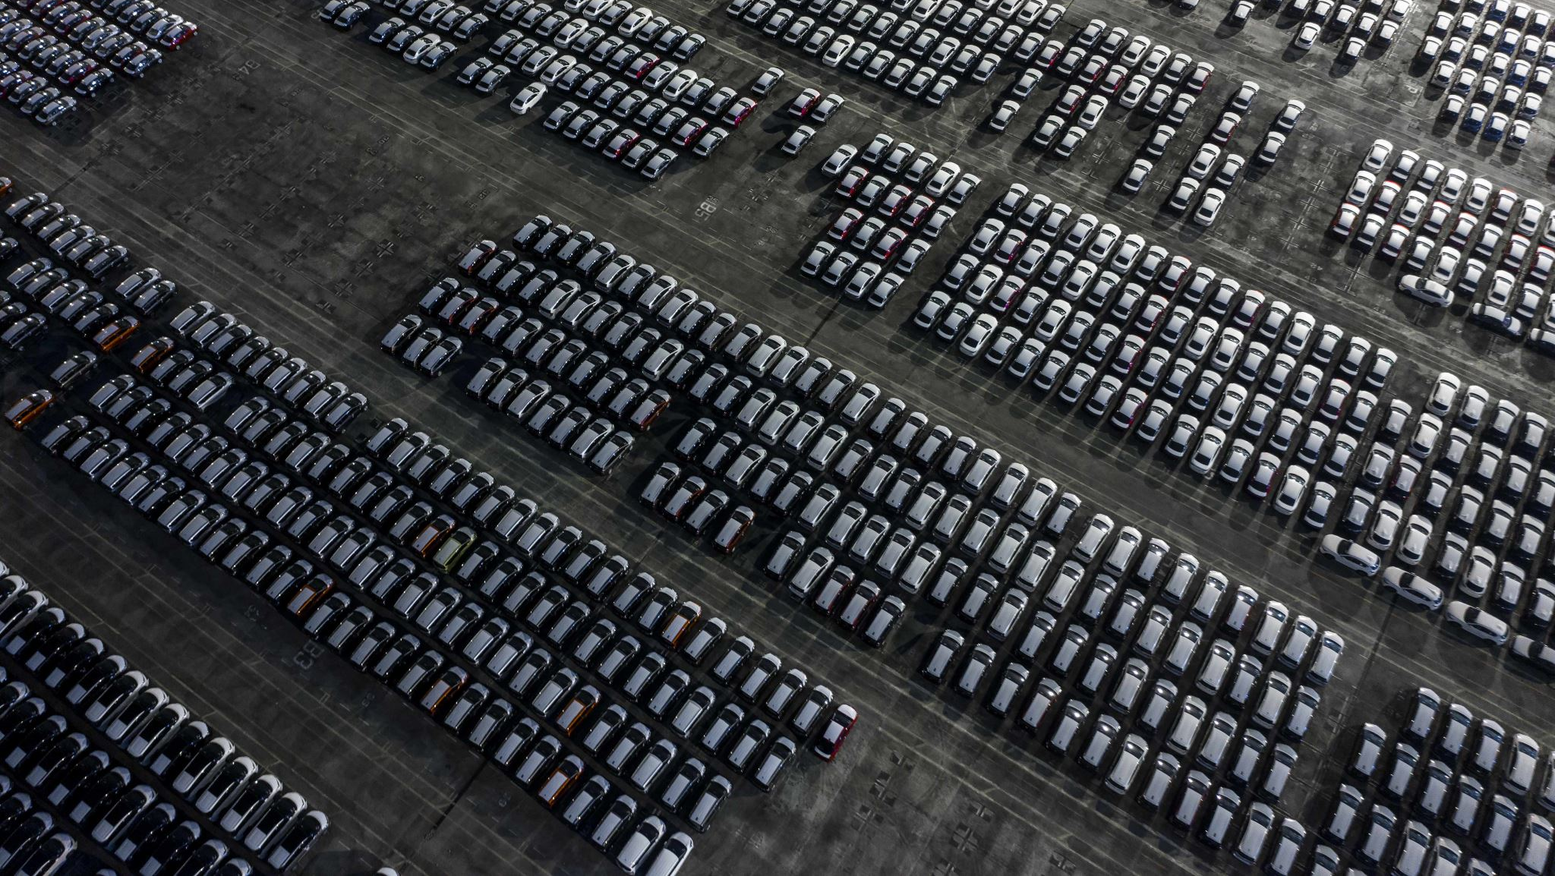
Parking Problems
The main difficulty with the parking lot was when cars got rented, entities would park their cars and fill up the space to the max. Then the renters would return and the cars in the lot would go over the max.
Car out of lot <= 0.18 parking lot size

Slide 10
Results
The operation is not feasible!
300 scenarios run each with 20 replications
Not a single one made profit
The employee costs alone are greater than the revenue received from the car rental.

Slide 11
Suggestions
Purchasing a fleet of rental cars.
Have advertisements for rental company on them.
Reduce the amount paid to the parker.
Currently 50/50 split; try 60/40 or 70/30

Slide 12
Thank you!
Any questions?

