Slide 1
Legal Disclaimer
INFORMATION IN THIS DOCUMENT IS PROVIDED IN CONNECTION WITH INTEL® PRODUCTS. NO LICENSE, EXPRESS OR IMPLIED, BY ESTOPPEL OR OTHERWISE, TO ANY INTELLECTUAL PROPERTY RIGHTS IS GRANTED BY THIS DOCUMENT. EXCEPT AS PROVIDED IN INTEL'S TERMS AND CONDITIONS OF SALE FOR SUCH PRODUCTS, INTEL ASSUMES NO LIABILITY WHATSOEVER, AND INTEL DISCLAIMS ANY EXPRESS OR IMPLIED WARRANTY, RELATING TO SALE AND/OR USE OF INTEL PRODUCTS INCLUDING LIABILITY OR WARRANTIES RELATING TO FITNESS FOR A PARTICULAR PURPOSE, MERCHANTABILITY, OR INFRINGEMENT OF ANY PATENT, COPYRIGHT OR OTHER INTELLECTUAL PROPERTY RIGHT.
UNLESS OTHERWISE AGREED IN WRITING BY INTEL, THE INTEL PRODUCTS ARE NOT DESIGNED NOR INTENDED FOR ANY APPLICATION IN WHICH THE FAILURE OF THE INTEL PRODUCT COULD CREATE A SITUATION WHERE PERSONAL INJURY OR DEATH MAY OCCUR.
Intel may make changes to specifications and product descriptions at any time, without notice. Designers must not rely on the absence or characteristics of any features or instructions marked "reserved" or "undefined." Intel reserves these for future definition and shall have no responsibility whatsoever for conflicts or incompatibilities arising from future changes to them. The information here is subject to change without notice. Do not finalize a design with this information.
The products described in this document may contain design defects or errors known as errata which may cause the product to deviate from published specifications. Current characterized errata are available on request.
Contact your local Intel sales office or your distributor to obtain the latest specifications and before placing your product order.
This document contains information on products in the design phase of development.
All products, platforms, dates, and figures specified are preliminary based on current expectations, and are subject to change without notice. All dates specified are target dates, are provided for planning purposes only and are subject to change.
This document contains information on products in the design phase of development. Do not finalize a design with this information. Revised information will be published when the product is available. Verify with your local sales office that you have the latest datasheet before finalizing a design.
Intel processor numbers are not a measure of performance. Processor numbers differentiate features within each processor family, not across different processor families. See www.intel.com/products/processor_number for details.
Intel and the Intel logo are trademarks of Intel Corporation in the U.S. and other countries.
*Other names and brands may be claimed as the property of others.
Copyright © 2009, Intel Corporation. All rights reserved.

Slide 2
UART & The Serial Port
Embedded Systems Course
Netanel Kaufman, Intel Corporation
Hebrew University, Jerusalem
Spring Semester 2010

Slide 3
Communication: Abstract
Encoded Data
Decoded Data
Source
Transmitter
Receiver
Destination
Communication Channel
Signal

Slide 4

Communication: Taxonomy
User
data
Digital signal
Transmission media
Digital signal
…abc…
…abc…
Data Terminal Equipment
Data
Circuit-terminating Equipment
Data Transmission Circuit
Notes:
Data Terminal Equipment - converts user information into signals or reconverts received signals.
Data circuit-terminating equipment - signal conversion, coding, and line clocking. may be a part of the DTE or intermediate equipment.

Slide 5

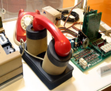
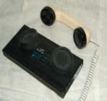
Modem modulator / demodulator
Digital signal
Analog audio signal
Digital signal
Data Terminal Equipment
Data
Circuit-terminating Equipment
Data Transmission Circuit

Slide 6
Communication: Parallel data to Serial signal
Digital signal
Analog audio signal
Digital signal
The terminal generates
8-bit data
The modem encodes
1-bit data

Slide 7
UART Universal Asynchronous Receiver Transmitter
A piece of hardware that translate data between parallel and serial form.
Serial
Device
CPU
UART
1 Byte == 8 bits at a time
1 bit
at a time

Slide 8
UART - Universal
Typically, separate interface devices are used to convert the logic level signals of the UART to and from the external signaling levels.
Voltage signaling – RS-232, RS-422, RS-485
Optical fibers
Infrared – IrDA
Wireless – Bluetooth
Audio modulation – modems
RF modulation
Power line communication

Slide 9
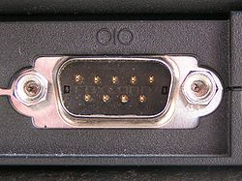
RS-232 The “serial port”
Recommended Standard 232
A standard for serial binary data signals connecting between a DTE (Data Terminal Equipment) and a DCE (Data Circuit-terminating Equipment)
Serial port
A serial communication physical interface through which information transfers in or out one bit at a time

Slide 10
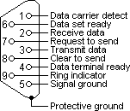
Signals & Pinouts
From DTE to DCE
3. Transmitted Data
4. Data Terminal Ready
7. Request To Send / Ready To Receive
From DCE to DTE
2. Received Data
6. Data Set Ready
8. Clear To Send
1. Data Carrier Detect
9. Ring Indicator

Slide 11
All together now
Serial
Port
RS-232
CPU
UART
Modem
Serial
Port
RS-232
CPU
UART
Modem

Slide 12
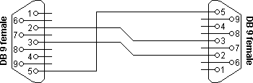
Null modems
CPU
UART
UART
CPU
Serial
Port
RS-232
Serial
Port
RS-232

Slide 13
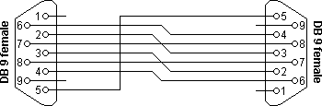
Null modems
CPU
UART
UART
CPU
Serial
Port
RS-232
Serial
Port
RS-232

Slide 14
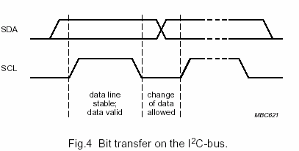
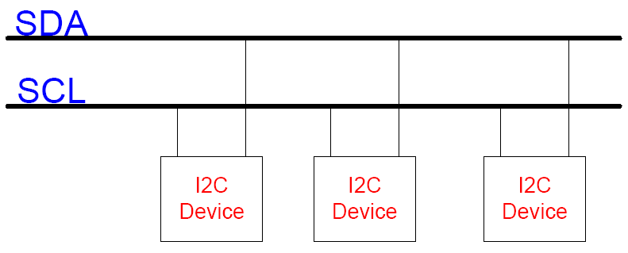
UART – Asynchronous
As opposed to Synchronous transmission, where the clock data is recovered separately from the data stream
Example: I²C – Inter-Integrated Connect Bus
Two lines: SCK (serial clock) and SDA (serial data)

Slide 15

Asynchronous serial to parallel transmission
Start bit – always a space (logic low)
Data bits – LSB first
Optional Parity bit(s)
Stop bit - always a mark (logic high)

Slide 16
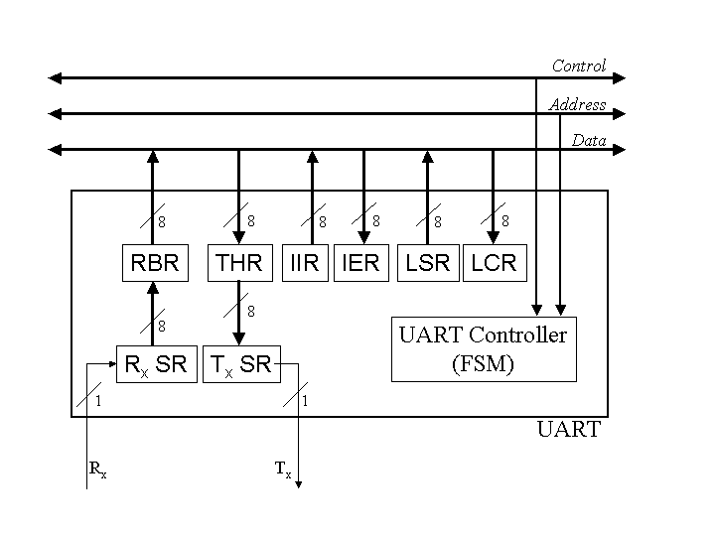
Serial to Parallel
UART use internal Shift Registers to actually build / breakdown bytes to bits

Slide 17
UART Registers
The communication between the processor and the UART is controlled by 12 registers.
Only 8 I/O lines are used to access the registers.
How this is done:
Use same line for two registers that one is read-only and the other is write-only
Control the functionality of a line by setting a special bit somewhere else

Slide 18
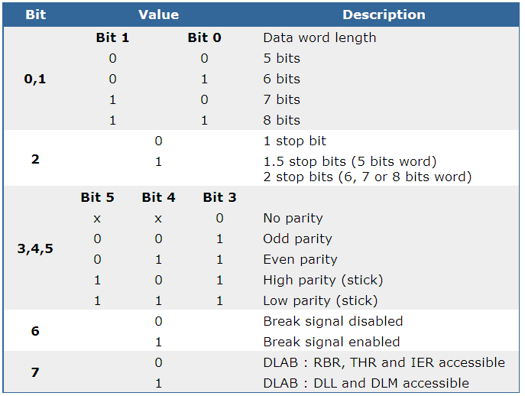
Line Control register Set the communication parameters

Slide 19
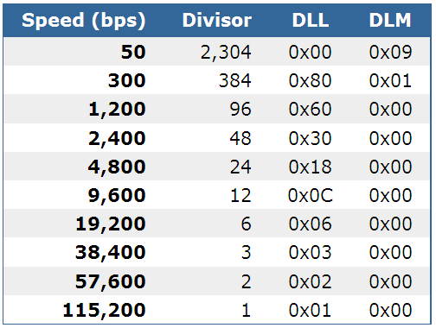
Divisor latch registers Set the communication speed by dividing the base speed with the divisor

Slide 20
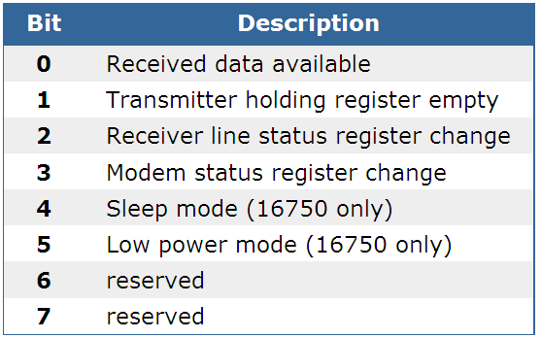
Interrupt enable register

Slide 21
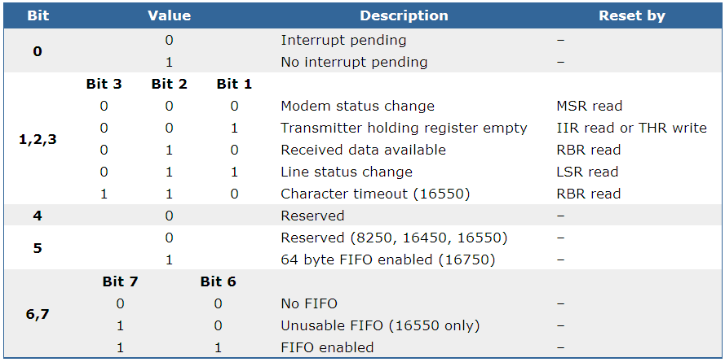
Interrupt identification register

Slide 22
FIFO
8250 / 16450 – No FIFO
Firmware need to perform an action for each single byte to Rx or Tx.
16550 – Two 16 bytes FIFO buffers
Implementation contained a bug which made the FIFO unusable.
16550A – Bug fixed!
16750 – 64 bytes FIFO’s

Slide 23
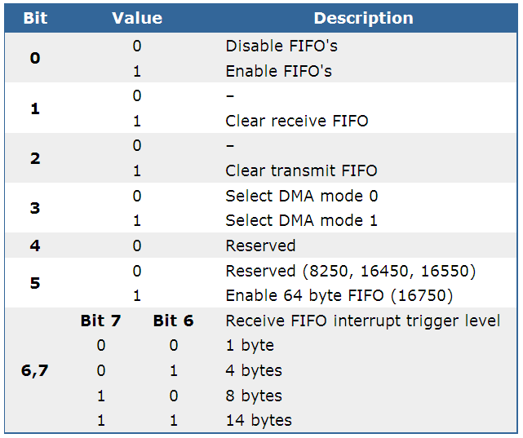
FIFO control register

Slide 24
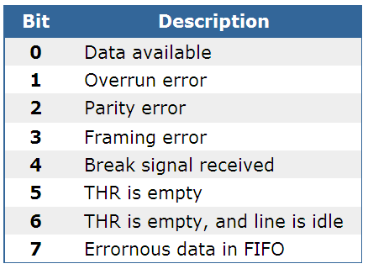
Line status register Shows the current state of the communication

Slide 25
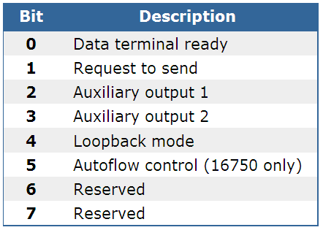
Modem control register Perform handshaking actions with the attached device

Slide 26
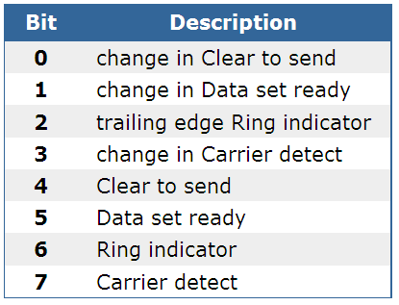
Modem status register Report information about the four incoming modem control lines

Slide 27
Reference
Serial Programming
Complete Wikibook

Slide 28
Backup

Slide 29


Acoustic coupler
Source: Wikipedia / Acoustic coupler

