Slide 1
Legal Disclaimer
INFORMATION IN THIS DOCUMENT IS PROVIDED IN CONNECTION WITH INTEL® PRODUCTS. NO LICENSE, EXPRESS OR IMPLIED, BY ESTOPPEL OR OTHERWISE, TO ANY INTELLECTUAL PROPERTY RIGHTS IS GRANTED BY THIS DOCUMENT. EXCEPT AS PROVIDED IN INTEL'S TERMS AND CONDITIONS OF SALE FOR SUCH PRODUCTS, INTEL ASSUMES NO LIABILITY WHATSOEVER, AND INTEL DISCLAIMS ANY EXPRESS OR IMPLIED WARRANTY, RELATING TO SALE AND/OR USE OF INTEL PRODUCTS INCLUDING LIABILITY OR WARRANTIES RELATING TO FITNESS FOR A PARTICULAR PURPOSE, MERCHANTABILITY, OR INFRINGEMENT OF ANY PATENT, COPYRIGHT OR OTHER INTELLECTUAL PROPERTY RIGHT.
UNLESS OTHERWISE AGREED IN WRITING BY INTEL, THE INTEL PRODUCTS ARE NOT DESIGNED NOR INTENDED FOR ANY APPLICATION IN WHICH THE FAILURE OF THE INTEL PRODUCT COULD CREATE A SITUATION WHERE PERSONAL INJURY OR DEATH MAY OCCUR.
Intel may make changes to specifications and product descriptions at any time, without notice. Designers must not rely on the absence or characteristics of any features or instructions marked "reserved" or "undefined." Intel reserves these for future definition and shall have no responsibility whatsoever for conflicts or incompatibilities arising from future changes to them. The information here is subject to change without notice. Do not finalize a design with this information.
The products described in this document may contain design defects or errors known as errata which may cause the product to deviate from published specifications. Current characterized errata are available on request.
Contact your local Intel sales office or your distributor to obtain the latest specifications and before placing your product order.
This document contains information on products in the design phase of development.
All products, platforms, dates, and figures specified are preliminary based on current expectations, and are subject to change without notice. All dates specified are target dates, are provided for planning purposes only and are subject to change.
This document contains information on products in the design phase of development. Do not finalize a design with this information. Revised information will be published when the product is available. Verify with your local sales office that you have the latest datasheet before finalizing a design.
Intel processor numbers are not a measure of performance. Processor numbers differentiate features within each processor family, not across different processor families. See www.intel.com/products/processor_number for details.
Intel and the Intel logo are trademarks of Intel Corporation in the U.S. and other countries.
*Other names and brands may be claimed as the property of others.
Copyright © 2009, Intel Corporation. All rights reserved.

Slide 2
Embedded Systems (67744)
Ari Yoskovitz, Intel Corporation
JCT 2013

Slide 3
Administration
Embedded System Course “lab”
Where: Biran 203
When: WED, 16:15 – 17:00
Who:
TA: Ari Yoskovitz, ari.yoskovitz@intel.com (might change)
Whenever possible use email (or course forums once we have it)
For a reception hour – set meeting in advance

Slide 4
Grading and Exercises
The grade will be based on the 5 mandatory programming exercises
Tentatively: Ex0 – 5%, Ex1 – 20%, Ex2-4 – 25%
The code will also be reviewed.
Submission is in pairs only
We still don’t have a website and a forum. When we will, they will be used for publishing exercises, guidelines, and communication.

Slide 5
Grading and Exercises
Exercise are tested automatically, so
Read carefully and follow the guidelines
Use the pre-submission test scripts
Malformed submissions (bad TAR, no README, doesn’t build, wrong file names, etc.) will be rejected by the system with a 10 points resubmission penalty.
Late submission
By mail.
Name your TAR file: “login1_login2” (i.e your logins)
2 points penalty per day, 10 days max, does not eligible for any bonus credit
Extensions will be given only for VERY good reasons (basically only Miluim)

Slide 6
Exercises overview

Slide 7
Exercise 0
Processor only
Tool-chain and simulator ramp up.
“Hello world”…

Slide 8
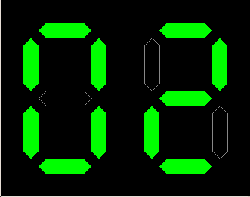
Exercise 1
First “real” device
2 simple peripherals, 1 complex (UART)
Simple FW
Notes:
NOTE

Slide 9
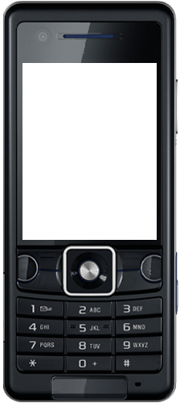
Exercise 2
1st part of final project
Device drivers
Interrupts handling w/o OS

Slide 10
Exercise 3
2nd part of final project
Adding RTOS
UI, communication protocol

Slide 11
Final project (Exercise 4)
3rd part of final project
Flash file system
Optimization

Slide 12
The MetaWare® Development Toolkit for ARC®

Slide 13
Where can I find…
The toolkit:
~embsys/MetaWare.
Documentation:
~embsys/MetaWare/arc/docs/pdf
On the course web site
More help:
Course website and forums

Slide 14
Toolkit main components
mcc – Metaware C/C++ Compiler
Also can be used as a driver to compile and link your program in one step
“C/C++ Programmer’s Guide for ARC”
“C/C++ Language Reference”
asac – Metaware Assembler
“ELF Assembler User’s Guide for ARC”
“ARCompact ISA for the ARC 600 Programmer’s Reference”
ldac – MetaWare Linker
“ELF Linker and Utilities User’s Guide”
mdb, runac – Debugger and Simulator
“Debugger User’s Guide”
mide – An Eclipse based IDE

Slide 15
Preliminaries
Configure the license: setenv LM_LICENSE_FILE ~embsys/ARC/license/arc.lic
Set your PATH: setenv PATH ~embsys/ARC/MetaWare/arc/bin:$PATH
TIP: To automatically execute these whenever you login, add both commands to your .cshrc:
Type in your shell:
echo 'setenv LM_LICENSE_FILE ~embsys/ARC/license/arc.lic ' >> ~/.cshrc echo 'setenv PATH ~embsys/ARC/MetaWare/arc/bin:$PATH' >> ~/.cshrc

Slide 16
Preliminaries
The simulator only simulate the CPU and memory
To simulate the device peripherals, the simulator loads “extensions” we supply
It needs to be configured to load the right extensions
It also needs to be configured to the simulated device unique characteristics, e.g. Memory(s) size and location
Option 1:
Manually configuration through the debugger menus
Option 2 (preferred):
Use pre-configured arguments file
mdb @ex1.args
Or place the argument file as ‘.sc.project/.sc.args’ under the path from where you run the simulator

Slide 17
Compile & Run
Output executable file name
Source file
mcc –w4 –a6 main.c –o a.out
runac a.out
Use highest warning level
Specify the ARC 600 processor series

Slide 18
Compile & Debug
Generate debugging information
for source-level debugging
mcc –w4 –a6 –g main.c –o a.out
mdb a.out

Slide 19
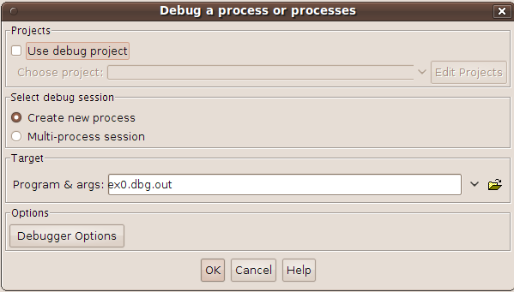
Using the debugger
The program’s executable file
being debugged
Set debugger options manually
(simulation extensions, memory, etc.)
You can use pre-configured arguments file we will supply instead of manually setting these options

Slide 20
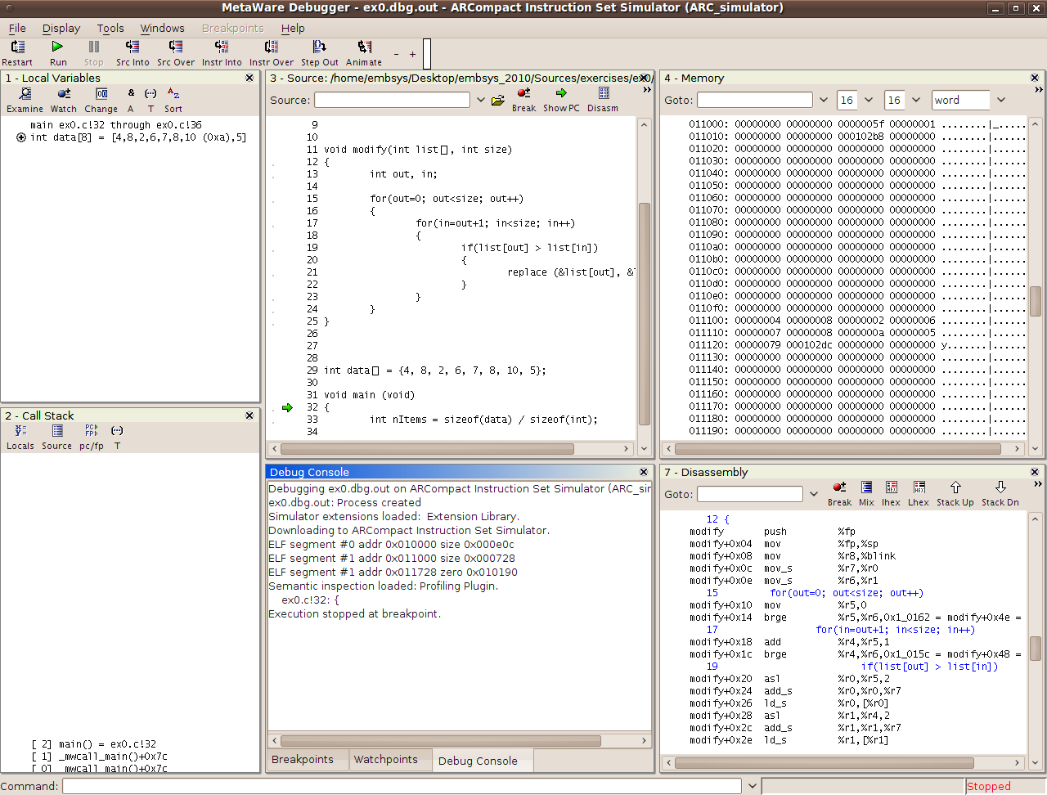
Local variables window
Source code window
Memory window
Call stack window
Debugger output console
Disassembly window

Slide 21

Controlling Program Execution
Restart the debugger and reset the device
Stop the execution
Statement step over
Instruction step over
Start or resume execution
Statement step into
Instruction step into
Run until return from function

Slide 22
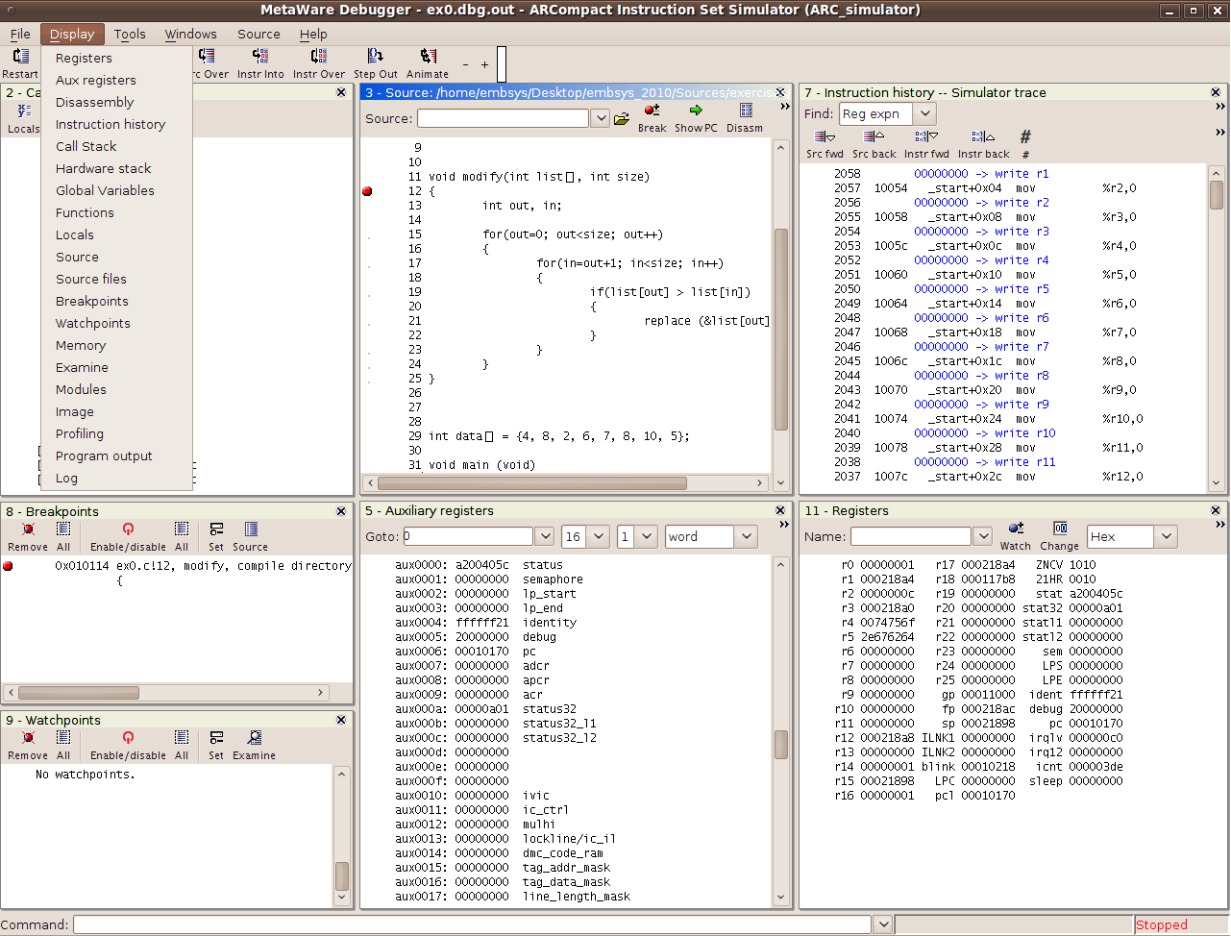
Select windows to display
Source code window
Instruction history
Breakpoints
Registers
window
Auxiliary
registers
Watchpoints
Command input field
e.g. b modify

