Slide 1
Legal Disclaimer
INFORMATION IN THIS DOCUMENT IS PROVIDED IN CONNECTION WITH INTEL® PRODUCTS. NO LICENSE, EXPRESS OR IMPLIED, BY ESTOPPEL OR OTHERWISE, TO ANY INTELLECTUAL PROPERTY RIGHTS IS GRANTED BY THIS DOCUMENT. EXCEPT AS PROVIDED IN INTEL'S TERMS AND CONDITIONS OF SALE FOR SUCH PRODUCTS, INTEL ASSUMES NO LIABILITY WHATSOEVER, AND INTEL DISCLAIMS ANY EXPRESS OR IMPLIED WARRANTY, RELATING TO SALE AND/OR USE OF INTEL PRODUCTS INCLUDING LIABILITY OR WARRANTIES RELATING TO FITNESS FOR A PARTICULAR PURPOSE, MERCHANTABILITY, OR INFRINGEMENT OF ANY PATENT, COPYRIGHT OR OTHER INTELLECTUAL PROPERTY RIGHT.
UNLESS OTHERWISE AGREED IN WRITING BY INTEL, THE INTEL PRODUCTS ARE NOT DESIGNED NOR INTENDED FOR ANY APPLICATION IN WHICH THE FAILURE OF THE INTEL PRODUCT COULD CREATE A SITUATION WHERE PERSONAL INJURY OR DEATH MAY OCCUR.
Intel may make changes to specifications and product descriptions at any time, without notice. Designers must not rely on the absence or characteristics of any features or instructions marked "reserved" or "undefined." Intel reserves these for future definition and shall have no responsibility whatsoever for conflicts or incompatibilities arising from future changes to them. The information here is subject to change without notice. Do not finalize a design with this information.
The products described in this document may contain design defects or errors known as errata which may cause the product to deviate from published specifications. Current characterized errata are available on request.
Contact your local Intel sales office or your distributor to obtain the latest specifications and before placing your product order.
This document contains information on products in the design phase of development.
All products, platforms, dates, and figures specified are preliminary based on current expectations, and are subject to change without notice. All dates specified are target dates, are provided for planning purposes only and are subject to change.
This document contains information on products in the design phase of development. Do not finalize a design with this information. Revised information will be published when the product is available. Verify with your local sales office that you have the latest datasheet before finalizing a design.
Intel processor numbers are not a measure of performance. Processor numbers differentiate features within each processor family, not across different processor families. See www.intel.com/products/processor_number for details.
Intel and the Intel logo are trademarks of Intel Corporation in the U.S. and other countries.
*Other names and brands may be claimed as the property of others.
Copyright © 2009, Intel Corporation. All rights reserved.

Slide 2
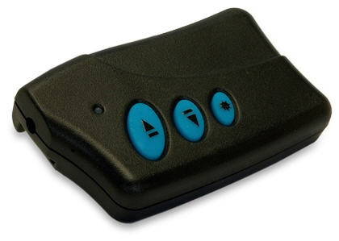
Interrupts example:
Power point remote control

Slide 3
Power point remote control
Buttons
RF Transmitter
ARC
Memory
Laser pointer

Slide 4
Board Design Doc
Buttons spec
BIER – Buttons Interrupt Enable Register
AUX register 0xA00
Bit | Access | Default Value | Description
31:1 |  | 0x00000000 | Reserved
0 | RW | 0x0 | Enable interrupts for buttons events

Slide 5
Board Design Doc
Buttons spec
BICR – Buttons Interrupt Cause Register
AUX register 0xA01
Bit | Access | Default Value | Description
31:2 |  | 0x0 | Reserved
1:0 | RWC | 0x0 | Hardware sets this value according to the last button that was pressed: 1 – back button 2 – forward button 3 – laser on/off If BIER Bit#0 is not 0, the hardware will interrupt on line 3. Writing 0xFF to this register reset it, and effectively acknowledge the interrupt

Slide 6
Buttons driver – Buttons.c
void (*LaserToggleCB)();
volatile unsigned *pButtonsFlag;
void ButtonsInit(void (*cb)(), unsigned *flag)
{
/* register the laser callback function
and the buttons event flag */
LaserToggleCB = cb;
pButtonsFlag = flag;
/* enable interrupts */
_sr(BIER, 1);
/* acknowledge any outstanding interrupts */
_sr(BICR, 0xFF);
}

Slide 7
Buttons driver – Buttons.c
_Interrupt1 void ButtonsISR()
{
/* save the cause of this interrupt */
unsigned cause = _lr(BICR);
/* acknowledge the interrupt */
_sr(BICR, 0xFF);
/* signal the application or use the callback */
if (cause==BICR_LASER_TOGGLE) {
LaserToggleCB();
} else {
*pButtonsFlag = cause;
}
}

Slide 8
Interrupt vector table - ivt.s
.seg "INTERRUPT_TABLE", text
.global InterruptTable
InterruptTable:
FLAG 0 ; IRQ 0
b _start
jal MEM_ERROR_ISR ; IRQ 1
jal BAD_INSTRUCTION_ISR ; IRQ 2
jal ButtonsISR ; IRQ 3
MEM_ERROR_ISR:
BAD_INSTRUCTION_ISR:
flag 1
nop
nop
nop
Sometime “-Hldopt=-uInterruptTable” is needed so that the
linker won’t “optimize out” this section, as no code calls it

Slide 9
Locator command file (SVR3)
MEMORY {
ROM: ORIGIN = 0x00000000 LENGTH = 0x2000
RAM: ORIGIN = 0x00004000 LENGTH = 0xC000
}
INITDATA !data
SECTIONS {
GROUP: {
INTERRUPT_TABLE: {}
* (TEXT): {}
* (LIT): {}
} > ROM
GROUP: {
*(BSS): {}
.stack ALIGN(4) SIZE(0x1000): {}
} > RAM
}

Slide 10
PPT-RC – Main Function
void main()
{
volatile unsigned ButtonsFlag = 0;
/* Initialize the hardware. */
LaserInit();
RFInit();
ButtonsInit(&LaserStateToggle, &ButtonsFlag);
/* Enable interrupts */
_enable();
...

Slide 11
PPT-RC – Main Function
...
while (1)
{
/* Disable interrupts to “lock” the flag */ _disable();
if (ButtonsFlag) {
unsigned direction = ButtonsFlag;
ButtonsFlag = 0;
_enable();
RFSend(direction);
} else {
_enable();
}
/* Here we can do stuff, sleep, etc’ */
}
}

Slide 12
ThreadX
Implementation

Slide 13
Buttons driver – Buttons.c
TX_EVENT_FLAGS_GROUP *gpLaserEventFlags;
TX_EVENT_FLAGS_GROUP *gpRFEventFlags;
void ButtonsInit(TX_EVENT_FLAGS_GROUP *pLaserEventFlags, TX_EVENT_FLAGS_GROUP *pRFEventFlags)
{
/* register the event flags*/
gpLaserEventFlags = pLaserEventFlags;
gpRFEventFlags = pRFEventFlags;
/* enable interrupts */
_sr(BIER, 1);
/* acknowledge any outstanding interrupts */
_sr(BICR, 0xFF);
}

Slide 14
Buttons driver – Buttons.c
void ButtonsISR()
{
/* save the cause of this interrupt */
unsigned cause = _lr(BICR);
/* acknowledge the interrupt */
_sr(BICR, 0xFF);
/* signal the application using the event flags*/
if (cause==BICR_LASER_TOGGLE) {
tx_event_flags_set(&gpLaserEventFlags, 1, TX_OR);
} else {
tx_event_flags_set(&gpRFEventFlags, cause, TX_OR);
}
}
This is a very ugly hack that abuses the use of events flag,
but it makes the example simpler

Slide 15
Interrupt vector table - ivt.s
.seg "INTERRUPT_TABLE", text
.global InterruptTable
InterruptTable:
FLAG 0 ; IRQ 0
b _start
jal MEM_ERROR_ISR ; IRQ 1
jal BAD_INSTRUCTION_ISR ; IRQ 2
jal BUTTONS_ISR ; IRQ 3
BUTTONS_ISR:
sub sp,sp,172
st blink, [sp,16]
bl _tx_thread_context_save
sub sp,sp,16
bl ButtonsISR
add sp,sp,16
jal _tx_thread_context_restore
MEM_ERROR_ISR:
BAD_INSTRUCTION_ISR:
flag 1
nop
nop
nop

Slide 16
Locator command file (SVR3)
MEMORY {
ROM: ORIGIN = 0x00000000 LENGTH = 0x2000
RAM: ORIGIN = 0x00004000 LENGTH = 0xC000
}
INITDATA !data
SECTIONS {
GROUP: {
INTERRUPT_TABLE: {}
* (TEXT): {}
* (LIT): {}
} > ROM
GROUP: {
*(BSS): {}
.stack ALIGN(4) SIZE(0x1000): {}
} > RAM
}
Same as before

Slide 17
PPT-RC – Main Function
#define STACK_SIZE 0x1000
TX_THREAD gLaserThread;
TX_EVENT_FLAGS_GROUP gLaserEventFlags;
unsigned char gLaserThreadStack[STACK_SIZE];
TX_THREAD gRFThread;
TX_EVENT_FLAGS_GROUP gRFEventFlags;
unsigned char gRFThreadStack[STACK_SIZE];
void main (void) {
tx_kernel_enter();
}

Slide 18
PPT-RC – Main Function
void tx_application_define(void *first) {
/* Create the event flags. */
tx_event_flags_create(&gLaserEventFlags, laser_event");
tx_event_flags_create(&gRFEventFlags, "RF_event");
/* Initialize the hardware. */
LaserInit();
RFInit();
ButtonsInit(&gLaserEventFlags, &gRFEventFlags);
tx_thread_create(&gLaserThread, "laser_thread",
laserTask , 0,
gLaserThreadStack, STACK_SIZE,
3, 3, TX_NO_TIME_SLICE, TX_AUTO_START);
tx_thread_create(&gRFThread, "RF_thread",
RFTask , 0,
gRFThreadStack, STACK_SIZE,
3, 3, TX_NO_TIME_SLICE, TX_AUTO_START);
_enable();
}

Slide 19
PPT-RC – Main Function
void laserTask(ULONG thread_input) {
ULONG actual_flags;
while (1) {
tx_event_flags_get(&gLaserEventFlags, 0xFFFFFFFF, TX_OR_CLEAR,
&actual_flags, TX_WAIT_FOREVER);
LaserStateToggle();
}
}
void RFTask(ULONG thread_input) {
ULONG actual_flags;
while (1) {
tx_event_flags_get(&gRFEventFlags,
0xFFFFFFFF, TX_OR_CLEAR,
&actual_flags, TX_WAIT_FOREVER);
RFSend(actual_flags);
}
}
The “ugly hack”
How this could be done better?

Slide 20
Odds and sods

Slide 21
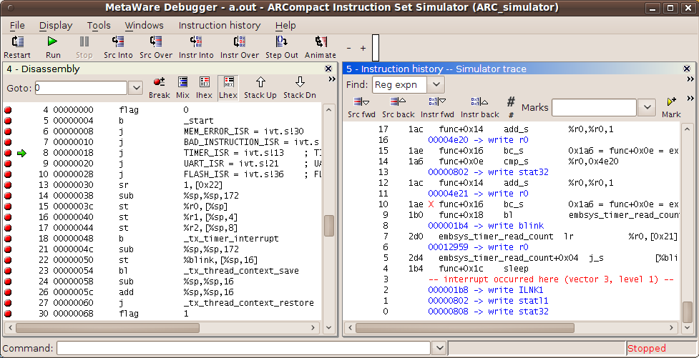
Break points into your IVT
Instruction history

Slide 22
Inline ISR with IVT
.seg "INTERRUPT_TABLE", text
.global InterruptTable
InterruptTable:
FLAG 0 ; IRQ 0
b _start
jal MEM_ERROR_ISR ; IRQ 1
jal BAD_INSTRUCTION_ISR ; IRQ 2
jal BUTTONS_ISR ; IRQ 3
BUTTONS_ISR:
sub sp,sp,172
st blink, [sp,16]
bl _tx_thread_context_save
sub sp,sp,16
bl ButtonsISR
add sp,sp,16
jal _tx_thread_context_restore
MEM_ERROR_ISR:
BAD_INSTRUCTION_ISR:
flag 1
nop
nop
nop

Slide 23
Inline ISR with IVT
.seg "INTERRUPT_TABLE", text
.global InterruptTable
InterruptTable:
FLAG 0 ; IRQ 0
b _start
jal MEM_ERROR_ISR ; IRQ 1
jal BAD_INSTRUCTION_ISR ; IRQ 2
sub sp,sp,172 ; IRQ 3
st blink, [sp,16]
bl _tx_thread_context_save
sub sp,sp,16
bl ButtonsISR
add sp,sp,16
jal _tx_thread_context_restore
MEM_ERROR_ISR:
BAD_INSTRUCTION_ISR:
flag 1
nop
nop
nop

Slide 24
Configure IVT at runtime
extern void _setvect1
(int vector, _Interrupt1 void (*target)());
extern void _setvect2
(int vector, _Interrupt2 void (*target)());
Interrupt vector base register (0x25)

Slide 25
Software Generated Interrupts
Also known as “software trap”
SWI or _swi()
Manually generate an “instruction error” interrupt
Hence, a level 2 interrupt

Slide 26
Sleeping
SLEEP or _sleep()
Reduced power consumption:
  Pipeline is stalled
  RAMs are disabled
The processor is waken on an interrupt
For RTOS use:
.equ EI,0x06 ; Constant to enable both interrupt levels
.align 8 ; ensure cache alignment is to 8 bytes
FLAG EI ; Enable interrupts
SLEEP ; Put processor into sleep mode

