Slide 1
Legal Disclaimer
INFORMATION IN THIS DOCUMENT IS PROVIDED IN CONNECTION WITH INTEL® PRODUCTS. NO LICENSE, EXPRESS OR IMPLIED, BY ESTOPPEL OR OTHERWISE, TO ANY INTELLECTUAL PROPERTY RIGHTS IS GRANTED BY THIS DOCUMENT. EXCEPT AS PROVIDED IN INTEL'S TERMS AND CONDITIONS OF SALE FOR SUCH PRODUCTS, INTEL ASSUMES NO LIABILITY WHATSOEVER, AND INTEL DISCLAIMS ANY EXPRESS OR IMPLIED WARRANTY, RELATING TO SALE AND/OR USE OF INTEL PRODUCTS INCLUDING LIABILITY OR WARRANTIES RELATING TO FITNESS FOR A PARTICULAR PURPOSE, MERCHANTABILITY, OR INFRINGEMENT OF ANY PATENT, COPYRIGHT OR OTHER INTELLECTUAL PROPERTY RIGHT.
UNLESS OTHERWISE AGREED IN WRITING BY INTEL, THE INTEL PRODUCTS ARE NOT DESIGNED NOR INTENDED FOR ANY APPLICATION IN WHICH THE FAILURE OF THE INTEL PRODUCT COULD CREATE A SITUATION WHERE PERSONAL INJURY OR DEATH MAY OCCUR.
Intel may make changes to specifications and product descriptions at any time, without notice. Designers must not rely on the absence or characteristics of any features or instructions marked "reserved" or "undefined." Intel reserves these for future definition and shall have no responsibility whatsoever for conflicts or incompatibilities arising from future changes to them. The information here is subject to change without notice. Do not finalize a design with this information.
The products described in this document may contain design defects or errors known as errata which may cause the product to deviate from published specifications. Current characterized errata are available on request.
Contact your local Intel sales office or your distributor to obtain the latest specifications and before placing your product order.
This document contains information on products in the design phase of development.
All products, platforms, dates, and figures specified are preliminary based on current expectations, and are subject to change without notice. All dates specified are target dates, are provided for planning purposes only and are subject to change.
This document contains information on products in the design phase of development. Do not finalize a design with this information. Revised information will be published when the product is available. Verify with your local sales office that you have the latest datasheet before finalizing a design.
Intel processor numbers are not a measure of performance. Processor numbers differentiate features within each processor family, not across different processor families. See www.intel.com/products/processor_number for details.
Intel and the Intel logo are trademarks of Intel Corporation in the U.S. and other countries.
*Other names and brands may be claimed as the property of others.
Copyright © 2009, Intel Corporation. All rights reserved.

Slide 2
ThreadX
Netanel Kaufman, Intel Corporation
Hebrew University, Jerusalem
Spring Semester 2010

Slide 3
ThreadX components
tx.a
ThreadX object files library
tx_api.h, tx_port.h
ThreadX header files
_tx_initialize_low_level.s
Implementation of _tx_initialize_low_level function.

Slide 4
_tx_initialize_low_level.s
Includes _tx_initialize_low_level function, which is responsible for any low-level, architecture specific, processor initialization, including:
setting up interrupt vectors
setting up a periodic timer interrupt source
saving the system stack pointer for use in ISR processing late
finding the first available RAM memory address for tx_application_define
…

Slide 5
_tx_initialize_low_level.s
We already build and archived _tx_initialize_low_level.s into tx.a
You only need to provide code that take care for:
setting up the interrupt vectors
setting up the periodic timer interrupt source

Slide 6
ThreadX Timer Interrupt
The Timer device has a special role in ThreadX
ThreadX requires a periodic interrupt source to manage all time-slicing, thread sleeps, timeouts, and application timers
All time values within ThreadX are always in terms of “timer ticks”; a “tick” elapse every time the Timer interrupts
Without such a timer interrupt source, these services are not functional but the remainder of ThreadX will still run.

Slide 7
ThreadX Timer Interrupt
;/* Define the ARC Xtimer registers. */
;
.extAuxRegister aux_timer, 0x21, r|w
.extAuxRegister aux_tcontrol, 0x22, r|w
.extAuxRegister aux_tlimit, 0x23, r|w
.equ TIMER_INT_ENABLE, 0x3
.extern TIMER_INT_VALUE
_tx_vector_interrupt_3:
sub sp, sp, 172 ; Allocate an interrupt stack frame
st r0, [sp, 0] ; Save r0
st r1, [sp, 4] ; Save r1
st r2, [sp, 8] ; Save r2
sr TIMER_INT_VALUE, [aux_tlimit] ; Setup timer count
sr TIMER_INT_ENABLE, [aux_tcontrol] ; Enable timer interrupts
; End of target specific timer interrupt handling.
; Jump to generic ThreadX timer interrupt handler
b _tx_timer_interrupt

Slide 8
ThreadX general ISR Template
.global_tx_vector_irq_level1
_tx_vector_irq_level1:
sub sp, sp, 172 ; Allocate an interrupt stack frame
st blink, [sp, 16] ; Save blink (blink must be saved before ; _tx_thread_context_save)
bl _tx_thread_context_save ; Save interrupt context
;
; /* Application ISR processing goes here! Your ISR can be written in
; assembly language or in C. If it is written in C, you must allocate
; 16 bytes of stack space before it is called. This must also be
; recovered once your C ISR return. An example of this is shown below.
;
; If the ISR is written in assembly language, only the compiler scratch
; registers are available for use without saving/restoring (r0-r12).
; If use of additional registers are required they must be saved and
; restored. */
;
sub sp,sp,16 ; Allocate 16 bytes of stack space
bl your_ISR_written_in_C ; Call an ISR written in C
add sp,sp,16 ; Recover 16 bytes of stack space
;
b _tx_thread_context_restore ; Restore interrupt context

Slide 9

Small Example System
#include "tx_api.h"
unsigned long my_thread_counter = 0;
TX_THREAD my_thread;
main( ) {
/* Enter the ThreadX kernel. */
tx_kernel_enter( );
}
void tx_application_define(void *first_unused_memory) {
/* Create my_thread! */
tx_thread_create(&my_thread, "My Thread",
my_thread_entry, 0x1234, first_unused_memory, 1024,
3, 3, TX_NO_TIME_SLICE, TX_AUTO_START);
}
void my_thread_entry(ULONG thread_input) {
/* Enter into a forever loop. */
while(1)
{
/* Increment thread counter. */
my_thread_counter++;
/* Sleep for 1 tick. */
tx_thread_sleep(1);
}
}

Slide 10
Debugging Multi-Tasked RTOS Applications
The MetaWare debugger provides multi-tasked/threaded debugging facilities
To enable the debugger’s multi-tasked/threaded features, you must tell the debugger what operating system you are debugging
From the GUI at “Debugger option”
From the command line with option –OS=TX

Slide 11
Debugging Multi-Tasked RTOS Applications
Read Appendix A of the MetaWare® Debugger User’s Guide to learn how to work with the RTOS support

Slide 12
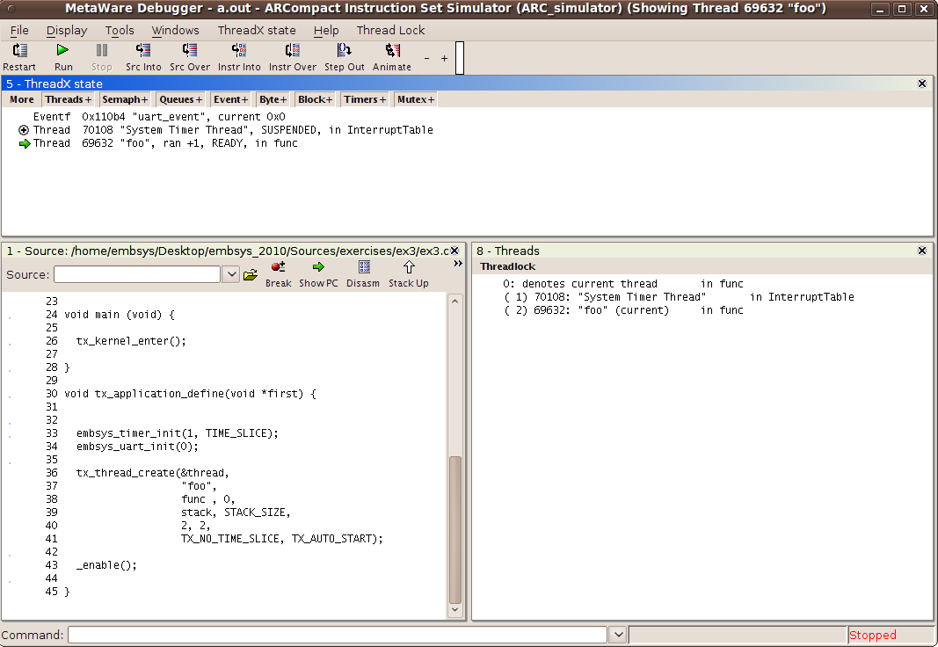
Thread Lock menu
ThreadX objects state
Threads information

